Slide 1

St. James' School Homework Booklet
Year 7
Lent Term HT4
Building good people who take PRIDE in their time at school, RESPECT themselves and others, WORK TOGETHER as a community, showing RESILIENCE and EMPATHY for all.

Slide 2

Name -
My Timetable at St. James’ School
Friday
Thursday
Wednesday
Tuesday
Monday
 | Tutorial (8.40-8.50) | Tutorial Lesson (8.50-9.20) | Lesson 1 (9.20-10.10) | Lesson 2 (10.10-11.00) | Lesson 3 (11.20-12.10) | Lesson 4 (12.10-13.00) | Extracurricular (13.40-14.10) | Lesson 5 (14.10-15.05) | Lesson 6 (15.05-16.00)
Building good people who take PRIDE in their time at school, RESPECT themselves and others, WORK TOGETHER as a community, showing RESILIENCE and EMPATHY for all.

Slide 3
Homework at St. James’ School
Independent study is an essential part of the learning. Pupils will have homework set on a regular basis that is meaningful and appropriate. This must be clearly recorded in the planner with an appropriate deadline.
Homework is set in order to, involve parents and guardians with learning, develop independent study skills which will allow pupils to achieve academic success, allow pupils to grow as independent and life-long learners through developing their confidence, motivation and self-discipline, reinforce, consolidate and/or extend what pupils know and can do in the classroom.
Regularity of Homework
This will be dependent on curriculum time and the allocation for each subject as well as the age range of the pupils. Pupils will receive at least one piece of homework per subject per week.
Guideline allocation for Homework:
Year 7, 8 and 9: 30 minutes per subject
Year 10 and 11: Around 45 minutes per subject
Year 7 Homework Timetable
Monday​ | Tuesday​ | Wednesday​ | Thursday​ | Friday​
Building good people who take PRIDE in their time at school, RESPECT themselves and others, WORK TOGETHER as a community, showing RESILIENCE and EMPATHY for all.

Slide 4
Lent Term HT4 Uniform and Equipment
Required uniform for ALL pupils:
St. James’ Blazer
St. James’ Tie
Black Trousers/St. James’ Skirt
White Collared Shirt
Black School Shoes
Black Socks with Trousers
Black Tights with Skirts
Optional - Black Jumper/Cardigan
Optional – Plain Dark Coat
St. James’ PE Polo Shirt
St. James’ PE Shorts/Skort
St. James’ PE Tracksuit
St. James’ PE Sports Socks (green)
PE Trainers (any design)
Optional - St. James’ PE Waterproof
Required equipment for ALL pupils:
Black pen
Pencil
Ruler
Rubber
Calculator
Memory Pen
Is your uniform perfect all week? | Tutor Signature
Week 1 – Uniform Perfection?
Week 2 – Uniform Perfection?
Week 3 – Uniform Perfection?
Week 4 – Uniform Perfection?
Week 5 – Uniform Perfection?
Week 6 – Uniform Perfection?
Building good people who take PRIDE in their time at school, RESPECT themselves and others, WORK TOGETHER as a community, showing RESILIENCE and EMPATHY for all.

Slide 5
Lent Term HT4 Attendance
Being in school is important to your achievement, wellbeing, and wider development. Evidence shows that the students with the highest attendance throughout their time in school gain the best GCSE and A Level results.
Research found that pupils who performed better at secondary school missed fewer days than those who didn’t perform as well.
In 2019, secondary school pupils who didn’t achieve grade 9 to 4 in English and Maths missed 10 more days on average over the key stage than those who achieved grade 9 to 5 in both English and Maths.
Every moment in school counts, and days missed add up quickly. For example, a child who is absent for three days over a half term could miss 18 lessons in total.
The higher a pupil’s attendance, the more they are likely to learn, and the better they are likely to perform in exams and formal assessments.
*Information for the Department for Education (https://educationhub.blog.gov.uk/2023/05/18/school-attendance-important-risks-missing-day/)
Year 7 Lent Term HT4 Attendance
How many days did you miss last Half Term?
Last Half Term’s Attendance Percentage
How many days have you missed this Half Term?
This Half Term’s Attendance Percentage
Building good people who take PRIDE in their time at school, RESPECT themselves and others, WORK TOGETHER as a community, showing RESILIENCE and EMPATHY for all.

Slide 6


Pupil Wellbeing Information
Pupil wellbeing is at the centre of life at St. James’, in school you can talk to any member of the school staff who will be willing to listen and support you. Below is the school email for any questions you have or support you require:
wearelistening@saintjames.co.uk
Below this is a series of external support that the school has links with and can also be used:
Building good people who take PRIDE in their time at school, RESPECT themselves and others, WORK TOGETHER as a community, showing RESILIENCE and EMPATHY for all.

Slide 7
Lent Term HT4 Calendar
 | Monday | Tuesday | Wednesday | Thursday | Friday
Week 1 W/C 19/2/24
Week 2 W/C 26/2/24 | Year 11 and 13 Mock Exams | Year 11 and 13 Mock Exams | Year 11 and 13 Mock Exams | Year 11 and 13 Mock Exams | Year 11 and 13 Mock Exams
Week 3 W/C 4/3/24 | Year 11 and 13 Mock Exams English Week | Year 11 and 13 Mock Exams | Year 11 and 13 Mock Exams | Year 11 and 13 Mock Exams | Year 11 and 13 Mock Exams
Week 4 W/C 11/3/24 | Science Week
Week 5 W/C 18/3/24 |  |  |  |  | Blakeney Charity Event
Week 6 W/C 25/3/24 |  | Year 7, 8, 9 Progress Consultation Evening | Year 10, 11, 12, 13 Progress Consultation Evening | School Ends of Easter | Good Friday
*Please note that we will email home if there are any changes to dates.
Building good people who take PRIDE in their time at school, RESPECT themselves and others, WORK TOGETHER as a community, showing RESILIENCE and EMPATHY for all.

Slide 8
Lent Term HT4 Merits
1 | 2 | 3 | 4 | 5
6 | 7 | 8 | 9 | 10
11 | 12 | 13 | 14 | 15
16 | 17 | 18 | 19 | 20
21 | 22 | 23 | 24 | 25
26 | 27 | 28 | 29 | 30
31 | 32 | 33 | 34 | 35
Building good people who take PRIDE in their time at school, RESPECT themselves and others, WORK TOGETHER as a community, showing RESILIENCE and EMPATHY for all.

Slide 9
Lent Term HT4 Merits
36 | 37 | 38 | 39 | 40
41 | 42 | 43 | 44 | 45
46 | 47 | 48 | 49 | 50
51 | 52 | 53 | 54 | 55
56 | 57 | 58 | 59 | 60
61 | 62 | 63 | 64 | 65
66 | 67 | 68 | 69 | 70
Building good people who take PRIDE in their time at school, RESPECT themselves and others, WORK TOGETHER as a community, showing RESILIENCE and EMPATHY for all.

Slide 10
Lent Term HT4 Merits
71 | 72 | 73 | 74 | 75
76 | 77 | 78 | 79 | 80
81 | 82 | 83 | 84 | 85
86 | 87 | 88 | 89 | 90
91 | 92 | 93 | 94 | 95
96 | 97 | 98 | 99 | 100
101 | 102 | 103 | 104 | 105
Building good people who take PRIDE in their time at school, RESPECT themselves and others, WORK TOGETHER as a community, showing RESILIENCE and EMPATHY for all.

Slide 11
Lent Term HT4 Merits
106 | 107 | 108 | 109 | 110
111 | 112 | 113 | 114 | 115
116 | 117 | 118 | 119 | 120
121 | 122 | 123 | 124 | 125
126 | 127 | 128 | 129 | 130
131 | 132 | 133 | 134 | 135
136 | 137 | 138 | 139 | 140
Building good people who take PRIDE in their time at school, RESPECT themselves and others, WORK TOGETHER as a community, showing RESILIENCE and EMPATHY for all.

Slide 12
Lent Term HT4 Notes
Building good people who take PRIDE in their time at school, RESPECT themselves and others, WORK TOGETHER as a community, showing RESILIENCE and EMPATHY for all.

Slide 13
Lent Term HT4 Notes
Building good people who take PRIDE in their time at school, RESPECT themselves and others, WORK TOGETHER as a community, showing RESILIENCE and EMPATHY for all.

Slide 14
Lent Term HT4 Notes
Building good people who take PRIDE in their time at school, RESPECT themselves and others, WORK TOGETHER as a community, showing RESILIENCE and EMPATHY for all.

Slide 15
Lent Term HT4 Notes
Building good people who take PRIDE in their time at school, RESPECT themselves and others, WORK TOGETHER as a community, showing RESILIENCE and EMPATHY for all.

Slide 16
Week 1 Homework

Slide 17
Week 1 Homework Due Dates
Subject | Day Due | Date Due
Academic PE
Art
English
Geography
History
Languages
Maths
Music
RE
Science
Young Enterprise
Building good people who take PRIDE in their time at school, RESPECT themselves and others, WORK TOGETHER as a community, showing RESILIENCE and EMPATHY for all.

Slide 18
Year 7 Academic PE Homework – Half Term 4, Weeks 1-6 (30 mins per week)
The homework that you have been set is once again an individual research project that we have discussed in class. The aim of the project is based upon an independent research with you having the choice of subject area from the criteria below.
The criteria for your research project is to be based upon one of the two areas below:
1. A sports person or sporting role model that you may look up to. The research must include how they entered the sport, how they became the professional or amateur they are today and any honours such as medals etc. that they may have achieved.
2. A presentation based upon your own achievements in a sport that you play. This can be for a team or in an individual sport. Please state why you chose the sport, your pathway to where you are today and why you play it.
The criteria will be briefed each week during lesson time with the final week (6) been left for the presentation of each pupil's research.
Key Words: Research, History, Role Model
Extension Task – Could you research further into how a role model that you look up to may have a person they look up to as well?
What have been your strengths in Academic PE this week?
What have been the areas that have challenged you in Academic PE this week?
How could you improve next week?
Building good people who take PRIDE in their time at school, RESPECT themselves and others, WORK TOGETHER as a community, showing RESILIENCE and EMPATHY for all.

Slide 19
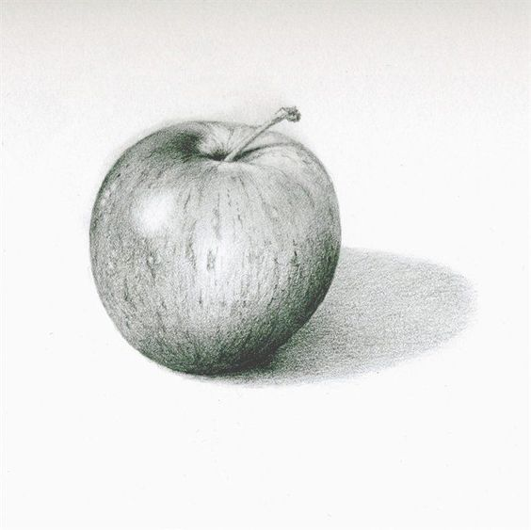
Year 7 Art Homework – Half Term 4, Week 1
Recap task:
Before each homework task practice your tones with your
2b pencil or your coloured crayons.
Main Task:
Complete a drawing
of this apple.
Key words – Primary, Secondary,, tonal, shading, value
Extension Task –
Find a piece of artwork which your admire or like a bit and write a paragraph about it – Use the descriptive words on the last lage of Art to help you.
What have been your strengths in this week?
What have been the areas that have challenged you in Photography this week?
How could you improve next week?
Building good people who take PRIDE in their time at school, RESPECT themselves and others, WORK TOGETHER as a community, showing RESILIENCE and EMPATHY for all.

Slide 21
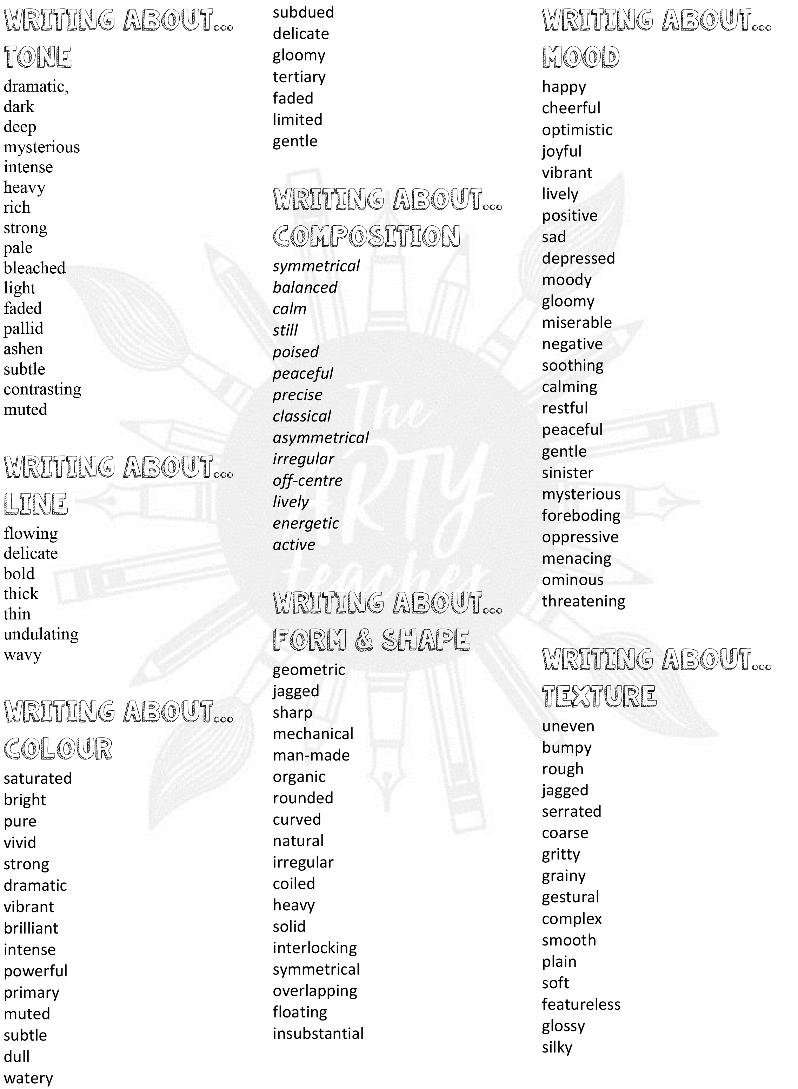
For internal use in school only - Copyright for the keywords list to the Arty Teacher

Slide 22
Year 7 English Homework
Half Term 4, Week 1
This is taken from the following Department for Education report:
Research Evidence on Reading for Pleasure. Report conducted by the government's Education Standards research team. For the full report, please access https://assets.publishing.service.gov.uk/government/uploads/system/uploads/attachment_data/file/284286/reading_for_pleasure.pdf
‘A growing number of studies show that promoting reading can have a major impact on children and adults and their future. Upon reviewing the research literature, there are several main areas of benefit to reading for pleasure:
• Reading attainment and writing ability;
• Text comprehension and grammar;
• Breadth of vocabulary;
• Positive reading attitudes;
• Greater self-confidence as a reader;
• Pleasure in reading in later life;
• General knowledge;
• A better understanding of other cultures;
• Community participation; and
• A greater insight into human nature and decision-making.’
Read at least four times per week for at least twenty minutes each time. Use your planner to record what you have read and for how long you have read. Have a parent or guardian sign your planner to confirm that you have completed your reading.
Key words – pleasure, effectiveness, success, comfort, relaxation, growth, vocabulary, understanding, enjoyment, interest, passion,
Extension Task – Share ideas about what books to read with friends and family. Can you tell them why your book is effective? Can you ask them what’s effective about the book they recommend? Step out of your comfort zone; find new authors and titles. Talk to friends, family and teachers about what they think is a good read.
What have been your strengths in (insert subject) this week?
What have been the areas that have challenged you in (insert topic) this week?
How could you improve next week?
Building good people who take PRIDE in their time at school, RESPECT themselves and others, WORK TOGETHER as a community, showing RESILIENCE and EMPATHY for all.

Slide 23

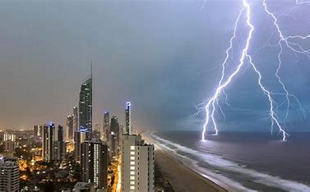
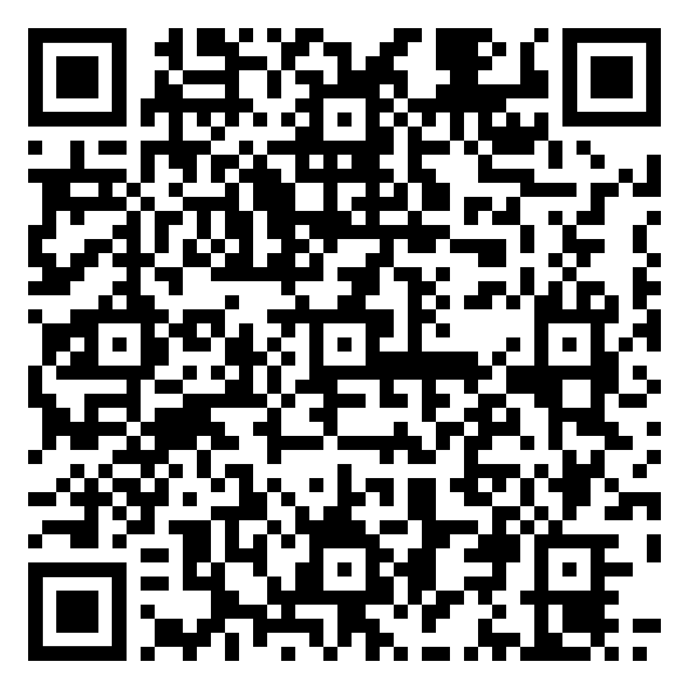
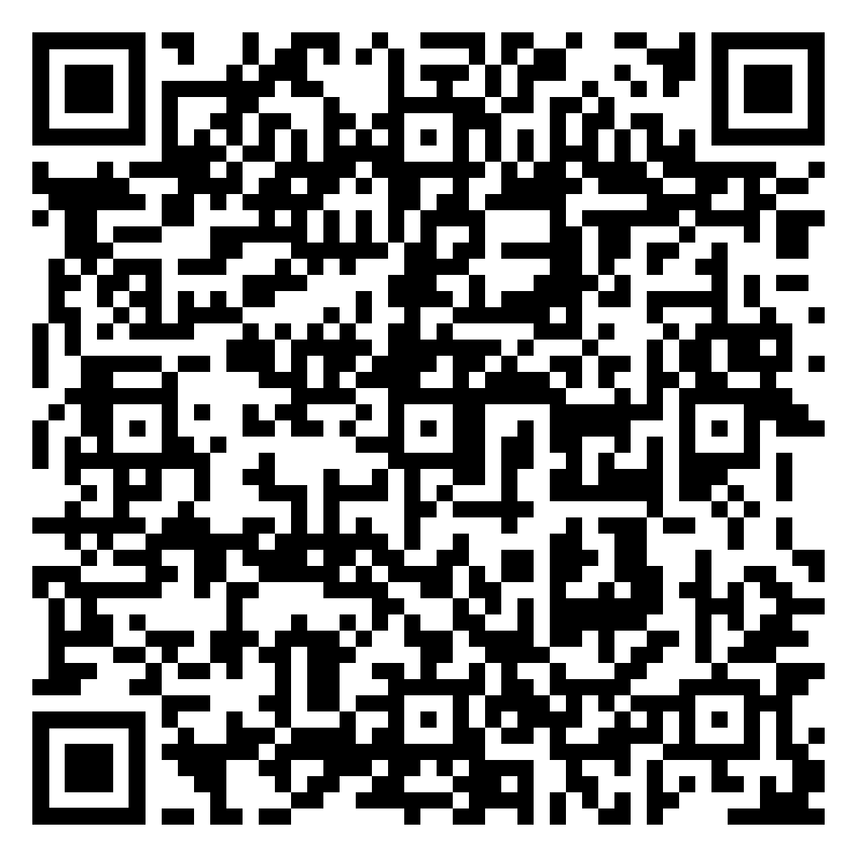
Year 7 Geography Homework – Half Term 4 Week 1
Extreme
Weather Quiz
Complete the card sorting sheet about different air masses. See Air Mass Homework Week 1 document.
Online versions of documents can be found by the link or QR code below:
Year 7 Geography Homework Booklet
Key words – air mass, tropical, polar, maritime, continental, weather, climate, arctic, pressure
Extension Task – Choose one air mass and create a weather forecast for the UK if it were to be the dominant air mass affecting our weather.
What have been your strengths in Geography this week?
What have been the areas that have challenged you in Geography this week?
How could you improve next week?
Building good people who take PRIDE in their time at school, RESPECT themselves and others, WORK TOGETHER as a community, showing RESILIENCE and EMPATHY for all.

Slide 24
Year 7 History Homework – Half Term 4, Week 1
1. What was the Domesday Book? | 5. Who was third in the Feudal System?
2. Who was King after 1066? | 6. Who was fourth in the Feudal System?
3. Who was at the top of the Feudal System? | 7. What is a portcullis?
4. Who was second in the Feudal System? | 8. What is a garderobe?
Source tasks:
Read both sources.
Highlighted and annotate key phrases/words in the sources.
What does source A tell you about King Henry II?
What does source B tell you about King Henry II?
What do the sources agree and disagree about?
(A) Gerald of Wales, The History and Topography of Ireland (c. 1190)
No one can doubt how splendidly, how vigorously, how skillfully our most excellent king has practiced armed warfare against his enemies in time of war... He not only brought strong peace in England... he won victories in remote and foreign lands.
(B) Peter of Blois, The Chronicles of Peter of Blois (c. 1185)
With King Henry II it is school every day, constant conversation with the best scholars and discussions of intellectual problems... He does not linger in his palaces like other kings but hunts through the country inquiring into what everyone was doing, especially judges whom he has made judges of others.
Key words – reign, king, agree, disagree, monarch, qualities.
Extension Task – what are the sources nature, origin and purpose? Does these make you trust the sources more or less?
What have been your strengths in History this week?
What have been the areas that have challenged you in History this week?
How could you improve next week?
Building good people who take PRIDE in their time at school, RESPECT themselves and others, WORK TOGETHER as a community, showing RESILIENCE and EMPATHY for all.

Slide 25
Year 7 Languages Homework
Half Term 4
Vocabulary and Translation Practise
For this homework, you will need a copy of the Sentence Builder.
Task 1 | Test yourself on the items in the sentence builder using the Look-Say-Cover-Write-Check method.
Task 2 | Ask a friend or a relative to test you on individual items from the sentence builder.
Task 3 | Ask a friend or a relative to test you on full sentences from the sentence builder.
Task 4 | Practise this week's topic on Linguascope. (See Mr Downey for the login details).
Task 5 | Find a new song in your preferred language on Lyrics Training. Can you challenge yourself to the higher levels?
Language Gym – Check for online assignments
Username: ______________________
Password: _______________________
What have been your strengths in Languages this week?
What have been the areas that have challenged you in Languages this week?
How could you improve next week?
Building good people who take PRIDE in their time at school, RESPECT themselves and others, WORK TOGETHER as a community, showing RESILIENCE and EMPATHY for all.

Slide 26
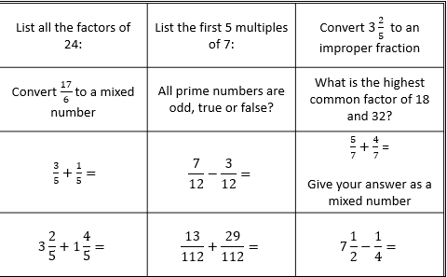
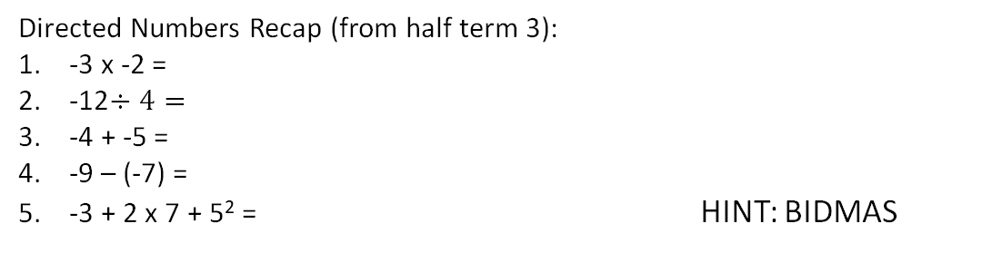
Year 7 Mathematics Homework – Half Term 4, Week 1
Directed Numbers Recap (from Half Term 4):
-3 x -2 =
-12$÷4=$
-4 + -5 =
-9 – (-7) =
-3 + 2 x 7 + 5² = HINT: BIDMAS
Key words – Factor, Multiple, Denominator, Numerator, Improper
Extension Task – A blue light flashes every 8 seconds. A red light flashes every 12 seconds. Both lights have just flashed together. After how many seconds will both lights flash together again?
What have been your strengths in maths this week?
What have been the areas that have challenged you in maths this week?
How could you improve next week?
Building good people who take PRIDE in their time at school, RESPECT themselves and others, WORK TOGETHER as a community, showing RESILIENCE and EMPATHY for all.

Slide 27
Year 7 Music - Reading Music & Keyboard Skills
Homework - Half Term 4 Week 1
What family of instruments does the piano belong to? Name the white notes found on a piano. Explain how to find Middle C on a keyboard.
This week’s listening – Title: Prelude in C Major
Composer: Johann Sebastian Bach
Genre: Baroque
Spend time listening to the above piece of music.
Complete the page in your listening booklet –
1.Give some background information on the piece and artist/composer
2.Comment on the instrumentation and how the musical elements are used in as much detail as you can.
3.Give your personal response to the music – remember to explain why you liked or did not like the piece of music.
Key words – Tempo, Dynamics, Duration, Pitch, Silence, Articulation, Melody, Texture, Timbre
Extension Task – Listen to and comment on further pieces of music by the same artist/composer.
What have been your strengths in Music this week?
What have been the areas that have challenged you in Music this week?
How could you improve next week?
Building good people who take PRIDE in their time at school, RESPECT themselves and others, WORK TOGETHER as a community, showing RESILIENCE and EMPATHY for all.

Slide 28


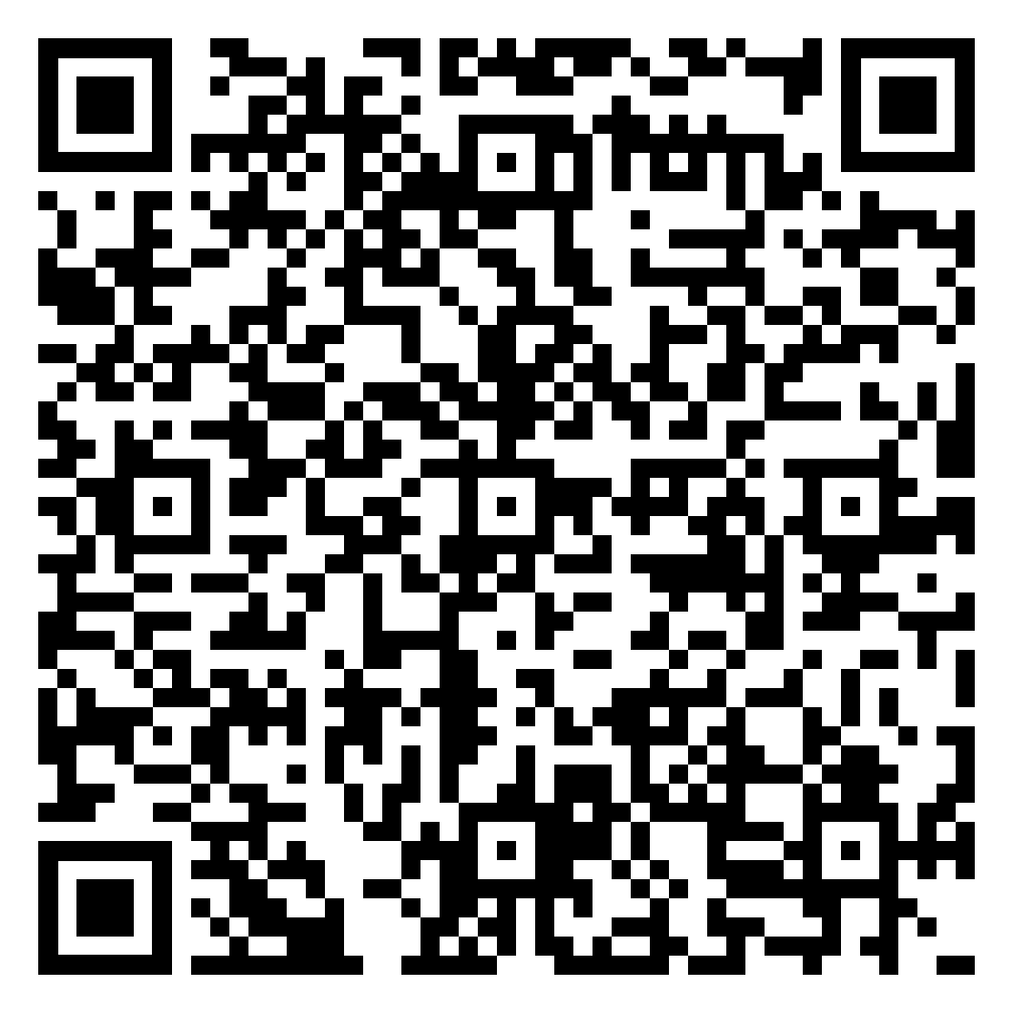
Year 7 RE Homework – Half Term 4, Week 1
Name five facts you remember about Judaism from last half term.
Read the Christian influences in the UK week 1 document and answer the following questions:
Give three important ways that Christianity has influenced the UK today.
Think about food – can you think of any Christain-sounding foods?
Think about music – do you know any pop songs with Christian messages?
Online document link - Christian influences in the UK Week 1.pdf
Key words – Bible, crucifixion, resurrection, church, The Ten Commandments
Extension Task – Look at the nine boxes on the Christian influences in the UK week 1 document. For each, decide whether, in your opinion, it has a big or little influence on how we live our lives in the UK today. Explain your answer in each case.
What have been your strengths in RE this week?
What have been the areas that have challenged you in Christianity this week?
How could you improve next week?
Building good people who take PRIDE in their time at school, RESPECT themselves and others, WORK TOGETHER as a community, showing RESILIENCE and EMPATHY for all.

Slide 29
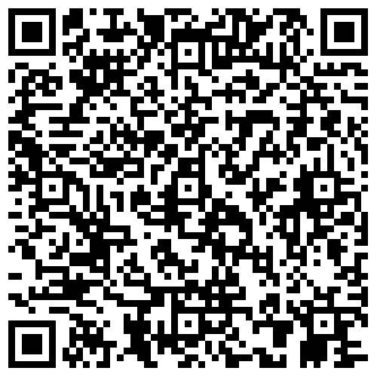
Year 7 Science Homework – Half Term 4, Week 1
Recap:
See Below
Main Task (20th February 2024):
Due: 27th February 2024
Recap on Energy
3.1.1 to 3.1.4 - Energy Stores & Pathways
to Wasted Energy
Recap on Light and Space
3.6.1 to 3.6.4 - The Sun
To The Milky Way
Key words – Energy, Energy Store, Kinetic, Gravitational, Elastic, Efficiency, Wasted Energy, Thermal Energy, Sun, Planet, Satellite, Asteroid, Cosmos, Nebula
Extension Task – Complete Crosswords / Exam Style Questions inside Chemistry or Biology Extension Booklets, Mark Date Completed.
What have been your strengths in (insert subject) this week?
What have been the areas that have challenged you in (insert topic) this week?
How could you improve next week?
Building good people who take PRIDE in their time at school, RESPECT themselves and others, WORK TOGETHER as a community, showing RESILIENCE and EMPATHY for all.

Slide 30
Year 7 Young Enterprise, Homework – Half Term 4, Week 1
Recap: Define the following terms:
Aims and Objectives
Main Task
Q1 Define the term ‘tactics’. (1 mark)
Q2 Define the term ‘strategy ‘ (1 mark)
Q3 What tactics do Amazon use to try and stay successful? Give 3 examples (3 marks)
Q4 What tactics do Coca-Cola use to try and stay successful? Give 3 examples (3 marks)
Q5 Explain why tactics and strategy are important in the business world. (5 marks)
Key words: Tactics, Strategy
Extension Task
Give examples of businesses using tactics and strategy that went wrong. What happened? (6 marks)
What have been your strengths this week?
What have been the areas that have challenged you this week?
How could you improve next week?
Building good people who take PRIDE in their time at school, RESPECT themselves and others, WORK TOGETHER as a community, showing RESILIENCE and EMPATHY for all.

Slide 31
Week 2 Homework

Slide 32
Week 2 Homework Due Dates
Subject | Day Due | Date Due
Academic PE
Art
English
Geography
History
Languages
Maths
Music
RE
Science
Young Enterprise
Building good people who take PRIDE in their time at school, RESPECT themselves and others, WORK TOGETHER as a community, showing RESILIENCE and EMPATHY for all.

Slide 33
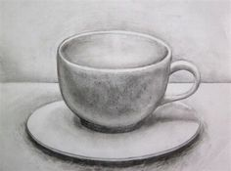
Year 7 Art Homework – Half Term 4, Week 2
Recap task:
Before each homework task practice your tones with your
2b pencil or your coloured crayons.
Main Task:
Complete a drawing of
A cup and saucer
Key words – Primary, Secondary,, tonal, shading, value
Extension Task –
Find a piece of artwork which your admire or like a bit and write a paragraph about it – Use the descriptive words on the last lage of Art to help you.
What have been your strengths in this week?
What have been the areas that have challenged you in Photography this week?
How could you improve next week?
Building good people who take PRIDE in their time at school, RESPECT themselves and others, WORK TOGETHER as a community, showing RESILIENCE and EMPATHY for all.

Slide 35
For internal use in school only - Copyright for the keywords list to the Arty Teacher

Slide 36
Year 7 English Homework
Half Term 4, Week 2
This is taken from the following Department for Education report:
Research Evidence on Reading for Pleasure. Report conducted by the government's Education Standards research team. For the full report, please access https://assets.publishing.service.gov.uk/government/uploads/system/uploads/attachment_data/file/284286/reading_for_pleasure.pdf
‘Strategies to improve independent reading
• Having access to resources and having books of their own has an impact on children’s attainment. There is a positive relationship between the estimated number of books in the home and attainment. Children who have books of their own enjoy reading more and read more frequently
• An important factor in developing reading for pleasure is choice; choice and interest are highly related
• Literacy-targeted rewards, such as books or book vouchers have been found to be more effective in developing reading motivation than rewards that are unrelated to the activity
• Parents and the home environment are essential to the early teaching of reading and fostering a love of reading; children are more likely to continue to be readers in homes where books and reading are valued.
• Reading for pleasure is strongly influenced by relationships between teachers and children, and children and families.’
Read at least four times per week for at least twenty minutes each time. Use your planner to record what you have read and for how long you have read. Have a parent or guardian sign your planner to confirm that you have completed your reading.
Key words – pleasure, effectiveness, success, comfort, relaxation, growth, vocabulary, understanding, enjoyment, interest, passion,
Extension Task – Share ideas about what books to read with friends and family. Can you tell them why your book is effective? Can you ask them what’s effective about the book they recommend? Step out of your comfort zone; find new authors and titles. Talk to friends, family and teachers about what they think is a good read.
What have been your strengths in (insert subject) this week?
What have been the areas that have challenged you in (insert topic) this week?
How could you improve next week?
Building good people who take PRIDE in their time at school, RESPECT themselves and others, WORK TOGETHER as a community, showing RESILIENCE and EMPATHY for all.

Slide 37


Year 7 Geography Homework – Half Term 4 Week 2
Describe the climate of a hot desert.
Visit the BBC bitesize site:
https://www.bbc.co.uk/bitesize/topics/ztgw2hv/articles/znnhp4j#z3m6hcw
Read through the hot desert guide, complete the activities and watch the video. When you have done this complete the quiz. Screenshot or tell me your score next lesson.
Key words – hot desert, biome, arid, oasis, climate graph, adaptation, challenges
Extension Task – Create another section that could be added to the BBC Bitesize hot desert guide. What else do you think people would like to learn about concerning hot deserts?
What have been your strengths in Geography this week?
What have been the areas that have challenged you in Geography this week?
How could you improve next week?
Building good people who take PRIDE in their time at school, RESPECT themselves and others, WORK TOGETHER as a community, showing RESILIENCE and EMPATHY for all.

Slide 38
Year 7 History Homework – Half Term 4, Week 2
1. What does reign mean?
2. What does monarch mean?
3. Give 3 qualities a leader needs to have.
4. What qualities did William the Conqueror have as King?
5. Give 3 qualities a medieval monarch needed.
Quiz Review:
Read your work from this week.
Pick 3-4 key facts from each lesson.
Take the key facts and turn them into a Quiz WITH Answers.
Make sure you write Questions AND Answers.
Make sure you have at least 10 Questions WITH Answers.
Make sure you have a mix between short AND long answer questions.
Think about how you can make a quiz look attractive.
Key words – King Henry II, Thomas Becket, Archbishop of Canterbury, Advisor, Pope
Extension Task – Look at the source below. What is the message of the source? What is the origin, nature and purpose of the source?
(Source 3) Thomas Becket in a letter to Henry II (1166)
There are two principles by which the world is ruled: the authority of priests and the royal power. The authority of priests is the greater because God will demand an accounting of them even in regard to kings.
What have been your strengths in History this week?
What have been the areas that have challenged you in History this week?
How could you improve next week?
Building good people who take PRIDE in their time at school, RESPECT themselves and others, WORK TOGETHER as a community, showing RESILIENCE and EMPATHY for all.

Slide 39
Year 7 Languages Homework
Half Term 4
Vocabulary and Translation Practise
For this homework, you will need a copy of the Sentence Builder.
Task 1 | Test yourself on the items in the sentence builder using the Look-Say-Cover-Write-Check method.
Task 2 | Ask a friend or a relative to test you on individual items from the sentence builder.
Task 3 | Ask a friend or a relative to test you on full sentences from the sentence builder.
Task 4 | Practise this week's topic on Linguascope. (See Mr Downey for the login details).
Task 5 | Find a new song in your preferred language on Lyrics Training. Can you challenge yourself to the higher levels?
Language Gym – Check for online assignments
Username: ______________________
Password: _______________________
What have been your strengths in Languages this week?
What have been the areas that have challenged you in Languages this week?
How could you improve next week?
Building good people who take PRIDE in their time at school, RESPECT themselves and others, WORK TOGETHER as a community, showing RESILIENCE and EMPATHY for all.

Slide 40
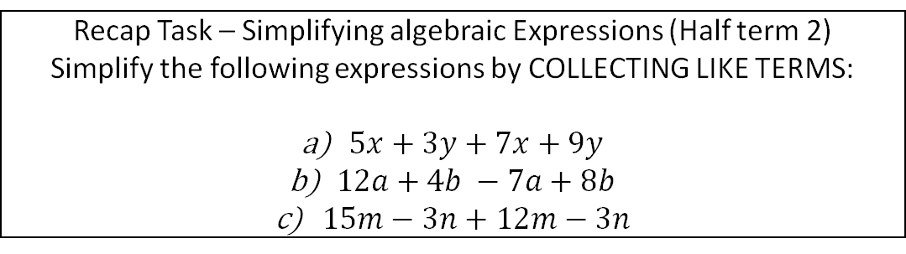
Year 7 Mathematics Homework – Half Term 4, Week 2
Recap Task – Simplifying algebraic Expressions (Half term 2)
Simplify the following expressions by COLLECTING LIKE TERMS:
$5x+3y+7x+9y$
$12a+4b −7a+8b$
$15m−3n+12m−3n$
This weeks homework task is assigned on SENECA, please log in and complete all relevant sections, ensuring you watch the videos where necessary to improve your understanding.
1.2.1 Factors
1.2.3 Multiples
1.4.1 Fractions
1.4.2 Mixed and Improper Fractions
Key words – integer, equivalent, factor, multiple, prime, improper, denominator, numerator
Extension Task – Jasper feeds his dog ⅔ of a can of dog food each day. Work out how many cans of dog food are eaten each week. Give your answer as a mixed number.
What have been your strengths in maths this week?
What have been the areas that have challenged you in maths this week?
How could you improve next week?
Building good people who take PRIDE in their time at school, RESPECT themselves and others, WORK TOGETHER as a community, showing RESILIENCE and EMPATHY for all.

Slide 41
Year 7 Music - Reading Music & Keyboard Skills
Homework - Half Term 4 Week 2
Explain what is meant by a scale. How many notes are there in an octave scale? How many octaves are on an average piano? How many white notes are on an average piano?
This week’s listening – Title: Moonlight Sonata
Composer: Ludwig van Beethoven
Genre: Classical
Spend time listening to the above piece of music.
Complete the page in your listening booklet –
1.Give some background information on the piece and artist/composer
2.Comment on the instrumentation and how the musical elements are used in as much detail as you can.
3.Give your personal response to the music – remember to explain why you liked or did not like the piece of music.
Key words – Tempo, Dynamics, Duration, Pitch, Silence, Articulation, Melody, Texture, Timbre
Extension Task – Listen to and comment on further pieces of music by the same artist/composer.
What have been your strengths in Music this week?
What have been the areas that have challenged you in Music this week?
How could you improve next week?
Building good people who take PRIDE in their time at school, RESPECT themselves and others, WORK TOGETHER as a community, showing RESILIENCE and EMPATHY for all.

Slide 42
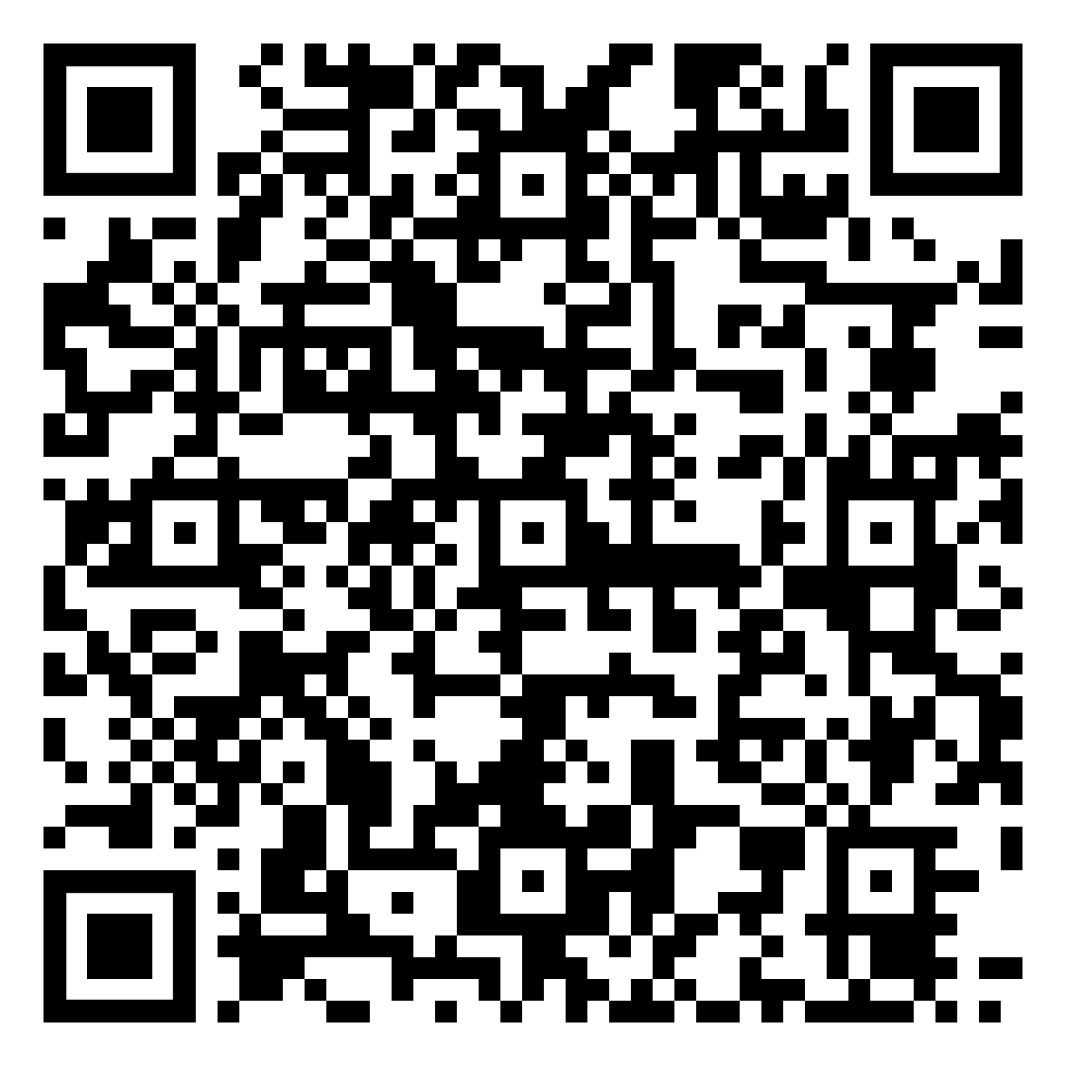
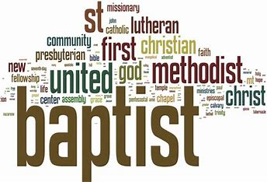
Year 7 RE Homework – Half Term 4, Week 2
Christianity Today Quiz
1. Why are there so many different types of Christian groups?
2. Choose one denomination and create a fact file about it, including information about when it began and how they worship.
Key words – Denominations, Christian, Clergy, Protestant, Orthodox, Catholic
Extension Task – Compare the denomination that you researched with another one. How do they differ? How are they similar?
What have been your strengths in RE this week?
What have been the areas that have challenged you in Christianity this week?
How could you improve next week?
Building good people who take PRIDE in their time at school, RESPECT themselves and others, WORK TOGETHER as a community, showing RESILIENCE and EMPATHY for all.

Slide 43
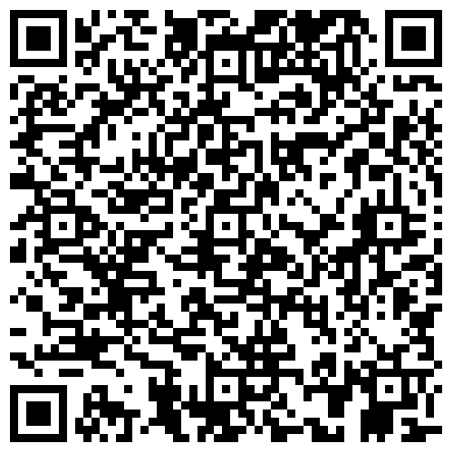
Year 7 Science Homework – Half Term 4, Week 2
Recap:
See Below
Main Task (27th February 2024):
Due: 5th March 2024
Recap on Energy
3.1.5 to 3.1.8 – Efficiency of Energy
Transfer to Heat Transfer
Recap on Light and Space
3.6.5 to 3.6.8 - Beyond the Milky Way
To The Moon
Key words – Efficiency, Wasted Energy, Thermal Energy, Conduction, Convection, Radiation, Milky Way, Galaxy, Moon, Seasons, Days, Months, Years
Extension Task – Complete Crosswords / Exam Style Questions inside Chemistry or Biology Extension Booklets, Mark Date Completed.
What have been your strengths in (insert subject) this week?
What have been the areas that have challenged you in (insert topic) this week?
How could you improve next week?
Building good people who take PRIDE in their time at school, RESPECT themselves and others, WORK TOGETHER as a community, showing RESILIENCE and EMPATHY for all.

Slide 44
Year 7 Young Enterprise, Homework – Half Term 4, Week 2
Recap
Define:
Tactics Strategy
Main Task
Come up with an idea for a business. Imagine you are in charge of this business.
Explain the strategy and tactics that you would use in order to try and help the business succeed. Explain your ideas. Try to convince the reader that your business could work. (10 marks)
Key words: Strategy, Tactics, Convince
Extension Task: What are the 3 biggest problems that you think could stop your idea being successful? Explain each point. (6 marks)
What have been your strengths this week?
What have been the areas that have challenged you this week?
How could you improve next week?
Building good people who take PRIDE in their time at school, RESPECT themselves and others, WORK TOGETHER as a community, showing RESILIENCE and EMPATHY for all.

Slide 45
Week 3 Homework

Slide 46
Week 3 Homework Due Dates
Subject | Day Due | Date Due
Academic PE
Art
English
Geography
History
Languages
Maths
Music
RE
Science
Young Enterprise
Building good people who take PRIDE in their time at school, RESPECT themselves and others, WORK TOGETHER as a community, showing RESILIENCE and EMPATHY for all.

Slide 47
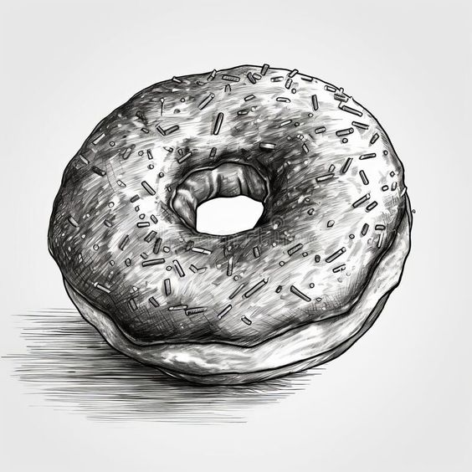
Year 7 Art Homework – Half Term 4, Week 3
Recap task:
Before each homework task practice your tones with your
2b pencil or your coloured crayons.
Complete a drawing of a Donut
Key words – Primary, Secondary,, tonal, shading, value
Extension Task –
Find a piece of artwork which your admire or like a bit and write a paragraph about it – Use the descriptive words on the last page of Art to help you.
What have been your strengths in this week?
What have been the areas that have challenged you in Photography this week?
How could you improve next week?
Building good people who take PRIDE in their time at school, RESPECT themselves and others, WORK TOGETHER as a community, showing RESILIENCE and EMPATHY for all.

Slide 49
For internal use in school only - Copyright for the keywords list to the Arty Teacher

Slide 50
Year 7 English Homework
Half Term 4, Week 3
This is taken from the following Department for Education report:
Research Evidence on Reading for Pleasure. Report conducted by the government's Education Standards research team. For the full report, please access https://assets.publishing.service.gov.uk/government/uploads/system/uploads/attachment_data/file/284286/reading_for_pleasure.pdf
‘Evidence suggests that reading for pleasure leads to increased attainment. Clark and DeZoya found a significant positive relationship between enjoyment and attainment indicating that pupils who read more are also better readers. Similarly Clark in a large scale survey of over 18,000 young people found that those who reported enjoying reading very much were six times more likely than those who did not enjoy reading to read above the expected level for their age. Young people who reported not enjoying reading at all were 11 times more likely than those who enjoyed reading very much to read below the level expected for their age. Evidence from OECD found that reading enjoyment is more important for children’s educational success than their family’s socio-economic status.’
Read at least four times per week for at least twenty minutes each time. Use your planner to record what you have read and for how long you have read. Have a parent or guardian sign your planner to confirm that you have completed your reading.
Key words – pleasure, effectiveness, success, comfort, relaxation, growth, vocabulary, understanding, enjoyment, interest, passion,
Extension Task – Share ideas about what books to read with friends and family. Can you tell them why your book is effective? Can you ask them what’s effective about the book they recommend? Step out of your comfort zone; find new authors and titles. Talk to friends, family and teachers about what they think is a good read.
What have been your strengths in (insert subject) this week?
What have been the areas that have challenged you in (insert topic) this week?
How could you improve next week?
Building good people who take PRIDE in their time at school, RESPECT themselves and others, WORK TOGETHER as a community, showing RESILIENCE and EMPATHY for all.

Slide 51

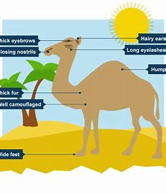
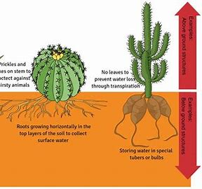
Year 7 Geography Homework – Half Term 4 Week 3
Why are deserts hot and dry?
Use the Internet to find out about what adaptations one plant and one animal have adopted to help them survive in hot deserts. You should include a picture of each and should identify how and why they have those adaptations.
Key words – adaptations, camouflage, roots, leaves, biome
Extension Task – You could research adaptations a plant and/or an animal have adopted to help them to live in a different biome and compare those adaptations to the ones above. How are they similar? How do they differ?
What have been your strengths in Geography this week?
What have been the areas that have challenged you in Geography this week?
How could you improve next week?
Building good people who take PRIDE in their time at school, RESPECT themselves and others, WORK TOGETHER as a community, showing RESILIENCE and EMPATHY for all.

Slide 52
Year 7 History Homework – Half Term 4, Week 3
1. Which job did Henry II give Thomas Becket?
2. What did Henry II fight with the bishops over?
3. Why was Henry II whipped?
4. Who killed Thomas Becket?
5. What happened when Becket returned to England?
Storyboard:
Look at your classwork and use other resources to research what happened to Thomas Becket.
Pick 8-10 key facts.
Take the key facts and turn them into a storyboard (template available if required) to show what you have learnt.
Make sure it has pictures and description.
Key words – whipped, rebellion, Edward Grim, monks, Richard Brito
Extension Task – Can you write a pneumonic to help you remember the events relating to the murder of Thomas Becket?
What have been your strengths in History this week?
What have been the areas that have challenged you in History this week?
How could you improve next week?
Building good people who take PRIDE in their time at school, RESPECT themselves and others, WORK TOGETHER as a community, showing RESILIENCE and EMPATHY for all.

Slide 53
Year 7 Languages Homework
Half Term 4
Vocabulary and Translation Practise
For this homework, you will need a copy of the Sentence Builder.
Task 1 | Test yourself on the items in the sentence builder using the Look-Say-Cover-Write-Check method.
Task 2 | Ask a friend or a relative to test you on individual items from the sentence builder.
Task 3 | Ask a friend or a relative to test you on full sentences from the sentence builder.
Task 4 | Practise this week's topic on Linguascope. (See Mr Downey for the login details).
Task 5 | Find a new song in your preferred language on Lyrics Training. Can you challenge yourself to the higher levels?
Language Gym – Check for online assignments
Username: ______________________
Password: _______________________
What have been your strengths in Languages this week?
What have been the areas that have challenged you in Languages this week?
How could you improve next week?
Building good people who take PRIDE in their time at school, RESPECT themselves and others, WORK TOGETHER as a community, showing RESILIENCE and EMPATHY for all.

Slide 54
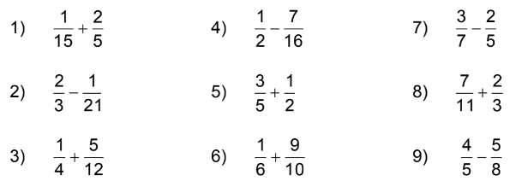
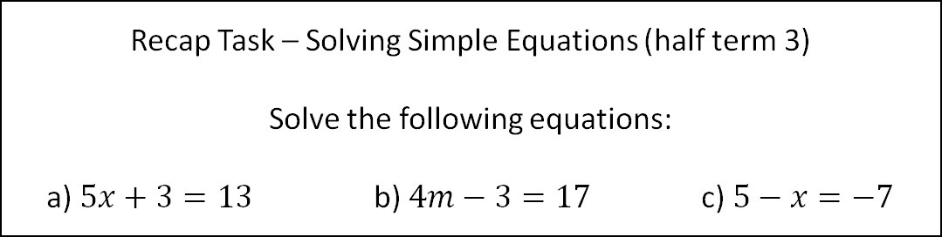
Year 7 Mathematics Homework
Half Term 4, Week 3
Recap Task – Solving Simple Equations (Half Term 4)
Solve the following equations:
a) $5x+3=13$ b) $4m−3=17$ c) $5−x=−7$
Main Task – Add or Subtract the following fractions, leave your answers as mixed numbers where necessary.
Key words – Multiple, Numerator, Denominator, improper, mixed number
Extension Task – Answer the following questions, give your answers as mixed numbers.
What have been your strengths in maths this week?
What have been the areas that have challenged you in maths this week?
How could you improve next week?
Building good people who take PRIDE in their time at school, RESPECT themselves and others, WORK TOGETHER as a community, showing RESILIENCE and EMPATHY for all.

Slide 55
Year 7 Music - Reading Music & Keyboard Skills
Homework - Half Term 4 Week 3
How many beats are each of the following notes worth? Semibreve Minim Crotchet 2. Draw one of each note names above. 3. Create some short rhythmic patterns using some of the above notes – Try and clap the patterns you created.
This week’s listening – Title: Minute Waltz
Composer: Frédéric Chopin
Genre: Romantic
Spend time listening to the above piece of music.
Complete the page in your listening booklet –
1.Give some background information on the piece and artist/composer
2.Comment on the instrumentation and how the musical elements are used in as much detail as you can.
3.Give your personal response to the music – remember to explain why you liked or did not like the piece of music.
Key words – Tempo, Dynamics, Duration, Pitch, Silence, Articulation, Melody, Texture, Timbre
Extension Task – Listen to and comment on further pieces of music by the same artist/composer.
What have been your strengths in Music this week?
What have been the areas that have challenged you in Music this week?
How could you improve next week?
Building good people who take PRIDE in their time at school, RESPECT themselves and others, WORK TOGETHER as a community, showing RESILIENCE and EMPATHY for all.

Slide 56

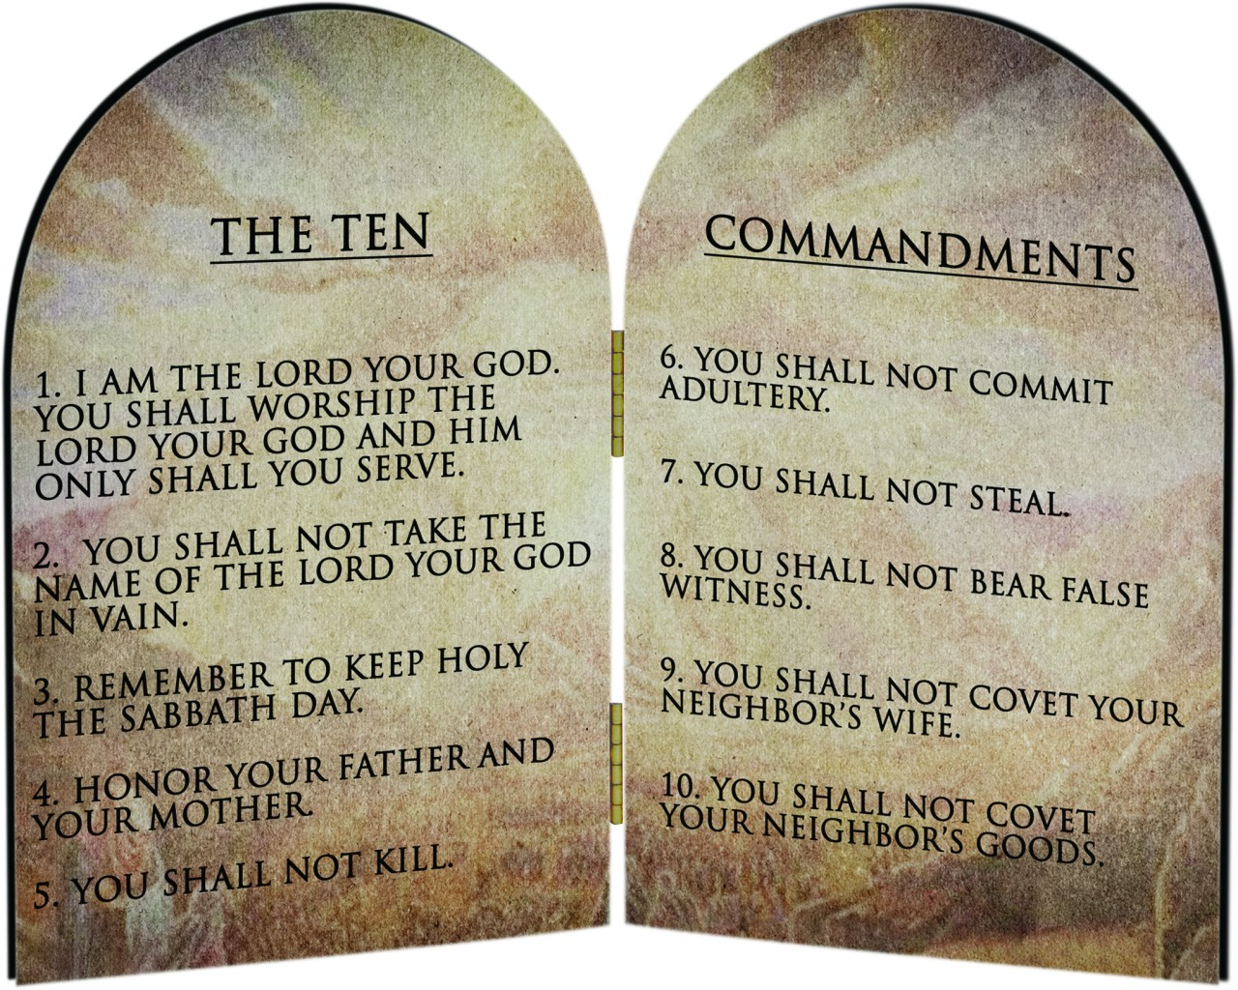
Year 7 RE Homework – Half Term 4, Week 3
Name at least five Christian denominations
Look at The Ten Commandments above, if you were to write ten rules for people to follow today, what you would they be?
Key words – The Ten Commandments
Extension Task – To what extent do you think that The Ten Commandments are still relevant today?
What have been your strengths in RE this week?
What have been the areas that have challenged you in Christianity this week?
How could you improve next week?
Building good people who take PRIDE in their time at school, RESPECT themselves and others, WORK TOGETHER as a community, showing RESILIENCE and EMPATHY for all.

Slide 57
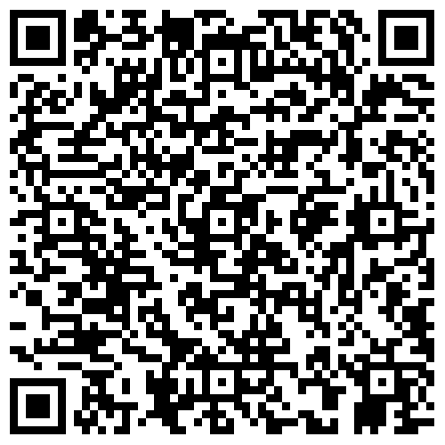
Year 7 Science Homework – Half Term 4, Week 3
Recap:
See Below
Main Task (5th March 2024):
Due: 12th March 2024
Recap on Energy
3.1.9 to 3.1.12 Conductors vs Insulators
To Energy in Food
Recap on Light and Space
3.6.7 to 3.6.10 – Days, Months and Years
To End of Topic Test - Space
Key words – Conductors, Insulators, Energy, Calories, Days, Months, Years, Sun, Milky Way
Extension Task – Complete Crosswords / Exam Style Questions inside Chemistry or Biology Extension Booklets, Mark Date Completed.
What have been your strengths in (insert subject) this week?
What have been the areas that have challenged you in (insert topic) this week?
How could you improve next week?
Building good people who take PRIDE in their time at school, RESPECT themselves and others, WORK TOGETHER as a community, showing RESILIENCE and EMPATHY for all.

Slide 58
Year 7 Young Enterprise, Homework – Half Term 4, Week 3
Recap:
Why are tactics and strategy important when being enterprising? Give 3 reasons. (3 marks)
Main Task
Q1Why is finance so important in the business world? Give 3 points. (3 marks)
Q2 What does CEO stand for? (1 mark)
Q2 What does CFO stand for? (1 mark)
Q3 What does a CFO do? List their possible roles and tasks. (5 marks)
Key words:
Finance, CFO, CEO
Extension Task-
If a business is lacking finance, what problems could occur? Explain at least 3 points (6 marks)
What have been your strengths this week?
What have been the areas that have challenged this week?
How could you improve next week?
Building good people who take PRIDE in their time at school, RESPECT themselves and others, WORK TOGETHER as a community, showing RESILIENCE and EMPATHY for all.

Slide 59
Week 4 Homework

Slide 60
Week 4 Homework Due Dates
Subject | Day Due | Date Due
Academic PE
Art
English
Geography
History
Languages
Maths
Music
RE
Science
Young Enterprise
Building good people who take PRIDE in their time at school, RESPECT themselves and others, WORK TOGETHER as a community, showing RESILIENCE and EMPATHY for all.

Slide 61
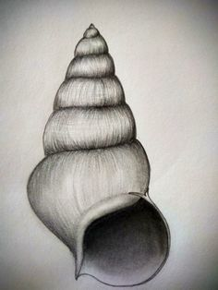
Year 7 Art Homework – Half Term 4, Week 4
Recap task:
Before each homework task practice your tones with your
2b pencil or your coloured crayons.
Complete a drawing of a shell
Key words – Primary, Secondary,, tonal, shading, value
Extension Task –
Find a piece of artwork which your admire or like a bit and write a paragraph about it – Use the descriptive words on the last lage of Art to help you.
What have been your strengths in this week?
What have been the areas that have challenged you in Photography this week?
How could you improve next week?
Building good people who take PRIDE in their time at school, RESPECT themselves and others, WORK TOGETHER as a community, showing RESILIENCE and EMPATHY for all.

Slide 63
For internal use in school only - Copyright for the keywords list to the Arty Teacher

Slide 64
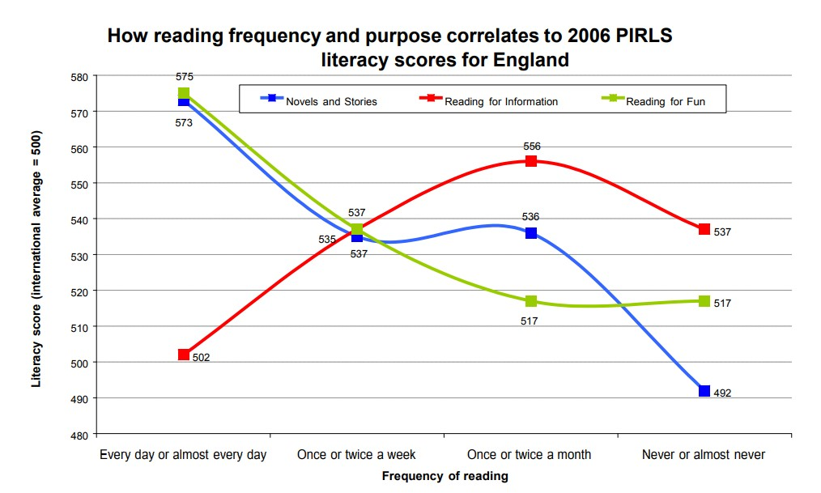
Year 7 English Homework
Half Term 4, Week 4
This is taken from the following Department for Education report:
Research Evidence on Reading for Pleasure. Report conducted by the government's Education Standards research team. For the full report, please access https://assets.publishing.service.gov.uk/government/uploads/system/uploads/attachment_data/file/284286/reading_for_pleasure.pdf
Read at least four times per week for at least twenty minutes each time. Use your planner to record what you have read and for how long you have read. Have a parent or guardian sign your planner to confirm that you have completed your reading.
Key words – pleasure, effectiveness, success, comfort, relaxation, growth, vocabulary, understanding, enjoyment, interest, passion,
Extension Task – Share ideas about what books to read with friends and family. Can you tell them why your book is effective? Can you ask them what’s effective about the book they recommend? Step out of your comfort zone; find new authors and titles. Talk to friends, family and teachers about what they think is a good read.
What have been your strengths in (insert subject) this week?
What have been the areas that have challenged you in (insert topic) this week?
How could you improve next week?
Building good people who take PRIDE in their time at school, RESPECT themselves and others, WORK TOGETHER as a community, showing RESILIENCE and EMPATHY for all.

Slide 65
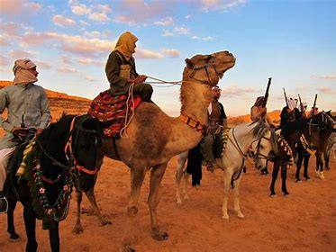
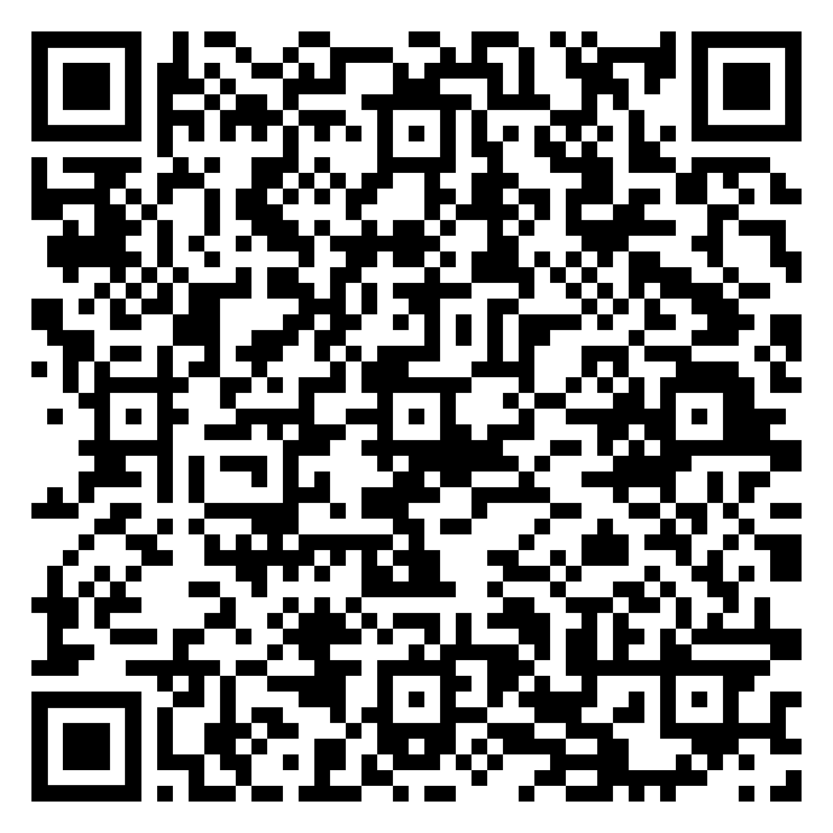
Year 7 Geography Homework – Half Term 4 Week 4
Which plants and animals are found in hot deserts? Name THREE adaptations they have to help them live there.
Complete the reading comprehension about how people survive in hot deserts (see QR code)
Key words – Bedouin, water, food, elements, nomadic, protection
Extension Task – Complete the Extension Task on the reading comprehension (see QR code).
What have been your strengths in Geography this week?
What have been the areas that have challenged you in Geography this week?
How could you improve next week?
Building good people who take PRIDE in their time at school, RESPECT themselves and others, WORK TOGETHER as a community, showing RESILIENCE and EMPATHY for all.

Slide 66
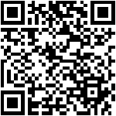
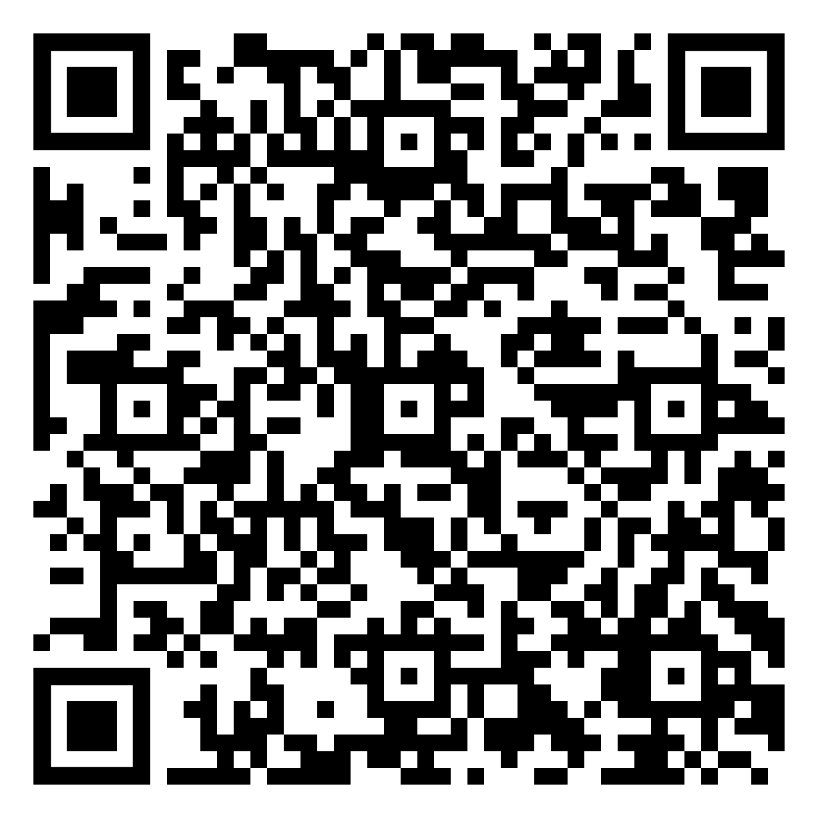
Year 7 History Homework – Half Term 4, Week 4
1. How many knights entered the church to murder Becket?
2. Who did the monks blame for Becket's death?
3. Did Henry II take full responsibility for the knights killing Becket?
4. Why did Henry II make Becket Archbishop of Canterbury?
5. What did Becket refuse to do for Henry II?
YouTube:
Go onto YouTube and find 2 videos about King John.
For each video write down the below:
  The URL/link for the video.
  A 3-sentence summary of what the video summarised.
  An explanation about why you chose that video.
  A review of the video – how well do you think it covers the topic and why?
  Compare the videos.
Key words – taxes, barons, pope, monks, civil war, trials
Extension Task – Seneca:
Join class - Seneca task -
What have been your strengths in History this week?
What have been the areas that have challenged you in History this week?
How could you improve next week?
Building good people who take PRIDE in their time at school, RESPECT themselves and others, WORK TOGETHER as a community, showing RESILIENCE and EMPATHY for all.

Slide 67
Year 7 Languages Homework
Half Term 4
Vocabulary and Translation Practise
For this homework, you will need a copy of the Sentence Builder.
Task 1 | Test yourself on the items in the sentence builder using the Look-Say-Cover-Write-Check method.
Task 2 | Ask a friend or a relative to test you on individual items from the sentence builder.
Task 3 | Ask a friend or a relative to test you on full sentences from the sentence builder.
Task 4 | Practise this week's topic on Linguascope. (See Mr Downey for the login details).
Task 5 | Find a new song in your preferred language on Lyrics Training. Can you challenge yourself to the higher levels?
Language Gym – Check for online assignments
Username: ______________________
Password: _______________________
What have been your strengths in Languages this week?
What have been the areas that have challenged you in Languages this week?
How could you improve next week?
Building good people who take PRIDE in their time at school, RESPECT themselves and others, WORK TOGETHER as a community, showing RESILIENCE and EMPATHY for all.

Slide 68
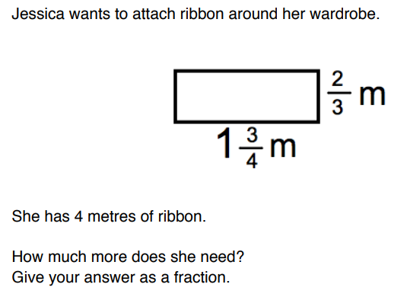
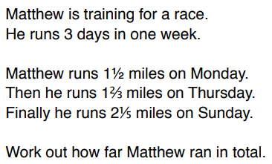
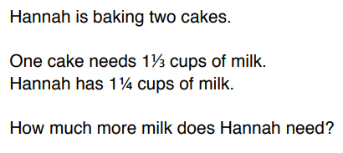
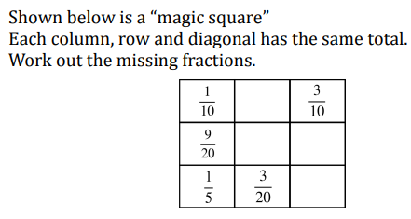
Year 7 Mathematics Homework
Half Term 4, Week 4
Recap Task – Finding fractions of an amount (Half Term 4)
Write an explanation of how you find a fraction of an amount, and show a clearly worked example.
Main Task:
Answer the following 3 problems involving adding and subtracting mixed numbers, show your working clearly.
Key words – Perimeter, Mixed Number, Improper Fraction, Common Denominator
Extension Task:
This is a ‘magic square’. Find the missing numbers, so that every row, column and diagonal has the same total.
What have been your strengths in maths this week?
What have been the areas that have challenged you in maths this week?
How could you improve next week?
Building good people who take PRIDE in their time at school, RESPECT themselves and others, WORK TOGETHER as a community, showing RESILIENCE and EMPATHY for all.

Slide 69
Year 7 Music - Reading Music & Keyboard Skills
Homework - Half Term 4 Week 4
What is a stave? How many lines does a stave usually have? What are bars and bar lines?
This week’s listening – Title: The Maple Leaf Rag
Composer: Scott Joplin
Genre: Ragtime
Spend time listening to the above piece of music.
Complete the page in your listening booklet –
1.Give some background information on the piece and artist/composer
2.Comment on the instrumentation and how the musical elements are used in as much detail as you can.
3.Give your personal response to the music – remember to explain why you liked or did not like the piece of music.
Key words – Tempo, Dynamics, Duration, Pitch, Silence, Articulation, Melody, Texture, Timbre
Extension Task – Listen to and comment on further pieces of music by the same artist/composer.
What have been your strengths in Music this week?
What have been the areas that have challenged you in Music this week?
How could you improve next week?
Building good people who take PRIDE in their time at school, RESPECT themselves and others, WORK TOGETHER as a community, showing RESILIENCE and EMPATHY for all.

Slide 70

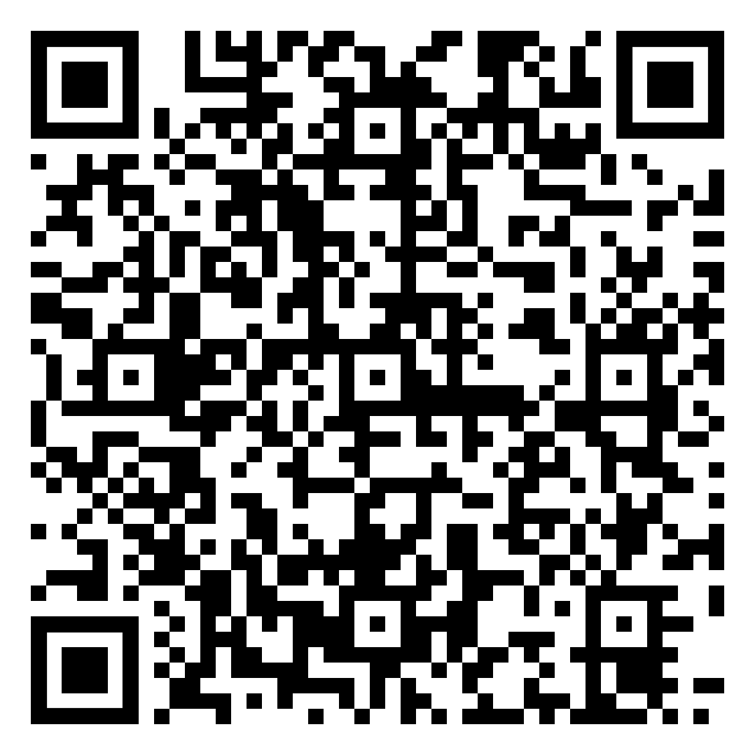
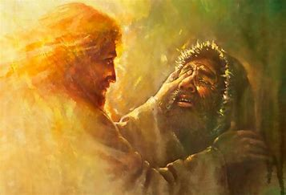
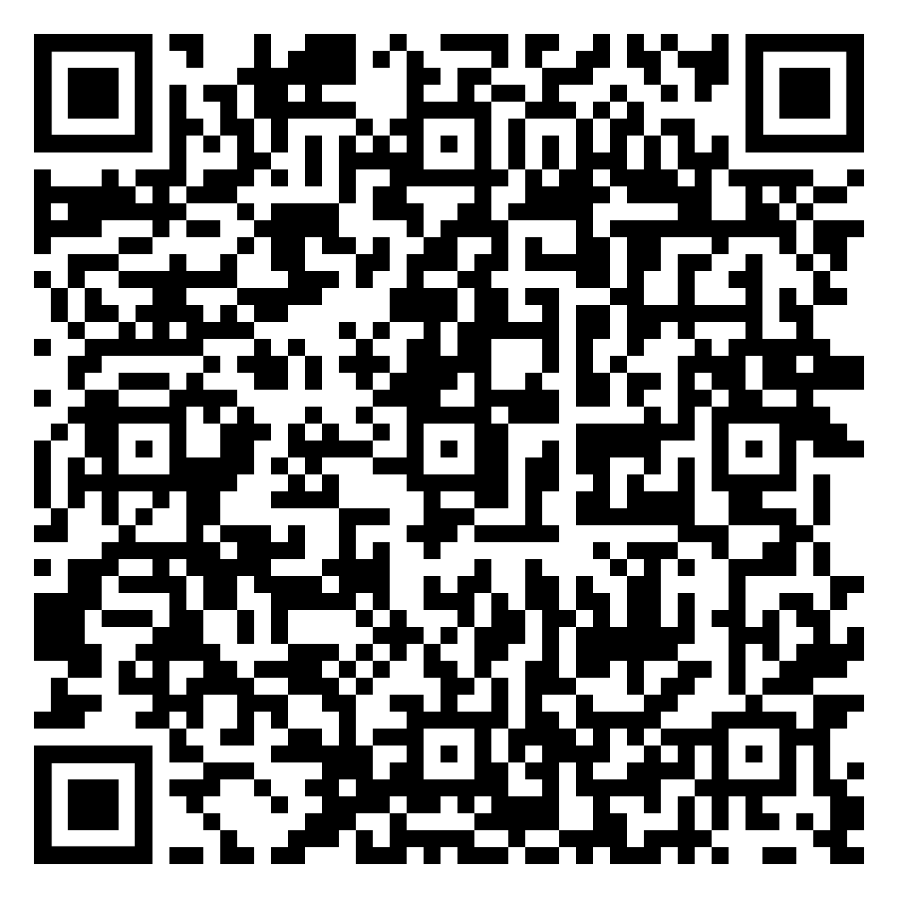
Year 7 RE Homework – Half Term 4, Week 4
Easter Quiz
1. List some of the miracles Jesus performed.
2. Write a newspaper article about one of Jesus' miracles. It should include what happened and include an eye-witness account and an image. You can use the Miracles Week 4 document to help you if you wish.
Online document link - Miracles Week 4.pdf
Key words – miracles, Gospels, compassion, parable
Extension Task – 'Jesus only performed miracles to help people' Do you think that is true? What might have been his other motives? Explain your arguments.
What have been your strengths in RE this week?
What have been the areas that have challenged you in Christianity this week?
How could you improve next week?
Building good people who take PRIDE in their time at school, RESPECT themselves and others, WORK TOGETHER as a community, showing RESILIENCE and EMPATHY for all.

Slide 71
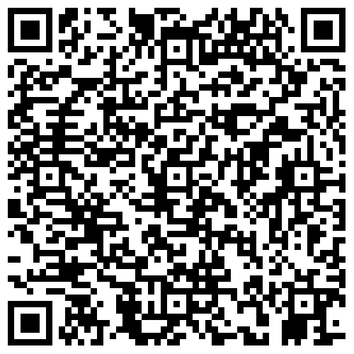
Year 7 Science Homework – Half Term 4, Week 4
Recap:
See Below
Main Task (12th March 2024):
Due: 19th March 2024
Recap on Energy
3.1.13 to 3.1.16 – Calories to Fuel Bills
Recap on Light and Space
3.3.14 to 3.1.17 Light Waves to Reflection
Key words – Calories, Food Labels, Nutritional Labels, Energy in the Home, Fuels, Renewable, Non-Renewable, Light, Wave, Reflection, Drawing Reflections, Refraction
Extension Task – Complete Crosswords / Exam Style Questions inside Chemistry or Biology Extension Booklets, Mark Date Completed.
What have been your strengths in (insert subject) this week?
What have been the areas that have challenged you in (insert topic) this week?
How could you improve next week?
Building good people who take PRIDE in their time at school, RESPECT themselves and others, WORK TOGETHER as a community, showing RESILIENCE and EMPATHY for all.

Slide 72
Year 7 Young Enterprise, Homework – Half Term 4, Week 4
Recap:
Define:
CEO CFO
Main Task
OH DEAR! The business idea you came up with in Week 2 is having financial problems. You are losing money and will soon not have enough to pay your bills.
Explain what you could do to keep the business alive.
Explain sources of finance available (at least 3) and say why these options could help the business carry on. (10 Marks)
Key words: Sources of Finance
Extension Task — If you could be a CFO or a CEO, which would you choose? Explain your response by giving clear reasons (at least 3). (6 marks)
What have been your strengths this week?
What have been the areas that have challenged you this week?
How could you improve next week?
Building good people who take PRIDE in their time at school, RESPECT themselves and others, WORK TOGETHER as a community, showing RESILIENCE and EMPATHY for all.

Slide 73
Week 5 Homework

Slide 74
Week 5 Homework Due Dates
Subject | Day Due | Date Due
Academic PE
Art
English
Geography
History
Languages
Maths
Music
RE
Science
Young Enterprise
Building good people who take PRIDE in their time at school, RESPECT themselves and others, WORK TOGETHER as a community, showing RESILIENCE and EMPATHY for all.

Slide 75
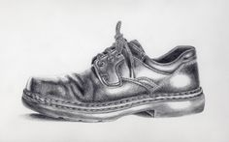
Year 7 Art Homework – Half Term 4, Week 5
Recap task:
Before each homework task practice your tones with your
2b pencil or your coloured crayons.
Complete a drawing of a shoe
Key words – Primary, Secondary,, tonal, shading, value
Extension Task –
Find a piece of artwork which your admire or like a bit and write a paragraph about it – Use the descriptive words on the last lage of Art to help you.
What have been your strengths in this week?
What have been the areas that have challenged you in Photography this week?
How could you improve next week?
Building good people who take PRIDE in their time at school, RESPECT themselves and others, WORK TOGETHER as a community, showing RESILIENCE and EMPATHY for all.

Slide 77
For internal use in school only - Copyright for the keywords list to the Arty Teacher

Slide 78
Year 7 English Homework
Half Term 4, Week 5
This is taken from the following Department for Education report:
Research Evidence on Reading for Pleasure. Report conducted by the government's Education Standards research team. For the full report, please access https://assets.publishing.service.gov.uk/government/uploads/system/uploads/attachment_data/file/284286/reading_for_pleasure.pdf
‘The graph relates reading frequency and reading materials to PIRLS scores. The key finding is that frequent reading for pleasure is correlated to higher PIRLS literacy scores. However, reading for information is much less well correlated. The graph shows that:
• Frequently reading novels and stories and reading for fun is strongly correlated to PIRLS literacy score.
• However, reading for information (regardless of the source) is much less well correlated. Those who reported the most frequent reading of information texts.’
Read at least four times per week for at least twenty minutes each time. Use your planner to record what you have read and for how long you have read. Have a parent or guardian sign your planner to confirm that you have completed your reading.
Key words – pleasure, effectiveness, success, comfort, relaxation, growth, vocabulary, understanding, enjoyment, interest, passion,
Extension Task – Share ideas about what books to read with friends and family. Can you tell them why your book is effective? Can you ask them what’s effective about the book they recommend? Step out of your comfort zone; find new authors and titles. Talk to friends, family and teachers about what they think is a good read.
What have been your strengths in (insert subject) this week?
What have been the areas that have challenged you in (insert topic) this week?
How could you improve next week?
Building good people who take PRIDE in their time at school, RESPECT themselves and others, WORK TOGETHER as a community, showing RESILIENCE and EMPATHY for all.

Slide 79


Year 7 Geography Homework – Half Term 4 Week 5
What is fast fashion?
Design a campaign poster to stop people spending money on fast fashion.
The poster should encourage people to re-use clothing, buy sustainably and consider second-hand shopping through charity shops or sites such as Vinted.
It should be both colourful and
informative.
It should raise awareness of the issues
associated with fast fashion.
Key words – fast fashion, campaign, re-use, second-hand, sustainably
Extension Task – Can you find any examples of companies that are encouraging people to ditch fast fashion? Do you think that people will ever give up fast fashion?
What have been your strengths in Geography this week?
What have been the areas that have challenged you in Geography this week?
How could you improve next week?
Building good people who take PRIDE in their time at school, RESPECT themselves and others, WORK TOGETHER as a community, showing RESILIENCE and EMPATHY for all.

Slide 80
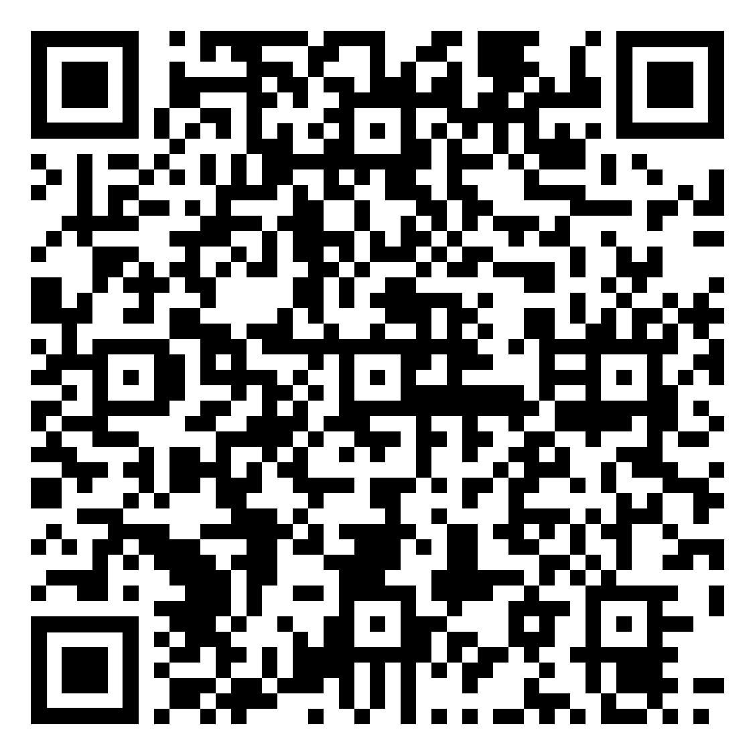
Year 7 History Homework – Half Term 4, Week 5
1. Describe two of the punishments John used on people who opposed him.
2. Why did losing wars make John a bad King?
3. Why did upsetting the pope make John a bad King?
4. Why did asking for high taxes make John a bad King?
5. Why did cruelty make John a bad King?
Mind Map:
Next, we will look at the Magna Carta, research this and complete the tasks below (link to a good website - https://www.bbc.co.uk/bitesize/topics/zcyx2v4/articles/zcg66g8)
Take the key events and put them onto a Mind Map (examples/templates available).
Make sure the events have a title and a brief description.
Make sure it has arrows LINKING events – does one cause another? Do they have things in common? Have you described why they link together?
Make sure it has either colour coding (one colour per area) or pictures/symbols.
Key words – Magna Carta, Tax, Kingdom, Merchant, Freeman
Extension Task – Seneca:
Join class - Seneca task -
What have been your strengths in History this week?
What have been the areas that have challenged you in History this week?
How could you improve next week?
Building good people who take PRIDE in their time at school, RESPECT themselves and others, WORK TOGETHER as a community, showing RESILIENCE and EMPATHY for all.

Slide 81
Year 7 Languages Homework
Half Term 4
Vocabulary and Translation Practise
For this homework, you will need a copy of the Sentence Builder.
Task 1 | Test yourself on the items in the sentence builder using the Look-Say-Cover-Write-Check method.
Task 2 | Ask a friend or a relative to test you on individual items from the sentence builder.
Task 3 | Ask a friend or a relative to test you on full sentences from the sentence builder.
Task 4 | Practise this week's topic on Linguascope. (See Mr Downey for the login details).
Task 5 | Find a new song in your preferred language on Lyrics Training. Can you challenge yourself to the higher levels?
Language Gym – Check for online assignments
Username: ______________________
Password: _______________________
What have been your strengths in Languages this week?
What have been the areas that have challenged you in Languages this week?
How could you improve next week?
Building good people who take PRIDE in their time at school, RESPECT themselves and others, WORK TOGETHER as a community, showing RESILIENCE and EMPATHY for all.

Slide 82
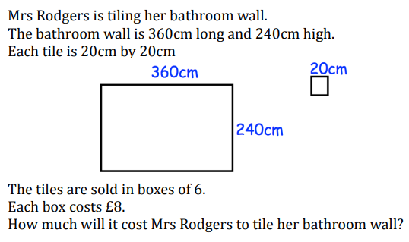
Year 7 Mathematics Homework
Half Term 4, Week 5
Recap Task – Write an explanation of how to find a percentage of an amount, give 2 or 3 clearly worked examples
This weeks homework task is assigned on SENECA, please log in and complete all relevant sections, ensuring you watch the videos where necessary to improve your understanding. Show any written working clearly in your homework book.
1.4.4 Adding Fractions
1.4.5 Subtracting Fractions
1.4.9 Improper and mixed numbers
Key words – Improper Fraction, Mixed Number, Common Denominator, Numerator, Perimeter
Extension Task – Area
Extension Task - Area
What have been your strengths in maths this week?
What have been the areas that have challenged you in maths this week?
How could you improve next week?
Building good people who take PRIDE in their time at school, RESPECT themselves and others, WORK TOGETHER as a community, showing RESILIENCE and EMPATHY for all.

Slide 83
Year 7 Music - Reading Music & Keyboard Skills
Homework - Half Term 4 Week 5
What is the difference between a treble clef and a bass clef? Which instruments would usually read music written using a bass clef? Which instruments would usually read music written using a treble clef Draw one of each clef, correctly positioned on a stave.
This week’s listening – Title: Vers La Vie Nouvelle
Composer: Nadia Boulanger
Genre: 20th Century
Spend time listening to the above piece of music.
Complete the page in your listening booklet –
1.Give some background information on the piece and artist/composer
2.Comment on the instrumentation and how the musical elements are used in as much detail as you can.
3.Give your personal response to the music – remember to explain why you liked or did not like the piece of music.
Key words – Tempo, Dynamics, Duration, Pitch, Silence, Articulation, Melody, Texture, Timbre
Extension Task – Listen to and comment on further pieces of music by the same artist/composer.
What have been your strengths in Music this week?
What have been the areas that have challenged you in Music this week?
How could you improve next week?
Building good people who take PRIDE in their time at school, RESPECT themselves and others, WORK TOGETHER as a community, showing RESILIENCE and EMPATHY for all.

Slide 84

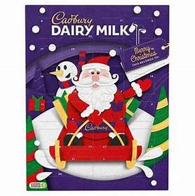
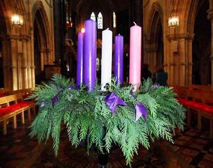
Year 7 RE Homework – Half Term 4, Week 5
Name one of the miracles that Jesus performed. Do you believe in miracles? Justify your answer.
‘Advent doesn’t mean anything anymore.
It’s like Easter – it just means chocolate,
so, there’s no point in celebrating it.’
1. Write down any arguments you can think of that agree with this statement.
2. Write down any arguments that you can think of that disagree with this statement.
Key words – Advent, saviour, covenant, wreath
Extension Task – What is your own opinion on the question above? Justify your answer.
What have been your strengths in RE this week?
What have been the areas that have challenged you in Christianity this week?
How could you improve next week?
Building good people who take PRIDE in their time at school, RESPECT themselves and others, WORK TOGETHER as a community, showing RESILIENCE and EMPATHY for all.

Slide 85
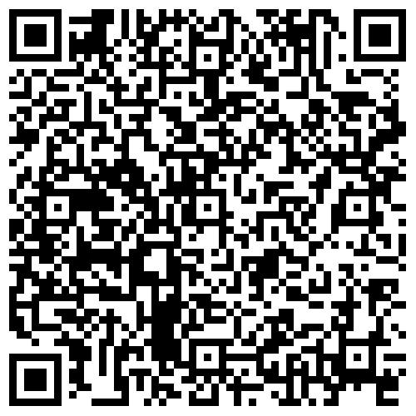
Year 7 Science Homework – Half Term 4, Week 5
Recap:
See Below
Main Task (19th March 2024):
Due: 26th March 2024
Recap on Energy
3.1.17 to 3.1.20 – Calculating Fuel Bills
to Renewable Energy
Recap on Light and Space
3.3.18 to 3.3.21 – The Human Eye
to Colour
Key words – Refraction, Lenses, Human Eye, Colour, Seeing Colour, Fuel Cost, Fuel Bills, Renewable Energy, Non-Renewable Energy
Extension Task – Complete Crosswords / Exam Style Questions inside Chemistry or Biology Extension Booklets, Mark Date Completed.
What have been your strengths in (insert subject) this week?
What have been the areas that have challenged you in (insert topic) this week?
How could you improve next week?
Building good people who take PRIDE in their time at school, RESPECT themselves and others, WORK TOGETHER as a community, showing RESILIENCE and EMPATHY for all.

Slide 86
Year7 Young Enterprise, Homework – Half Term 4, Week 5
Define the following terms:
Bank Loan Overdraft
Main Task
Q1 Many people mix-up or incorrectly define revenue and profit.
What do the terms revenue and profit actually mean? (2 marks)
Q2 Having lots of revenue doesn’t mean you will have lots of profit. Why? (2 marks)
Q3 Give examples of 4 costs a business could have. (4 marks)
Q4 Having lots of costs doesn’t mean a business will not have profit. Explain why. (2 marks)
Key words: Revenue, Profit
Extension Task —
How could a business minimise costs? Give 5 examples. (5 marks)
What have been your strengths this week?
What have been the areas that have challenged you this week?
How could you improve next week?
Building good people who take PRIDE in their time at school, RESPECT themselves and others, WORK TOGETHER as a community, showing RESILIENCE and EMPATHY for all.

Slide 87
Week 6 Homework

Slide 88
Week 6 Homework Due Dates
Subject | Day Due | Date Due
Academic PE
Art
English
Geography
History
Languages
Maths
Music
RE
Science
Young Enterprise
Building good people who take PRIDE in their time at school, RESPECT themselves and others, WORK TOGETHER as a community, showing RESILIENCE and EMPATHY for all.

Slide 89
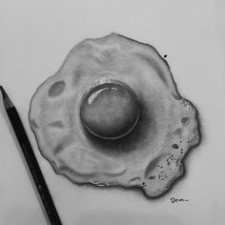
Year 7 Art Homework – Half Term 4, Week 6
Recap task:
Before each homework task practice your tones with your
2b pencil or your coloured crayons.
Complete a drawing of a fried egg
Key words – Primary, Secondary,, tonal, shading, value
Extension Task –
Find a piece of artwork which your admire or like a bit and write a paragraph about it – Use the descriptive words on the last lage of Art to help you.
What have been your strengths in this week?
What have been the areas that have challenged you in Photography this week?
How could you improve next week?
Building good people who take PRIDE in their time at school, RESPECT themselves and others, WORK TOGETHER as a community, showing RESILIENCE and EMPATHY for all.

Slide 91
For internal use in school only - Copyright for the keywords list to the Arty Teacher

Slide 92
Year 7 English Homework
Half Term 4, Week 6
This is taken from the following Department for Education report:
Research Evidence on Reading for Pleasure. Report conducted by the government's Education Standards research team. For the full report, please access https://assets.publishing.service.gov.uk/government/uploads/system/uploads/attachment_data/file/284286/reading_for_pleasure.pdf
‘In England (and in most other countries) there was a positive association between the frequency of reading for pleasure and reading attainment. England had the greatest difference between the mean attainment of children who read for fun (outside of school) on a daily basis (mean scale score 575) and those who read on a weekly basis (mean scale score 537), a difference of 38 points. Reading for pleasure is an activity that has real emotional and social consequences. There is a growing body of evidence which illustrates the importance of reading for pleasure for both educational purposes as well as personal development. The evidence strongly supports the argument that those who read more are better readers; and the amount of reading and reading achievement are thought to be reciprocally related to each other – as reading amount increases, reading achievement increases, which in turn increases reading amount. Children who read very little do not have the benefits that come with reading, and studies show that when struggling readers are not motivated to read, their opportunities to learn decrease significantly.’
Read at least four times per week for at least twenty minutes each time. Use your planner to record what you have read and for how long you have read. Have a parent or guardian sign your planner to confirm that you have completed your reading.
Key words – pleasure, effectiveness, success, comfort, relaxation, growth, vocabulary, understanding, enjoyment, interest, passion,
Extension Task – Share ideas about what books to read with friends and family. Can you tell them why your book is effective? Can you ask them what’s effective about the book they recommend? Step out of your comfort zone; find new authors and titles. Talk to friends, family and teachers about what they think is a good read.
What have been your strengths in (insert subject) this week?
What have been the areas that have challenged you in (insert topic) this week?
How could you improve next week?
Building good people who take PRIDE in their time at school, RESPECT themselves and others, WORK TOGETHER as a community, showing RESILIENCE and EMPATHY for all.

Slide 93

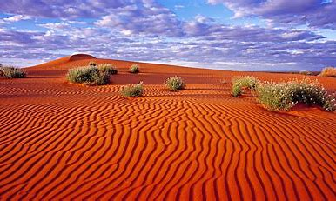
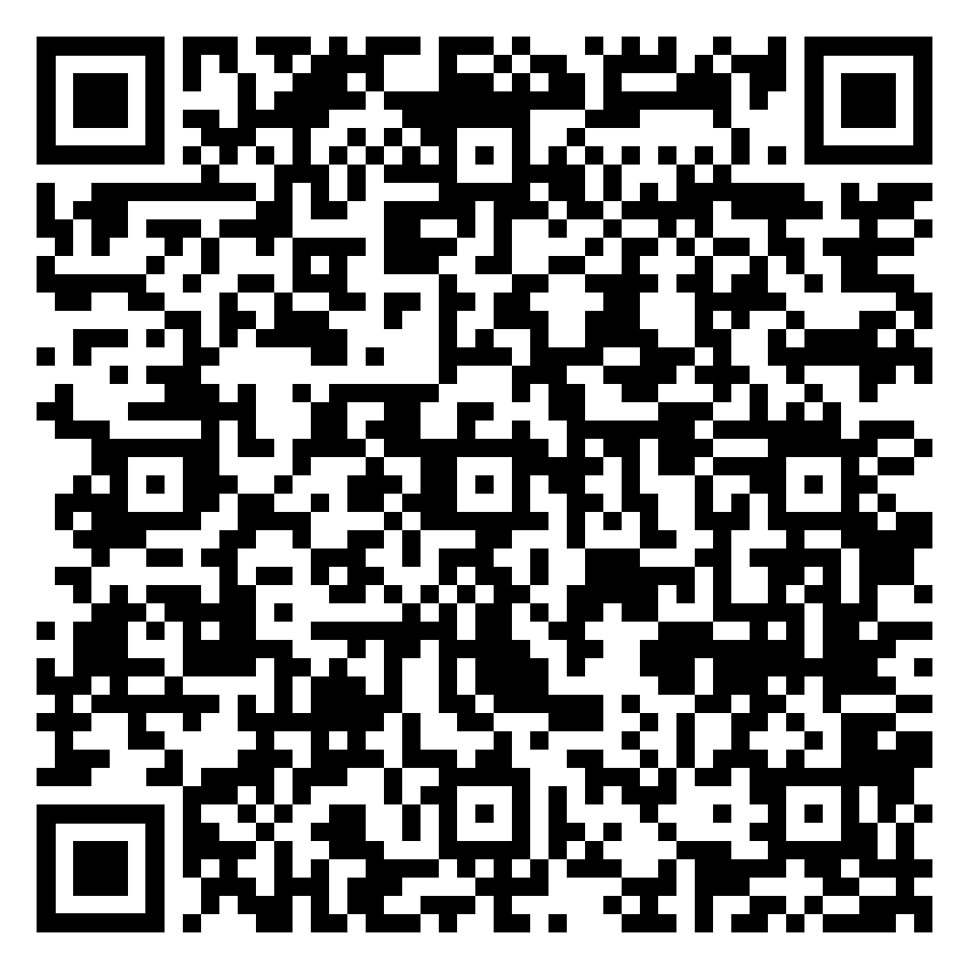
Year 7 Geography Homework – Half Term 4 Week 6
List as many key terms as you can remember from this topic, Hot Deserts
Create a brain dump (mind map) of everything that you can remember from this topic, Types of Christianity. Include as many key words and links as you can.
Key words – Follow QR code for key vocabulary
Extension Task – Include definitions of any key words you include in your brain dump
What have been your strengths in Geography this week?
What have been the areas that have challenged you in Geography this week?
How could you improve next week?
Building good people who take PRIDE in their time at school, RESPECT themselves and others, WORK TOGETHER as a community, showing RESILIENCE and EMPATHY for all.

Slide 94
Year 7 History Homework – Half Term 4, Week 6
1. What does 'Magna Carta' mean?
2. What was the Magna Carta?
3. Why did the barons think the Magna Carta needed to happen?
4. Who benefitted from the Magna Carta?
5. Who did not benefit from the Magna Carta?
Flash Cards:
Go back through the work we have completed on Medieval Monarchs.
Pick 3-4 key bits from each week.
Take the bits and turn them into flash cards (examples available).
Each card should be around 10cm long and 5cm high.
Each card should have 1 of the key bits described on one side and on the other side it should have a word/clue/picture to summarise it.
Key words – Henry II, Thomas Becket, Qualities, Magna Carta, John
Extension Task – Seneca:
Join class - Seneca task -
What have been your strengths in History this week?
What have been the areas that have challenged you in History this week?
How could you improve next week?
Building good people who take PRIDE in their time at school, RESPECT themselves and others, WORK TOGETHER as a community, showing RESILIENCE and EMPATHY for all.

Slide 95
Year 7 Languages Homework
Half Term 4
Vocabulary and Translation Practise
For this homework, you will need a copy of the Sentence Builder.
Task 1 | Test yourself on the items in the sentence builder using the Look-Say-Cover-Write-Check method.
Task 2 | Ask a friend or a relative to test you on individual items from the sentence builder.
Task 3 | Ask a friend or a relative to test you on full sentences from the sentence builder.
Task 4 | Practise this week's topic on Linguascope. (See Mr Downey for the login details).
Task 5 | Find a new song in your preferred language on Lyrics Training. Can you challenge yourself to the higher levels?
Language Gym – Check for online assignments
Username: ______________________
Password: _______________________
What have been your strengths in Languages this week?
What have been the areas that have challenged you in Languages this week?
How could you improve next week?
Building good people who take PRIDE in their time at school, RESPECT themselves and others, WORK TOGETHER as a community, showing RESILIENCE and EMPATHY for all.

Slide 96
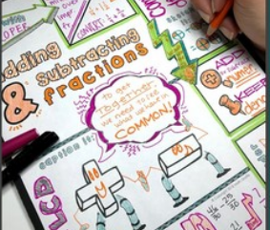
Year 7 Maths Homework – Half Term 4, Week 6
Recap Task – Review
Review the homework from this half term, make any corrections or improvements where necessary.
Main task – Make notes in your homework book reviewing everything learnt this half term in maths (both Mrs Thompson and Mr Oakes lessons). Include clearly explained examples of each topic.
Key words – Mixed, Improper, Top Heavy, Equivalent, Numerator, Denominator, Area, decimals, place value
Extension Task – ask a friend or relative to test you using your notes
What have been your strengths in maths this week?
What have been the areas that have challenged you in maths this week?
How could you improve next week?
Building good people who take PRIDE in their time at school, RESPECT themselves and others, WORK TOGETHER as a community, showing RESILIENCE and EMPATHY for all.

Slide 97
Year 7 Music - Reading Music & Keyboard Skills
Homework - Half Term 4 Week 6
Draw a simple piano keyboard and label all the notes with their note names.
This week’s listening – Title: Tiger
Composer: Henry Cowell
Genre: Avant Garde
Spend time listening to the above piece of music.
Complete the page in your listening booklet –
1.Give some background information on the piece and artist/composer
2.Comment on the instrumentation and how the musical elements are used in as much detail as you can.
3.Give your personal response to the music – remember to explain why you liked or did not like the piece of music.
Key words – Tempo, Dynamics, Duration, Pitch, Silence, Articulation, Melody, Texture, Timbre
Extension Task – Listen to and comment on further pieces of music by the same artist/composer.
What have been your strengths in Music this week?
What have been the areas that have challenged you in Music this week?
How could you improve next week?
Building good people who take PRIDE in their time at school, RESPECT themselves and others, WORK TOGETHER as a community, showing RESILIENCE and EMPATHY for all.

Slide 98


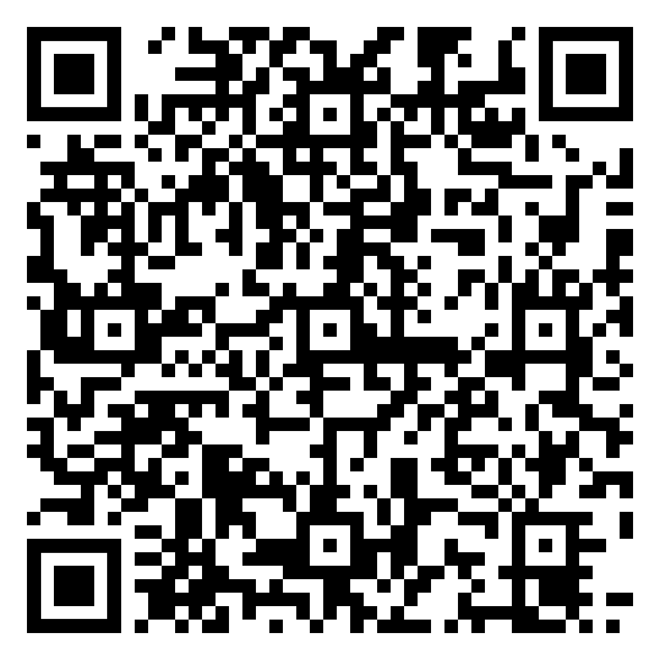

Year 7 RE Homework – Half Term 4, Week 6
Nativity Quiz
Answer the following questions:
1. What is Stewardship?
2. How does Stewardship differ from Dominion?
3. Can you suggest some ways that you could help look after the environment?
Key words – Stewardship, Dominion, environment, pollution
Extension Task – Research Green Christians, A Rocha, and write down at least five facts about them
What have been your strengths in RE this week?
What have been the areas that have challenged you in Christianity this week?
How could you improve next week?
Building good people who take PRIDE in their time at school, RESPECT themselves and others, WORK TOGETHER as a community, showing RESILIENCE and EMPATHY for all.

Slide 99
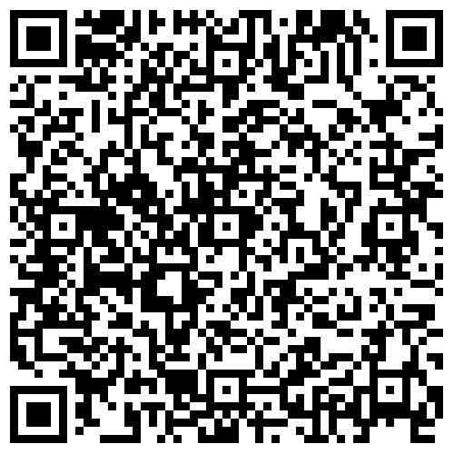
Year 7 Science Homework – Half Term 4, Week 6
Recap:
See Below
Main Task (26th March 2024):
Due: Tuesday 16th April 2024
Recap on Energy
3.1.9 to 3.1.22 – Other Non-Renewables
To End of Topic Test - Energy
Recap on Light and Space
3.3.23 to 3.3.28 – Colours of Light to
End of Topic Test – Sound (and Light)
Key words – Refraction, Lenses, Human Eye, Colour, Seeing Colour, Fuel Cost, Fuel Bills, Renewable Energy, Non-Renewable Energy
Extension Task – Complete Crosswords / Exam Style Questions inside Chemistry or Biology Extension Booklets, Mark Date Completed.
What have been your strengths in (insert subject) this week?
What have been the areas that have challenged you in (insert topic) this week?
How could you improve next week?
Building good people who take PRIDE in their time at school, RESPECT themselves and others, WORK TOGETHER as a community, showing RESILIENCE and EMPATHY for all.

Slide 100
Year7 Young Enterprise, Homework – Half Term 4, Week 6
Recap Task – Define:
Revenue Profit (2 marks)
List 3 possible costs a business could have. (3 marks)
Main Task
Q1 What is the break-even formula? (1 mark)
Q2 Explain what the break-even point is and why a business would use break-even analysis. (4 marks)
Q3 If costs are higher than the revenue, is the business making a profit or a loss? 1 mark
Q4 What is the margin of safety? (4 marks)
Key words – Break-even, Margin of Safety
Extension Task –
What is contribution and how is it calculated? (4 marks)
What have been your strengths this week?
What have been the areas that have challenged you this week?
How could you improve next week?
Building good people who take PRIDE in their time at school, RESPECT themselves and others, WORK TOGETHER as a community, showing RESILIENCE and EMPATHY for all.

Slide 101
Building good people who take PRIDE in their time at school, RESPECT themselves and others, WORK TOGETHER as a community, showing RESILIENCE and EMPATHY for all.

