Slide 1

St. James' School Homework Booklet
Year 8
Lent Term HT4
Building good people who take PRIDE in their time at school, RESPECT themselves and others, WORK TOGETHER as a community, showing RESILIENCE and EMPATHY for all.

Slide 2

Name -
My Timetable at St. James’ School
Friday
Thursday
Wednesday
Tuesday
Monday
 | Tutorial (8.40-8.50) | Tutorial Lesson (8.50-9.20) | Lesson 1 (9.20-10.10) | Lesson 2 (10.10-11.00) | Lesson 3 (11.20-12.10) | Lesson 4 (12.10-13.00) | Extracurricular (13.40-14.10) | Lesson 5 (14.10-15.05) | Lesson 6 (15.05-16.00)
Building good people who take PRIDE in their time at school, RESPECT themselves and others, WORK TOGETHER as a community, showing RESILIENCE and EMPATHY for all.

Slide 3
Homework at St. James’ School
Independent study is an essential part of the learning. Pupils will have homework set on a regular basis that is meaningful and appropriate. This must be clearly recorded in the planner with an appropriate deadline.
Homework is set in order to, involve parents and guardians with learning, develop independent study skills which will allow pupils to achieve academic success, allow pupils to grow as independent and life-long learners through developing their confidence, motivation and self-discipline, reinforce, consolidate and/or extend what pupils know and can do in the classroom.
Regularity of Homework
This will be dependent on curriculum time and the allocation for each subject as well as the age range of the pupils. Pupils will receive at least one piece of homework per subject per week.
Guideline allocation for Homework:
Year 7, 8 and 9: 30 minutes per subject
Year 10 and 11: Around 45 minutes per subject
Year 8 Homework Timetable
Monday​ | Tuesday​ | Wednesday​ | Thursday​ | Friday​
Building good people who take PRIDE in their time at school, RESPECT themselves and others, WORK TOGETHER as a community, showing RESILIENCE and EMPATHY for all.

Slide 4
Lent Term HT4 Uniform and Equipment
Required uniform for ALL pupils:
St. James’ Blazer
St. James’ Tie
Black Trousers/St. James’ Skirt
White Collared Shirt
Black School Shoes
Black Socks with Trousers
Black Tights with Skirts
Optional - Black Jumper/Cardigan
Optional – Plain Dark Coat
St. James’ PE Polo Shirt
St. James’ PE Shorts/Skort
St. James’ PE Tracksuit
St. James’ PE Sports Socks (green)
PE Trainers (any design)
Optional - St. James’ PE Waterproof
Required equipment for ALL pupils:
Black pen
Pencil
Ruler
Rubber
Calculator
Memory Pen
Is your uniform perfect all week? | Tutor Signature
Week 1 – Uniform Perfection?
Week 2 – Uniform Perfection?
Week 3 – Uniform Perfection?
Week 4 – Uniform Perfection?
Week 5 – Uniform Perfection?
Week 6 – Uniform Perfection?
Building good people who take PRIDE in their time at school, RESPECT themselves and others, WORK TOGETHER as a community, showing RESILIENCE and EMPATHY for all.

Slide 5
Lent Term HT4 Attendance
Being in school is important to your achievement, wellbeing, and wider development. Evidence shows that the students with the highest attendance throughout their time in school gain the best GCSE and A Level results.
Research found that pupils who performed better at secondary school missed fewer days than those who didn’t perform as well.
In 2019, secondary school pupils who didn’t achieve grade 9 to 4 in English and Maths missed 10 more days on average over the key stage than those who achieved grade 9 to 5 in both English and Maths.
Every moment in school counts, and days missed add up quickly. For example, a child who is absent for three days over a half term could miss 18 lessons in total.
The higher a pupil’s attendance, the more they are likely to learn, and the better they are likely to perform in exams and formal assessments.
*Information for the Department for Education (https://educationhub.blog.gov.uk/2023/05/18/school-attendance-important-risks-missing-day/)
Year 8 Lent Term HT4 Attendance
How many days did you miss last Half Term?
Last Half Term’s Attendance Percentage
How many days have you missed this Half Term?
This Half Term’s Attendance Percentage
Building good people who take PRIDE in their time at school, RESPECT themselves and others, WORK TOGETHER as a community, showing RESILIENCE and EMPATHY for all.

Slide 6


Pupil Wellbeing Information
Pupil wellbeing is at the centre of life at St. James’, in school you can talk to any member of the school staff who will be willing to listen and support you. Below is the school email for any questions you have or support you require:
wearelistening@saintjames.co.uk
Below this is a series of external support that the school has links with and can also be used:
Building good people who take PRIDE in their time at school, RESPECT themselves and others, WORK TOGETHER as a community, showing RESILIENCE and EMPATHY for all.

Slide 7
Lent Term HT4 Calendar
 | Monday | Tuesday | Wednesday | Thursday | Friday
Week 1 W/C 19/2/24
Week 2 W/C 26/2/24 | Year 11 and 13 Mock Exams | Year 11 and 13 Mock Exams | Year 11 and 13 Mock Exams | Year 11 and 13 Mock Exams | Year 11 and 13 Mock Exams
Week 3 W/C 4/3/24 | Year 11 and 13 Mock Exams English Week | Year 11 and 13 Mock Exams | Year 11 and 13 Mock Exams | Year 11 and 13 Mock Exams | Year 11 and 13 Mock Exams
Week 4 W/C 11/3/24 | Science Week
Week 5 W/C 18/3/24 |  |  |  |  | Blakeney Charity Event
Week 6 W/C 25/3/24 |  | Year 7, 8, 9 Progress Consultation Evening | Year 10, 11, 12, 13 Progress Consultation Evening | School Ends of Easter | Good Friday
*Please note that we will email home if there are any changes to dates.
Building good people who take PRIDE in their time at school, RESPECT themselves and others, WORK TOGETHER as a community, showing RESILIENCE and EMPATHY for all.

Slide 8
Lent Term HT4 Merits
1 | 2 | 3 | 4 | 5
6 | 7 | 8 | 9 | 10
11 | 12 | 13 | 14 | 15
16 | 17 | 18 | 19 | 20
21 | 22 | 23 | 24 | 25
26 | 27 | 28 | 29 | 30
31 | 32 | 33 | 34 | 35
Building good people who take PRIDE in their time at school, RESPECT themselves and others, WORK TOGETHER as a community, showing RESILIENCE and EMPATHY for all.

Slide 9
Lent Term HT4 Merits
36 | 37 | 38 | 39 | 40
41 | 42 | 43 | 44 | 45
46 | 47 | 48 | 49 | 50
51 | 52 | 53 | 54 | 55
56 | 57 | 58 | 59 | 60
61 | 62 | 63 | 64 | 65
66 | 67 | 68 | 69 | 70
Building good people who take PRIDE in their time at school, RESPECT themselves and others, WORK TOGETHER as a community, showing RESILIENCE and EMPATHY for all.

Slide 10
Lent Term HT4 Merits
71 | 72 | 73 | 74 | 75
76 | 77 | 78 | 79 | 80
81 | 82 | 83 | 84 | 85
86 | 87 | 88 | 89 | 90
91 | 92 | 93 | 94 | 95
96 | 97 | 98 | 99 | 100
101 | 102 | 103 | 104 | 105
Building good people who take PRIDE in their time at school, RESPECT themselves and others, WORK TOGETHER as a community, showing RESILIENCE and EMPATHY for all.

Slide 11
Lent Term HT4 Merits
106 | 107 | 108 | 109 | 110
111 | 112 | 113 | 114 | 115
116 | 117 | 118 | 119 | 120
121 | 122 | 123 | 124 | 125
126 | 127 | 128 | 129 | 130
131 | 132 | 133 | 134 | 135
136 | 137 | 138 | 139 | 140
Building good people who take PRIDE in their time at school, RESPECT themselves and others, WORK TOGETHER as a community, showing RESILIENCE and EMPATHY for all.

Slide 12
Lent Term HT4 Notes
Building good people who take PRIDE in their time at school, RESPECT themselves and others, WORK TOGETHER as a community, showing RESILIENCE and EMPATHY for all.

Slide 13
Lent Term HT4 Notes
Building good people who take PRIDE in their time at school, RESPECT themselves and others, WORK TOGETHER as a community, showing RESILIENCE and EMPATHY for all.

Slide 14
Lent Term HT4 Notes
Building good people who take PRIDE in their time at school, RESPECT themselves and others, WORK TOGETHER as a community, showing RESILIENCE and EMPATHY for all.

Slide 15
Lent Term HT4 Notes
Building good people who take PRIDE in their time at school, RESPECT themselves and others, WORK TOGETHER as a community, showing RESILIENCE and EMPATHY for all.

Slide 16
Week 1 Homework

Slide 17
Week 1 Homework Due Dates
Subject | Day Due | Date Due
Academic PE
Art
English
Geography
History
Languages
Maths
Music
RE
Science
Young Enterprise
Building good people who take PRIDE in their time at school, RESPECT themselves and others, WORK TOGETHER as a community, showing RESILIENCE and EMPATHY for all.

Slide 18
Year 8 Academic PE Homework – Half Term 4, Week 1 –6 (30mins each week)
The homework that you have been set is once again an individual research project that we have discussed in class. The aim of the project is based upon an independent research with you having the choice of subject area from the criteria below.
The criteria for your research project is to be based upon one of the two areas below:
1. A sports person or sporting role model that you may look up to. The research must include how they entered the sport, how they became the professional or amateur they are today and any honours such as medals etc. that they may have achieved.
2. A presentation based upon your own achievements in a sport that you play. This can be for a team or in an individual sport. Please state why you chose the sport, your pathway to where you are today and why you play it.
The criteria will be briefed each week during lesson time with the final week (6) been left for the presentation of each pupil's research.
Key Words: Research, History, Role Model
Extension Task – Could you research further into how a role model that you look up to may have a person they look up to as well?
What have been your strengths in Academic PE this week?
What have been the areas that have challenged you in Academic PE this week?
How could you improve next week?
Building good people who take PRIDE in their time at school, RESPECT themselves and others, WORK TOGETHER as a community, showing RESILIENCE and EMPATHY for all.

Slide 19

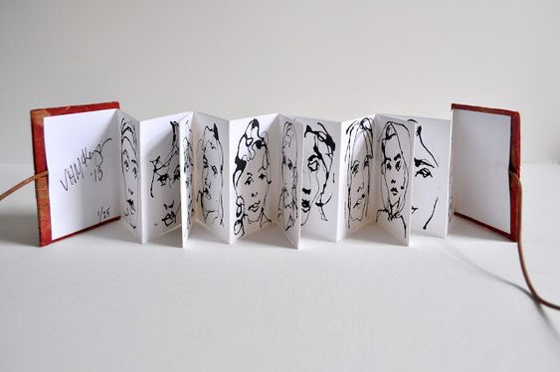
Year 8 Art Homework Term 1,
Week 1 - 6
REVISION – PRACTICE YOUR SHADING BEFORE STARTING EACH TASK
MAIN TASK:
Create a portrait drawing each week, in your
flip book sketchbook.
Each week draw two portraits, one per page, try to consider the proportions of the overall face on each of the pages and use the space well.
Week 1 Design a front cover for your portrait book and do two drawings ( pages)
Week 2 - 2 x drawings
Week 3 2 x drawings
Week 4 2 x drawings
Week 5 2 x drawings
Week 6 2 x drawings
Key words – Tone, value, shading, shape, form, depth
Extension Task –Spend an extra 10 mins on the tasks above each week.
What have been your strengths in (insert subject) this week?
What have been the areas that have challenged you in (insert topic) this week?
How could you improve next week?
Building good people who take PRIDE in their time at school, RESPECT themselves and others, WORK TOGETHER as a community, showing RESILIENCE and EMPATHY for all.

Slide 20
Year 8 English Homework
Half Term 4, Week 1
This is taken from the following Department for Education report:
Research Evidence on Reading for Pleasure. Report conducted by the government's Education Standards research team. For the full report, please access https://assets.publishing.service.gov.uk/government/uploads/system/uploads/attachment_data/file/284286/reading_for_pleasure.pdf
‘A growing number of studies show that promoting reading can have a major impact on children and adults and their future. Upon reviewing the research literature, there are several main areas of benefit to reading for pleasure:
• Reading attainment and writing ability;
• Text comprehension and grammar;
• Breadth of vocabulary;
• Positive reading attitudes;
• Greater self-confidence as a reader;
• Pleasure in reading in later life;
• General knowledge;
• A better understanding of other cultures;
• Community participation; and
• A greater insight into human nature and decision-making.’
Read at least four times per week for at least twenty minutes each time. Use your planner to record what you have read and for how long you have read. Have a parent or guardian sign your planner to confirm that you have completed your reading.
Key words – pleasure, effectiveness, success, comfort, relaxation, growth, vocabulary, understanding, enjoyment, interest, passion,
Extension Task – Share ideas about what books to read with friends and family. Can you tell them why your book is effective? Can you ask them what’s effective about the book they recommend? Step out of your comfort zone; find new authors and titles. Talk to friends, family and teachers about what they think is a good read.
What have been your strengths in (insert subject) this week?
What have been the areas that have challenged you in (insert topic) this week?
How could you improve next week?
Building good people who take PRIDE in their time at school, RESPECT themselves and others, WORK TOGETHER as a community, showing RESILIENCE and EMPATHY for all.

Slide 21

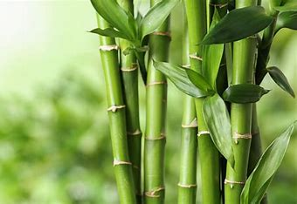
Year 8 Geography Homework – Half Term 4 Week 1
List as many threats to Antarctica as you can.
Use a search engine on the Internet to research 'bamboo products for sale'. Produce a poster showing the range of bamboo products that you can buy.
Key words – bamboo, sustainable resource, commercial, construction, fuel, products
Extension Task – compare three of the products that you have identified with similar products that are not made out of bamboo. How do they differ in cost, environmental credentials and availability?
What have been your strengths in Geography this week?
What have been the areas that have challenged you in Geography this week?
How could you improve next week?
Building good people who take PRIDE in their time at school, RESPECT themselves and others, WORK TOGETHER as a community, showing RESILIENCE and EMPATHY for all.

Slide 22
Year 8 History Homework – Half Term 4, Week 1
1. What was the Hue and Cry? | 5. What was Conscientious Objection?
2. What was 'Divine Right'? | 6. Why was capital punishment abolished?
3. What was the Bloody Code? | 7. What was the punishment for major crimes in Roman Britain?
4. Give one impact of technology on crime. | 8. What was Trial by Ordeal?
Source tasks:
Read both sources.
Highlighted and annotate key phrases/words in the sources.
What does source A tell you about how Britain treated India?
What does source B tell you about how Britain treated India?
What do the sources agree and disagree about?
(A) Florence Nightingale, the famous British nurse, said the late 1800s about the Indian famine
We do not care enough to stop them dying slow and terrible deaths from things we could easily stop. We have taken their land, and we rule it, for our good, not theirs.
(B) Adapted from Indian Home Rule, written by Mohandas K. Gandhi in 1938
India has become impoverished by their [Britain's] government. They take away our money from year to year. The most important jobs are reserved for themselves. We are kept in a state of slavery. They behave insolently towards us and disregard our feelings.
Key words – Empire, colony, famine, poverty, empathy
Extension Task – what are the sources nature, origin and purpose? Does these make you trust the sources more or less?
What have been your strengths in History this week?
What have been the areas that have challenged you in History this week?
How could you improve next week?
Building good people who take PRIDE in their time at school, RESPECT themselves and others, WORK TOGETHER as a community, showing RESILIENCE and EMPATHY for all.

Slide 23

Year 8 Languages Homework
Half Term 4
Vocabulary and Translation Practise
For this homework, you will need a copy of the Sentence Builder.
Task 1 | Test yourself on the items in the sentence builder using the Look-Say-Cover-Write-Check method.
Task 2 | Ask a friend or a relative to test you on individual items from the sentence builder.
Task 3 | Ask a friend or a relative to test you on full sentences from the sentence builder.
Task 4 | Practise this week's topic on Linguascope. (See Mr Downey for the login details).
Task 5 | Find a new song in your preferred language on Lyrics Training. Can you challenge yourself to the higher levels?
Language Gym – Check for online assignments
Username: ______________________
Password: _______________________
What have been your strengths in Languages this week?
What have been the areas that have challenged you in Languages this week?
How could you improve next week?
Building good people who take PRIDE in their time at school, RESPECT themselves and others, WORK TOGETHER as a community, showing RESILIENCE and EMPATHY for all.

Slide 24
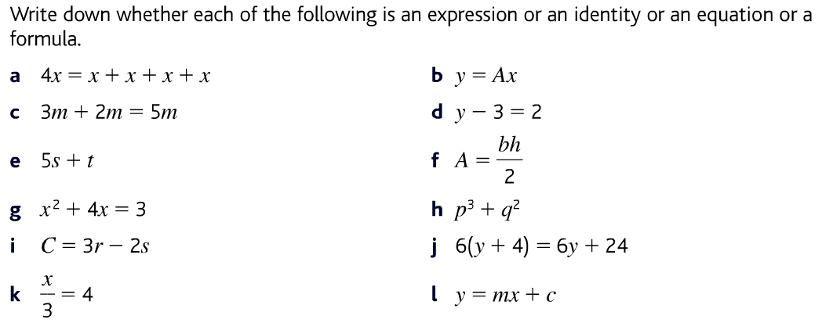
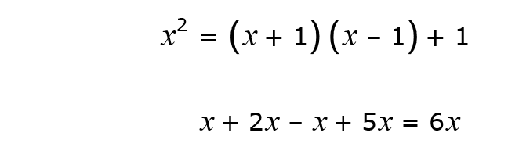
Year 8 Mathematics Homework
Half Term 4, Week 1
Recap Task – Ratio (Half Term 1)
Simplify the ratio 14 : 35
Share £240 in the ratio 3:5
The ratio of boys to girls is 3 : 4, what fraction of pupils are boys?
The ratio of dogs to cats is 4 : 9, if there are 20 dogs, how many cats are there?
Main Task – Identifying Expressions, Identities, Equations and Formulae
Key words – term, expression, formulae, identity, equation, counter example
Extension Task –
Are these IDENTITIES?
If yes explain why, if no give a COUNTER-EXAMPLE.
What have been your strengths in maths this week?
What have been the areas that have challenged you in maths this week?
How could you improve next week?
Building good people who take PRIDE in their time at school, RESPECT themselves and others, WORK TOGETHER as a community, showing RESILIENCE and EMPATHY for all.

Slide 25
Year 8 Music - Variation
Homework - Half Term 4 Week 1
What is meant by the musical terms form and structure? What is the theme? What does the musical term variation mean? Name ways that a simple tune can be varied using the musical elements.
This week’s listening – Title: Variations on Ah Vous, Dirai-Je, Maman
Composer: Wolfgang Amadeus Mozart
Genre: Classical
Spend time listening to the above piece of music.
Complete the page in your listening booklet –
1.Give some background information on the piece and artist/composer
2.Comment on the instrumentation and how the musical elements are used in as much detail as you can.
3.Give your personal response to the music – remember to explain why you liked or did not like the piece of music.
Key words – Tempo, Dynamics, Duration, Pitch, Silence, Articulation, Melody, Texture, Timbre
Extension Task – Listen to and comment on further pieces of music by the same artist/composer.
What have been your strengths in Music this week?
What have been the areas that have challenged you in Music this week?
How could you improve next week?
Building good people who take PRIDE in their time at school, RESPECT themselves and others, WORK TOGETHER as a community, showing RESILIENCE and EMPATHY for all.

Slide 26
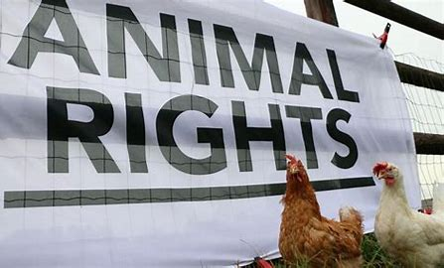
Year 8 RE Homework –
Half Term 4, Week 1
List FIVE facts you remember out Buddhism.
Visit the BBC Bitesize page about whether it matters how we treat animals:
https://www.bbc.co.uk/bitesize/topics/zkdk382/articles/zns2kmn
Read the information, click on the different religions and watch the video clip. Once you have done this, please take the quiz about scientific and religious teachings about animals. Screen shot or tell me your score next lesson.
Key words – animal rights, sanctity of life, practical, moral, halal, kosher, slaughter, suffering, sacrifices, treatment
Extension Task – Do you think that animals should have rights? Justify your answer.
What have been your strengths in RE this week?
What have been the areas that have challenged you in RE this week?
How could you improve next week?
Building good people who take PRIDE in their time at school, RESPECT themselves and others, WORK TOGETHER as a community, showing RESILIENCE and EMPATHY for all.

Slide 27
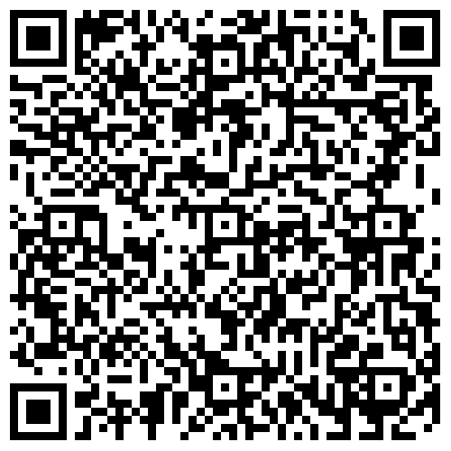
Year 8 Science Homework – Half Term 4, Week 1
Recap: See Below
Main Task (Available 22nd February 2024)
Due: 29th February 2024
Recap on Biological Systems and
Processes
1.6.1 to 1.6.4 – Living Organisms to
The Skeleton
Recap on Electricity and Magnetism
3.4.1 to 3.4.4 Circuit Symbols to
Measuring Current
Key words – Organisms, Skeleton, Dichotomous, Muscles, Circuit Symbols, Resistors and Diodes, Electric Current, Measuring Current
Extension Task – Complete Crosswords / Exam Style Questions inside Chemistry or Biology Extension Booklets, Mark Date Completed.
What have been your strengths in (insert subject) this week?
What have been the areas that have challenged you in (insert topic) this week?
How could you improve next week?
Building good people who take PRIDE in their time at school, RESPECT themselves and others, WORK TOGETHER as a community, showing RESILIENCE and EMPATHY for all.

Slide 28

Year 8 Young Enterprise, Homework – Half Term 4, Week 1
Define the following terms:
Break-even Margin of Safety
Main Task
Q1 What does cash flow in a business mean? (2 marks)
Q2 Why is it important that a business has good cash flow? Give 3 reasons. (3 marks)
Q3 If a business has negative cash flow figures what could it possibly do to get by? Give 2 ideas and explain what these could do to help the business. (4 marks)
Key Words - Cash flow
Extension Task
If cash flow is positive one month, what could change this in the next month? What could make cash flow go from positive to negative? (4 marks)
What have been your strengths this week?
What have been the areas that have challenged you this week?
How could you improve next week?
Building good people who take PRIDE in their time at school, RESPECT themselves and others, WORK TOGETHER as a community, showing RESILIENCE and EMPATHY for all.

Slide 29
Week 2 Homework

Slide 30
Week 2 Homework Due Dates
Subject | Day Due | Date Due
Academic PE
Art
English
Geography
History
Languages
Maths
Music
RE
Science
Young Enterprise
Building good people who take PRIDE in their time at school, RESPECT themselves and others, WORK TOGETHER as a community, showing RESILIENCE and EMPATHY for all.

Slide 31
Year 8 Art Homework Term 1,
Week 1 - 6
REVISION – PRACTICE YOUR SHADING BEFORE STARTING EACH TASK
MAIN TASK:
Create a portrait drawing each week, in your
flip book sketchbook.
Each week draw two portraits, one per page, try to consider the proportions of the overall face on each of the pages and use the space well.
Week 1 Design a front cover for your portrait book and do two drawings ( pages)
Week 2 - 2 x drawings
Week 3 2 x drawings
Week 4 2 x drawings
Week 5 2 x drawings
Week 6 2 x drawings
Key words – Tone, value, shading, shape, form, depth
Extension Task –Spend an extra 10 mins on the tasks above each week.
What have been your strengths in (insert subject) this week?
What have been the areas that have challenged you in (insert topic) this week?
How could you improve next week?
Building good people who take PRIDE in their time at school, RESPECT themselves and others, WORK TOGETHER as a community, showing RESILIENCE and EMPATHY for all.

Slide 32
Year 8 English Homework
Half Term 4, Week 2
This is taken from the following Department for Education report:
Research Evidence on Reading for Pleasure. Report conducted by the government's Education Standards research team. For the full report, please access https://assets.publishing.service.gov.uk/government/uploads/system/uploads/attachment_data/file/284286/reading_for_pleasure.pdf
‘Strategies to improve independent reading
• Having access to resources and having books of their own has an impact on children’s attainment. There is a positive relationship between the estimated number of books in the home and attainment. Children who have books of their own enjoy reading more and read more frequently
• An important factor in developing reading for pleasure is choice; choice and interest are highly related
• Literacy-targeted rewards, such as books or book vouchers have been found to be more effective in developing reading motivation than rewards that are unrelated to the activity
• Parents and the home environment are essential to the early teaching of reading and fostering a love of reading; children are more likely to continue to be readers in homes where books and reading are valued.
• Reading for pleasure is strongly influenced by relationships between teachers and children, and children and families.’
Read at least four times per week for at least twenty minutes each time. Use your planner to record what you have read and for how long you have read. Have a parent or guardian sign your planner to confirm that you have completed your reading.
Key words – pleasure, effectiveness, success, comfort, relaxation, growth, vocabulary, understanding, enjoyment, interest, passion,
Extension Task – Share ideas about what books to read with friends and family. Can you tell them why your book is effective? Can you ask them what’s effective about the book they recommend? Step out of your comfort zone; find new authors and titles. Talk to friends, family and teachers about what they think is a good read.
What have been your strengths in (insert subject) this week?
What have been the areas that have challenged you in (insert topic) this week?
How could you improve next week?
Building good people who take PRIDE in their time at school, RESPECT themselves and others, WORK TOGETHER as a community, showing RESILIENCE and EMPATHY for all.

Slide 33
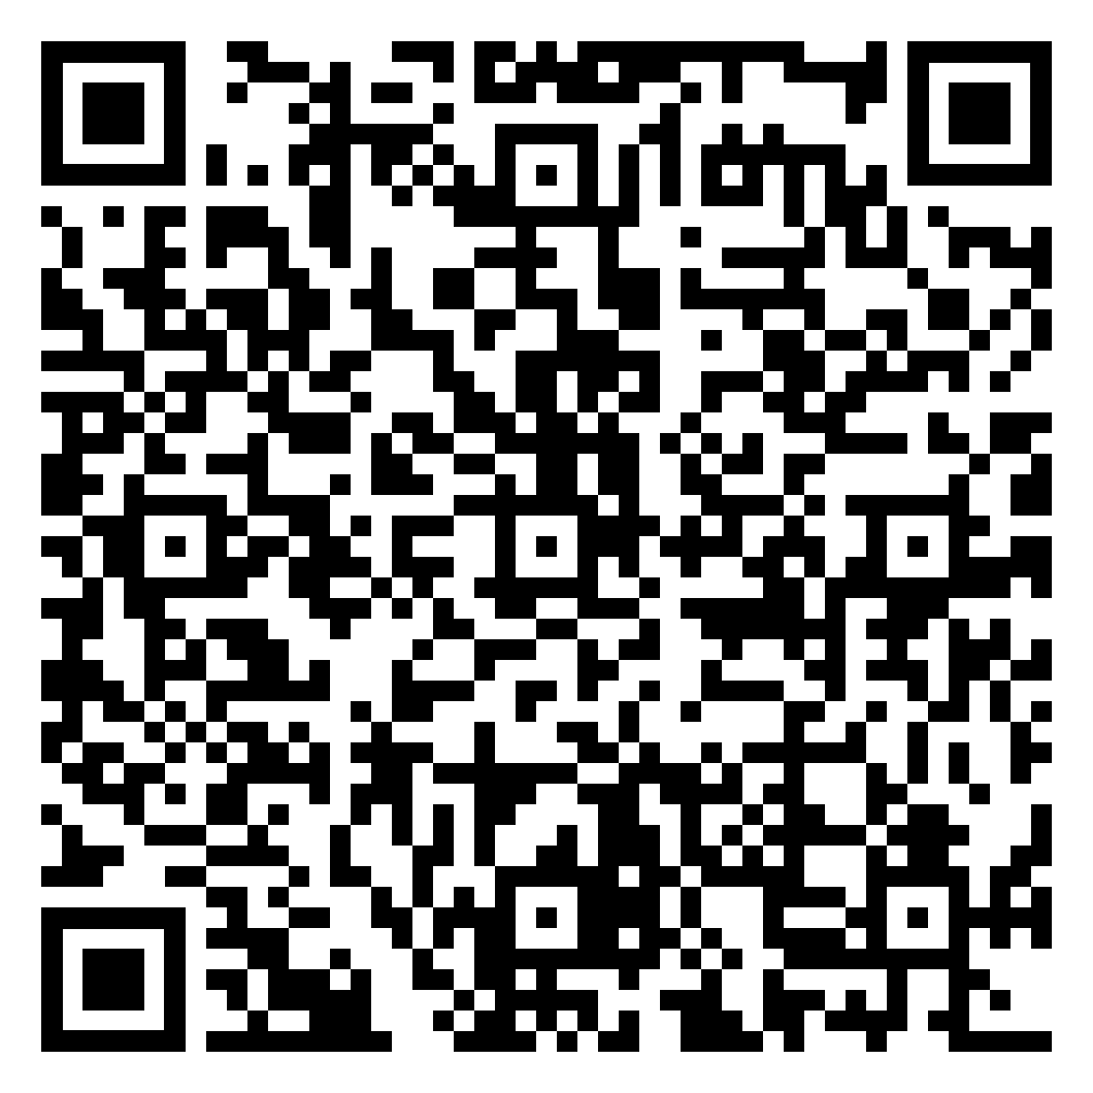
Year 8 Geography Homework – Half Term 4 Week 2
What is a sustainable resource?
Why is bamboo a sustainable resource?
Complete a map to identify the countries of origin for five food items bought by your family by following the steps below:
a) Look at the labels on fresh fruit and vegetables to discover their country of origin. For each food item:
- locate the country of origin on a world map and draw an arrow from it to the UK. See World Map Week 2 document for a blank map.
- use a symbol, sketch or label to identify the food item.
Give your map a title.
b) Write a few sentences to describe your map. Where does most food come from? Are there any surprises?
Document online link - World Map Week 2.pdf
Key words – production, locally sourced, food miles, staple food
Extension Task – Calculate how many food miles each item of food has travelled. Suggest ways that the food miles could be reduced.
What have been your strengths in Geography this week?
What have been the areas that have challenged you in Geography this week?
How could you improve next week?
Building good people who take PRIDE in their time at school, RESPECT themselves and others, WORK TOGETHER as a community, showing RESILIENCE and EMPATHY for all.

Slide 34
Year 8 History Homework – Half Term 4, Week 2
1. What does Empire mean?
2. What does Imperial mean?
3. What does British mean?
4. What does Colony mean?
5. Name one thing Britain got from a colony.
Quiz Review:
Read your work from this week.
Pick 3-4 key facts from each lesson.
Take the key facts and turn them into a Quiz WITH Answers.
Make sure you write Questions AND Answers.
Make sure you have at least 10 Questions WITH Answers.
Make sure you have a mix between short AND long answer questions.
Think about how you can make a quiz look attractive.
Key words – Atlantic, Triangle, Slavery, Trade, Revolt
Extension Task – Look at the source below. What is the message of the source? What is the origin, nature and purpose of the source?
(3) Olaudah Equiano, was captured and sold as a slave. He wrote about his experiences in 1789.
Generally, when the grown people in the neighbourhood were gone far in the fields to labour, the children assembled together in some of the neighborhood to play; and commonly some of us used to get up a tree to look out for any kidnapper that might come upon us; for they sometimes took those opportunities of our parents' absence, to attack and carry off as many as they could seize.
What have been your strengths in History this week?
What have been the areas that have challenged you in History this week?
How could you improve next week?
Building good people who take PRIDE in their time at school, RESPECT themselves and others, WORK TOGETHER as a community, showing RESILIENCE and EMPATHY for all.

Slide 35
Year 8 Languages Homework
Half Term 4
Vocabulary and Translation Practise
For this homework, you will need a copy of the Sentence Builder.
Task 1 | Test yourself on the items in the sentence builder using the Look-Say-Cover-Write-Check method.
Task 2 | Ask a friend or a relative to test you on individual items from the sentence builder.
Task 3 | Ask a friend or a relative to test you on full sentences from the sentence builder.
Task 4 | Practise this week's topic on Linguascope. (See Mr Downey for the login details).
Task 5 | Find a new song in your preferred language on Lyrics Training. Can you challenge yourself to the higher levels?
Language Gym – Check for online assignments
Username: ______________________
Password: _______________________
What have been your strengths in Languages this week?
What have been the areas that have challenged you in Languages this week?
How could you improve next week?
Building good people who take PRIDE in their time at school, RESPECT themselves and others, WORK TOGETHER as a community, showing RESILIENCE and EMPATHY for all.

Slide 36
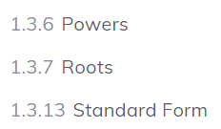

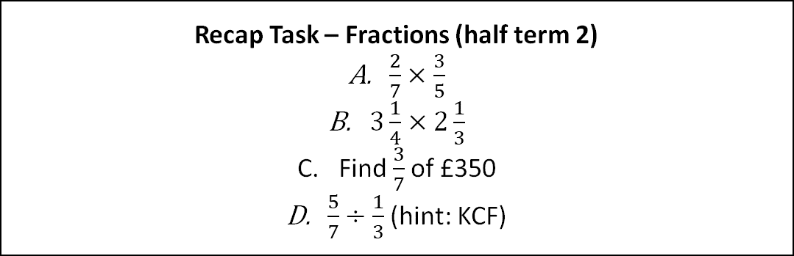
Year 8 Mathematics Homework
Half Term 4, Week 2
Recap Task – Fractions (half term 2)
$\frac{2}{7}×\frac{3}{5}$
$3\frac{1}{4}×2\frac{1}{3}$
Find $\frac{3}{7}$of £350
$\frac{5}{7}÷\frac{1}{3}$(hint: KCF)
Main Task –SENECA
This weeks homework task is assigned on SENECA, please complete all the sections to the best of your ability. Do any written working in your homework book. Watch the videos on SENECA where necessary to improve your understanding.
Key words – Index, Indices, Base, Power, Root, Standard Form, Integer,
Extension Task –
What have been your strengths in maths this week?
What have been the areas that have challenged you in maths this week?
How could you improve next week?
Building good people who take PRIDE in their time at school, RESPECT themselves and others, WORK TOGETHER as a community, showing RESILIENCE and EMPATHY for all.

Slide 37
Year 8 Music - Variation
Homework - Half Term 4 Week 2
What does the term retrograde mean? Explain the meaning of the term inversion. What is the job of an arranger? Describe the difference between a minor and a major tonality.
This week’s listening – Title: My Grandfather’s Clock
Artist: Black Dyke Band
Genre: Brass Band
Spend time listening to the above piece of music.
Complete the page in your listening booklet –
1.Give some background information on the piece and artist/composer
2.Comment on the instrumentation and how the musical elements are used in as much detail as you can.
3.Give your personal response to the music – remember to explain why you liked or did not like the piece of music.
Key words – Tempo, Dynamics, Duration, Pitch, Silence, Articulation, Melody, Texture, Timbre
Extension Task – Listen to and comment on further pieces of music by the same artist/composer.
What have been your strengths in Music this week?
What have been the areas that have challenged you in Music this week?
How could you improve next week?
Building good people who take PRIDE in their time at school, RESPECT themselves and others, WORK TOGETHER as a community, showing RESILIENCE and EMPATHY for all.

Slide 38

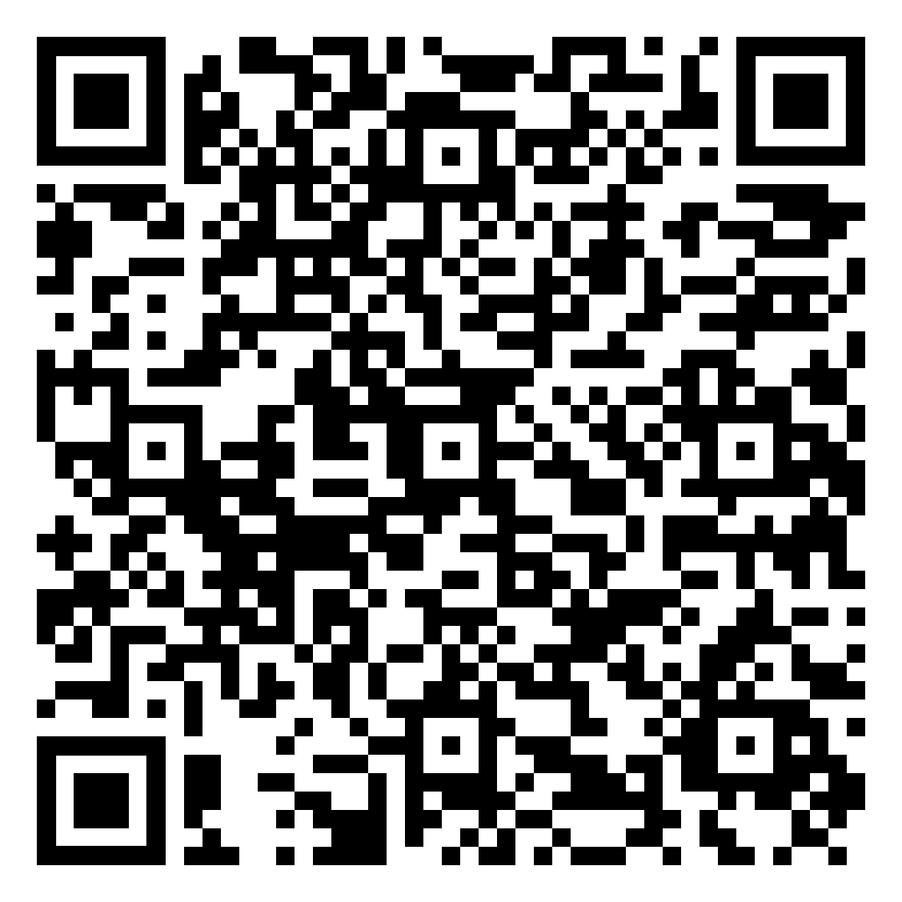
Year 8 RE Homework –
Half Term 4, Week 2
What do different religions believe about using animals for food?
Complete the Seneca questions about equality in the UK.
Key words – equal society, community, legal, scripture
Extension Task – Do you think that there is equality in the UK today? Explain your answer.
What have been your strengths in RE this week?
What have been the areas that have challenged you in RE this week?
How could you improve next week?
Building good people who take PRIDE in their time at school, RESPECT themselves and others, WORK TOGETHER as a community, showing RESILIENCE and EMPATHY for all.

Slide 39
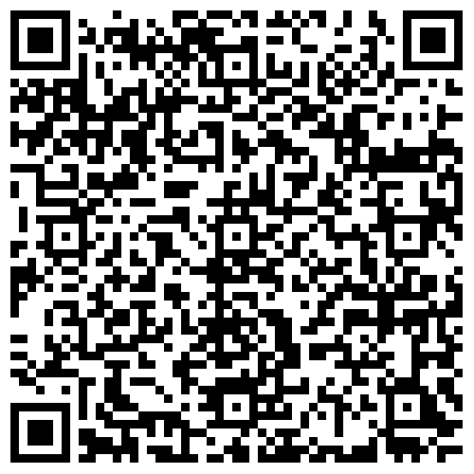
Year 8 Science Homework – Half Term 4, Week 2
Recap: See Below
Main Task (Available 29th February 2024)
Due: 7th March 2024
Recap on Biological Systems and
Processes
1.6.5 to 1.6.8 – Measuring Forces to
Breathing
Recap on Electricity and Magnetism
3.4.5 to 3.4.8 Potential Difference to
Resistance
Key words – Forces, Muscles, Bones, Breathing, Potential Difference, voltage, resistance, ohms
Extension Task – Complete Crosswords / Exam Style Questions inside Chemistry or Biology Extension Booklets, Mark Date Completed.
What have been your strengths in (insert subject) this week?
What have been the areas that have challenged you in (insert topic) this week?
How could you improve next week?
Building good people who take PRIDE in their time at school, RESPECT themselves and others, WORK TOGETHER as a community, showing RESILIENCE and EMPATHY for all.

Slide 40
Year 8 Young Enterprise, Homework – Half Term 4, Week 2
Define the following terms:
Cash flow
Main Task
Complete the activity given out in lesson this week. This will be stapled into your book, so it doesn't get lost.
Extension Task —
Refer to sheet
What have been your strengths this week?
What have been the areas that have challenged you this week?
How could you improve next week?
Building good people who take PRIDE in their time at school, RESPECT themselves and others, WORK TOGETHER as a community, showing RESILIENCE and EMPATHY for all.

Slide 41
Week 3 Homework

Slide 42
Week 3 Homework Due Dates
Subject | Day Due | Date Due
Academic PE
Art
English
Geography
History
Languages
Maths
Music
RE
Science
Young Enterprise
Building good people who take PRIDE in their time at school, RESPECT themselves and others, WORK TOGETHER as a community, showing RESILIENCE and EMPATHY for all.

Slide 43
Year 8 Art Homework Term 1,
Week 1 - 6
REVISION – PRACTICE YOUR SHADING BEFORE STARTING EACH TASK
MAIN TASK:
Create a portrait drawing each week, in your
flip book sketchbook.
Each week draw two portraits, one per page, try to consider the proportions of the overall face on each of the pages and use the space well.
Week 1 Design a front cover for your portrait book and do two drawings ( pages)
Week 2 - 2 x drawings
Week 3 2 x drawings
Week 4 2 x drawings
Week 5 2 x drawings
Week 6 2 x drawings
Key words – Tone, value, shading, shape, form, depth
Extension Task –Spend an extra 10 mins on the tasks above each week.
What have been your strengths in (insert subject) this week?
What have been the areas that have challenged you in (insert topic) this week?
How could you improve next week?
Building good people who take PRIDE in their time at school, RESPECT themselves and others, WORK TOGETHER as a community, showing RESILIENCE and EMPATHY for all.

Slide 44
Year 8 English Homework
Half Term 4, Week 3
This is taken from the following Department for Education report:
Research Evidence on Reading for Pleasure. Report conducted by the government's Education Standards research team. For the full report, please access https://assets.publishing.service.gov.uk/government/uploads/system/uploads/attachment_data/file/284286/reading_for_pleasure.pdf
‘Evidence suggests that reading for pleasure leads to increased attainment. Clark and DeZoya found a significant positive relationship between enjoyment and attainment indicating that pupils who read more are also better readers. Similarly Clark in a large scale survey of over 18,000 young people found that those who reported enjoying reading very much were six times more likely than those who did not enjoy reading to read above the expected level for their age. Young people who reported not enjoying reading at all were 11 times more likely than those who enjoyed reading very much to read below the level expected for their age. Evidence from OECD found that reading enjoyment is more important for children’s educational success than their family’s socio-economic status.’
Read at least four times per week for at least twenty minutes each time. Use your planner to record what you have read and for how long you have read. Have a parent or guardian sign your planner to confirm that you have completed your reading.
Key words – pleasure, effectiveness, success, comfort, relaxation, growth, vocabulary, understanding, enjoyment, interest, passion,
Extension Task – Share ideas about what books to read with friends and family. Can you tell them why your book is effective? Can you ask them what’s effective about the book they recommend? Step out of your comfort zone; find new authors and titles. Talk to friends, family and teachers about what they think is a good read.
What have been your strengths in (insert subject) this week?
What have been the areas that have challenged you in (insert topic) this week?
How could you improve next week?
Building good people who take PRIDE in their time at school, RESPECT themselves and others, WORK TOGETHER as a community, showing RESILIENCE and EMPATHY for all.

Slide 45
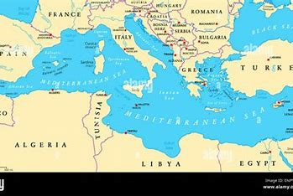
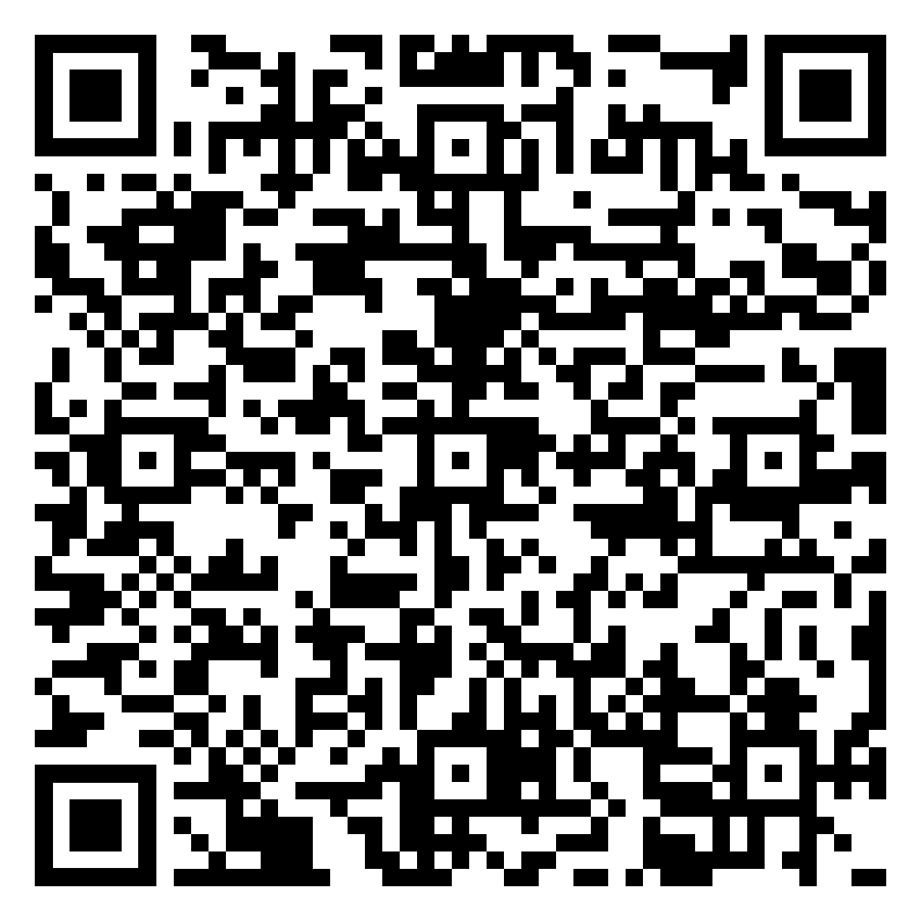
Year 8 Geography Homework – Half Term 4 Week 3
Draw the production chain for breakfast cereal from land to bowl.
Complete a fact file about the Mediterranean using the Mediterranean Region Homework Week 3 document.
Online document link - Mediterranean Region Homework Week 3.pdf
Key words – Mediterranean biome, flash flood, landslide, climate graph, climate, adaptations
Extension Task – Add some extra categories to your fact file and research them.
What have been your strengths in Geography this week?
What have been the areas that have challenged you in Geography this week?
How could you improve next week?
Building good people who take PRIDE in their time at school, RESPECT themselves and others, WORK TOGETHER as a community, showing RESILIENCE and EMPATHY for all.

Slide 46
Year 8 History Homework – Half Term 4, Week 3
1. What was stage one of the trade triangle?
2. What was stage two of the trade triangle?
3. What was stage three of the trade triangle?
4. Roughly, how many slaves were moved to America?
5. What goods did the Europeans mainly want?
Storyboard:
Look at your classwork and use other resources to research what happened to slaves taken to America.
Pick 8-10 key facts.
Take the key facts and turn them into a storyboard (template available if required) to show what you have learnt.
Make sure it has pictures and description.
Key words – Plantation, Slavery, Auctions, Gangs, Punishments
Extension Task – Can you write a pneumonic to help you remember the trade triangle and slave auctions.
What have been your strengths in History this week?
What have been the areas that have challenged you in History this week?
How could you improve next week?
Building good people who take PRIDE in their time at school, RESPECT themselves and others, WORK TOGETHER as a community, showing RESILIENCE and EMPATHY for all.

Slide 47
Year 8 Languages Homework
Half Term 4
Vocabulary and Translation Practise
For this homework, you will need a copy of the Sentence Builder.
Task 1 | Test yourself on the items in the sentence builder using the Look-Say-Cover-Write-Check method.
Task 2 | Ask a friend or a relative to test you on individual items from the sentence builder.
Task 3 | Ask a friend or a relative to test you on full sentences from the sentence builder.
Task 4 | Practise this week's topic on Linguascope. (See Mr Downey for the login details).
Task 5 | Find a new song in your preferred language on Lyrics Training. Can you challenge yourself to the higher levels?
Language Gym – Check for online assignments
Username: ______________________
Password: _______________________
What have been your strengths in Languages this week?
What have been the areas that have challenged you in Languages this week?
How could you improve next week?
Building good people who take PRIDE in their time at school, RESPECT themselves and others, WORK TOGETHER as a community, showing RESILIENCE and EMPATHY for all.

Slide 48
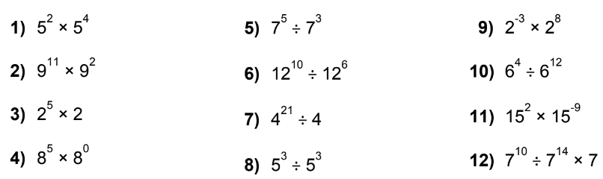
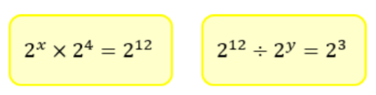
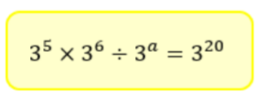
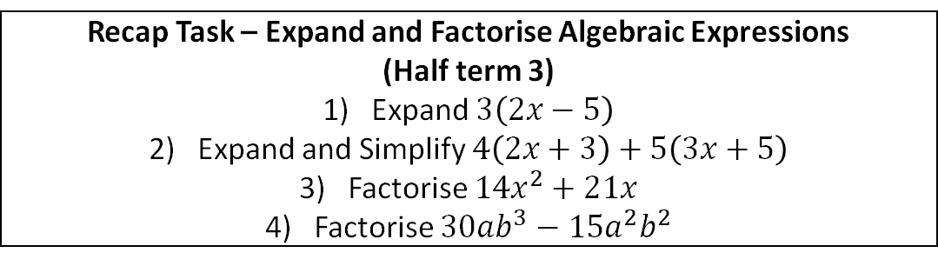
Year 8 Mathematics Homework
Half Term 4, Week 3
Recap Task – Expand and Factorise Algebraic Expressions
(Half Term 4)
Expand $3\left(2x−5\right)$
Expand and Simplify $4\left(2x+3\right)+5\left(3x+5\right)$
Factorise $14x^{2}+21x$
Factorise $30ab^{3}−15a^{2}b^{2}$
Main Task –Laws of Indices
Write the answers to the following using indices:
Key words – Base, Power, Index, Indices, exponent
Extension Task – Solve the following equations
What have been your strengths in maths this week?
What have been the areas that have challenged you in maths this week?
How could you improve next week?
Building good people who take PRIDE in their time at school, RESPECT themselves and others, WORK TOGETHER as a community, showing RESILIENCE and EMPATHY for all.

Slide 49
Year 8 Music - Variation
Homework - Half Term 4 Week 3
Explain what is meant by the term diminution. What effect does diminution have on how the music sounds. What does the term augmentation mean? What effect does augmentation have on how the music sounds?
This week’s listening – Title: Canon in D Major
Composer: Johann Pachelbel
Genre: Baroque
Spend time listening to the above piece of music.
Complete the page in your listening booklet –
1.Give some background information on the piece and artist/composer
2.Comment on the instrumentation and how the musical elements are used in as much detail as you can.
3.Give your personal response to the music – remember to explain why you liked or did not like the piece of music.
Key words – Tempo, Dynamics, Duration, Pitch, Silence, Articulation, Melody, Texture, Timbre
Extension Task – Listen to and comment on further pieces of music by the same artist/composer.
What have been your strengths in Music this week?
What have been the areas that have challenged you in Music this week?
How could you improve next week?
Building good people who take PRIDE in their time at school, RESPECT themselves and others, WORK TOGETHER as a community, showing RESILIENCE and EMPATHY for all.

Slide 50


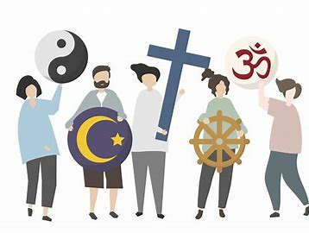
Year 8 RE Homework –
Half Term 4, Week 3
How has equality in the UK changed over time?
“As a society, we value the right to
religious expression just as much as
we value the right to free speech.”
To what extent do you agree with this statement?
Answer the question above, using the sentence starters below:
I mostly / completely agree / disagree with the statement.
I think this because...
An example of this is …
Therefore, I believe that....
Key words – religious expression, free speech, human rights, hate speech
Extension Task – Evaluate the effectiveness of the arguments on both sides, using counter arguments. Use PEEL (Point, Evidence, Explain, Link) to structure your points.
What have been your strengths in RE this week?
What have been the areas that have challenged you in RE this week?
How could you improve next week?
Building good people who take PRIDE in their time at school, RESPECT themselves and others, WORK TOGETHER as a community, showing RESILIENCE and EMPATHY for all.

Slide 51
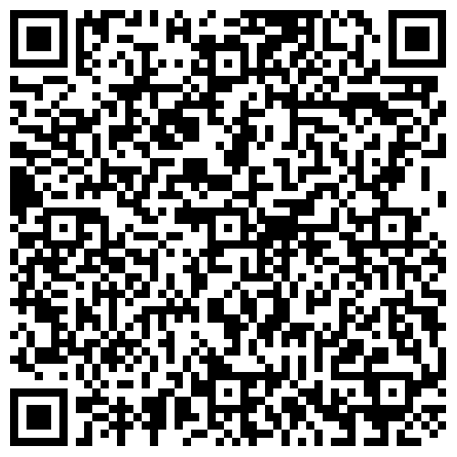
Year 8 Science Homework – Half Term 4, Week 3
Recap: See Below
Main Task (Available 7th March 2024)
Due: 14st March 2024
Recap on Biological Systems and
Processes
1.6.9 to 1.6.12 – Respiration to
Balanced Diets
Recap on Electricity and Magnetism
3.4.9 to 3.4.12 – Charges to
Magnetic Fields
Key words – Respiration, Glucose, Carbon dioxide, Balanced diets, Scurvy, Charges, Positive, Negative, Magnetic Fields, North, South
Extension Task – Complete Crosswords / Exam Style Questions inside Chemistry or Biology Extension Booklets, Mark Date Completed.
What have been your strengths in (insert subject) this week?
What have been the areas that have challenged you in (insert topic) this week?
How could you improve next week?
Building good people who take PRIDE in their time at school, RESPECT themselves and others, WORK TOGETHER as a community, showing RESILIENCE and EMPATHY for all.

Slide 52
Year 8 Young Enterprise, Homework – Half Term 4, Week 3
Recap
What’s the difference between a bank loan and a bank overdraft? (2 marks)
Main Task
Q1 What figures go into making an Income Statement?
Q2 Why are Income Statements important for a business? (3 marks)
Q3 What is the difference between Gross Profit and Net Profit? (2 marks)
Key words: Income Statement
Extension Task - How could you improve a Net Profit figure of an Income Statement?
What have been your strengths this week?
What have been the areas that have challenged you this week?
How could you improve next week?
Building good people who take PRIDE in their time at school, RESPECT themselves and others, WORK TOGETHER as a community, showing RESILIENCE and EMPATHY for all.

Slide 53
Week 4 Homework

Slide 54
Week 4 Homework Due Dates
Subject | Day Due | Date Due
Academic PE
Art
English
Geography
History
Languages
Maths
Music
RE
Science
Young Enterprise
Building good people who take PRIDE in their time at school, RESPECT themselves and others, WORK TOGETHER as a community, showing RESILIENCE and EMPATHY for all.

Slide 55
Year 8 Art Homework Term 1,
Week 1 - 6
REVISION – PRACTICE YOUR SHADING BEFORE STARTING EACH TASK
MAIN TASK:
Create a portrait drawing each week, in your
flip book sketchbook.
Each week draw two portraits, one per page, try to consider the proportions of the overall face on each of the pages and use the space well.
Week 1 Design a front cover for your portrait book and do two drawings ( pages)
Week 2 - 2 x drawings
Week 3 2 x drawings
Week 4 2 x drawings
Week 5 2 x drawings
Week 6 2 x drawings
Key words – Tone, value, shading, shape, form, depth
Extension Task –Spend an extra 10 mins on the tasks above each week.
What have been your strengths in (insert subject) this week?
What have been the areas that have challenged you in (insert topic) this week?
How could you improve next week?
Building good people who take PRIDE in their time at school, RESPECT themselves and others, WORK TOGETHER as a community, showing RESILIENCE and EMPATHY for all.

Slide 56
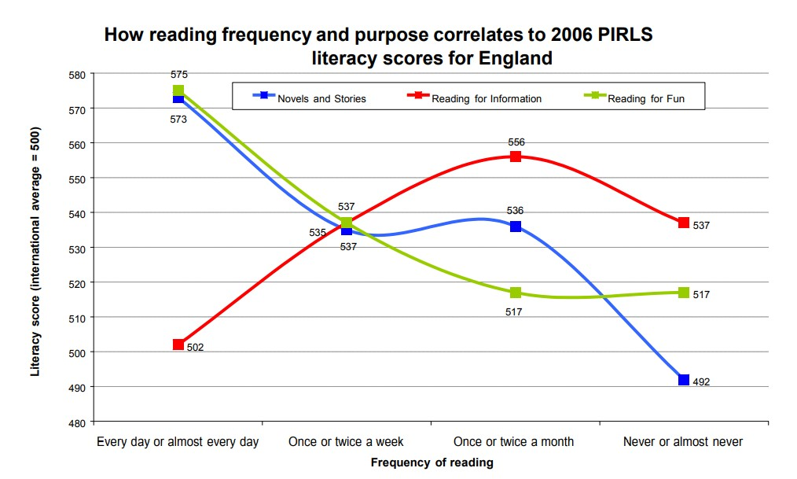
Year 8 English Homework
Half Term 4, Week 4
This is taken from the following Department for Education report:
Research Evidence on Reading for Pleasure. Report conducted by the government's Education Standards research team. For the full report, please access https://assets.publishing.service.gov.uk/government/uploads/system/uploads/attachment_data/file/284286/reading_for_pleasure.pdf
Read at least four times per week for at least twenty minutes each time. Use your planner to record what you have read and for how long you have read. Have a parent or guardian sign your planner to confirm that you have completed your reading.
Key words – pleasure, effectiveness, success, comfort, relaxation, growth, vocabulary, understanding, enjoyment, interest, passion,
Extension Task – Share ideas about what books to read with friends and family. Can you tell them why your book is effective? Can you ask them what’s effective about the book they recommend? Step out of your comfort zone; find new authors and titles. Talk to friends, family and teachers about what they think is a good read.
What have been your strengths in (insert subject) this week?
What have been the areas that have challenged you in (insert topic) this week?
How could you improve next week?
Building good people who take PRIDE in their time at school, RESPECT themselves and others, WORK TOGETHER as a community, showing RESILIENCE and EMPATHY for all.

Slide 57
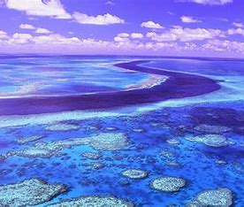
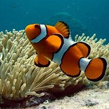
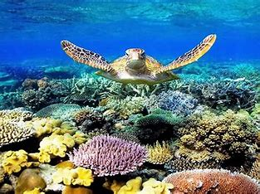
Year 8 Geography Homework – Half Term 4 Week 4
List all the ways that the Mediterranean pine tree has adapted so that it can survive in the Mediterranean climate.
Use the Internet to find out how Australia's Great Barrier Reef is threatened and managed. A good place to start is the Great Barrier Reef Marine Park Authority's website:
https://www2.gbrmpa.gov.au/learn
A) Identify the main threats to the reef.
B) Outline how the reef is being managed to address these threats.
Key words – coral reef, coral, algae, fringing reef, barrier reef, coral atoll
Extension Task – Research the threats and management of another coral reef. You could compare your findings to Australia's Great Barrier Reef.
What have been your strengths in Geography this week?
What have been the areas that have challenged you in Geography this week?
How could you improve next week?
Building good people who take PRIDE in their time at school, RESPECT themselves and others, WORK TOGETHER as a community, showing RESILIENCE and EMPATHY for all.

Slide 58
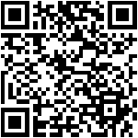
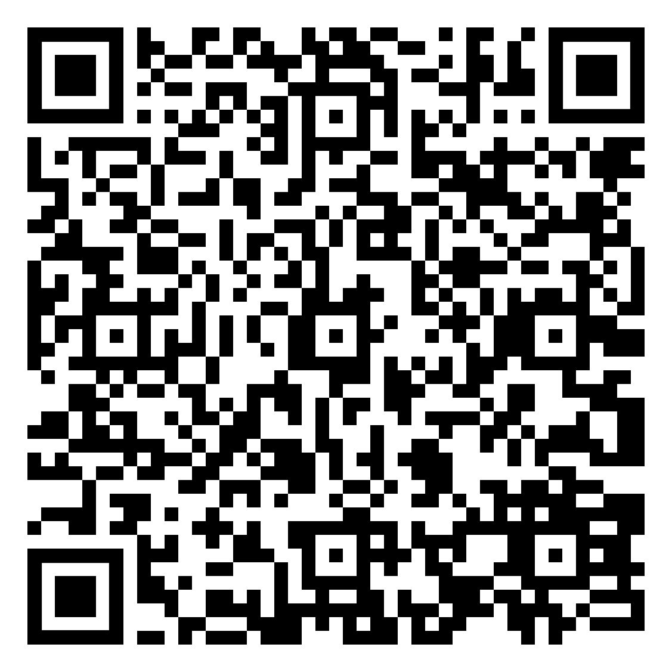
Year 8 History Homework – Half Term 4, Week 4
1. What were the three different slave 'gangs' on a plantation?
2. Describe the food given to slaves.
3. Describe the clothing given to slaves.
4. Describe the work slaves had to do.
5. Describe the punishments slaves suffered.
YouTube:
Go onto YouTube and find 2 videos about how the slave trade was abolished.
For each video write down the below:
  The URL/link for the video.
  A 3-sentence summary of what the video summarised.
  An explanation about why you chose that video.
  A review of the video – how well do you think it covers the topic and why?
  Compare the videos.
Key words – Slave Trade, Abolished, Civil War, North, South
Extension Task – Seneca:
Join class - Seneca task -
What have been your strengths in History this week?
What have been the areas that have challenged you in History this week?
How could you improve next week?
Building good people who take PRIDE in their time at school, RESPECT themselves and others, WORK TOGETHER as a community, showing RESILIENCE and EMPATHY for all.

Slide 59
Year 8 Languages Homework
Half Term 4
Vocabulary and Translation Practise
For this homework, you will need a copy of the Sentence Builder.
Task 1 | Test yourself on the items in the sentence builder using the Look-Say-Cover-Write-Check method.
Task 2 | Ask a friend or a relative to test you on individual items from the sentence builder.
Task 3 | Ask a friend or a relative to test you on full sentences from the sentence builder.
Task 4 | Practise this week's topic on Linguascope. (See Mr Downey for the login details).
Task 5 | Find a new song in your preferred language on Lyrics Training. Can you challenge yourself to the higher levels?
Language Gym – Check for online assignments
Username: ______________________
Password: _______________________
What have been your strengths in Languages this week?
What have been the areas that have challenged you in Languages this week?
How could you improve next week?
Building good people who take PRIDE in their time at school, RESPECT themselves and others, WORK TOGETHER as a community, showing RESILIENCE and EMPATHY for all.

Slide 60
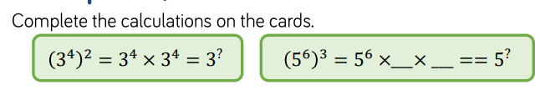
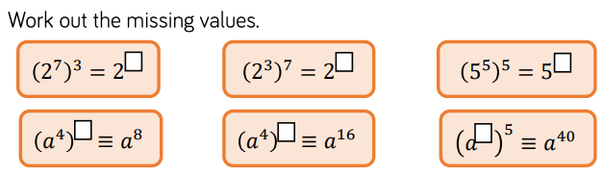


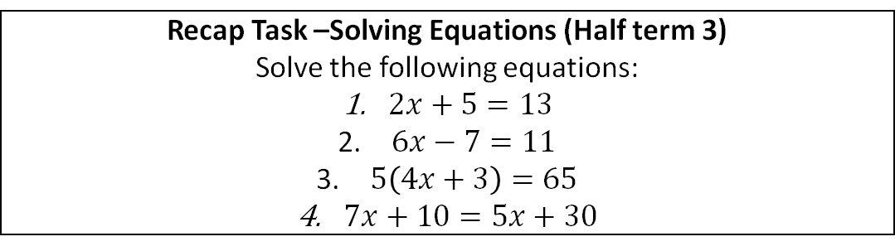
Year 8 Mathematics Homework
Half Term 4, Week 4
Recap Task –Solving Equations (Half Term 4)
Solve the following equations:
$2x+5=13$
$6x−7=11$
$5\left(4x+3\right)=65$
$7x+10=5x+30$
Main Task –Powers of Powers
Key words – Base, Power, Index, Indices, exponent, product
Extension Task –
What have been your strengths in maths this week?
What have been the areas that have challenged you in maths this week?
How could you improve next week?
Building good people who take PRIDE in their time at school, RESPECT themselves and others, WORK TOGETHER as a community, showing RESILIENCE and EMPATHY for all.

Slide 61
Year 8 Music - Variation
Homework - Half Term 4 Week 4
What is meant by the term ostinato? Explain what a ground bass is and what instruments it may have been played on. In what musical period was ground bass most popular? What is a canon?
This week’s listening – Title: Theme And Variation On A Theme Of Paganini,
Variation 1-4
Composer: Andrew Lloyd-Weber
Genre: Crossover
Spend time listening to the above piece of music.
Complete the page in your listening booklet –
1.Give some background information on the piece and artist/composer
2.Comment on the instrumentation and how the musical elements are used in as much detail as you can.
3.Give your personal response to the music – remember to explain why you liked or did not like the piece of music.
Key words – Tempo, Dynamics, Duration, Pitch, Silence, Articulation, Melody, Texture, Timbre
Extension Task – Listen to and comment on further pieces of music by the same artist/composer.
What have been your strengths in Music this week?
What have been the areas that have challenged you in Music this week?
How could you improve next week?
Building good people who take PRIDE in their time at school, RESPECT themselves and others, WORK TOGETHER as a community, showing RESILIENCE and EMPATHY for all.

Slide 62

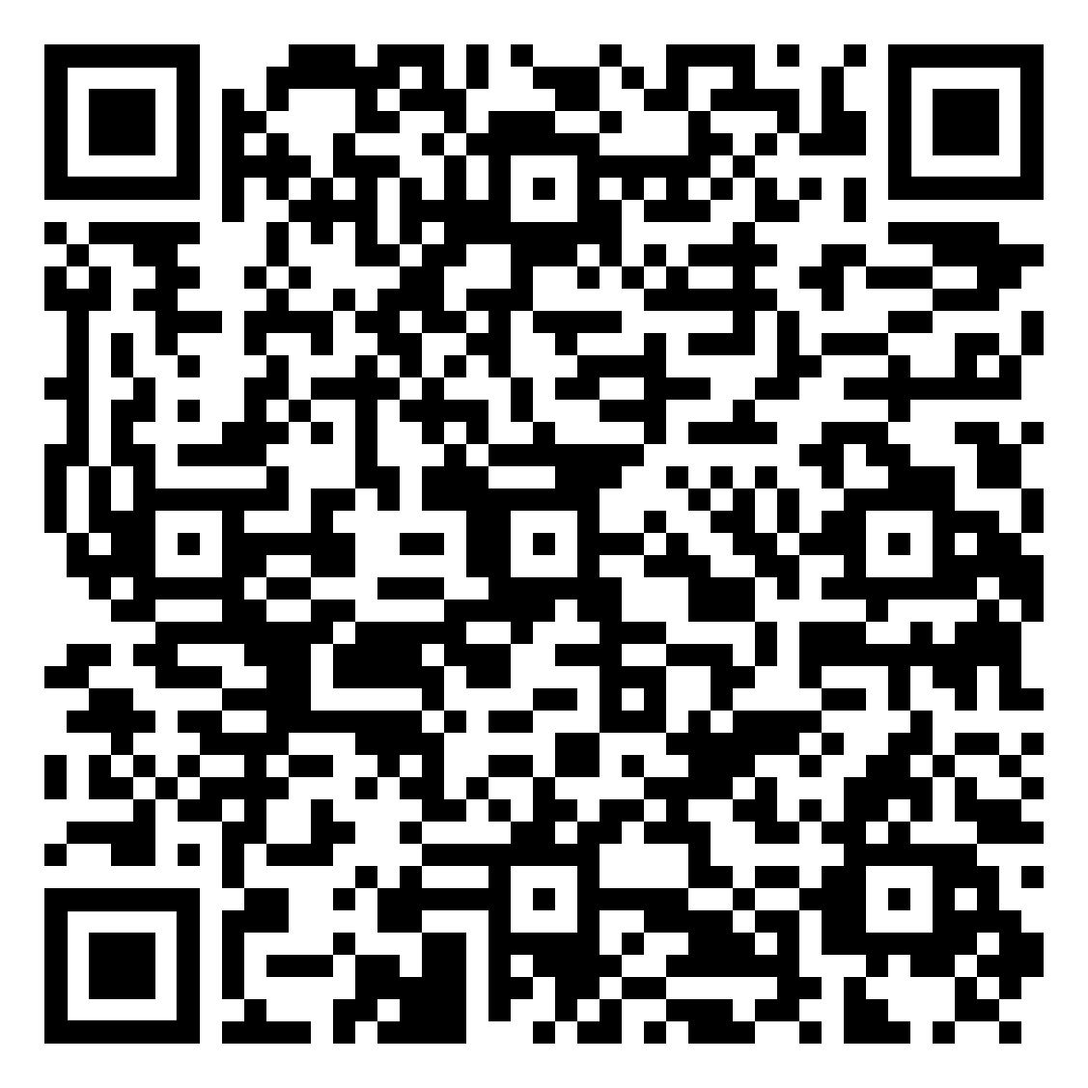
Year 8 RE Homework –
Half Term 4, Week 4
What is religious freedom? What is free speech?
Complete the Seneca questions about equality, gender and religion.
Key words – gender equality, scripture, patriarchal, worship, priest
Extension Task – Research what one religion believes about gender. Are they equal? Do they have specific roles?
What have been your strengths in RE this week?
What have been the areas that have challenged you in RE this week?
How could you improve next week?
Building good people who take PRIDE in their time at school, RESPECT themselves and others, WORK TOGETHER as a community, showing RESILIENCE and EMPATHY for all.

Slide 63
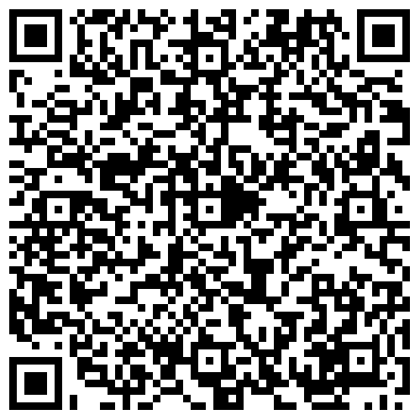
Year 8 Science Homework – Half Term 4, Week 4
Recap: See Below
Main Task (Available 14st March 2024)
Due: 21th March 2024
Recap on Biological Systems and
Processes
1.6.13 to 1.6.16 – Human Growth to
Genotypes vs Phenotype
Recap on Electricity and Magnetism
3.4.13 to 3.4.16 – The Earth’s Field to
Strength of Magnetic Fields
Key words – Human, Growth, DNA, Alleles, Genotype, Phenotype, Earth, Magnetic Field
Extension Task – Complete Crosswords / Exam Style Questions inside Chemistry or Biology Extension Booklets, Mark Date Completed.
What have been your strengths in (insert subject) this week?
What have been the areas that have challenged you in (insert topic) this week?
How could you improve next week?
Building good people who take PRIDE in their time at school, RESPECT themselves and others, WORK TOGETHER as a community, showing RESILIENCE and EMPATHY for all.

Slide 64

Year 8 Young Enterprise, Homework – Half Term 4, Week 4
Recap:
Define the following:
Gross Profit Net Profit
Main Task
Complete the activity given out in lesson this week. This will be stapled into your book, so it doesn't get lost.
Key words – Income Statement, Profit
Extension Task —
See activity sheet
What have been your strengths this week?
What have been the areas that have challenged you this week?
How could you improve next week?
Building good people who take PRIDE in their time at school, RESPECT themselves and others, WORK TOGETHER as a community, showing RESILIENCE and EMPATHY for all.

Slide 65
Week 5 Homework

Slide 66
Week 5 Homework Due Dates
Subject | Day Due | Date Due
Academic PE
Art
English
Geography
History
Languages
Maths
Music
RE
Science
Young Enterprise
Building good people who take PRIDE in their time at school, RESPECT themselves and others, WORK TOGETHER as a community, showing RESILIENCE and EMPATHY for all.

Slide 67
Year 8 Art Homework Term 1,
Week 1 - 6
REVISION – PRACTICE YOUR SHADING BEFORE STARTING EACH TASK
MAIN TASK:
Create a portrait drawing each week, in your
flip book sketchbook.
Each week draw two portraits, one per page, try to consider the proportions of the overall face on each of the pages and use the space well.
Week 1 Design a front cover for your portrait book and do two drawings ( pages)
Week 2 - 2 x drawings
Week 3 2 x drawings
Week 4 2 x drawings
Week 5 2 x drawings
Week 6 2 x drawings
Key words – Tone, value, shading, shape, form, depth
Extension Task –Spend an extra 10 mins on the tasks above each week.
What have been your strengths in (insert subject) this week?
What have been the areas that have challenged you in (insert topic) this week?
How could you improve next week?
Building good people who take PRIDE in their time at school, RESPECT themselves and others, WORK TOGETHER as a community, showing RESILIENCE and EMPATHY for all.

Slide 68
Year 8 English Homework
Half Term 4, Week 5
This is taken from the following Department for Education report:
Research Evidence on Reading for Pleasure. Report conducted by the government's Education Standards research team. For the full report, please access https://assets.publishing.service.gov.uk/government/uploads/system/uploads/attachment_data/file/284286/reading_for_pleasure.pdf
‘The graph relates reading frequency and reading materials to PIRLS scores. The key finding is that frequent reading for pleasure is correlated to higher PIRLS literacy scores. However, reading for information is much less well correlated. The graph shows that:
• Frequently reading novels and stories and reading for fun is strongly correlated to PIRLS literacy score.
• However, reading for information (regardless of the source) is much less well correlated. Those who reported the most frequent reading of information texts.’
Read at least four times per week for at least twenty minutes each time. Use your planner to record what you have read and for how long you have read. Have a parent or guardian sign your planner to confirm that you have completed your reading.
Key words – pleasure, effectiveness, success, comfort, relaxation, growth, vocabulary, understanding, enjoyment, interest, passion,
Extension Task – Share ideas about what books to read with friends and family. Can you tell them why your book is effective? Can you ask them what’s effective about the book they recommend? Step out of your comfort zone; find new authors and titles. Talk to friends, family and teachers about what they think is a good read.
What have been your strengths in (insert subject) this week?
What have been the areas that have challenged you in (insert topic) this week?
How could you improve next week?
Building good people who take PRIDE in their time at school, RESPECT themselves and others, WORK TOGETHER as a community, showing RESILIENCE and EMPATHY for all.

Slide 69
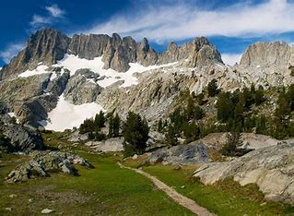
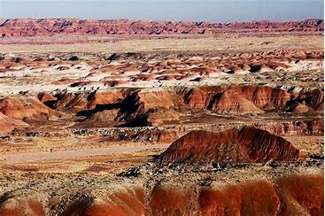
Year 8 Geography Homework – Half Term 4 Week 5
Describe the global distribution of coral reefs. Refer to lines of latitude in your response.
Use the information about Wilderness areas on the cool geography website to research why wilderness areas are so important.
https://www.coolgeography.co.uk/gcsen/GCSE_LW_Wilderness.php
Present your findings as an article for a Geography magazine aimed at Key Stage 3 students (Years 7-9).
Key words – wilderness, biodiverse, threats, commercial farming, forest biomes, carbon dioxide, global warming, invertebrates
Extension Task – You could also find out about why Wilderness areas and under threat and how they are being managed. Add this information to your article.
What have been your strengths in Geography this week?
What have been the areas that have challenged you in Geography this week?
How could you improve next week?
Building good people who take PRIDE in their time at school, RESPECT themselves and others, WORK TOGETHER as a community, showing RESILIENCE and EMPATHY for all.

Slide 70
Year 8 History Homework – Half Term 4, Week 5
Give three reasons why white people fought in the American Civil War
Give two reasons why Black people fought in the American Civil War
What are your thoughts on whether Black people would get what they fought for?
Mind Map:
Next, we will look at the overall impact of slavery, research this and complete the tasks below (link to a good website - https://www.bbc.co.uk/bitesize/topics/z2qj6sg)
Take the key events and put them onto a Mind Map (examples/templates available).
Make sure the events have a title and a brief description.
Make sure it has arrows LINKING events – does one cause another? Do they have things in common? Have you described why they link together?
Make sure it has either colour coding (one colour per area) or pictures/symbols.
Key words – Slavery, Abolition, Plantations, Impact
Extension Task – Seneca:
Join class - Seneca task -
What have been your strengths in History this week?
What have been the areas that have challenged you in History this week?
How could you improve next week?
Building good people who take PRIDE in their time at school, RESPECT themselves and others, WORK TOGETHER as a community, showing RESILIENCE and EMPATHY for all.

Slide 71
Year 8 Languages Homework
Half Term 4
Vocabulary and Translation Practise
For this homework, you will need a copy of the Sentence Builder.
Task 1 | Test yourself on the items in the sentence builder using the Look-Say-Cover-Write-Check method.
Task 2 | Ask a friend or a relative to test you on individual items from the sentence builder.
Task 3 | Ask a friend or a relative to test you on full sentences from the sentence builder.
Task 4 | Practise this week's topic on Linguascope. (See Mr Downey for the login details).
Task 5 | Find a new song in your preferred language on Lyrics Training. Can you challenge yourself to the higher levels?
Language Gym – Check for online assignments
Username: ______________________
Password: _______________________
What have been your strengths in Languages this week?
What have been the areas that have challenged you in Languages this week?
How could you improve next week?
Building good people who take PRIDE in their time at school, RESPECT themselves and others, WORK TOGETHER as a community, showing RESILIENCE and EMPATHY for all.

Slide 72
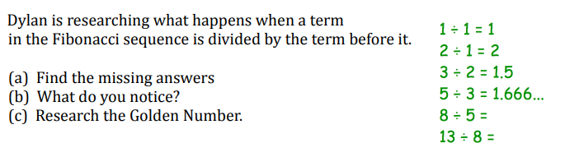
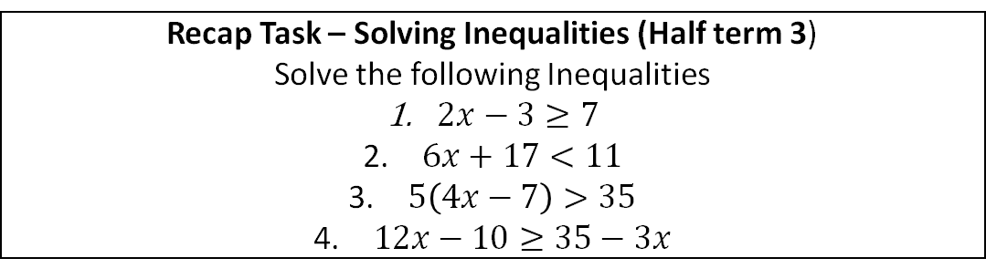
Year 8 Mathematics Homework
Half Term 4, Week 5
Recap Task – Solving Inequalities (Half Term 4)
Solve the following Inequalities
$2x−3≥7$
$6x+17<11$
$5\left(4x−7\right)>35$
$12x−10≥35−3x$
Main Task – Sequences
Research the FIBONACCI SEQUENCE.
Write up some notes of what you find out, include examples of where the Fibonacci sequence appears in the natural world.
Key words –Sequence, position, term, Fibonacci, consecutive, successive
Extension Task –The Golden Number
What have been your strengths in maths this week?
What have been the areas that have challenged you in maths this week?
How could you improve next week?
Building good people who take PRIDE in their time at school, RESPECT themselves and others, WORK TOGETHER as a community, showing RESILIENCE and EMPATHY for all.

Slide 73
Year 8 Music - Variation
Homework - Half Term 4 Week 5
What is a chaconne? What is meant by a counter melody? What is the difference between a drone and a pedal note? Name some different ways that harmony can be created.
This week’s listening – Title: Rhapsody On A Theme Of Paganini, Variation 18
Composer: Sergei Rachmaninov
Genre: Romantic
Spend time listening to the above piece of music.
Complete the page in your listening booklet –
1.Give some background information on the piece and artist/composer
2.Comment on the instrumentation and how the musical elements are used in as much detail as you can.
3.Give your personal response to the music – remember to explain why you liked or did not like the piece of music.
Key words – Tempo, Dynamics, Duration, Pitch, Silence, Articulation, Melody, Texture, Timbre
Extension Task – Listen to and comment on further pieces of music by the same artist/composer.
What have been your strengths in Music this week?
What have been the areas that have challenged you in Music this week?
How could you improve next week?
Building good people who take PRIDE in their time at school, RESPECT themselves and others, WORK TOGETHER as a community, showing RESILIENCE and EMPATHY for all.

Slide 74

Year 8 RE Homework –
Half Term 4, Week 5
How are people discriminated against because of their gender?
Visit the BBC Bitesize webpage about equality and social justice:
https://www.bbc.co.uk/bitesize/topics/znbrpg8/articles/z42khbk
Read through the information, watch the video and take the test. Screen shot or tell me your score next lesson.
Key words – social justice, equality, human rights, discrimination, legislation
Extension Task – How could you promote social justice?
What have been your strengths in RE this week?
What have been the areas that have challenged you in RE this week?
How could you improve next week?
Building good people who take PRIDE in their time at school, RESPECT themselves and others, WORK TOGETHER as a community, showing RESILIENCE and EMPATHY for all.

Slide 75
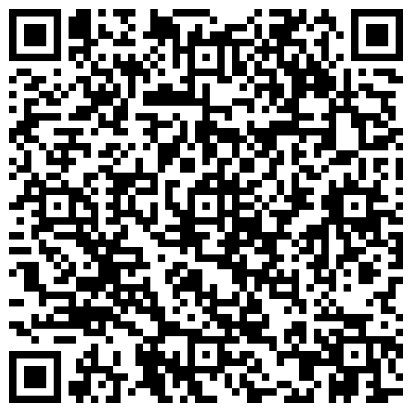
Year 8 Science Homework – Half Term 4, Week 5
Recap: See Below
Main Task (Available 21st March 2024)
Due: 28th March 2024
Recap on Biological Systems and
Processes
1.6.17 to 1.6.20 – Punnett Squares to
The Circulatory System
Recap on Electricity and Magnetism
3.4.14 to 3.4.17 – Circuit Symbols
Hyperlearning
Key words – Punnett, Squares, Inheritance, Joints, Renal System, Circulatory System, Electromagnetism, Circuit Symbols,
Extension Task – Complete Crosswords / Exam Style Questions inside Chemistry or Biology Extension Booklets, Mark Date Completed.
What have been your strengths in (insert subject) this week?
What have been the areas that have challenged you in (insert topic) this week?
How could you improve next week?
Building good people who take PRIDE in their time at school, RESPECT themselves and others, WORK TOGETHER as a community, showing RESILIENCE and EMPATHY for all.

Slide 76
Year 8 Young Enterprise, Homework – Half Term 4, Week 5
Recap
Name 4 possible expenses on an Income Statement (4 marks)
Main Task
Finance plays a big part in life.
How can learning about finance improve your life? Give 5 reasons and explain your answers
(10 marks)
Extension Task — What could happen if you lack basic finance skills? Name 3 negatives that could happen and explain what you could do to make sure you have these finance skills. (6 marks)
What have been your strengths this week?
What have been the areas that have challenged you this week?
How could you improve next week?
Building good people who take PRIDE in their time at school, RESPECT themselves and others, WORK TOGETHER as a community, showing RESILIENCE and EMPATHY for all.

Slide 77
Week 6 Homework

Slide 78
Week 6 Homework Due Dates
Subject | Day Due | Date Due
Academic PE
Art
English
Geography
History
Languages
Maths
Music
RE
Science
Young Enterprise
Building good people who take PRIDE in their time at school, RESPECT themselves and others, WORK TOGETHER as a community, showing RESILIENCE and EMPATHY for all.

Slide 79
Year 8 Art Homework Term 1,
Week 1 - 6
REVISION – PRACTICE YOUR SHADING BEFORE STARTING EACH TASK
MAIN TASK:
Create a portrait drawing each week, in your
flip book sketchbook.
Each week draw two portraits, one per page, try to consider the proportions of the overall face on each of the pages and use the space well.
Week 1 Design a front cover for your portrait book and do two drawings ( pages)
Week 2 - 2 x drawings
Week 3 2 x drawings
Week 4 2 x drawings
Week 5 2 x drawings
Week 6 2 x drawings
Key words – Tone, value, shading, shape, form, depth
Extension Task –Spend an extra 10 mins on the tasks above each week.
What have been your strengths in (insert subject) this week?
What have been the areas that have challenged you in (insert topic) this week?
How could you improve next week?
Building good people who take PRIDE in their time at school, RESPECT themselves and others, WORK TOGETHER as a community, showing RESILIENCE and EMPATHY for all.

Slide 80
Year 8 English Homework
Half Term 4, Week 6
This is taken from the following Department for Education report:
Research Evidence on Reading for Pleasure. Report conducted by the government's Education Standards research team. For the full report, please access https://assets.publishing.service.gov.uk/government/uploads/system/uploads/attachment_data/file/284286/reading_for_pleasure.pdf
‘In England (and in most other countries) there was a positive association between the frequency of reading for pleasure and reading attainment. England had the greatest difference between the mean attainment of children who read for fun (outside of school) on a daily basis (mean scale score 575) and those who read on a weekly basis (mean scale score 537), a difference of 38 points. Reading for pleasure is an activity that has real emotional and social consequences. There is a growing body of evidence which illustrates the importance of reading for pleasure for both educational purposes as well as personal development. The evidence strongly supports the argument that those who read more are better readers; and the amount of reading and reading achievement are thought to be reciprocally related to each other – as reading amount increases, reading achievement increases, which in turn increases reading amount. Children who read very little do not have the benefits that come with reading, and studies show that when struggling readers are not motivated to read, their opportunities to learn decrease significantly.’
Read at least four times per week for at least twenty minutes each time. Use your planner to record what you have read and for how long you have read. Have a parent or guardian sign your planner to confirm that you have completed your reading.
Key words – pleasure, effectiveness, success, comfort, relaxation, growth, vocabulary, understanding, enjoyment, interest, passion,
Extension Task – Share ideas about what books to read with friends and family. Can you tell them why your book is effective? Can you ask them what’s effective about the book they recommend? Step out of your comfort zone; find new authors and titles. Talk to friends, family and teachers about what they think is a good read.
What have been your strengths in (insert subject) this week?
What have been the areas that have challenged you in (insert topic) this week?
How could you improve next week?
Building good people who take PRIDE in their time at school, RESPECT themselves and others, WORK TOGETHER as a community, showing RESILIENCE and EMPATHY for all.

Slide 81

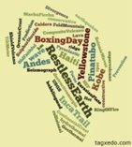
Year 8 Geography Homework – Half Term 4 Week 6
List as many different types of wilderness as you can.
Create a Wordle or Tagxedo resource (example above) for the key vocabulary we have used in this unit – print it and bring it to class or e-mail it to me on ruth.varley@saintjamesschool.co.uk
Key words – ecosystem, biome, climate, trade, coral reef, Mediterranean, Wilderness
Extension Task – Create a set of flashcards for the key words identified and their definitions.
What have been your strengths in Geography this week?
What have been the areas that have challenged you in Geography this week?
How could you improve next week?
Building good people who take PRIDE in their time at school, RESPECT themselves and others, WORK TOGETHER as a community, showing RESILIENCE and EMPATHY for all.

Slide 82
Year 8 History Homework – Half Term 4, Week 6
1. Who was William Wilberforce?
2. Who was Harriet Tubman?
3. Who was Olaudah Equiano?
4. When did Britain begin building an empire?
5. How many men, women and children were in slavery in America?
Flash Cards:
Go back through the work we have completed on the British Empire and Slavery.
Pick 3-4 key bits from each week.
Take the bits and turn them into flash cards (examples available).
Each card should be around 10cm long and 5cm high.
Each card should have 1 of the key bits described on one side and on the other side it should have a word/clue/picture to summarise it.
Key words –
Extension Task – Seneca:
Join class - Seneca task -
What have been your strengths in History this week?
What have been the areas that have challenged you in History this week?
How could you improve next week?
Building good people who take PRIDE in their time at school, RESPECT themselves and others, WORK TOGETHER as a community, showing RESILIENCE and EMPATHY for all.

Slide 83
Year 8 Languages Homework
Half Term 4
Vocabulary and Translation Practise
For this homework, you will need a copy of the Sentence Builder.
Task 1 | Test yourself on the items in the sentence builder using the Look-Say-Cover-Write-Check method.
Task 2 | Ask a friend or a relative to test you on individual items from the sentence builder.
Task 3 | Ask a friend or a relative to test you on full sentences from the sentence builder.
Task 4 | Practise this week's topic on Linguascope. (See Mr Downey for the login details).
Task 5 | Find a new song in your preferred language on Lyrics Training. Can you challenge yourself to the higher levels?
What have been your strengths in Languages this week?
What have been the areas that have challenged you in Languages this week?
How could you improve next week?
Building good people who take PRIDE in their time at school, RESPECT themselves and others, WORK TOGETHER as a community, showing RESILIENCE and EMPATHY for all.

Slide 84
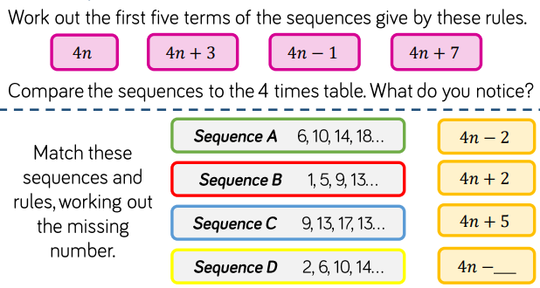
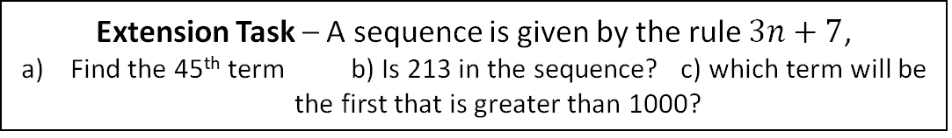
Year 8 Mathematics Homework
Half Term 4, Week 6
Recap Task – Percentages (Half Term 4)
Find 40% of 360
Increase £42 by 20%
Decrease £300 by 7%
There are 700 students in a school, 140 of them are in year 8. What percentage of the school is in year 8?
Main Task – nth term of a linear sequence
Key words – Rule, Term, Linear, Substitute, Position
Extension Task – A sequence is given by the rule $3n+7$,
Find the 45th term b) Is 213 in the sequence? c) which term will be the first that is greater than 1000?
What have been your strengths in maths this week?
What have been the areas that have challenged you in maths this week?
How could you improve next week?
Building good people who take PRIDE in their time at school, RESPECT themselves and others, WORK TOGETHER as a community, showing RESILIENCE and EMPATHY for all.

Slide 85
Year 8 Music - Variation
Homework - Half Term 4 Week 6
Imagine you are writing a ‘Theme and Variations’. What different ways can you arrange your theme to include as many variations as possible?
This week’s listening – Title: Nimrod
Composer: Edward Elgar
Genre: Romantic
Spend time listening to the above piece of music.
Complete the page in your listening booklet –
1.Give some background information on the piece and artist/composer
2.Comment on the instrumentation and how the musical elements are used in as much detail as you can.
3.Give your personal response to the music – remember to explain why you liked or did not like the piece of music.
Key words – Tempo, Dynamics, Duration, Pitch, Silence, Articulation, Melody, Texture, Timbre
Extension Task – Listen to and comment on further pieces of music by the same artist/composer.
What have been your strengths in Music this week?
What have been the areas that have challenged you in Music this week?
How could you improve next week?
Building good people who take PRIDE in their time at school, RESPECT themselves and others, WORK TOGETHER as a community, showing RESILIENCE and EMPATHY for all.

Slide 86
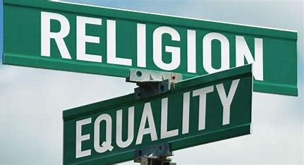
Year 8 RE Homework –
Half Term 4, Week 6
List as many key terms as you can remember from this topic, Religion and Human Rights.
Create a brain dump (mind map) of everything that you can remember from this topic, Religion and Human Rights. Include as many key words and links as you can.
Key words – human rights, animal rights, social justice, freedom of expression, community, gender, discrimination, legislation
Extension Task – Include definitions of any key words you include in your brain dump
What have been your strengths in RE this week?
What have been the areas that have challenged you in RE this week?
How could you improve next week?
Building good people who take PRIDE in their time at school, RESPECT themselves and others, WORK TOGETHER as a community, showing RESILIENCE and EMPATHY for all.

Slide 87
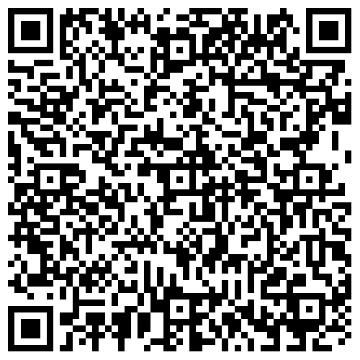
Year 8 Science Homework – Half Term 4, Week 6
Recap: See Below
Main Task (Available 28th March 2024)
Due: 18th April 2024
Recap on Biological Systems and
Processes
1.6.20 to 1.6.23 -
Recap on Reactivity: All of it!
Key words – Punnett, Squares, Inheritance, Joints, Renal System, Circulatory System, Electromagnetism, Circuit Symbols,
Extension Task – Complete Crosswords / Exam Style Questions inside Chemistry or Biology Extension Booklets, Mark Date Completed.
What have been your strengths in (insert subject) this week?
What have been the areas that have challenged you in (insert topic) this week?
How could you improve next week?
Building good people who take PRIDE in their time at school, RESPECT themselves and others, WORK TOGETHER as a community, showing RESILIENCE and EMPATHY for all.

Slide 88
Year 8 Young Enterprise, Homework – Half Term 4, Week 6
Recap Task
Name 3 reasons why learning about finance skills could help you in life. (3 marks)
Main Task
Create a poster that highlights the main reasons (at least 4) why finance skills are so important in life.
Be creative!
Prepare to present your poster in class.
(10 marks)
Key words – Finance, Life Skills
Extension Task –How could you improve your poster skills in future? Give at least 3 ideas for improvement. (3 marks)
What have been your strengths this week?
What have been the areas that have challenged you this week?
How could you improve next week?
Building good people who take PRIDE in their time at school, RESPECT themselves and others, WORK TOGETHER as a community, showing RESILIENCE and EMPATHY for all.

Slide 89
Building good people who take PRIDE in their time at school, RESPECT themselves and others, WORK TOGETHER as a community, showing RESILIENCE and EMPATHY for all.

