Slide 1

St. James' School Homework Booklet
Year 9
Lent Term HT4
Building good people who take PRIDE in their time at school, RESPECT themselves and others, WORK TOGETHER as a community, showing RESILIENCE and EMPATHY for all.

Slide 2

Name -
My Timetable at St. James’ School
Friday
Thursday
Wednesday
Tuesday
Monday
 | Tutorial (8.40-8.50) | Tutorial Lesson (8.50-9.20) | Lesson 1 (9.20-10.10) | Lesson 2 (10.10-11.00) | Lesson 3 (11.20-12.10) | Lesson 4 (12.10-13.00) | Extracurricular (13.40-14.10) | Lesson 5 (14.10-15.05) | Lesson 6 (15.05-16.00)
Building good people who take PRIDE in their time at school, RESPECT themselves and others, WORK TOGETHER as a community, showing RESILIENCE and EMPATHY for all.

Slide 3
Homework at St. James’ School
Independent study is an essential part of the learning. Pupils will have homework set on a regular basis that is meaningful and appropriate. This must be clearly recorded in the planner with an appropriate deadline.
Homework is set in order to, involve parents and guardians with learning, develop independent study skills which will allow pupils to achieve academic success, allow pupils to grow as independent and life-long learners through developing their confidence, motivation and self-discipline, reinforce, consolidate and/or extend what pupils know and can do in the classroom.
Regularity of Homework
This will be dependent on curriculum time and the allocation for each subject as well as the age range of the pupils. Pupils will receive at least one piece of homework per subject per week.
Guideline allocation for Homework:
Year 7, 8 and 9: 30 minutes per subject
Year 10 and 11: Around 45 minutes per subject
Year 9 Homework Timetable
Monday​ | Tuesday​ | Wednesday​ | Thursday​ | Friday​
Building good people who take PRIDE in their time at school, RESPECT themselves and others, WORK TOGETHER as a community, showing RESILIENCE and EMPATHY for all.

Slide 4
Lent Term HT4 Uniform and Equipment
Required uniform for ALL pupils:
St. James’ Blazer
St. James’ Tie
Black Trousers/St. James’ Skirt
White Collared Shirt
Black School Shoes
Black Socks with Trousers
Black Tights with Skirts
Optional - Black Jumper/Cardigan
Optional – Plain Dark Coat
St. James’ PE Polo Shirt
St. James’ PE Shorts/Skort
St. James’ PE Tracksuit
St. James’ PE Sports Socks (green)
PE Trainers (any design)
Optional - St. James’ PE Waterproof
Required equipment for ALL pupils:
Black pen
Pencil
Ruler
Rubber
Calculator
Memory Pen
Is your uniform perfect all week? | Tutor Signature
Week 1 – Uniform Perfection?
Week 2 – Uniform Perfection?
Week 3 – Uniform Perfection?
Week 4 – Uniform Perfection?
Week 5 – Uniform Perfection?
Week 6 – Uniform Perfection?
Building good people who take PRIDE in their time at school, RESPECT themselves and others, WORK TOGETHER as a community, showing RESILIENCE and EMPATHY for all.

Slide 5
Lent Term HT4 Attendance
Being in school is important to your achievement, wellbeing, and wider development. Evidence shows that the students with the highest attendance throughout their time in school gain the best GCSE and A Level results.
Research found that pupils who performed better at secondary school missed fewer days than those who didn’t perform as well.
In 2019, secondary school pupils who didn’t achieve grade 9 to 4 in English and Maths missed 10 more days on average over the key stage than those who achieved grade 9 to 5 in both English and Maths.
Every moment in school counts, and days missed add up quickly. For example, a child who is absent for three days over a half term could miss 18 lessons in total.
The higher a pupil’s attendance, the more they are likely to learn, and the better they are likely to perform in exams and formal assessments.
*Information for the Department for Education (https://educationhub.blog.gov.uk/2023/05/18/school-attendance-important-risks-missing-day/)
Year 9 Lent Term HT4 Attendance
How many days did you miss last Half Term?
Last Half Term’s Attendance Percentage
How many days have you missed this Half Term?
This Half Term’s Attendance Percentage
Building good people who take PRIDE in their time at school, RESPECT themselves and others, WORK TOGETHER as a community, showing RESILIENCE and EMPATHY for all.

Slide 6


Pupil Wellbeing Information
Pupil wellbeing is at the centre of life at St. James’, in school you can talk to any member of the school staff who will be willing to listen and support you. Below is the school email for any questions you have or support you require:
wearelistening@saintjames.co.uk
Below this is a series of external support that the school has links with and can also be used:
Building good people who take PRIDE in their time at school, RESPECT themselves and others, WORK TOGETHER as a community, showing RESILIENCE and EMPATHY for all.

Slide 7
Lent Term HT4 Calendar
 | Monday | Tuesday | Wednesday | Thursday | Friday
Week 1 W/C 19/2/24
Week 2 W/C 26/2/24 | Year 11 and 13 Mock Exams | Year 11 and 13 Mock Exams | Year 11 and 13 Mock Exams | Year 11 and 13 Mock Exams | Year 11 and 13 Mock Exams
Week 3 W/C 4/3/24 | Year 11 and 13 Mock Exams English Week | Year 11 and 13 Mock Exams | Year 11 and 13 Mock Exams | Year 11 and 13 Mock Exams | Year 11 and 13 Mock Exams
Week 4 W/C 11/3/24 | Science Week
Week 5 W/C 18/3/24 |  |  |  |  | Blakeney Charity Event
Week 6 W/C 25/3/24 |  | Year 7, 8, 9 Progress Consultation Evening | Year 10, 11, 12, 13 Progress Consultation Evening | School Ends of Easter | Good Friday
*Please note that we will email home if there are any changes to dates.
Building good people who take PRIDE in their time at school, RESPECT themselves and others, WORK TOGETHER as a community, showing RESILIENCE and EMPATHY for all.

Slide 8
Lent Term HT4 Merits
1 | 2 | 3 | 4 | 5
6 | 7 | 8 | 9 | 10
11 | 12 | 13 | 14 | 15
16 | 17 | 18 | 19 | 20
21 | 22 | 23 | 24 | 25
26 | 27 | 28 | 29 | 30
31 | 32 | 33 | 34 | 35
Building good people who take PRIDE in their time at school, RESPECT themselves and others, WORK TOGETHER as a community, showing RESILIENCE and EMPATHY for all.

Slide 9
Lent Term HT4 Merits
36 | 37 | 38 | 39 | 40
41 | 42 | 43 | 44 | 45
46 | 47 | 48 | 49 | 50
51 | 52 | 53 | 54 | 55
56 | 57 | 58 | 59 | 60
61 | 62 | 63 | 64 | 65
66 | 67 | 68 | 69 | 70
Building good people who take PRIDE in their time at school, RESPECT themselves and others, WORK TOGETHER as a community, showing RESILIENCE and EMPATHY for all.

Slide 10
Lent Term HT4 Merits
71 | 72 | 73 | 74 | 75
76 | 77 | 78 | 79 | 80
81 | 82 | 83 | 84 | 85
86 | 87 | 88 | 89 | 90
91 | 92 | 93 | 94 | 95
96 | 97 | 98 | 99 | 100
101 | 102 | 103 | 104 | 105
Building good people who take PRIDE in their time at school, RESPECT themselves and others, WORK TOGETHER as a community, showing RESILIENCE and EMPATHY for all.

Slide 11
Lent Term HT4 Merits
106 | 107 | 108 | 109 | 110
111 | 112 | 113 | 114 | 115
116 | 117 | 118 | 119 | 120
121 | 122 | 123 | 124 | 125
126 | 127 | 128 | 129 | 130
131 | 132 | 133 | 134 | 135
136 | 137 | 138 | 139 | 140
Building good people who take PRIDE in their time at school, RESPECT themselves and others, WORK TOGETHER as a community, showing RESILIENCE and EMPATHY for all.

Slide 12
Lent Term HT4 Notes
Building good people who take PRIDE in their time at school, RESPECT themselves and others, WORK TOGETHER as a community, showing RESILIENCE and EMPATHY for all.

Slide 13
Lent Term HT4 Notes
Building good people who take PRIDE in their time at school, RESPECT themselves and others, WORK TOGETHER as a community, showing RESILIENCE and EMPATHY for all.

Slide 14
Lent Term HT4 Notes
Building good people who take PRIDE in their time at school, RESPECT themselves and others, WORK TOGETHER as a community, showing RESILIENCE and EMPATHY for all.

Slide 15
Lent Term HT4 Notes
Building good people who take PRIDE in their time at school, RESPECT themselves and others, WORK TOGETHER as a community, showing RESILIENCE and EMPATHY for all.

Slide 16
Week 1 Homework

Slide 17
Week 1 Homework Due Dates
Subject | Day Due | Date Due
Academic PE
Art
English
Geography
History
Languages
Maths
Music
RE
Science
Young Enterprise
Building good people who take PRIDE in their time at school, RESPECT themselves and others, WORK TOGETHER as a community, showing RESILIENCE and EMPATHY for all.

Slide 18
Year 9 Academic PE Homework – Half Term 4, Week 1–6 (30 mins each week)
The homework that you have been set is once again an individual research project that we have discussed in class. The aim of the project is based upon an independent research with you having the choice of subject area from the criteria below
The criteria for your research project is to be based upon one of the two areas below:
1. A sports person or sporting role model that you may look up to. The research must include how they entered the sport, how they became the professional or amateur they are today and any honours such as medals etc. that they may have achieved.
2. A presentation based upon your own achievements in a sport that you play. This can be for a team or in an individual sport. Please state why you chose the sport, your pathway to where you are today and why you play it.
The criteria will be briefed each week during lesson time with the final week (6) been left for the presentation of each pupil's research.
Key Words: Project, Research, Facts, History
Extension Task – Could you research further into how a role model that you look up to may have a person they look up to as well?
What have been your strengths in Academic PE this week?
What have been the areas that have challenged you in Academic PE this week?
How could you improve next week?
Building good people who take PRIDE in their time at school, RESPECT themselves and others, WORK TOGETHER as a community, showing RESILIENCE and EMPATHY for all.

Slide 19

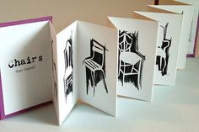
Year 9 Art Homework Term 1,
Week 1 - 6
REVISION – PRACTICE YOUR SHADING BEFORE STARTING EACH TASK
MAIN TASK:
Select a theme for your observational drawing flip book sketchbook.
Each week draw two items linked to your theme, one per page, try to consider the proportions of the overall objects on each of the pages.
Week 1 Pick a theme and design a front cover for your book and do two drawings ( pages)
Week 2 - 2 x drawings of theme
Week 3 2 x drawings of theme
Week 4 2 x drawings of theme
Week 5 2 x drawings of theme
Week 6 2 x drawings of theme
Key words – Tone, value, shading, shape, form, depth
Extension Task –Spend an extra 10 mins on the tasks above each week.
What have been your strengths in (insert subject) this week?
What have been the areas that have challenged you in (insert topic) this week?
How could you improve next week?
Building good people who take PRIDE in their time at school, RESPECT themselves and others, WORK TOGETHER as a community, showing RESILIENCE and EMPATHY for all.

Slide 20
Year 9 English Homework
Half Term 4, Week 1
Recap: Define these words: troupe, production, militia, august ………………………………………………………………………………………………………………………………………………………………………………………………………………………………………………………………………………………………………………………………………………………………………………………………………………………………………………………………………………………………………………………………………………………………………..
Read Text A and answer the questions based on IGCSE Language Paper 1, Question 1.
Key words – identify, give, explain
Extension Task – Are you reading for pleasure? Aim for four times per week for at least 20 minutes each time.
What have been your strengths in (insert subject) this week?
What have been the areas that have challenged you in (insert topic) this week?
How could you improve next week?
Building good people who take PRIDE in their time at school, RESPECT themselves and others, WORK TOGETHER as a community, showing RESILIENCE and EMPATHY for all.

Slide 21
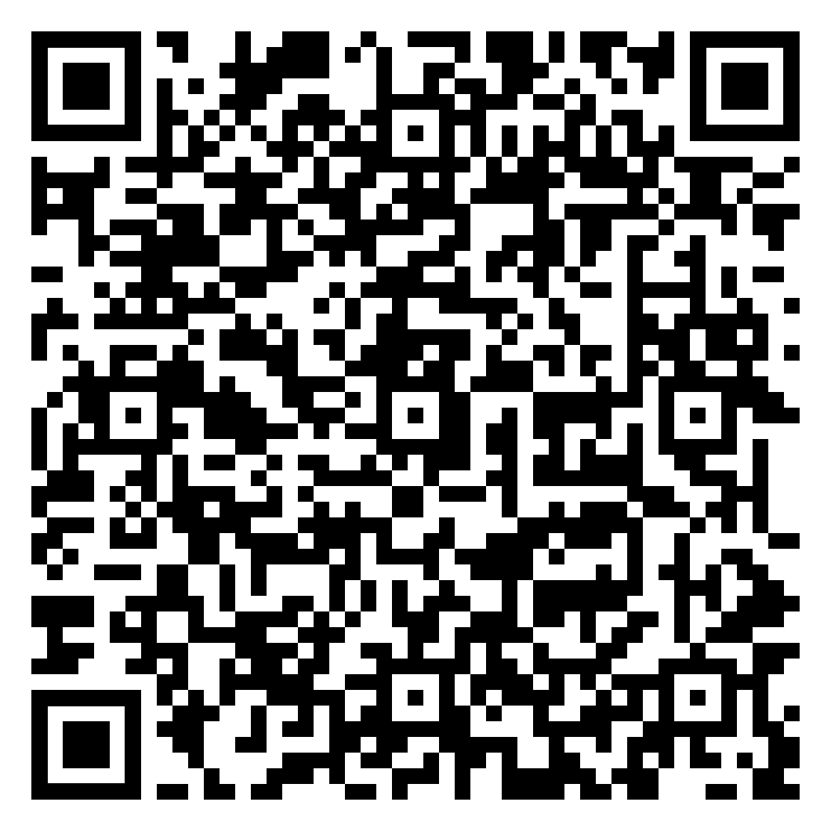
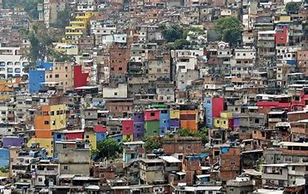
Year 9 Geography Homework – Half Term 4, Week 1
Give three reasons why deforestation is occurring in the Amazon Rainforest.
Open the Favelas Homework Week 1 document.
Annotate around it anything you have learnt about favelas.
You can shade your diagram to highlight issues/features if you wish.
Online document below:
Favelas Homework Week 1.pdf
Key words – Favela, informal settlement, social, economic, environmental, services, management strategies
Extension Task – Add social, economic and environment impacts to your annotated diagram. How have/could any negative impacts be solved?
What have been your strengths in Geography this week?
What have been the areas that have challenged you in Geography this week?
How could you improve next week?
Building good people who take PRIDE in their time at school, RESPECT themselves and others, WORK TOGETHER as a community, showing RESILIENCE and EMPATHY for all.

Slide 22
Year 9 History Homework – Half Term 4, Week 1
1. What does Holocaust mean? | 5. What is a ghetto?
2. What is antisemitism? | 6. How many Jewish people died in the Holocaust?
3. What is historical antisemitism? | 7. Which other groups were affected by Nazi persecution?
4. Name 2 laws that against Jewish people in Nazi Germany? | 8. What was the Final Solution?
Source tasks:
Read both sources.
Highlighted and annotate key phrases/words in the sources.
What does source A tell you about the Cold War?
What does source B tell you about the Cold War?
What do the sources agree and disagree about?
(A) In 1984 Fidel Castro was interviewed by the American journalist, Tad Szulc. The journalist asked Castro why he was willing to allow Soviet missiles to be placed in Cuba.
It was necessary to make it clear to the United States that an invasion of Cuba would imply a war with the Soviet Union. It was then that they proposed the missiles... We preferred the risks, whatever they were, of a great tension, a great crisis, to the risks of the impotence of having to await a United States invasion of Cuba.
(B) Walter Trohan wrote about the Cuban Missile Crisis in the New York Tribune in November 1962.
For the first time in twenty years Americans can carry their head high because the president of the United States had stood up to the premier of Russia and made him back down.
Key words – Missile, Cuba, United States, Communism, Capitalism
Extension Task – what are the sources nature, origin and purpose? Does these make you trust the sources more or less?
What have been your strengths in History this week?
What have been the areas that have challenged you in History this week?
How could you improve next week?
Building good people who take PRIDE in their time at school, RESPECT themselves and others, WORK TOGETHER as a community, showing RESILIENCE and EMPATHY for all.

Slide 23

Year 9 Languages Homework
Half Term 4
Vocabulary and Translation Practise
For this homework, you will need a copy of the Sentence Builder.
Task 1 | Test yourself on the items in the sentence builder using the Look-Say-Cover-Write-Check method.
Task 2 | Ask a friend or a relative to test you on individual items from the sentence builder.
Task 3 | Ask a friend or a relative to test you on full sentences from the sentence builder.
Task 4 | Practise this week's topic on Linguascope. (See Mr Downey for the login details).
Task 5 | Find a new song in your preferred language on Lyrics Training. Can you challenge yourself to the higher levels?
What have been your strengths in Languages this week?
What have been the areas that have challenged you in Languages this week?
How could you improve next week?
Building good people who take PRIDE in their time at school, RESPECT themselves and others, WORK TOGETHER as a community, showing RESILIENCE and EMPATHY for all.

Slide 24
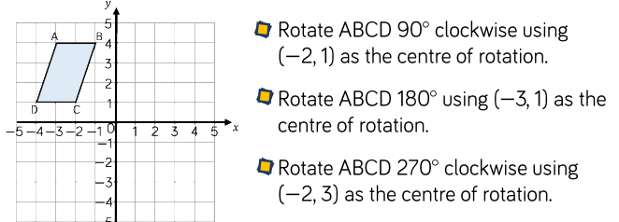
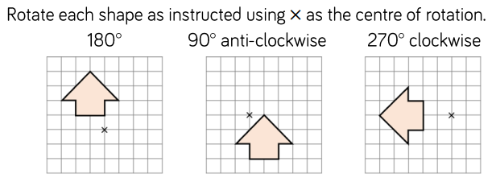
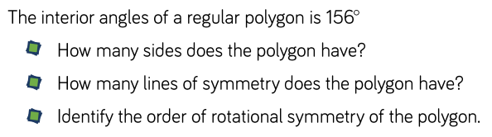
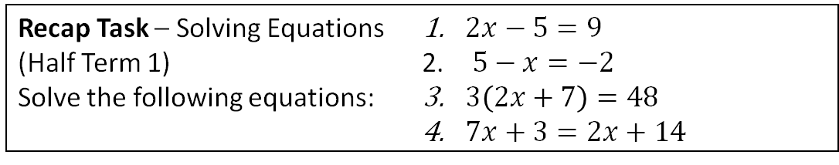
Year 9 Mathematics Homework
Half Term 4, Week 1
Recap Task – Solving Equations (Half Term 1)
Solve the following equations:
$2x−5=9$
$5−x=−2$
$3\left(2x+7\right)=48$
$7x+3=2x+14$
Main Task –Rotations
Key words –Image, Object, Clockwise, Anticlockwise, Rotate, Centre
Extension Task –
What have been your strengths in maths this week?
What have been the areas that have challenged you in maths this week?
How could you improve next week?
Building good people who take PRIDE in their time at school, RESPECT themselves and others, WORK TOGETHER as a community, showing RESILIENCE and EMPATHY for all.

Slide 25
Year 9 Music - Musical Theatre
Homework - Half Term 4 Week 1
Explain the terms Music Hall, Operetta and Vaudeville. What are usually the main elements of a Musical Theatre production?
This week’s listening – Title: Doe A Deer (from The Sound Of Music)
Composer: Richard Rogers & Oscar Hammerstein
Genre: Musical Theatre (Concept)
www.youtube.com/watch?v=dlBrNHySWiA&t=6s
Spend time listening to the above piece of music.
Complete the page in your listening booklet –
1.Give some background information of the piece and artist/composer
2.Comment on the instrumentation and how the musical elements are used in as much detail as you can.
3.Give your personal response to the music – remember to explain why you liked or did not like the piece of music.
Key words – Tempo, Dynamics, Duration, Pitch, Silence, Articulation, Melody, Texture, Timbre
Extension Task – Listen to and comment on further pieces of music by the same artist/composer.
What have been your strengths in Music this week?
What have been the areas that have challenged you in Music this week?
How could you improve next week?
Building good people who take PRIDE in their time at school, RESPECT themselves and others, WORK TOGETHER as a community, showing RESILIENCE and EMPATHY for all.

Slide 26
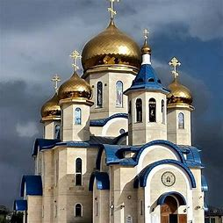
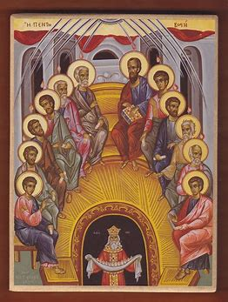
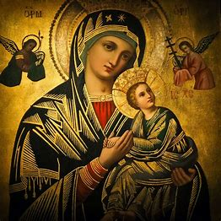
Year 9 RE Homework – Half Term 4, Week 1
List at least FIVE Christian denominations.
Your mate, Lazy Larry, has missed this week's RE lessons (he overslept!). Create 2 x 40 character messages for him, summarising:
1) The origins of the Orthodox Church
2) The denomination’s key beliefs
Key words – Denomination, Great Schism, Nicene Creed, patriarch, excommunication, Eucharist, icons, incense
Extension Task – Send him two more messages summarising Catholicism.
What have been your strengths in RE this week?
What have been the areas that have challenged you in Types of Christianity this week?
How could you improve next week?
Building good people who take PRIDE in their time at school, RESPECT themselves and others, WORK TOGETHER as a community, showing RESILIENCE and EMPATHY for all.

Slide 27
Year 9 Science Homework – Half Term 4, Week 1
Available: 21st February 2024
Due: 28th February 2024
C2: Structure and Bonding
P3: Particle Model
B1: Cells
Note: If you have any issues with homework, you must contact Mr Chan – If you do not notify Mr Chan before the lesson on the due date
an automatic detention is issued.
Three Assignments:
Sci (Bio)
Sci (Chem)
Sci (Phys)
Main Task:
AND: Complete at least 10 marks of questions inside your exam question mastery booklets.
Leave on the table in lesson, let me know and I’ll mark the questions.
All questions completed should be stamped/ marked by your teacher on or before the due date.
Booklet (E.G: C3) | Question / Marks
What have been your strengths in (insert subject) this week?
What have been the areas that have challenged you in (insert topic) this week?
How could you improve next week?
Building good people who take PRIDE in their time at school, RESPECT themselves and others, WORK TOGETHER as a community, showing RESILIENCE and EMPATHY for all.

Slide 28
Year 9 Young Enterprise, Homework – Half Term 4, Week 1
Define the following terms:
SMART Objectives
Main Task
Q1 Why is growth in a business important? (2 marks)
Q2 Why could growth in a business possible cause problems? (2 marks)
Q3 Imagine yourself in charge of a business of your choice. You want to grow the business. How could you do this? Make sure to consider the type of business and the market that it is in. Think also about possible customers and your competitors. Explain your ideas for growing your business. (10 marks)
Key words: Growth
Extension Task — What are the 3 main problems you foresee that could prevent growth in your business? Explain these. (6 marks)
What have been your strengths this week?
What have been the areas that have challenged you this week?
How could you improve next week?
Building good people who take PRIDE in their time at school, RESPECT themselves and others, WORK TOGETHER as a community, showing RESILIENCE and EMPATHY for all.

Slide 29
Week 2 Homework

Slide 30
Week 2 Homework Due Dates
Subject | Day Due | Date Due
Academic PE
Art
English
Geography
History
Languages
Maths
Music
RE
Science
Young Enterprise
Building good people who take PRIDE in their time at school, RESPECT themselves and others, WORK TOGETHER as a community, showing RESILIENCE and EMPATHY for all.

Slide 31
Year 9 Art Homework Term 1,
Week 1 - 6
REVISION – PRACTICE YOUR SHADING BEFORE STARTING EACH TASK
MAIN TASK:
Select a theme for your observational drawing flip book sketchbook.
Each week draw two items linked to your theme, one per page, try to consider the proportions of the overall objects on each of the pages.
Week 1 Pick a theme and design a front cover for your book and do two drawings ( pages)
Week 2 - 2 x drawings of theme
Week 3 2 x drawings of theme
Week 4 2 x drawings of theme
Week 5 2 x drawings of theme
Week 6 2 x drawings of theme
Key words – Tone, value, shading, shape, form, depth
Extension Task –Spend an extra 10 mins on the tasks above each week.
What have been your strengths in (insert subject) this week?
What have been the areas that have challenged you in (insert topic) this week?
How could you improve next week?
Building good people who take PRIDE in their time at school, RESPECT themselves and others, WORK TOGETHER as a community, showing RESILIENCE and EMPATHY for all.

Slide 32
Year 9 English Homework
Half Term 4, Week 2
Recap: Define these word: ………………………………………………………………………………………………………………………………………………………………………………………………………………………………………………………………………………………………………………………………………………………………………………………………………………………………………………………………………………………………………………………………………………………………………..
Read Text B and answer the questions based on IGCSE Language Paper 1, Question 1.
Key words – identify, give, explain
Extension Task – Are you reading for pleasure? Aim for four times per week for at least 20 minutes each time.
What have been your strengths in (insert subject) this week?
What have been the areas that have challenged you in (insert topic) this week?
How could you improve next week?
Building good people who take PRIDE in their time at school, RESPECT themselves and others, WORK TOGETHER as a community, showing RESILIENCE and EMPATHY for all.

Slide 33


Year 9 Geography Homework – Half Term 4, Week 2
What are favelas? Name THREE challenges people who live in favelas face.
Use all the knowledge that you have gained in this week's lessons about the impacts of the 2016 Olympic Games, to write a newspaper article about whether it was a good idea for Rio de Janeiro to hold the games or not. You need to justify any points that you make and use evidence to support.
Key words – environmental challenges, social challenges, economic challenges, impact
Extension Task – Consider how any of the challenges posed by hosting the Olympic Games could have been overcome.
What have been your strengths in Geography this week?
What have been the areas that have challenged you in Geography this week?
How could you improve next week?
Building good people who take PRIDE in their time at school, RESPECT themselves and others, WORK TOGETHER as a community, showing RESILIENCE and EMPATHY for all.

Slide 34
Year 9 History Homework – Half Term 4, Week 2
1. What is communism?
2. What is capitalism?
3. How did communism treat leadership?
4. How did capitalism treat factories?
5. How did communism treat farmers?
Quiz Review:
Read your work from this week.
Pick 3-4 key facts from each lesson.
Take the key facts and turn them into a Quiz WITH Answers.
Make sure you write Questions AND Answers.
Make sure you have at least 10 Questions WITH Answers.
Make sure you have a mix between short AND long answer questions.
Think about how you can make a quiz look attractive.
Key words – Capitalism, Communism, Conference, Telegrams, Origins
Extension Task – Look at the source below. What is the message of the source? What is the origin, nature and purpose of the source?
(A) Churchill writing to Roosevelt shortly after the Yalta Conference.
The Soviet Union has become a danger to the free world. A new front must be created against her onward sweep. This front should be as far east as possible. A settlement must be reached on all major issues between West and Eat in Europe before the armies of democracy melt.
What have been your strengths in History this week?
What have been the areas that have challenged you in History this week?
How could you improve next week?
Building good people who take PRIDE in their time at school, RESPECT themselves and others, WORK TOGETHER as a community, showing RESILIENCE and EMPATHY for all.

Slide 35
Year 9 Languages Homework
Half Term 4
Vocabulary and Translation Practise
For this homework, you will need a copy of the Sentence Builder.
Task 1 | Test yourself on the items in the sentence builder using the Look-Say-Cover-Write-Check method.
Task 2 | Ask a friend or a relative to test you on individual items from the sentence builder.
Task 3 | Ask a friend or a relative to test you on full sentences from the sentence builder.
Task 4 | Practise this week's topic on Linguascope. (See Mr Downey for the login details).
Task 5 | Find a new song in your preferred language on Lyrics Training. Can you challenge yourself to the higher levels?
What have been your strengths in Languages this week?
What have been the areas that have challenged you in Languages this week?
How could you improve next week?
Building good people who take PRIDE in their time at school, RESPECT themselves and others, WORK TOGETHER as a community, showing RESILIENCE and EMPATHY for all.

Slide 36
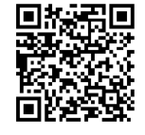
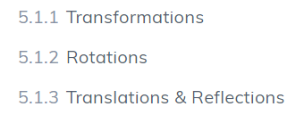
Year 9 Mathematics Homework
Half Term 4, Week 2
Recap Task –Review Compound Interest
Recap how to increase and decrease an amount by a repeated percentage change ready for a mini test in class.
Main Task –Transformations
This week's homework task is assigned on SENECA, please log in and complete all relevant sections, ensuring you watch the videos where necessary to improve your understanding.
Key words – Translation, Rotation, Enlargement, Reflection, Invariant, Object, Image
Extension Task – Investigate the order a series of transformations are performed in. Does the order matter? Will you always get the same end result if you change the order?
What have been your strengths in maths this week?
What have been the areas that have challenged you in maths this week?
How could you improve next week?
Building good people who take PRIDE in their time at school, RESPECT themselves and others, WORK TOGETHER as a community, showing RESILIENCE and EMPATHY for all.

Slide 37
Year 9 Music - Musical Theatre
Homework - Half Term 4 Week 2
What was the first Musical Theatre show to bring all the main elements of a modern musical theatre production together? Name some important early 20th century musical theatre composers and name some of the shows they wrote.
This week’s listening – Title: There’s No Business Like Show Business
(from Annie Get Your Gun)
Composer: Irving Berlin
Genre: Musical Theatre
www.youtube.com/watch?v=4lakGIwI9u0
Spend time listening to the above piece of music.
Complete the page in your listening booklet –
1.Give some background information of the piece and artist/composer
2.Comment on the instrumentation and how the musical elements are used in as much detail as you can.
3.Give your personal response to the music – remember to explain why you liked or did not like the piece of music.
Key words – Tempo, Dynamics, Duration, Pitch, Silence, Articulation, Melody, Texture, Timbre
Extension Task – Listen to and comment on further pieces of music by the same artist/composer.
What have been your strengths in Music this week?
What have been the areas that have challenged you in Music this week?
How could you improve next week?
Building good people who take PRIDE in their time at school, RESPECT themselves and others, WORK TOGETHER as a community, showing RESILIENCE and EMPATHY for all.

Slide 38

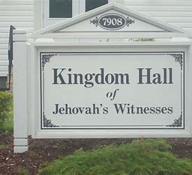
Year 9 RE Homework – Half Term 4, Week 2
List as many facts as you can remember about either Orthodox Christianity or Catholicism.
Try to find a newspaper article on the Internet about Jehovah's Witnesses. Write a summary of your article. Does it portray them in a positive or negative light? Do you think that is fair? Explain your answer.
Key words – paradise, Jehovah (God), Armageddon, blood transfusions, doctrine, The Watchtower Society, The Governing Body
Extension Task – Create flashcards of the key words above and their definitions. Relate them back to why they are significant for Jehovah's Witnesses.
What have been your strengths in RE this week?
What have been the areas that have challenged you in Types of Christianity this week?
How could you improve next week?
Building good people who take PRIDE in their time at school, RESPECT themselves and others, WORK TOGETHER as a community, showing RESILIENCE and EMPATHY for all.

Slide 39
Year 9 Science Homework – Half Term 4, Week 2
Available: 28th February 2024
Due: 6th March 2024
C2: Structure and Bonding
P3: Particle Model
B1: Cells
Note: If you have any issues with homework, you must contact Mr Chan – If you do not notify Mr Chan before the lesson on the due date
an automatic detention is issued.
Three Assignments:
Sci (Bio)
Sci (Chem)
Sci (Phys)
Main Task:
AND: Complete at least 10 marks of questions inside your exam question mastery booklets.
Leave on the table in lesson, let me know and I’ll mark the questions.
All questions completed should be stamped/ marked by your teacher on or before the due date.
Booklet (E.G: C3) | Question / Marks
What have been your strengths in (insert subject) this week?
What have been the areas that have challenged you in (insert topic) this week?
How could you improve next week?
Building good people who take PRIDE in their time at school, RESPECT themselves and others, WORK TOGETHER as a community, showing RESILIENCE and EMPATHY for all.

Slide 40

Year 9 Young Enterprise, Homework – Half Term 4, Week 2
Recap
Why is growth important in the business world? (3 marks)
Main Task
Q1 What does the word strategy mean? (1 mark)
Q2 Why is having a strategy important in enterprise? Give 5 reasons. (5 marks)
Q3 For a business of your choice (use a different one to the one used in last week’s homework) outline your strategy for this company to succeed. Explain each point you make. Be clear and rational.(10 marks)
Key words: Strategy
Extension Task — What problems could occur that c ould stop you achieving success with your strategy? Make at least 3 points and explain these. (6 marks)
What have been your strengths this week?
What have been the areas that have challenged you this week?
How could you improve next week?
Building good people who take PRIDE in their time at school, RESPECT themselves and others, WORK TOGETHER as a community, showing RESILIENCE and EMPATHY for all.

Slide 41
Week 3 Homework

Slide 42
Week 3 Homework Due Dates
Subject | Day Due | Date Due
Academic PE
Art
English
Geography
History
Languages
Maths
Music
RE
Science
Young Enterprise
Building good people who take PRIDE in their time at school, RESPECT themselves and others, WORK TOGETHER as a community, showing RESILIENCE and EMPATHY for all.

Slide 43
Year 9 Art Homework Term 1,
Week 1 - 6
REVISION – PRACTICE YOUR SHADING BEFORE STARTING EACH TASK
MAIN TASK:
Select a theme for your observational drawing flip book sketchbook.
Each week draw two items linked to your theme, one per page, try to consider the proportions of the overall objects on each of the pages.
Week 1 Pick a theme and design a front cover for your book and do two drawings ( pages)
Week 2 - 2 x drawings of theme
Week 3 2 x drawings of theme
Week 4 2 x drawings of theme
Week 5 2 x drawings of theme
Week 6 2 x drawings of theme
Key words – Tone, value, shading, shape, form, depth
Extension Task –Spend an extra 10 mins on the tasks above each week.
What have been your strengths in (insert subject) this week?
What have been the areas that have challenged you in (insert topic) this week?
How could you improve next week?
Building good people who take PRIDE in their time at school, RESPECT themselves and others, WORK TOGETHER as a community, showing RESILIENCE and EMPATHY for all.

Slide 44
Year 9 English Homework
Half Term 4, Week 3
Recap: Define the following: ………………………………………………………………………………………………………………………………………………………………………………………………………………………………………………………………………………………………………………………………………………………………………………………………………………………………………………………………………………………………………………………………………………………………………..
Read Text C and answer the questions based on IGCSE Language Paper 1, Question 1.
Key words – identify, explain, give
Extension Task – Are you reading for pleasure? Aim for four times per week for at least 20 minutes each time.
What have been your strengths in (insert subject) this week?
What have been the areas that have challenged you in (insert topic) this week?
How could you improve next week?
Building good people who take PRIDE in their time at school, RESPECT themselves and others, WORK TOGETHER as a community, showing RESILIENCE and EMPATHY for all.

Slide 45

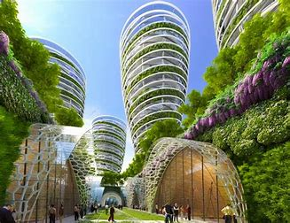

Year 9 Geography Homework – Half Term 4, Week 3
Identify three positive and three negative impacts of the 2016 Olympic Games on Rio de Janeiro.
Choose a photograph of a city. It could be one that you are familiar with.
a) Annotate the photograph to show how it can be sustainable.
b) Suggest what else could be done to make this city more sustainable.
Key words – eco-city, sustainable, renewable energy, recycling, green space, economic, environmental, social
Extension Task – Which city in the World is the most sustainable? What can other cities learn from it?
What have been your strengths in Geography this week?
What have been the areas that have challenged you in Geography this week?
How could you improve next week?
Building good people who take PRIDE in their time at school, RESPECT themselves and others, WORK TOGETHER as a community, showing RESILIENCE and EMPATHY for all.

Slide 46
Year 9 History Homework – Half Term 4, Week 3
1. Why was the USA worried by Cuba?
2. Who was president of the USA during the Cuban Missile Crisis?
3. Why was 'U2' important?
4. Why was the Cuban Missile Crisis important?
5. What was a consequence of the Cuban Missile Crisis?
Storyboard:
Look at your classwork and use other resources to research what happened in the Cuban Missile Crisis.
Pick 8-10 key facts.
Take the key facts and turn them into a storyboard (template available if required) to show what you have learnt.
Make sure it has pictures and description.
Key words – tension, blockade, Cuba, USA, crisis
Extension Task – Can you write a pneumonic to help you remember the Cuban Missile Crisis?
What have been your strengths in History this week?
What have been the areas that have challenged you in History this week?
How could you improve next week?
Building good people who take PRIDE in their time at school, RESPECT themselves and others, WORK TOGETHER as a community, showing RESILIENCE and EMPATHY for all.

Slide 47
Year 9 Languages Homework
Half Term 4
Vocabulary and Translation Practise
For this homework, you will need a copy of the Sentence Builder.
Task 1 | Test yourself on the items in the sentence builder using the Look-Say-Cover-Write-Check method.
Task 2 | Ask a friend or a relative to test you on individual items from the sentence builder.
Task 3 | Ask a friend or a relative to test you on full sentences from the sentence builder.
Task 4 | Practise this week's topic on Linguascope. (See Mr Downey for the login details).
Task 5 | Find a new song in your preferred language on Lyrics Training. Can you challenge yourself to the higher levels?
What have been your strengths in Languages this week?
What have been the areas that have challenged you in Languages this week?
How could you improve next week?
Building good people who take PRIDE in their time at school, RESPECT themselves and others, WORK TOGETHER as a community, showing RESILIENCE and EMPATHY for all.

Slide 48
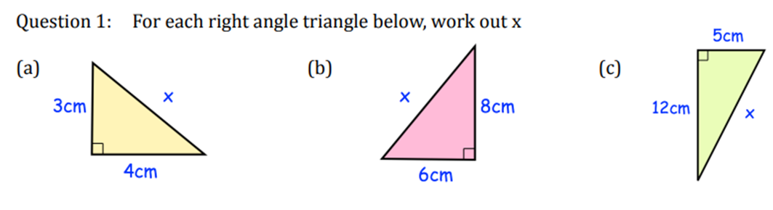
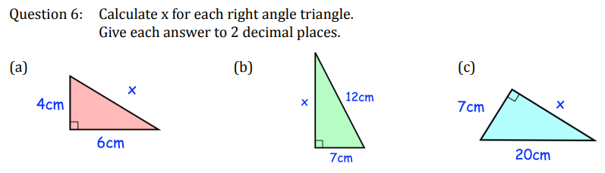
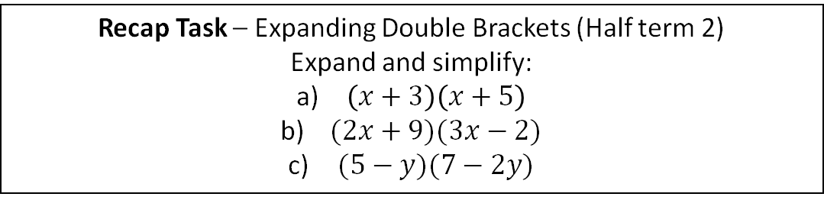
Year 9 Mathematics Homework
Half Term 4, Week 3
Recap Task – Expanding Double Brackets (Half term 2)
Expand and simplify:
$\left(x+3\right)\left(x+5\right)$
$(2x+9)(3x−2)$
$(5−y)(7−2y)$
Main Task – Pythagoras’ Theorem
2
Key words – Triangle, Hypotenuse, Square, Right Angled
Extension Task – A football pitch has a length of 100m and a width of 70m. The diagonal length is 125m. Justify whether the pitch is a rectangle or not.
What have been your strengths in maths this week?
What have been the areas that have challenged you in maths this week?
How could you improve next week?
Building good people who take PRIDE in their time at school, RESPECT themselves and others, WORK TOGETHER as a community, showing RESILIENCE and EMPATHY for all.

Slide 49
Year 9 Music - Musical Theatre
Homework - Half Term 4 Week 3
Name the most common sound types found in Musical Theatre productions. Give a brief definition of each song type.
This week’s listening – Title: Rhythm Of Life (from Sweet Charity)
Composer: Cy Coleman & Dorothy Fields
Genre: Musical Theatre
www.youtube.com/watch?v=xKSA049xkiU
Spend time listening to the above piece of music.
Complete the page in your listening booklet –
1.Give some background information of the piece and artist/composer
2.Comment on the instrumentation and how the musical elements are used in as much detail as you can.
3.Give your personal response to the music – remember to explain why you liked or did not like the piece of music.
Key words – Tempo, Dynamics, Duration, Pitch, Silence, Articulation, Melody, Texture, Timbre
Extension Task – Listen to and comment on further pieces of music by the same artist/composer.
What have been your strengths in Music this week?
What have been the areas that have challenged you in Music this week?
How could you improve next week?
Building good people who take PRIDE in their time at school, RESPECT themselves and others, WORK TOGETHER as a community, showing RESILIENCE and EMPATHY for all.

Slide 50

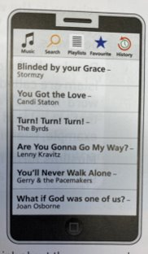
Year 9 RE Homework – Half Term 4, Week 3
Write three questions (with answers) about Jehovah's Witnesses
Find the lyrics to one of the songs.
Which Christian beliefs do the lyrics
contain?
Write your own song lyrics containing
Christian beliefs
Key words – Grace, God, Love, lyric
Extension Task – Can you add metaphors to your song.
What have been your strengths in RE this week?
What have been the areas that have challenged you in Types of Christianity this week?
How could you improve next week?
Building good people who take PRIDE in their time at school, RESPECT themselves and others, WORK TOGETHER as a community, showing RESILIENCE and EMPATHY for all.

Slide 51
Year 9 Science Homework – Half Term 4, Week 3
Available: 6th March 2024
Due: 13th March 2024
C2: Structure and Bonding
P3: Particle Model
B1: Cells
Note: If you have any issues with homework, you must contact Mr Chan – If you do not notify Mr Chan before the lesson on the due date
an automatic detention is issued.
Three Assignments:
Sci (Bio)
Sci (Chem)
Sci (Phys)
Main Task:
AND: Complete at least 10 marks of questions inside your exam question mastery booklets.
Leave on the table in lesson, let me know and I’ll mark the questions.
All questions completed should be stamped/ marked by your teacher on or before the due date.
Booklet (E.G: C3) | Question / Marks
What have been your strengths in (insert subject) this week?
What have been the areas that have challenged you in (insert topic) this week?
How could you improve next week?
Building good people who take PRIDE in their time at school, RESPECT themselves and others, WORK TOGETHER as a community, showing RESILIENCE and EMPATHY for all.

Slide 52
Year 9 Young Enterprise, Homework – Half Term 4, Week 3
Define the following term:
Strategic Planning
Main Task
You have been put in charge of a company that designs games. You need to come up with an idea for a game which will satisfy the demand for business strategy games.
Devise an idea for a business strategy game and explain how it would could be played.
Be enterprising and creative!
(12 marks)
Key words: Strategic Thinking
Extension Task — Do you think your game would be popular or not. Explain why.
What have been your strengths this week?
What have been the areas that have challenged you this week?
How could you improve next week?
Building good people who take PRIDE in their time at school, RESPECT themselves and others, WORK TOGETHER as a community, showing RESILIENCE and EMPATHY for all.

Slide 53
Week 4 Homework

Slide 54
Week 4 Homework Due Dates
Subject | Day Due | Date Due
Academic PE
Art
English
Geography
History
Languages
Maths
Music
RE
Science
Young Enterprise
Building good people who take PRIDE in their time at school, RESPECT themselves and others, WORK TOGETHER as a community, showing RESILIENCE and EMPATHY for all.

Slide 55
Year 9 Art Homework Term 1,
Week 1 - 6
REVISION – PRACTICE YOUR SHADING BEFORE STARTING EACH TASK
MAIN TASK:
Select a theme for your observational drawing flip book sketchbook.
Each week draw two items linked to your theme, one per page, try to consider the proportions of the overall objects on each of the pages.
Week 1 Pick a theme and design a front cover for your book and do two drawings ( pages)
Week 2 - 2 x drawings of theme
Week 3 2 x drawings of theme
Week 4 2 x drawings of theme
Week 5 2 x drawings of theme
Week 6 2 x drawings of theme
Key words – Tone, value, shading, shape, form, depth
Extension Task –Spend an extra 10 mins on the tasks above each week.
What have been your strengths in (insert subject) this week?
What have been the areas that have challenged you in (insert topic) this week?
How could you improve next week?
Building good people who take PRIDE in their time at school, RESPECT themselves and others, WORK TOGETHER as a community, showing RESILIENCE and EMPATHY for all.

Slide 56
Year 9 English Homework
Half Term 4, Week 4
Recap: Check homework booklet for key words to define ………………………………………………………………………………………………………………………………………………………………………………………………………………………………………………………………………………………………………………………………………………………………………………………………………………………………………………………………………………………………………………………………………………………………………..
Read Text D and answer the questions based on IGCSE Language Paper 1, Question 1.
Key words – explain, give, identify
Extension Task – Are you reading for pleasure? Aim for four times per week for at least 20 minutes each time.
What have been your strengths in (insert subject) this week?
What have been the areas that have challenged you in (insert topic) this week?
How could you improve next week?
Building good people who take PRIDE in their time at school, RESPECT themselves and others, WORK TOGETHER as a community, showing RESILIENCE and EMPATHY for all.

Slide 57
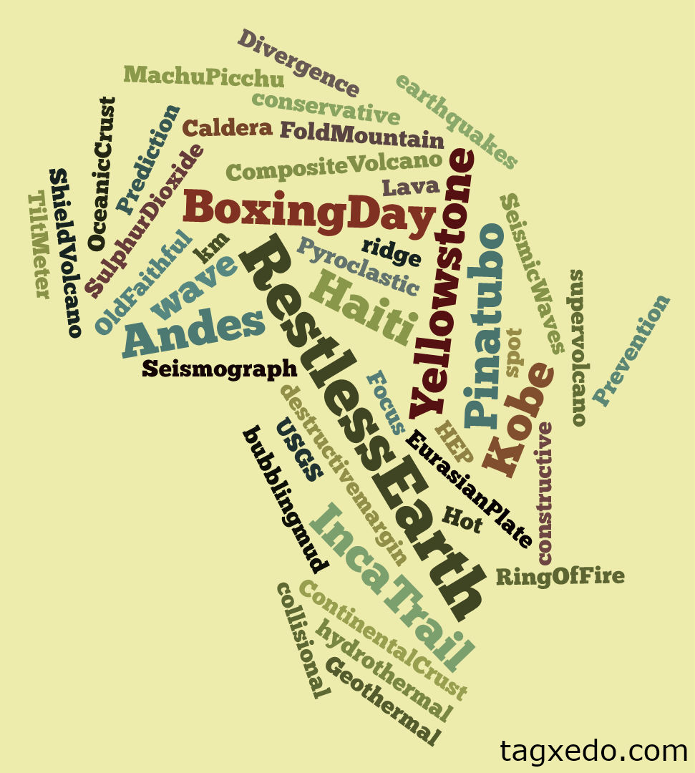
Year 9 Geography Homework – Half Term 4, Week 4
What is sustainability? Describe at least TWO ways that cities can become more sustainable.
Create a Wordle or Tagxedo resource (example above) for the key vocabulary we have used so far in this unit – print it and bring it to class or e-mail it to me on ruth.varley@saintjamesschool.co.uk
Key words – migration, push factors, pull factors, favelas, sustainability
Extension Task – Create a set of flashcards for the key words identified and their definitions.
What have been your strengths in Geography this week?
What have been the areas that have challenged you in Brazil this week?
How could you improve next week?
Building good people who take PRIDE in their time at school, RESPECT themselves and others, WORK TOGETHER as a community, showing RESILIENCE and EMPATHY for all.

Slide 58
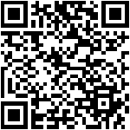
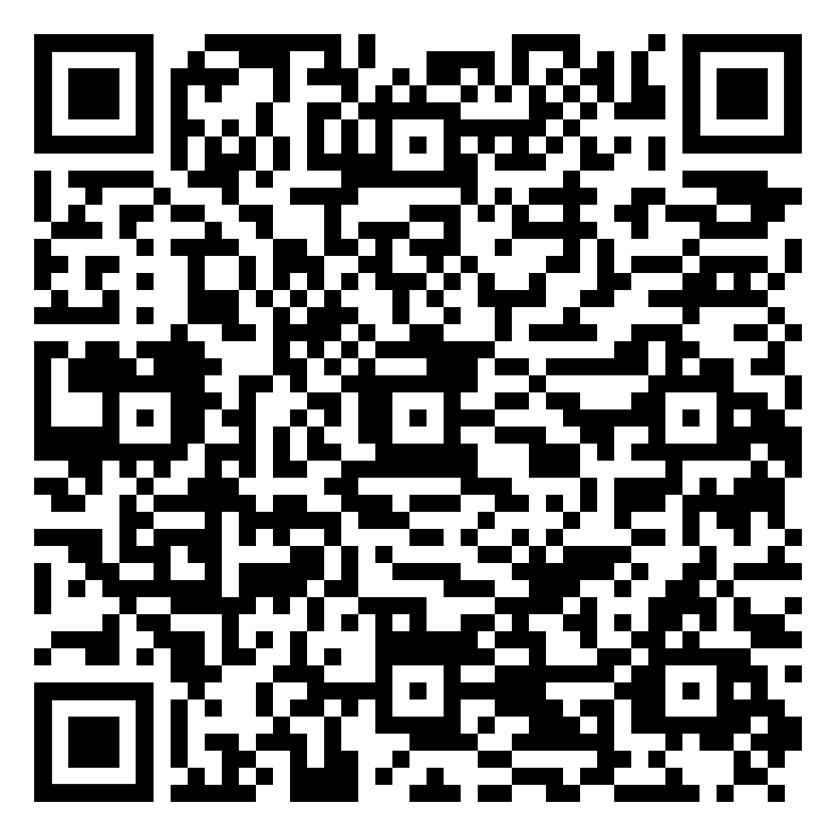
Year 9 History Homework – Half Term 4, Week 4
1. How many zones was Germany split into?
2. What were Britain and USA's aims for Germany?
3. What was the USSR's aims for Germany?
4. What was Britain, France and the USA's side of Germany called?
5. What was the USSR's side of Germany called?
YouTube:
Go onto YouTube and find 2 videos about the Vietnam War.
For each video write down the below:
  The URL/link for the video.
  A 3-sentence summary of what the video summarised.
  An explanation about why you chose that video.
  A review of the video – how well do you think it covers the topic and why?
  Compare the videos.
Key words – Vietcong, Vietnam, war, America, Communism
Extension Task – Seneca:
Join class - Seneca task -
What have been your strengths in History this week?
What have been the areas that have challenged you in History this week?
How could you improve next week?
Building good people who take PRIDE in their time at school, RESPECT themselves and others, WORK TOGETHER as a community, showing RESILIENCE and EMPATHY for all.

Slide 59
Year 9 Languages Homework
Half Term 4
Vocabulary and Translation Practise
For this homework, you will need a copy of the Sentence Builder.
Task 1 | Test yourself on the items in the sentence builder using the Look-Say-Cover-Write-Check method.
Task 2 | Ask a friend or a relative to test you on individual items from the sentence builder.
Task 3 | Ask a friend or a relative to test you on full sentences from the sentence builder.
Task 4 | Practise this week's topic on Linguascope. (See Mr Downey for the login details).
Task 5 | Find a new song in your preferred language on Lyrics Training. Can you challenge yourself to the higher levels?
What have been your strengths in Languages this week?
What have been the areas that have challenged you in Languages this week?
How could you improve next week?
Building good people who take PRIDE in their time at school, RESPECT themselves and others, WORK TOGETHER as a community, showing RESILIENCE and EMPATHY for all.

Slide 60
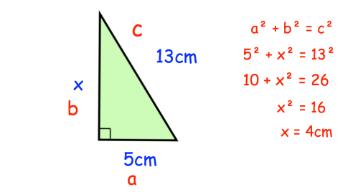
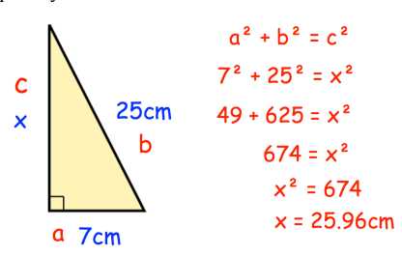
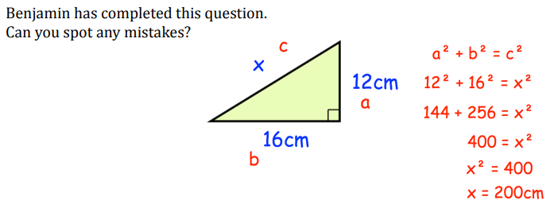
Year 9 Mathematics Homework
Half Term 4, Week 4
Recap Task – Review the work from last half term fractions (add, subtract, multiply and divide)
Main Task – Pythagoras’ Theorem – Find and Correct the mistakes
Key words – Right angled, Hypotenuse, Sum, Square, Subtract, Square Root
Extension Task – Stanley has drawn a right angled triangle. One side is 14cm, another is 18cm. What are the two possible lengths of the 3rd side?
What have been your strengths in maths this week?
What have been the areas that have challenged you in maths this week?
How could you improve next week?
Building good people who take PRIDE in their time at school, RESPECT themselves and others, WORK TOGETHER as a community, showing RESILIENCE and EMPATHY for all.

Slide 61
Year 9 Music - Musical Theatre
Homework - Half Term 4 Week 4
Name some musicals that started as film musicals before being transferred to the stage. Name some musicals that started as stage musicals before being turned into film musicals.
This week’s listening – Title: Louder Than Words (from Tick Tick Boom)
Composer: Jonathan Larson
Genre: Musical Theatre
www.youtube.com/watch?v=su6urM6Li5k&t=49s
Spend time listening to the above piece of music.
Complete the page in your listening booklet –
1.Give some background information of the piece and artist/composer
2.Comment on the instrumentation and how the musical elements are used in as much detail as you can.
3.Give your personal response to the music – remember to explain why you liked or did not like the piece of music.
Key words – Tempo, Dynamics, Duration, Pitch, Silence, Articulation, Melody, Texture, Timbre
Extension Task – Listen to and comment on further pieces of music by the same artist/composer.
What have been your strengths in Music this week?
What have been the areas that have challenged you in Music this week?
How could you improve next week?
Building good people who take PRIDE in their time at school, RESPECT themselves and others, WORK TOGETHER as a community, showing RESILIENCE and EMPATHY for all.

Slide 62

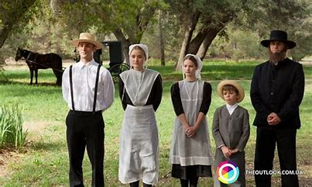
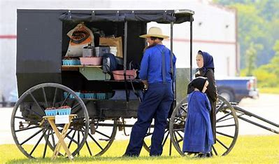
Year 9 RE Homework – Half Term 4, Week 4
Draw pictures to represent at least three key words you have learnt so far this topic.
The Amish reject modern conveniences so that they have to work together in order to survive and flourish.
Do you think the Amish community is stronger than most communities who use modern conveniences as a standard part of their daily lives?
Explain your answer.
Key words – community, Ordnung, sect, immorality, Worldliness, Old Order Amish Mennonite Church
Extension Task – Compare the Amish community to another community, explaining similarities and differences.
What have been your strengths in RE this week?
What have been the areas that have challenged you in Types of Christianity this week?
How could you improve next week?
Building good people who take PRIDE in their time at school, RESPECT themselves and others, WORK TOGETHER as a community, showing RESILIENCE and EMPATHY for all.

Slide 63
Year 9 Science Homework – Half Term 4, Week 4
Available: 13th March 2024
Due: 20th March 2024
C2: Structure and Bonding
P3: Particle Model
B1: Cells
Note: If you have any issues with homework, you must contact Mr Chan – If you do not notify Mr Chan before the lesson on the due date
an automatic detention is issued.
Three Assignments:
Sci (Bio)
Sci (Chem)
Sci (Phys)
Main Task:
AND: Complete at least 10 marks of questions inside your exam question mastery booklets.
Leave on the table in lesson, let me know and I’ll mark the questions.
All questions completed should be stamped/ marked by your teacher on or before the due date.
Booklet (E.G: C3) | Question / Marks
What have been your strengths in (insert subject) this week?
What have been the areas that have challenged you in (insert topic) this week?
How could you improve next week?
Building good people who take PRIDE in their time at school, RESPECT themselves and others, WORK TOGETHER as a community, showing RESILIENCE and EMPATHY for all.

Slide 64
Year 9 Young Enterprise, Homework – Half Term 4, Week 4
Define the following terms:
Strategic Thinking
Main Task
For your business strategy game (from last week) design an advertising campaign that would help sell your product.
Be strategic! Explain why you would do what you would do. Draw your adverts and consider costs for your campaign.
(10 marks)
Key words: Innovation, Design
Extension Task — Give examples of successful advertising campaigns in business. At least 3. What made them a success? (6 marks)
What have been your strengths this week?
What have been the areas that have challenged you this week?
How could you improve next week?
Building good people who take PRIDE in their time at school, RESPECT themselves and others, WORK TOGETHER as a community, showing RESILIENCE and EMPATHY for all.

Slide 65
Week 5 Homework

Slide 66
Week 5 Homework Due Dates
Subject | Day Due | Date Due
Academic PE
Art
English
Geography
History
Languages
Maths
Music
RE
Science
Young Enterprise
Building good people who take PRIDE in their time at school, RESPECT themselves and others, WORK TOGETHER as a community, showing RESILIENCE and EMPATHY for all.

Slide 67
Year 9 Art Homework Term 1,
Week 1 - 6
REVISION – PRACTICE YOUR SHADING BEFORE STARTING EACH TASK
MAIN TASK:
Select a theme for your observational drawing flip book sketchbook.
Each week draw two items linked to your theme, one per page, try to consider the proportions of the overall objects on each of the pages.
Week 1 Pick a theme and design a front cover for your book and do two drawings ( pages)
Week 2 - 2 x drawings of theme
Week 3 2 x drawings of theme
Week 4 2 x drawings of theme
Week 5 2 x drawings of theme
Week 6 2 x drawings of theme
Key words – Tone, value, shading, shape, form, depth
Extension Task –Spend an extra 10 mins on the tasks above each week.
What have been your strengths in (insert subject) this week?
What have been the areas that have challenged you in (insert topic) this week?
How could you improve next week?
Building good people who take PRIDE in their time at school, RESPECT themselves and others, WORK TOGETHER as a community, showing RESILIENCE and EMPATHY for all.

Slide 68
Year 9 English Homework
Half Term 4, Week 5
Recap: Check your homework booklet for key words to define ………………………………………………………………………………………………………………………………………………………………………………………………………………………………………………………………………………………………………………………………………………………………………………………………………………………………………………………………………………………………………………………………………………………………………..
Read Text E and answer the questions based on IGCSE Language Paper 1, Question 1.
Key words – explain, identify, give
Extension Task – Are you reading for pleasure? Aim for four times per week for at least 20 minutes each time.
What have been your strengths in (insert subject) this week?
What have been the areas that have challenged you in (insert topic) this week?
How could you improve next week?
Building good people who take PRIDE in their time at school, RESPECT themselves and others, WORK TOGETHER as a community, showing RESILIENCE and EMPATHY for all.

Slide 69

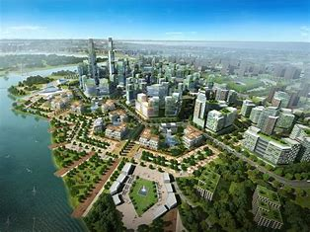
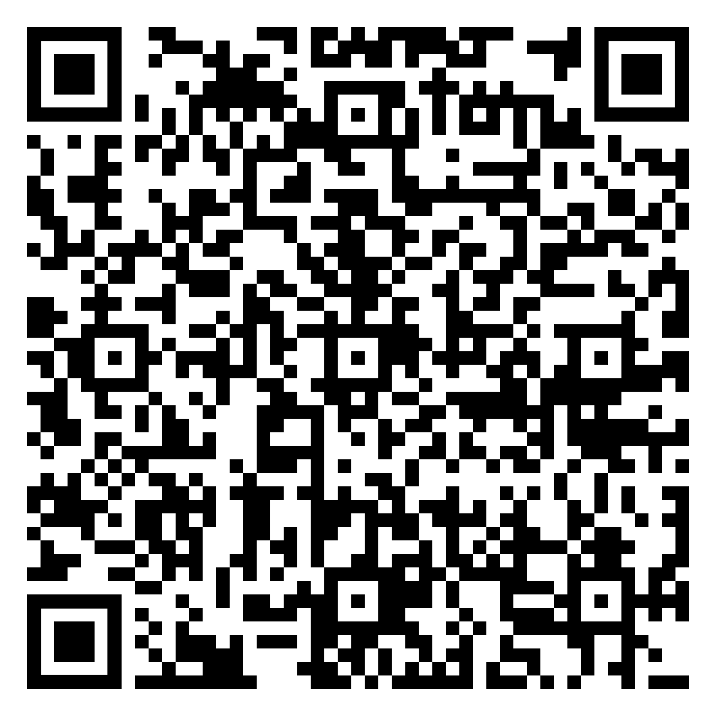
Year 9 Geography Homework – Half Term 4, Week 5
Write a paragraph about how Rio de Janeiro is sustainable.
Look at the Eco Cities Week 5 document and read through the information about Tianjin.
Tianjin eco-city claims to be 'resource-conserving'.
a) suggest what that means.
b) suggest two more features that the Chinese government should include to make Tianjin eco-city sustainable.
c) Imagine you are trying to sell a house in Tianjin eco-city. Write an advert to encourage people to live in the city.
Online document - Eco Cities Week 5.pdf
Key words – eco-city, sustainable, renewable energy, recycling, green space, economic, environmental, social
Extension Task – Which of the two cities, Tianjin or Copenhagen, do you think is most sustainable? Justify your answer. Use Eco Cities Week 5 document to help you.
What have been your strengths in Geography this week?
What have been the areas that have challenged you in Geography this week?
How could you improve next week?
Building good people who take PRIDE in their time at school, RESPECT themselves and others, WORK TOGETHER as a community, showing RESILIENCE and EMPATHY for all.

Slide 70
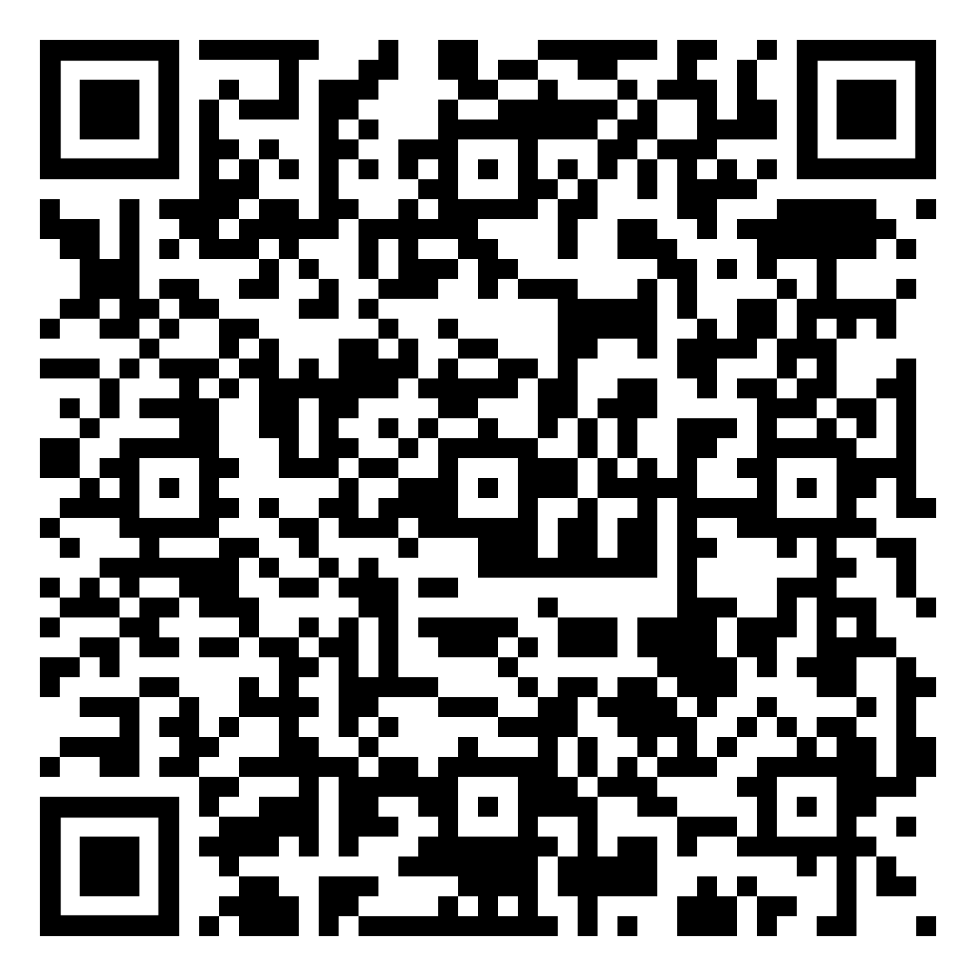
Year 9 History Homework – Half Term 4, Week 5
1. What countries are in Indochina?
2. Who were the Vietcong?
3. Give a reason why the USA became involved in the Vietnam war.
4. What was Operation Rolling Thunder?
5. How did the tunnel system work?
Mind Map:
Next, we will look at the tactics in the Vietnam War and Cold War, research this and complete the tasks below (link to a good website - https://www.bbc.co.uk/bitesize/guides/z89hg82/revision/4)
Take the key events and put them onto a Mind Map (examples/templates available).
Make sure the events have a title and a brief description.
Make sure it has arrows LINKING events – does one cause another? Do they have things in common? Have you described why they link together?
Make sure it has either colour coding (one colour per area) or pictures/symbols.
Key words – Vietcong, Vietnam, war, America, Communism
Extension Task – Seneca:
Join class - Seneca task -
What have been your strengths in History this week?
What have been the areas that have challenged you in History this week?
How could you improve next week?
Building good people who take PRIDE in their time at school, RESPECT themselves and others, WORK TOGETHER as a community, showing RESILIENCE and EMPATHY for all.

Slide 71
Year 9 Languages Homework
Half Term 4
Vocabulary and Translation Practise
For this homework, you will need a copy of the Sentence Builder.
Task 1 | Test yourself on the items in the sentence builder using the Look-Say-Cover-Write-Check method.
Task 2 | Ask a friend or a relative to test you on individual items from the sentence builder.
Task 3 | Ask a friend or a relative to test you on full sentences from the sentence builder.
Task 4 | Practise this week's topic on Linguascope. (See Mr Downey for the login details).
Task 5 | Find a new song in your preferred language on Lyrics Training. Can you challenge yourself to the higher levels?
What have been your strengths in Languages this week?
What have been the areas that have challenged you in Languages this week?
How could you improve next week?
Building good people who take PRIDE in their time at school, RESPECT themselves and others, WORK TOGETHER as a community, showing RESILIENCE and EMPATHY for all.

Slide 72
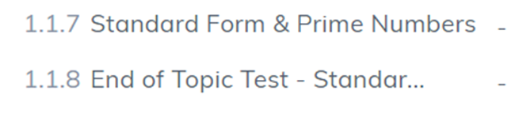

Year 9 Mathematics Homework
Half Term 4, Week 5
Recap Task – Standard Form
Review task on SENECA to review STANDARD FORM from last half term.
Watch the videos to improve understanding first
Main Task –
This week's homework task is assigned on SENECA, please log in and complete all relevant sections, ensuring you watch the videos where necessary to improve your understanding. Show any working clearly in your homework book. Please re try the task if you feel you could improve your score further.
Key words – Pythagoras, Hypotenuse, Pythagorean Triple, Square, Square Root, Right Angled
Extension Task – an equilateral triangle has side lengths of 10cm, what is the area of the triangle?
What have been your strengths in maths this week?
What have been the areas that have challenged you in maths this week?
How could you improve next week?
Building good people who take PRIDE in their time at school, RESPECT themselves and others, WORK TOGETHER as a community, showing RESILIENCE and EMPATHY for all.

Slide 73
Year 9 Music - Musical Theatre
Homework - Half Term 4 Week 5
What is a jukebox musical? What is the difference between a biographical jukebox musical and a non-biographical jukebox musical? Name some famous jukebox musicals.
This week’s listening – Title: The Winner Takes It All (from Mamma Mia)
Composer: Benny Andersson & Björn Ulvaus (Abba)
Genre: Musical Theatre (Jukebox)
www.youtube.com/watch?v=fLdToY4zw-Y
Spend time listening to the above piece of music.
Complete the page in your listening booklet –
1.Give some background information of the piece and artist/composer
2.Comment on the instrumentation and how the musical elements are used in as much detail as you can.
3.Give your personal response to the music – remember to explain why you liked or did not like the piece of music.
Key words – Tempo, Dynamics, Duration, Pitch, Silence, Articulation, Melody, Texture, Timbre
Extension Task – Listen to and comment on further pieces of music by the same artist/composer.
What have been your strengths in Music this week?
What have been the areas that have challenged you in Music this week?
How could you improve next week?
Building good people who take PRIDE in their time at school, RESPECT themselves and others, WORK TOGETHER as a community, showing RESILIENCE and EMPATHY for all.

Slide 74

Year 9 RE Homework – Half Term 4, Week 5
List as many key terms as you can remember from this topic, Types of Christianity.
Create a brain dump (mind map) of everything that you can remember from this topic, Types of Christianity. Include as many key words and links as you can.
Key words – Denomination, Great Schism, Nicene Creed, patriarch, excommunication, Eucharist, icons, incense, paradise, Jehovah (God), Armageddon, blood transfusions, doctrine, The Watchtower Society, The Governing Body, community, Ordnung, sect, immorality, Worldliness, Old Order Amish Mennonite Church
Extension Task – Include definitions of any key words you include in your brain dump
What have been your strengths in RE this week?
What have been the areas that have challenged you in Types of Christianity this week?
How could you improve next week?
Building good people who take PRIDE in their time at school, RESPECT themselves and others, WORK TOGETHER as a community, showing RESILIENCE and EMPATHY for all.

Slide 75
Year 9 Science Homework – Half Term 4, Week 5
Available: 20th March 2024
Due:27th March 2024
C2: Structure and Bonding
P3: Particle Model
B1: Cells
Note: If you have any issues with homework, you must contact Mr Chan – If you do not notify Mr Chan before the lesson on the due date
an automatic detention is issued.
Three Assignments:
Sci (Bio)
Sci (Chem)
Sci (Phys)
Main Task:
AND: Complete at least 10 marks of questions inside your exam question mastery booklets.
Leave on the table in lesson, let me know and I’ll mark the questions.
All questions completed should be stamped/ marked by your teacher on or before the due date.
Booklet (E.G: C3) | Question / Marks
What have been your strengths in (insert subject) this week?
What have been the areas that have challenged you in (insert topic) this week?
How could you improve next week?
Building good people who take PRIDE in their time at school, RESPECT themselves and others, WORK TOGETHER as a community, showing RESILIENCE and EMPATHY for all.

Slide 76
Year 9 Young Enterprise, Homework – Half Term 4, Week 5
Recap - Define the following term:
Business Innovation
Main Task
OH NO! Just as you've completed your advertising campaign (for your business strategy game) your advertising budget has to be cut in half. What parts of your advertising campaign would you keep and what would you get rid of due to lack of funds. Explain. (10 marks)
Key words: Adapting to Change
Extension Task — How could money possibly be raised in future for the business?
What have been your strengths this week?
What have been the areas that have challenged you this week?
How could you improve next week?
Building good people who take PRIDE in their time at school, RESPECT themselves and others, WORK TOGETHER as a community, showing RESILIENCE and EMPATHY for all.

Slide 77
Week 6 Homework

Slide 78
Week 6 Homework Due Dates
Subject | Day Due | Date Due
Academic PE
Art
English
Geography
History
Languages
Maths
Music
RE
Science
Young Enterprise
Building good people who take PRIDE in their time at school, RESPECT themselves and others, WORK TOGETHER as a community, showing RESILIENCE and EMPATHY for all.

Slide 79
Year 9 Art Homework Term 1,
Week 1 - 6
REVISION – PRACTICE YOUR SHADING BEFORE STARTING EACH TASK
MAIN TASK:
Select a theme for your observational drawing flip book sketchbook.
Each week draw two items linked to your theme, one per page, try to consider the proportions of the overall objects on each of the pages.
Week 1 Pick a theme and design a front cover for your book and do two drawings ( pages)
Week 2 - 2 x drawings of theme
Week 3 2 x drawings of theme
Week 4 2 x drawings of theme
Week 5 2 x drawings of theme
Week 6 2 x drawings of theme
Key words – Tone, value, shading, shape, form, depth
Extension Task –Spend an extra 10 mins on the tasks above each week.
What have been your strengths in (insert subject) this week?
What have been the areas that have challenged you in (insert topic) this week?
How could you improve next week?
Building good people who take PRIDE in their time at school, RESPECT themselves and others, WORK TOGETHER as a community, showing RESILIENCE and EMPATHY for all.

Slide 80
Year 9 English Homework
Half Term 4, Week 6
Recap: Check your homework booklet for key words to define ………………………………………………………………………………………………………………………………………………………………………………………………………………………………………………………………………………………………………………………………………………………………………………………………………………………………………………………………………………………………………………………………………………………………………..
Read Text F and answer the questions based on IGCSE Language Paper 1, Question 1.
Key words – give, explain, identify
Extension Task – Are you reading for pleasure? Aim for four times per week for at least 20 minutes each time.
What have been your strengths in (insert subject) this week?
What have been the areas that have challenged you in (insert topic) this week?
How could you improve next week?
Building good people who take PRIDE in their time at school, RESPECT themselves and others, WORK TOGETHER as a community, showing RESILIENCE and EMPATHY for all.

Slide 81



Year 9 Geography Homework – Half Term 4, Week 6
List the features of a sustainable city.
Imagine you work for North East Lincolnshire Council in town planning. You have been given the job of creating a proposal for ways that North East Lincolnshire could become more sustainable. You need to think of at least three ideas, describe them and explain why you think that they would be a good idea to introduce.
Key words – sustainable, renewable energy, recycling, green space, economic, environmental, social
Extension Task – Try to find examples that other councils have introduced to make themselves more sustainable.
What have been your strengths in Geography this week?
What have been the areas that have challenged you in Geography this week?
How could you improve next week?
Building good people who take PRIDE in their time at school, RESPECT themselves and others, WORK TOGETHER as a community, showing RESILIENCE and EMPATHY for all.

Slide 82
Year 9 History Homework – Half Term 4, Week 6
1. What was Agent Orange?
2. What was the Ho Chi Minh Trail?
3. What was the Tet Offensive?
4. How many Vietcong were killed?
5. How many Americans were killed?
Flash Cards:
Go back through the work we have completed on the Cold War.
Pick 3-4 key bits from each week.
Take the bits and turn them into flash cards (examples available).
Each card should be around 10cm long and 5cm high.
Each card should have 1 of the key bits described on one side and on the other side it should have a word/clue/picture to summarise it.
Key words – Communism, Capitalism, conflict, ideology,
Extension Task – Seneca:
Join class - Seneca task -
What have been your strengths in History this week?
What have been the areas that have challenged you in History this week?
How could you improve next week?
Building good people who take PRIDE in their time at school, RESPECT themselves and others, WORK TOGETHER as a community, showing RESILIENCE and EMPATHY for all.

Slide 83
Year 9 Languages Homework
Half Term 4
Vocabulary and Translation Practise
For this homework, you will need a copy of the Sentence Builder.
Task 1 | Test yourself on the items in the sentence builder using the Look-Say-Cover-Write-Check method.
Task 2 | Ask a friend or a relative to test you on individual items from the sentence builder.
Task 3 | Ask a friend or a relative to test you on full sentences from the sentence builder.
Task 4 | Practise this week's topic on Linguascope. (See Mr Downey for the login details).
Task 5 | Find a new song in your preferred language on Lyrics Training. Can you challenge yourself to the higher levels?
What have been your strengths in Languages this week?
What have been the areas that have challenged you in Languages this week?
How could you improve next week?
Building good people who take PRIDE in their time at school, RESPECT themselves and others, WORK TOGETHER as a community, showing RESILIENCE and EMPATHY for all.

Slide 84
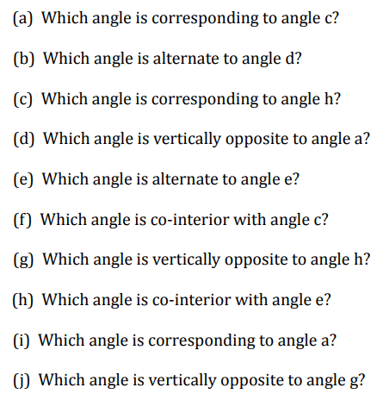
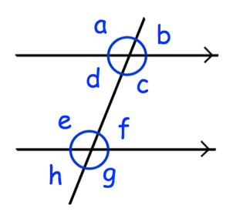
Year 9 Mathematics Homework
Half Term 4, Week 6
Recap Task – Angles
Main Task –
Create a single side of A4 summarising everything you have learnt about Pythagoras Theorem.
Include clearly worked examples.
Key words – Pythagoras, Hypotenuse, Pythagorean Triple, Square, Square Root, Right Angled
Extension Task – get a friend or relative to test your understanding of Pythagoras’ Theorem using your notes.
What have been your strengths in maths this week?
What have been the areas that have challenged you in maths this week?
How could you improve next week?
Building good people who take PRIDE in their time at school, RESPECT themselves and others, WORK TOGETHER as a community, showing RESILIENCE and EMPATHY for all.

Slide 85
Year 9 Music - Musical Theatre
Homework - Half Term 4 Week 6
What is a concept musical? Name some famous concept musicals.
This week’s listening – Title: Light At The End Of The Tunnel
(from Starlight Express)
Composer: Andrew Lloyd Webber & Richard Stilgoe
Genre: Musical Theatre (Concept)
www.youtube.com/watch?v=u-UoGYc906c&t=151s
Spend time listening to the above piece of music.
Complete the page in your listening booklet –
1.Give some background information of the piece and artist/composer
2.Comment on the instrumentation and how the musical elements are used in as much detail as you can.
3.Give your personal response to the music – remember to explain why you liked or did not like the piece of music.
Key words – Tempo, Dynamics, Duration, Pitch, Silence, Articulation, Melody, Texture, Timbre
Extension Task – Listen to and comment on further pieces of music by the same artist/composer.
What have been your strengths in Music this week?
What have been the areas that have challenged you in Music this week?
How could you improve next week?
Building good people who take PRIDE in their time at school, RESPECT themselves and others, WORK TOGETHER as a community, showing RESILIENCE and EMPATHY for all.

Slide 86

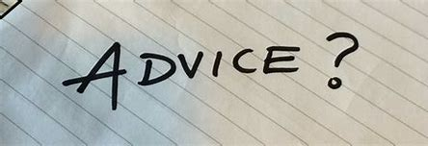
Year 9 RE Homework – Half Term 4, Week 6
List three beliefs/practices of Protestantism.
'We should consult the Bible today for important decisions.'
Write a paragraph supporting the statement above and a second paragraph disagreeing with the statement above.
Include a third paragraph, giving your opinion. Justify your argument.
Key words – Bible, liberal, fundamental
Extension Task – Where/ who do you think we should consult for important decisions?
What have been your strengths in RE this week?
What have been the areas that have challenged you in Types of Christianity this week?
How could you improve next week?
Building good people who take PRIDE in their time at school, RESPECT themselves and others, WORK TOGETHER as a community, showing RESILIENCE and EMPATHY for all.

Slide 87
Year 9 Science Homework – Half Term 4, Week 6
Main Task:
You should have the following within your folders:
Subject Dividers – Biology, Chemistry and Physics
Booklets:
Exam Mastery Booklets
Your task is to confirm and show me that all is present by the 18th of April
Biology | Chemistry | Physics
Cell Structure | C1 – Atoms and the Periodic Table | P1 – Energy
Cell Division |  | P3: Particle Model of Matter
Cell Transport
Principles of Organisation
Animal Tissues
Coronary Heart Disease
Biology | Chemistry | Physics
B1 – Cells | C1 – Atomic Structure and the Periodic Table | P1 – Energy
B2 - Organisation | C2 – Structure and Bonding | P3: Particle Model and Matter
What have been your strengths in (insert subject) this week?
What have been the areas that have challenged you in (insert topic) this week?
How could you improve next week?
Building good people who take PRIDE in their time at school, RESPECT themselves and others, WORK TOGETHER as a community, showing RESILIENCE and EMPATHY for all.

Slide 88
Year 9 Young Enterprise, Homework – Half Term 4, Week 6
Recap
How could a business try to adapt to changing economic conditions?
Main Task
Carry out a SWOT analysis (Strengths, Weaknesses, Opportunities, Threats) on yourself.
How has this term gone?
Use a full page and split it into quarters and complete a SWOT.
Key words: Reflection, SWOT, Review
Extension Task — What actions could you take to help bring around more success at school in future. At least five points.
What have been your strengths this week?
What have been the areas that have challenged you this week?
How could you improve next week?
Building good people who take PRIDE in their time at school, RESPECT themselves and others, WORK TOGETHER as a community, showing RESILIENCE and EMPATHY for all.

Slide 89
Building good people who take PRIDE in their time at school, RESPECT themselves and others, WORK TOGETHER as a community, showing RESILIENCE and EMPATHY for all.

