Slide 1

St. James' School Homework Booklet
Year 10
Lent Term HT4
Building good people who take PRIDE in their time at school, RESPECT themselves and others, WORK TOGETHER as a community, showing RESILIENCE and EMPATHY for all.

Slide 2

Name -
My Timetable at St. James’ School
Friday
Thursday
Wednesday
Tuesday
Monday
 | Tutorial (8.40-8.50) | Tutorial Lesson (8.50-9.20) | Lesson 1 (9.20-10.10) | Lesson 2 (10.10-11.00) | Lesson 3 (11.20-12.10) | Lesson 4 (12.10-13.00) | Extracurricular (13.40-14.10) | Lesson 5 (14.10-15.05) | Lesson 6 (15.05-16.00)
Building good people who take PRIDE in their time at school, RESPECT themselves and others, WORK TOGETHER as a community, showing RESILIENCE and EMPATHY for all.

Slide 3
Homework at St. James’ School
Independent study is an essential part of the learning. Pupils will have homework set on a regular basis that is meaningful and appropriate. This must be clearly recorded in the planner with an appropriate deadline.
Homework is set in order to, involve parents and guardians with learning, develop independent study skills which will allow pupils to achieve academic success, allow pupils to grow as independent and life-long learners through developing their confidence, motivation and self-discipline, reinforce, consolidate and/or extend what pupils know and can do in the classroom.
Regularity of Homework
This will be dependent on curriculum time and the allocation for each subject as well as the age range of the pupils. Pupils will receive at least one piece of homework per subject per week.
Guideline allocation for Homework:
Year 7, 8 and 9: 30 minutes per subject
Year 10 and 11: Around 45 minutes per subject
Year 10 Homework Timetable
Monday​ | Tuesday​ | Wednesday​ | Thursday​ | Friday​
Building good people who take PRIDE in their time at school, RESPECT themselves and others, WORK TOGETHER as a community, showing RESILIENCE and EMPATHY for all.

Slide 4
Lent Term HT4 Uniform and Equipment
Required uniform for ALL pupils:
St. James’ Blazer
St. James’ Tie
Black Trousers/St. James’ Skirt
White Collared Shirt
Black School Shoes
Black Socks with Trousers
Black Tights with Skirts
Optional - Black Jumper/Cardigan
Optional – Plain Dark Coat
St. James’ PE Polo Shirt
St. James’ PE Shorts/Skort
St. James’ PE Tracksuit
St. James’ PE Sports Socks (green)
PE Trainers (any design)
Optional - St. James’ PE Waterproof
Required equipment for ALL pupils:
Black pen
Pencil
Ruler
Rubber
Calculator
Memory Pen
Is your uniform perfect all week? | Tutor Signature
Week 1 – Uniform Perfection?
Week 2 – Uniform Perfection?
Week 3 – Uniform Perfection?
Week 4 – Uniform Perfection?
Week 5 – Uniform Perfection?
Week 6 – Uniform Perfection?
Building good people who take PRIDE in their time at school, RESPECT themselves and others, WORK TOGETHER as a community, showing RESILIENCE and EMPATHY for all.

Slide 5
Lent Term HT4 Attendance
Being in school is important to your achievement, wellbeing, and wider development. Evidence shows that the students with the highest attendance throughout their time in school gain the best GCSE and A Level results.
Research found that pupils who performed better at secondary school missed fewer days than those who didn’t perform as well.
In 2019, secondary school pupils who didn’t achieve grade 9 to 4 in English and Maths missed 10 more days on average over the key stage than those who achieved grade 9 to 5 in both English and Maths.
Every moment in school counts, and days missed add up quickly. For example, a child who is absent for three days over a half term could miss 18 lessons in total.
The higher a pupil’s attendance, the more they are likely to learn, and the better they are likely to perform in exams and formal assessments.
*Information for the Department for Education (https://educationhub.blog.gov.uk/2023/05/18/school-attendance-important-risks-missing-day/)
Year 10 Lent Term HT4 Attendance
How many days did you miss last Half Term?
Last Half Term’s Attendance Percentage
How many days have you missed this Half Term?
This Half Term’s Attendance Percentage
Building good people who take PRIDE in their time at school, RESPECT themselves and others, WORK TOGETHER as a community, showing RESILIENCE and EMPATHY for all.

Slide 6


Pupil Wellbeing Information
Pupil wellbeing is at the centre of life at St. James’, in school you can talk to any member of the school staff who will be willing to listen and support you. Below is the school email for any questions you have or support you require:
wearelistening@saintjames.co.uk
Below this is a series of external support that the school has links with and can also be used:
Building good people who take PRIDE in their time at school, RESPECT themselves and others, WORK TOGETHER as a community, showing RESILIENCE and EMPATHY for all.

Slide 7
Lent Term HT4 Calendar
 | Monday | Tuesday | Wednesday | Thursday | Friday
Week 1 W/C 19/2/24
Week 2 W/C 26/2/24 | Year 11 and 13 Mock Exams | Year 11 and 13 Mock Exams | Year 11 and 13 Mock Exams | Year 11 and 13 Mock Exams | Year 11 and 13 Mock Exams
Week 3 W/C 4/3/24 | Year 11 and 13 Mock Exams English Week | Year 11 and 13 Mock Exams | Year 11 and 13 Mock Exams | Year 11 and 13 Mock Exams | Year 11 and 13 Mock Exams
Week 4 W/C 11/3/24 | Science Week
Week 5 W/C 18/3/24 |  |  |  |  | Blakeney Charity Event
Week 6 W/C 25/3/24 |  | Year 7, 8, 9 Progress Consultation Evening | Year 10, 11, 12, 13 Progress Consultation Evening | School Ends of Easter | Good Friday
*Please note that we will email home if there are any changes to dates.
Building good people who take PRIDE in their time at school, RESPECT themselves and others, WORK TOGETHER as a community, showing RESILIENCE and EMPATHY for all.

Slide 8
Lent Term HT4 Merits
1 | 2 | 3 | 4 | 5
6 | 7 | 8 | 9 | 10
11 | 12 | 13 | 14 | 15
16 | 17 | 18 | 19 | 20
21 | 22 | 23 | 24 | 25
26 | 27 | 28 | 29 | 30
31 | 32 | 33 | 34 | 35
Building good people who take PRIDE in their time at school, RESPECT themselves and others, WORK TOGETHER as a community, showing RESILIENCE and EMPATHY for all.

Slide 9
Lent Term HT4 Merits
36 | 37 | 38 | 39 | 40
41 | 42 | 43 | 44 | 45
46 | 47 | 48 | 49 | 50
51 | 52 | 53 | 54 | 55
56 | 57 | 58 | 59 | 60
61 | 62 | 63 | 64 | 65
66 | 67 | 68 | 69 | 70
Building good people who take PRIDE in their time at school, RESPECT themselves and others, WORK TOGETHER as a community, showing RESILIENCE and EMPATHY for all.

Slide 10
Lent Term HT4 Merits
71 | 72 | 73 | 74 | 75
76 | 77 | 78 | 79 | 80
81 | 82 | 83 | 84 | 85
86 | 87 | 88 | 89 | 90
91 | 92 | 93 | 94 | 95
96 | 97 | 98 | 99 | 100
101 | 102 | 103 | 104 | 105
Building good people who take PRIDE in their time at school, RESPECT themselves and others, WORK TOGETHER as a community, showing RESILIENCE and EMPATHY for all.

Slide 11
Lent Term HT4 Merits
106 | 107 | 108 | 109 | 110
111 | 112 | 113 | 114 | 115
116 | 117 | 118 | 119 | 120
121 | 122 | 123 | 124 | 125
126 | 127 | 128 | 129 | 130
131 | 132 | 133 | 134 | 135
136 | 137 | 138 | 139 | 140
Building good people who take PRIDE in their time at school, RESPECT themselves and others, WORK TOGETHER as a community, showing RESILIENCE and EMPATHY for all.

Slide 12
Lent Term HT4 Notes
Building good people who take PRIDE in their time at school, RESPECT themselves and others, WORK TOGETHER as a community, showing RESILIENCE and EMPATHY for all.

Slide 13
Lent Term HT4 Notes
Building good people who take PRIDE in their time at school, RESPECT themselves and others, WORK TOGETHER as a community, showing RESILIENCE and EMPATHY for all.

Slide 14
Lent Term HT4 Notes
Building good people who take PRIDE in their time at school, RESPECT themselves and others, WORK TOGETHER as a community, showing RESILIENCE and EMPATHY for all.

Slide 15
Lent Term HT4 Notes
Building good people who take PRIDE in their time at school, RESPECT themselves and others, WORK TOGETHER as a community, showing RESILIENCE and EMPATHY for all.

Slide 16
Week 1 Homework

Slide 17
Week 1 Homework Due Dates
Subject | Day Due | Date Due
Building good people who take PRIDE in their time at school, RESPECT themselves and others, WORK TOGETHER as a community, showing RESILIENCE and EMPATHY for all.

Slide 18
Year 10 Business, Homework
Half Term 4, Week 1
Recap Task
What is the difference between Recruitment and Selection (2 marks)
Main Task
Main Task
The Toyota Motor Corporation’s way of making cars, known as the Toyota Production System (TPS), has the objective of ‘making the vehicles ordered by customers in the quickest and most efficient way, in order to deliver the vehicles as quickly as possible’. It is based on:
● Jidoka. This means that when a problem occurs, the production line stops immediately, preventing defective products from being produced.
● Just-in-time. This occurs when each process produces only what is needed by the next process in a continuous flow.
Based on the basic philosophies of jidoka and just- in-time, the TPS can efficiently and quickly produce vehicles of sound quality, one at a time, that fully satisfy customer requirements.
See www.toyota.co.jp for more about the TPS.
Analyse the benefits to the company of the Toyota production system (6 marks)
Key Words – Toyota Production System
Extension Task
See Seneca
What have been your strengths this week?
What have been the areas that have challenged you this week?
How could you improve next week?
Building good people who take PRIDE in their time at school, RESPECT themselves and others, WORK TOGETHER as a community, showing RESILIENCE and EMPATHY for all.

Slide 19
Year 10 English Homework
Half Term 4, Week 1
Recap: List the expectations of the summary task. ………………………………………………………………………………………………………………………………………………………………………………………………………………………………………………………………………………………………………………………………………………………………………………………………………………………………………………………………………………………………………………………………………………………………………..
Homework: read the short story given to you in class.
Key words – metaphor, simile, personification, pathetic fallacy.
Extension Task – What is the plot of 'Macbeth'?
What have been your strengths in (insert subject) this week?
What have been the areas that have challenged you in (insert topic) this week?
How could you improve next week?
Building good people who take PRIDE in their time at school, RESPECT themselves and others, WORK TOGETHER as a community, showing RESILIENCE and EMPATHY for all.

Slide 20
Year 10 Fine Art Homework – Half Term, Week 1-6
Preparation Task: Make sure you collect the sketchbook from Miss O'Malley and have the resources your need to work from.
If you need things printing off please arrange this before the deadlines
In your sketchbook over the next 6 week you will have:
Collage – ripped coloured paper pepper
Collage – cut paper collage pepper
Water colour papper
Acrylic painied pepper
String collage and printed pepper
Quick print foam pepper
Key words –Observational studies, media development, line, tone, colour, shape, pattern space
Extension Task Work into your drawings for longer than 20 mins per week.
What have been your strengths in (insert subject) this week?
What have been the areas that have challenged you in (insert topic) this week?
How could you improve next week?
Building good people who take PRIDE in their time at school, RESPECT themselves and others, WORK TOGETHER as a community, showing RESILIENCE and EMPATHY for all.

Slide 21
Year 10 GCSE PE Homework – Half Term 4, Weeks 1 to 6 ( coursework)
Most of the homework that will be set up until the Summer term will be based upon the pupils starting to understand and work upon the course work element of the course. This piece of work will go towards the pupils final overall GCSE PE grade at the end of Year 11.
Analysis and Evaluation:
The lesson just before the February half term break, you were given the task of choosing a sport for your Analysis and Evaluation, the course work part or element of your GCSE PE course. You were also tasked to look at a strength and weakness of skill in your chosen sport, a strength and weakness for a component of fitness in that chosen sport and to look at the fitness tests that link into the components of fitness that you chose for your sport.
Over the next six weeks, you will be set tasks that link into improving this piece of work and add improvements. This will be the homework basis for this half term.
I will be setting tasks and deadlines in lesson time, that need to be completed every two weeks.
This will be marked with recommended improvements that I expect to be made in lesson and for homework.
Key words: Analysis, Evaluation, Component of Fitness, Strength
Extension Task:
To recognise and include the fitness test relevant to your strength Component of Fitness stating the level achieved.
What have been your strengths in GCSE PE this week?
What have been the areas that have challenged you in GCSE PE this week?
How could you improve next week?
Building good people who take PRIDE in their time at school, RESPECT themselves and others, WORK TOGETHER as a community, showing RESILIENCE and EMPATHY for all.

Slide 22

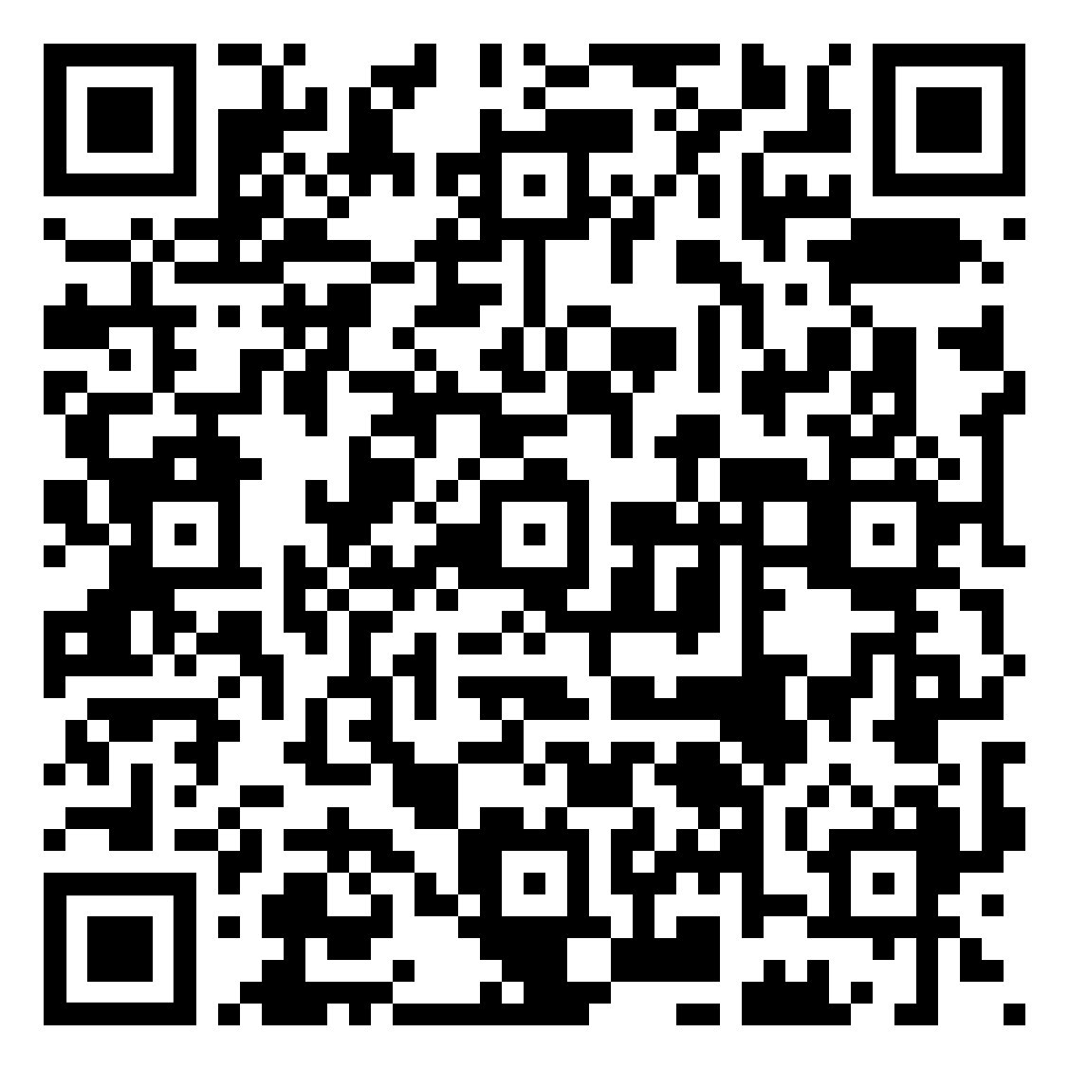
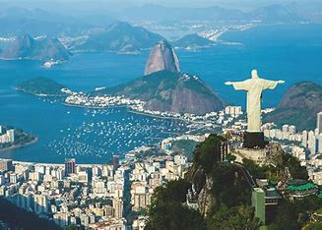
Year 10 Geography Homework – Half Term 4, Week 1
Urbanisation Quiz
https://www.bbc.co.uk/bitesize/guides/zw6pwxs/revision/5
Read through the information about challenges and opportunities in Rio de Janeiro and complete the quiz on BBC Bitesize.
Key words – social, economic, environmental, solutions, informal economy, formal economy, pollution
Extension Task – Exam Question: To what extent can the urban challenges in Rio de Janeiro be managed? (9marks)
What have been your strengths in Geography this week?
What have been the areas that have challenged you in Geography this week?
How could you improve next week?
Building good people who take PRIDE in their time at school, RESPECT themselves and others, WORK TOGETHER as a community, showing RESILIENCE and EMPATHY for all.

Slide 23
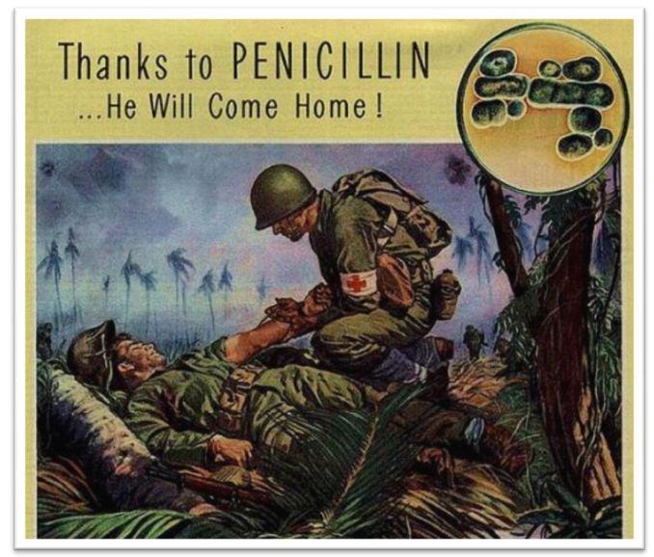
Year 10 History Homework – Half Term 4, Week 1
1. What did Alexander Fleming discover? | 5. Give two reasons why drugs and treatments have developed greatly in the 20th Century.
2. What did Chain and Florey do? | 6. How has antibiotic resistance become a problem?
3. When was IVF introduced? | 7. Give an alternative treatment.
4. When was the first heart transplant? | 8. What is the effect of homeopathy?
Source tasks:
Look at the source below.
Highlighted and annotate areas of the source.
What does the source tell you about penicillin.
From your own knowledge, what do you agree and disagree with in relation to the sources message?
Key words – drugs, treatment, war, luck, individuals
Extension Task – what are the sources nature, origin and purpose? Does these make you trust the sources more or less?
What have been your strengths in History this week?
What have been the areas that have challenged you in History this week?
How could you improve next week?
Building good people who take PRIDE in their time at school, RESPECT themselves and others, WORK TOGETHER as a community, showing RESILIENCE and EMPATHY for all.

Slide 24

Year 10 Languages Homework
Half Term 4
Vocabulary and Translation Practise
For this homework, you will need a copy of the Sentence Builder.
Task 1 | Test yourself on the items in the sentence builder using the Look-Say-Cover-Write-Check method.
Task 2 | Ask a friend or a relative to test you on individual items from the sentence builder.
Task 3 | Ask a friend or a relative to test you on full sentences from the sentence builder.
Task 4 | Practise this week's topic on Linguascope. (See Mr Downey for the login details).
Task 5 | Find a new song in your preferred language on Lyrics Training. Can you challenge yourself to the higher levels?
What have been your strengths in Languages this week?
What have been the areas that have challenged you in Languages this week?
How could you improve next week?
Building good people who take PRIDE in their time at school, RESPECT themselves and others, WORK TOGETHER as a community, showing RESILIENCE and EMPATHY for all.

Slide 25
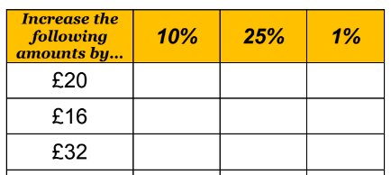
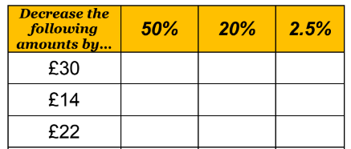
Year 10 Mathematics Homework
Half Term 4, Week 1
Recap Task – Ratio (Half Term 4)
Simplify the ratio 14 : 35
Share £240 in the ratio 3:5
The ratio of boys to girls is 3 : 4, what fraction of pupils are boys?
The ratio of dogs to cats is 4 : 9, if there are 20 dogs, how many cats are there?
Main Task – Percentages
Toy cars are made in a factory. 300 cars are made per hour for 9.5 hours each day. 8% of the cars made are faulty. How many of the cars made each day are NOT faulty?
Tom and Dani each start a job with a salary of £20000 per year.
Tom gets a 4% pay rise each year.
Dani gets a £900 pay rise each year.
Who will be earning more in 5 years time?
Who will be earning more in 10 years time?
Key words – percent, increase, decrease, multiplier, compound, repeated
What have been your strengths in maths this week?
What have been the areas that have challenged you in maths this week?
How could you improve next week?
Extension Task –
Mrs Smith uses oil to heat her home.
She has 1000 litres of oil in her tank, she then buys more oil, enough to fill the tank.
She pays 50p per litre, and it comes to a total of £750.
A month later she is down to 600 litres of oil in her tank. Again, she buys enough oil to fill the tank, but this time the price of oil has gone up by 4%. How much did the oil cost her this time?
Building good people who take PRIDE in their time at school, RESPECT themselves and others, WORK TOGETHER as a community, showing RESILIENCE and EMPATHY for all.

Slide 26


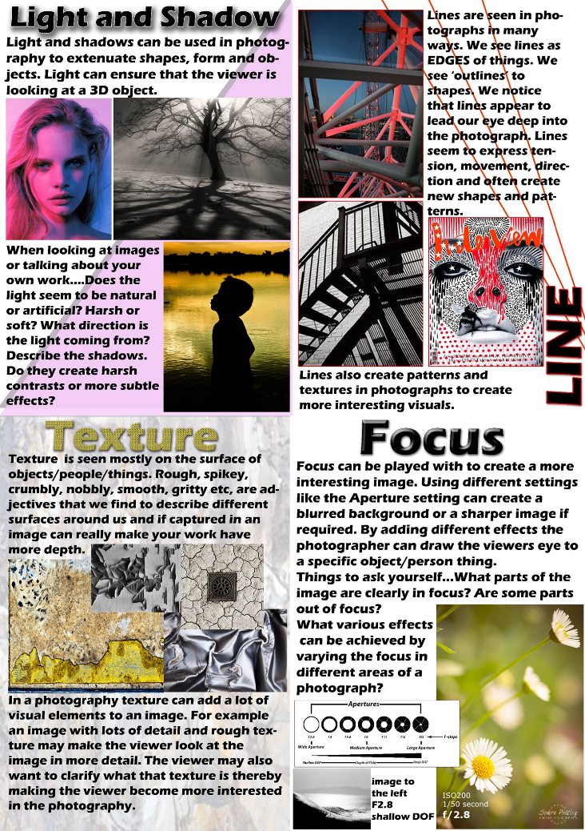
Year 10 Photography Homework – Half Term 4, Week 1 -6
Preparation Task: Use the power point I have sent to you labelled
Visual Elements – work through the elements and create a photographic library of images on the power point
Photography Year Ten
Visual Elements
LO: To what extent do I understand how to creatively approach the GCSE Photography Course.
Extension Task – Start to gather objects (you may need a shopping list) to create your own photoshoot for your next homework
What have been your strengths in (insert subject) this week?
What have been the areas that have challenged you in (insert topic) this week?
How could you improve next week?

Slide 27

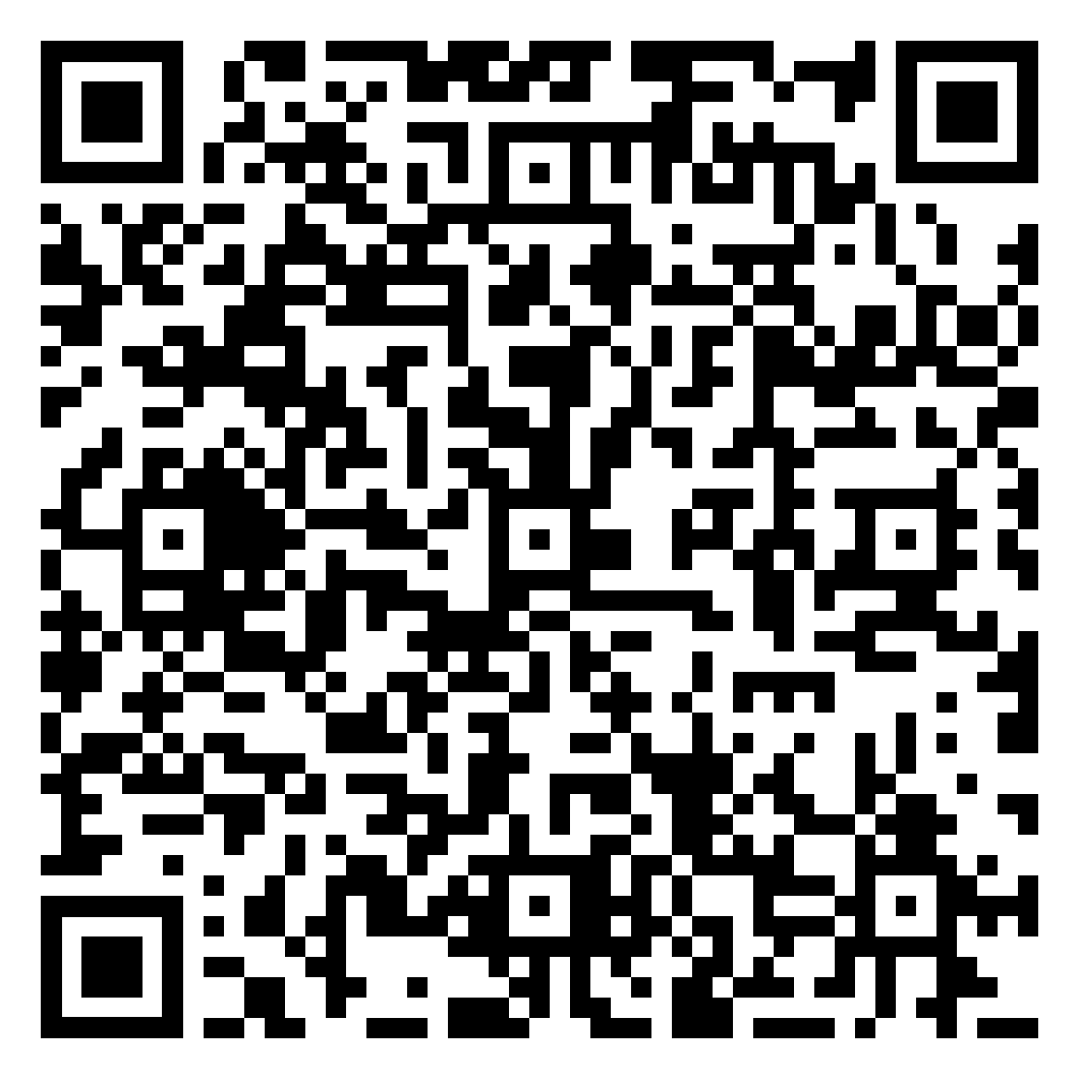
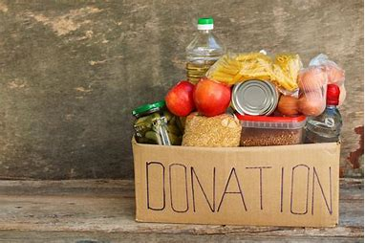
Year 10 RE Homework – Half Term 4, Week 1
Name two locations Christians go on pilgrimage.
Complete the following activities:
What is the role of the church?
Find out where the local food banks are.
Exam question (5 marks). Explain two reasons why Christians might donate to food banks.
Key words – food bank, street pastor, pilgrimage
Extension Task – Create a plan for the 12 mark exam question ' Street pastors are a great support for the police'.
What have been your strengths in RE this week?
What have been the areas that have challenged you in RE this week?
How could you improve next week?
Building good people who take PRIDE in their time at school, RESPECT themselves and others, WORK TOGETHER as a community, showing RESILIENCE and EMPATHY for all.

Slide 28
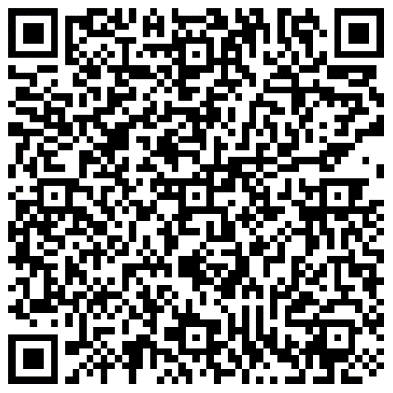
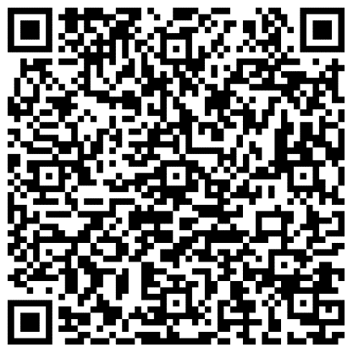
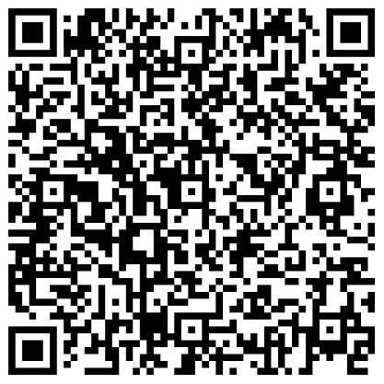
Year 10 Science Homework – Half Term 4, Week 1
Available: 22nd February 2024
Due: 29th February 2024
C5: Energy Changes
P4: Atomic Structure
B3: Infection and Response
Main Task:
AND: Complete at least 10 marks of questions inside your exam question mastery booklets.
Leave on the table in lesson, let me know and I’ll mark the questions.
All questions completed should be stamped/ marked by me on or before the due date.
What have been your strengths in (insert subject) this week?
What have been the areas that have challenged you in (insert topic) this week?
How could you improve next week?
Building good people who take PRIDE in their time at school, RESPECT themselves and others, WORK TOGETHER as a community, showing RESILIENCE and EMPATHY for all.

Slide 29
Week 2 Homework

Slide 30
Week 2 Homework Due Dates
Subject | Day Due | Date Due
Building good people who take PRIDE in their time at school, RESPECT themselves and others, WORK TOGETHER as a community, showing RESILIENCE and EMPATHY for all.

Slide 31
Year 10 Business, Homework –
Half Term 4, Week 2
Recap Task – define the following:
Toyota Production System
Main Task
In 2016, Unilever and Tesco were in a dispute over the price of many leading brands, such as Marmite. Unilever produces a range of very well-known brands, such as Persil washing powder, Ben & Jerry’s ice- cream, Dove, Lipton and Marmite. Unilever is the UK’s biggest grocery manufacturer, but many of its products are made outside the UK. Unilever argued that the fall in the value of the UK exchange rate made it more expensive to buy many supplies from abroad and that this meant that higher prices needed to be charged to supermarkets. Unilever had wanted to raise its prices by about 10 per cent, but Tesco refused to pay. This led to Unilever stopping supplies for a while and this resulted in a shortage of their products in some Tesco stores. After negotiations, the companies reached an agreement. Analyse the factors Tesco might consider when deciding whether to carry on buying from Unilever. (6 marks)
Key words
Price dispute
Extension Task — See Seneca
What have been your strengths this week?
What have been the areas that have challenged you this week?
How could you improve next week?
Building good people who take PRIDE in their time at school, RESPECT themselves and others, WORK TOGETHER as a community, showing RESILIENCE and EMPATHY for all.

Slide 32
Year 10 English Homework
Half Term 4, Week 2
Recap: what should you consider when summarising? ……………………………………………………………………………………………………………………………………………………………………………………………………………………………………………………………………………………………………………………………………………………………………………………………………………………………………………………………………………………………………………………………………………………………………..
Complete the summary task on page 2 of your homework booklet.
Key words – earlier, later, key moment, reveal, scene.
Extension Task – What are the rules of Shakespearian tragedy?
What have been your strengths in (insert subject) this week?
What have been the areas that have challenged you in (insert topic) this week?
How could you improve next week?
Building good people who take PRIDE in their time at school, RESPECT themselves and others, WORK TOGETHER as a community, showing RESILIENCE and EMPATHY for all.

Slide 33
Year 10 Fine Art Homework – Half Term, Week 1-6
Preparation Task: Make sure you collect the sketchbook from Miss O'Malley and have the resources your need to work from.
If you need things printing off please arrange this before the deadlines
In your sketchbook over the next 6 week you will have:
Collage – ripped coloured paper pepper
Collage – cut paper collage pepper
Water colour papper
Acrylic painied pepper
String collage and printed pepper
Quick print foam pepper
Key words –Observational studies, media development, line, tone, colour, shape, pattern space
Extension Task Work into your drawings for longer than 20 mins per week.
What have been your strengths in (insert subject) this week?
What have been the areas that have challenged you in (insert topic) this week?
How could you improve next week?
Building good people who take PRIDE in their time at school, RESPECT themselves and others, WORK TOGETHER as a community, showing RESILIENCE and EMPATHY for all.

Slide 34
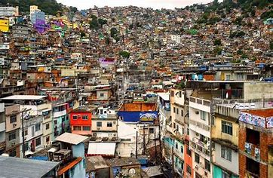
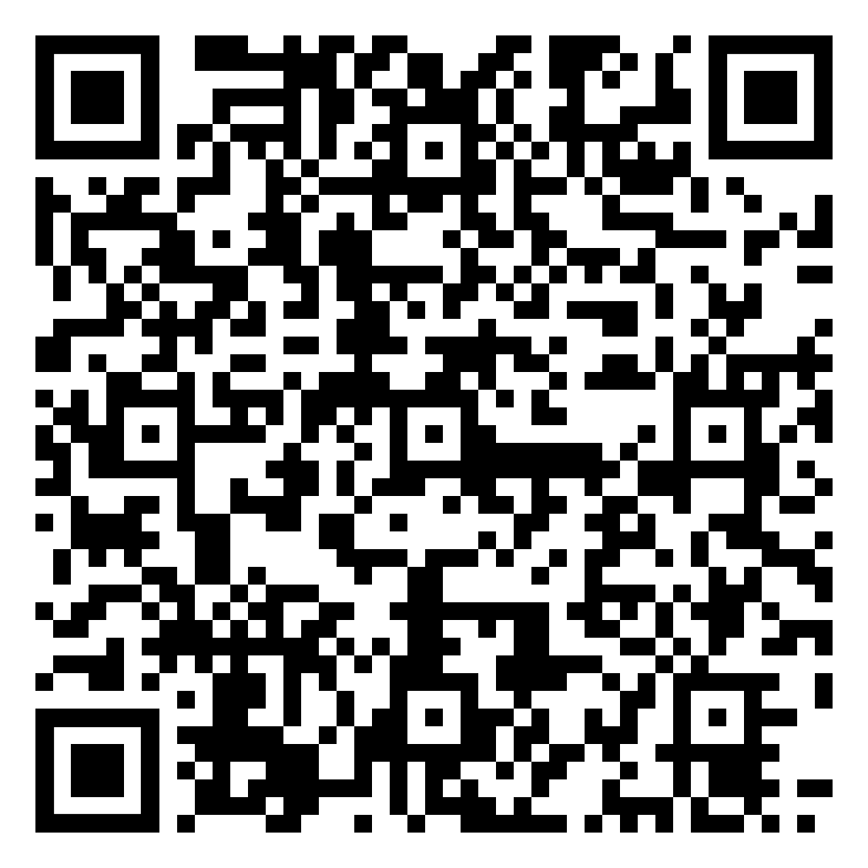
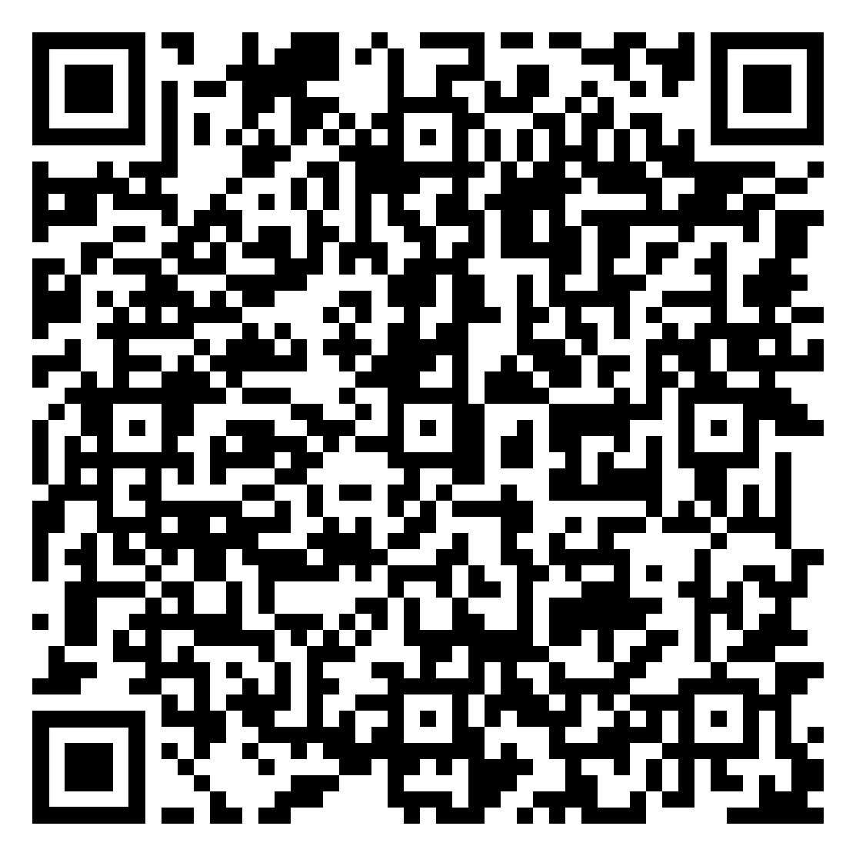
Year 10 Geography Homework – Half Term 4, Week 2
Rio de Janeiro Quiz
Open the challenges of squatter settlements Week 2 document. And read through the annotations around photo D.
Exam Question:
Explain why housing is a challenge in LIC and NEE cities. Use photo D and a case study of a city in a LIC or NEE (6 marks).
Your case study example is Rio de Janeiro
Online document -
The challenges of squatter settlements Week 2.pdf
Key words – squatter settlements, favela, construction, unemployment, crime, health, services
Extension Task – How are challenges surrounding housing in Rio de Janeiro managed? How successful do you think these management techniques are?
What have been your strengths in Geography this week?
What have been the areas that have challenged you in Geography this week?
How could you improve next week?
Building good people who take PRIDE in their time at school, RESPECT themselves and others, WORK TOGETHER as a community, showing RESILIENCE and EMPATHY for all.

Slide 35
Year 10 History Homework – Half Term 4, Week 2
1. Give two impacts that WW1 and WW2 had on medical progress.
2. How did surgical methods advance in modern times?
3. Name one of the two special reports on public health from the beginning of the 20th century.
4. Give a liberal reform from between 1906 and 1911 that changed public health.
5. When was the NHS introduced?
Quiz Review:
Read your work on modern medicine.
Pick 3-4 key facts from each lesson.
Take the key facts and turn them into a Quiz WITH Answers.
Make sure you write Questions AND Answers.
Make sure you have at least 10 Questions WITH Answers.
Make sure you have a mix between short AND long answer questions.
Think about how you can make a quiz look attractive.
Key words – NHS, liberal, reform, surgical, war
Extension Task – Look at the source below. What is the message of the source? What is the origin, nature and purpose of the source?
(A) An extract from Rowntree's Poverty (1901):
These children presented a pathetic sight; all bore some mark of the hard conditions against which they were struggling. Puny and feeble bodies, dirty and often sadly insufficient clothing, sore eyes, in many cases inflamed...
What have been your strengths in History this week?
What have been the areas that have challenged you in History this week?
How could you improve next week?
Building good people who take PRIDE in their time at school, RESPECT themselves and others, WORK TOGETHER as a community, showing RESILIENCE and EMPATHY for all.

Slide 36
Year 10 Languages Homework
Half Term 4
Vocabulary and Translation Practise
For this homework, you will need a copy of the Sentence Builder.
Task 1 | Test yourself on the items in the sentence builder using the Look-Say-Cover-Write-Check method.
Task 2 | Ask a friend or a relative to test you on individual items from the sentence builder.
Task 3 | Ask a friend or a relative to test you on full sentences from the sentence builder.
Task 4 | Practise this week's topic on Linguascope. (See Mr Downey for the login details).
Task 5 | Find a new song in your preferred language on Lyrics Training. Can you challenge yourself to the higher levels?
What have been your strengths in Languages this week?
What have been the areas that have challenged you in Languages this week?
How could you improve next week?
Building good people who take PRIDE in their time at school, RESPECT themselves and others, WORK TOGETHER as a community, showing RESILIENCE and EMPATHY for all.

Slide 37
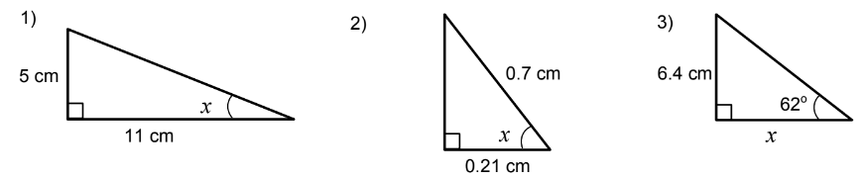
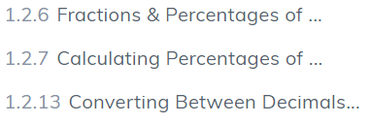
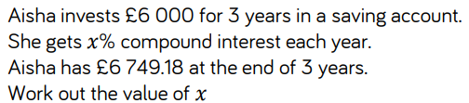
Year 10 Mathematics Homework
Half Term 4, Week 2
Recap Task – Trigonometry (Half Term 2)
Main Task –SENECA
This weeks homework task is assigned on SENECA, please complete all the sections to the best of your ability. Do any written working in your homework book. Watch the videos on SENECA where necessary to improve your understanding.
Key words – Fraction, Decimal, Percentage, Multiplier, Increase, Compound
Extension Task –
What have been your strengths in maths this week?
What have been the areas that have challenged you in maths this week?
How could you improve next week?
Building good people who take PRIDE in their time at school, RESPECT themselves and others, WORK TOGETHER as a community, showing RESILIENCE and EMPATHY for all.

Slide 38
Year 10 Photography Homework – Half Term 4, Week 1 -6
Preparation Task: Use the power point I have sent to you labelled
Visual Elements – work through the elements and create a photographic library of images on the power point
Photography Year Ten
Visual Elements
LO: To what extent do I understand how to creatively approach the GCSE Photography Course.
Extension Task – Start to gather objects (you may need a shopping list) to create your own photoshoot for your next homework
What have been your strengths in (insert subject) this week?
What have been the areas that have challenged you in (insert topic) this week?
How could you improve next week?

Slide 39


Year 10 RE Homework – Half Term 4, Week 2
What are street pastors? Why do some Christians become street pastors?
Read the reading about Paul and Silas in prison.
Do you think it was important for Paul to carry out missionary journeys? Explain your answer.
Read God's TV's Mission Statement and Vision Statement.
Explain how these statements compare with the instructions given to the followers of Jesus in the Great Commission.
Key words – street pastor, missionary, Great Commision, media
Extension Task – Do you think there are better strategies to aid the growth of the Church than the media? Explain your answer with examples.
What have been your strengths in RE this week?
What have been the areas that have challenged you in RE this week?
How could you improve next week?
Building good people who take PRIDE in their time at school, RESPECT themselves and others, WORK TOGETHER as a community, showing RESILIENCE and EMPATHY for all.

Slide 40
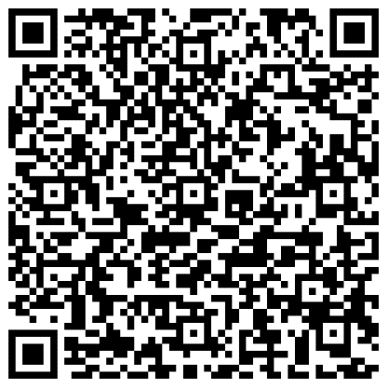
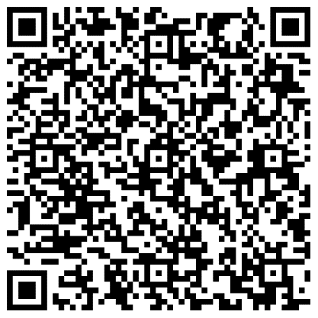
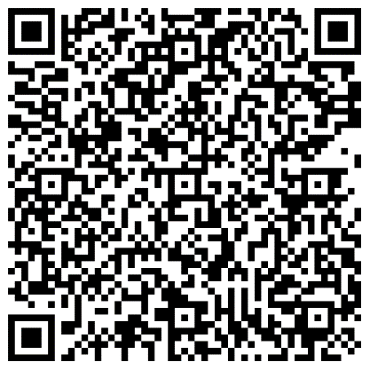
Year 10 Science Homework – Half Term 4, Week 2
Available: 29th February 2024
Due: 7th March 2024
C5: Energy Changes
P4: Atomic Structure
B3: Infection and Response
Main Task:
AND: Complete at least 10 marks of questions inside your exam question mastery booklets.
Leave on the table in lesson, let me know and I’ll mark the questions.
All questions completed should be stamped/ marked by me on or before the due date.
What have been your strengths in (insert subject) this week?
What have been the areas that have challenged you in (insert topic) this week?
How could you improve next week?
Building good people who take PRIDE in their time at school, RESPECT themselves and others, WORK TOGETHER as a community, showing RESILIENCE and EMPATHY for all.

Slide 41
Year 10 Science Homework – Half Term 4, Week 1
Available: 29th February 2024
Due: 7th March 2024
C5: Energy Changes
P4: Atomic Structure
B3: Infection and Response
Main Task:
AND: Complete at least 10 marks of questions inside your exam question mastery booklets.
Leave on the table in lesson, let me know and I’ll mark the questions.
All questions completed should be stamped/ marked by me on or before the due date.
What have been your strengths in (insert subject) this week?
What have been the areas that have challenged you in (insert topic) this week?
How could you improve next week?
Building good people who take PRIDE in their time at school, RESPECT themselves and others, WORK TOGETHER as a community, showing RESILIENCE and EMPATHY for all.

Slide 42
Week 3 Homework

Slide 43
Week 3 Homework Due Dates
Subject | Day Due | Date Due
Building good people who take PRIDE in their time at school, RESPECT themselves and others, WORK TOGETHER as a community, showing RESILIENCE and EMPATHY for all.

Slide 44
Year 10 Business, Homework –
Half Term 4, Week 3
Recap Task – define the following:
Price dispute
Main Task
One of the most famous cars ever made is the Model T Ford, which was produced by Ford from 1918. The car is famous because it was the first to be made using flow production techniques. The cars moved along the assembly line and at each stage another part of the car was fitted. The introduction of flow production increased the number of cars being made and meant they were much cheaper to produce. Ford cars were sold at a price much lower than anyone else’s and meant this was the first car that was affordable for millions of people.
Analyse how flow production helped the success of the Model T Ford. (6 Marks)
Key words – Flow production
Extension Task – See Seneca
What have been your strengths this week?
What have been the areas that have challenged you this week?
How could you improve next week?
Building good people who take PRIDE in their time at school, RESPECT themselves and others, WORK TOGETHER as a community, showing RESILIENCE and EMPATHY for all.

Slide 45
Year 10 English Homework
Half Term 4, Week 3
Recap: what should you consider when answering Q2a) to 2c) in Language Paper 1? ……………………………………………………………………………………………………………………………………………………………………………………………………………………………………………………………………………………………………………………………………………………………………………………………………………………………………………………………………………………………………………………………………………………………………..
Complete the tasks on pages 3 to 5 of your homework booklet.
Key words – shows, portrays, effective, metaphor, simile, personification, setting.
Extension Task – How does Shakespeare show the tragic waste in the character of Macbeth?
What have been your strengths in (insert subject) this week?
What have been the areas that have challenged you in (insert topic) this week?
How could you improve next week?
Building good people who take PRIDE in their time at school, RESPECT themselves and others, WORK TOGETHER as a community, showing RESILIENCE and EMPATHY for all.

Slide 46
Year 10 Fine Art Homework – Half Term, Week 1-6
Preparation Task: Make sure you collect the sketchbook from Miss O'Malley and have the resources your need to work from.
If you need things printing off please arrange this before the deadlines
In your sketchbook over the next 6 week you will have:
Collage – ripped coloured paper pepper
Collage – cut paper collage pepper
Water colour papper
Acrylic painied pepper
String collage and printed pepper
Quick print foam pepper
Key words –Observational studies, media development, line, tone, colour, shape, pattern space
Extension Task Work into your drawings for longer than 20 mins per week.
What have been your strengths in (insert subject) this week?
What have been the areas that have challenged you in (insert topic) this week?
How could you improve next week?
Building good people who take PRIDE in their time at school, RESPECT themselves and others, WORK TOGETHER as a community, showing RESILIENCE and EMPATHY for all.

Slide 47

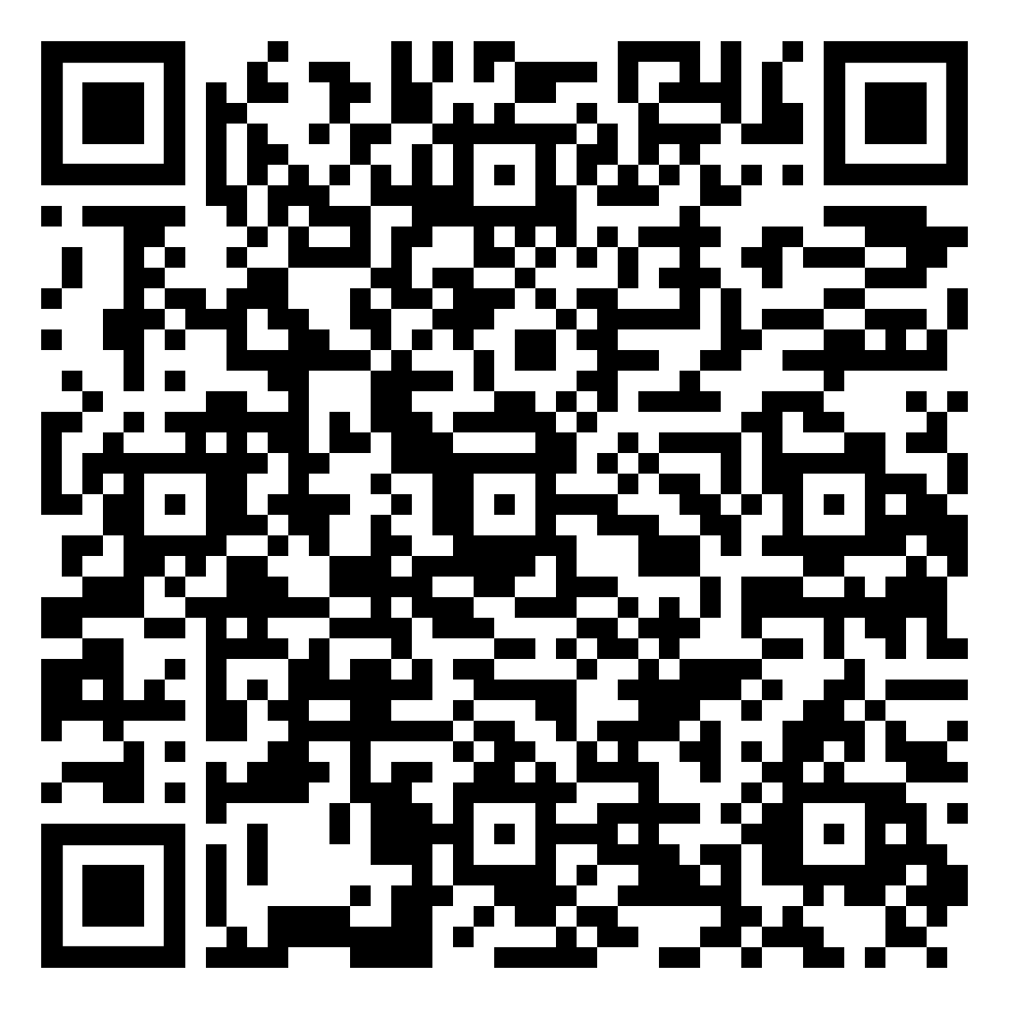
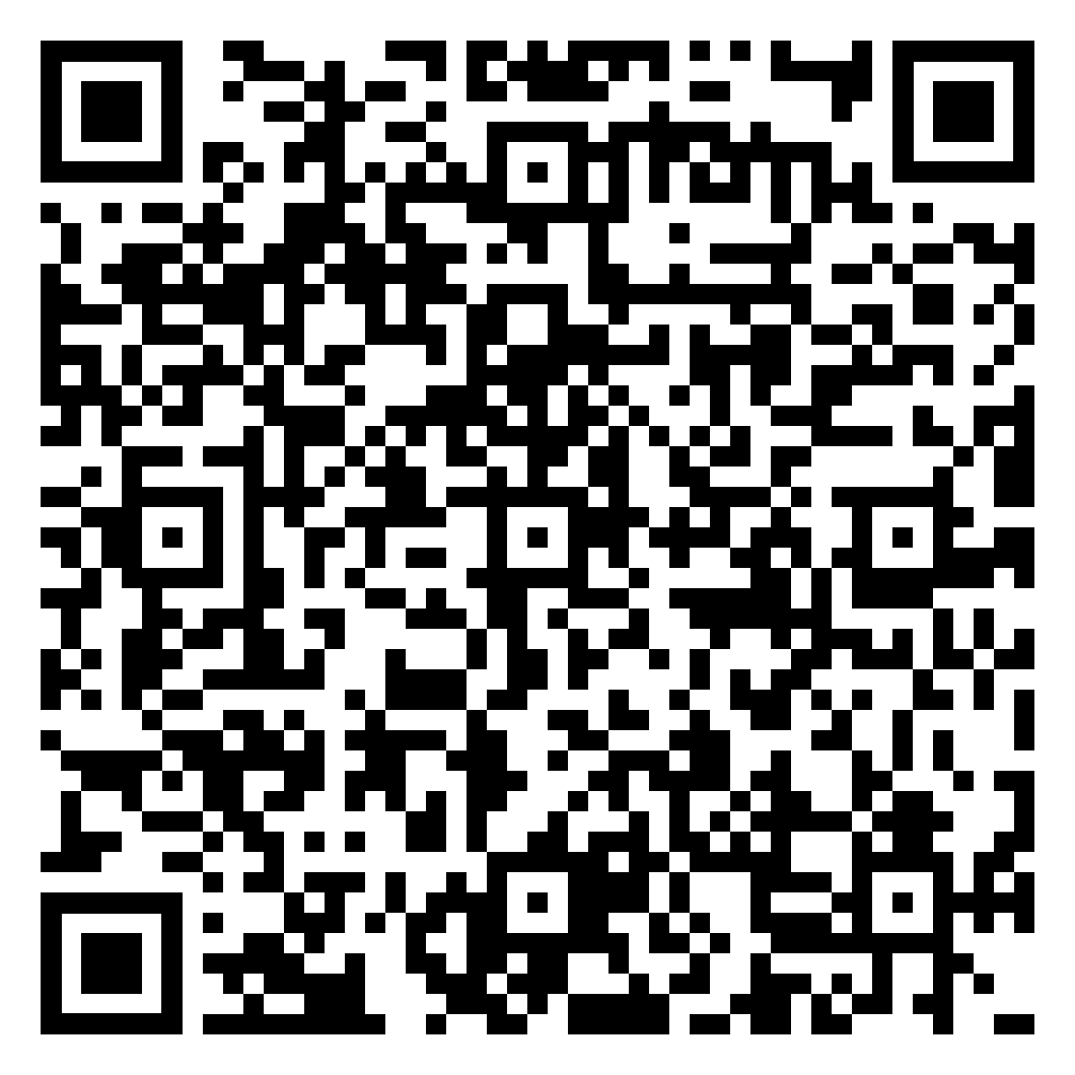
Year 10 Geography Homework – Half Term 4, Week 3
Quiz on UK Cities
Using the map of the UK (Map B) in UK population Week 3 document to help you, answer the following question:
Explain how the distribution of population in the UK reflects both physical and human geographical factors (6 marks)
Online document - UK population Week 3.pdf
Key words – distribution, sparsely populated, densely populated, density, distribution, urban, rural
Extension Task – Choose one of the cities on map B. do some research to find out when, how and why the city developed. Why is the city important today?
What have been your strengths in Geography this week?
What have been the areas that have challenged you in Geography this week?
How could you improve next week?
Building good people who take PRIDE in their time at school, RESPECT themselves and others, WORK TOGETHER as a community, showing RESILIENCE and EMPATHY for all.

Slide 48
Year 10 History Homework – Half Term 4, Week 3
1. Name a key job from Elizabeth's government.
2. What was the privy council?
3. Give two problems Elizabeth faced when she became queen.
4. Give an argument for and an argument against Elizabeth getting married.
5. Name three of Elizabeth's suitors for marriage.
Storyboard:
Look at your classwork and use other resources to research what happened in relation to Elizabeth's succession and marriage.
Pick 8-10 key facts.
Take the key facts and turn them into a storyboard (template available if required) to show what you have learnt.
Make sure it has pictures and description.
Key words – succession, marriage, suitors, earl, duke
Extension Task – Can you write a pneumonic to help you remember the issues relating to marriage and succession?
What have been your strengths in History this week?
What have been the areas that have challenged you in History this week?
How could you improve next week?
Building good people who take PRIDE in their time at school, RESPECT themselves and others, WORK TOGETHER as a community, showing RESILIENCE and EMPATHY for all.

Slide 49
Year 10 Languages Homework
Half Term 4
Vocabulary and Translation Practise
For this homework, you will need a copy of the Sentence Builder.
Task 1 | Test yourself on the items in the sentence builder using the Look-Say-Cover-Write-Check method.
Task 2 | Ask a friend or a relative to test you on individual items from the sentence builder.
Task 3 | Ask a friend or a relative to test you on full sentences from the sentence builder.
Task 4 | Practise this week's topic on Linguascope. (See Mr Downey for the login details).
Task 5 | Find a new song in your preferred language on Lyrics Training. Can you challenge yourself to the higher levels?
What have been your strengths in Languages this week?
What have been the areas that have challenged you in Languages this week?
How could you improve next week?
Building good people who take PRIDE in their time at school, RESPECT themselves and others, WORK TOGETHER as a community, showing RESILIENCE and EMPATHY for all.

Slide 50



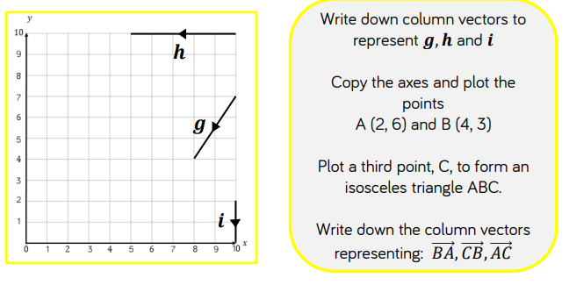
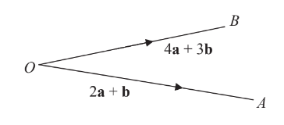
Year 10 Mathematics Homework
Half Term 4, Week 3
Recap Task – Simultaneous Equations (Half Term 2)
Main Task – Vectors
Key words – column, magnitude, size, arrow, vector, parallel, direction
Extension Task –
Find the vector A to B in its simplest form.
What have been your strengths in maths this week?
What have been the areas that have challenged you in maths this week?
How could you improve next week?
Building good people who take PRIDE in their time at school, RESPECT themselves and others, WORK TOGETHER as a community, showing RESILIENCE and EMPATHY for all.

Slide 51
Year 10 Photography Homework – Half Term 4, Week 1 -6
Preparation Task: Use the power point I have sent to you labelled
Visual Elements – work through the elements and create a photographic library of images on the power point
Photography Year Ten
Visual Elements
LO: To what extent do I understand how to creatively approach the GCSE Photography Course.
Extension Task – Start to gather objects (you may need a shopping list) to create your own photoshoot for your next homework
What have been your strengths in (insert subject) this week?
What have been the areas that have challenged you in (insert topic) this week?
How could you improve next week?

Slide 52
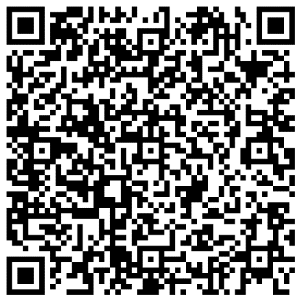
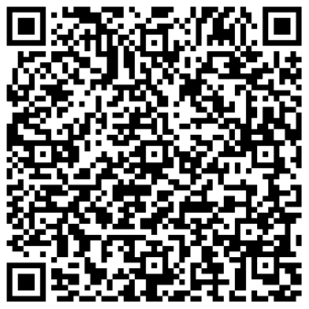
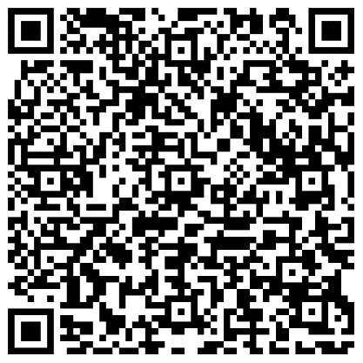
Year 10 Science Homework – Half Term 4, Week 3
Available: 7th March 2024
Due: 14th March 2024
C5: Energy Changes
P4: Atomic Structure
B3: Infection and Response
Main Task:
AND: Complete at least 10 marks of questions inside your exam question mastery booklets.
Leave on the table in lesson, let me know and I’ll mark the questions.
All questions completed should be stamped/ marked by me on or before the due date.
What have been your strengths in (insert subject) this week?
What have been the areas that have challenged you in (insert topic) this week?
How could you improve next week?
Building good people who take PRIDE in their time at school, RESPECT themselves and others, WORK TOGETHER as a community, showing RESILIENCE and EMPATHY for all.

Slide 53

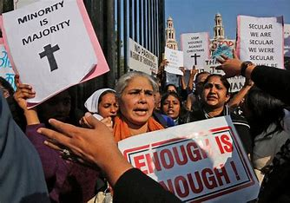
Year 10 RE Homework – Half Term 4, Week 3
How many Christians in the World are being persecuted now? Where in the World are Christians most likely to be persecuted?
Research three ways in which Christians' support those who live in countries where it is forbidden to follow Jesus.
Exam question: Explain two reasons why Christians try to help those who are persecuted for their faith. (5 marks)
Key words – persecution, church growth, world poverty, response, emergency aid
Extension Task – Write a plan to answer the 12-mark exam question, 'Religious charities should just concentrate on emergency aid'.
What have been your strengths in RE this week?
What have been the areas that have challenged you in RE this week?
How could you improve next week?
Building good people who take PRIDE in their time at school, RESPECT themselves and others, WORK TOGETHER as a community, showing RESILIENCE and EMPATHY for all.

Slide 54
Week 4 Homework

Slide 55
Week 4 Homework Due Dates
Subject | Day Due | Date Due
Building good people who take PRIDE in their time at school, RESPECT themselves and others, WORK TOGETHER as a community, showing RESILIENCE and EMPATHY for all.

Slide 56
Year 10 Business, Homework –
Half Term 4, Week 4
Recap Task –
Flow production
Main Task
Q1 What is meant by ‘quality’? (2 marks)
Q2 State two ways quality may be measured in a hospital. (2 marks)
Q3 State two ways quality may be measured in a car manufacturer. (2 marks)
Q4 State two problems caused by poor quality. (2 marks)
Q5 State two costs of improving quality. (2 marks)
Q6 State two benefits of having good quality. (2 marks)
Key words - Quality
Extension Task – See Seneca
What have been your strengths this week?
What have been the areas that have challenged you this week?
How could you improve next week?
Building good people who take PRIDE in their time at school, RESPECT themselves and others, WORK TOGETHER as a community, showing RESILIENCE and EMPATHY for all.

Slide 57
Year 10 English Homework
Half Term 4, Week 4
Recap: what should you consider when answering Q2d) in Language Paper 1? D = I = E =
Complete the task on page 6 of your homework booklet.
Key words – shows, portrays, effective, metaphor, simile, personification, setting, engage.
Extension Task – How does Shakespeare present the character of Banquo?
What have been your strengths in (insert subject) this week?
What have been the areas that have challenged you in (insert topic) this week?
How could you improve next week?
Building good people who take PRIDE in their time at school, RESPECT themselves and others, WORK TOGETHER as a community, showing RESILIENCE and EMPATHY for all.

Slide 58
Year 10 Fine Art Homework – Half Term, Week 1-6
Preparation Task: Make sure you collect the sketchbook from Miss O'Malley and have the resources your need to work from.
If you need things printing off please arrange this before the deadlines
In your sketchbook over the next 6 week you will have:
Collage – ripped coloured paper pepper
Collage – cut paper collage pepper
Water colour papper
Acrylic painied pepper
String collage and printed pepper
Quick print foam pepper
Key words –Observational studies, media development, line, tone, colour, shape, pattern space
Extension Task Work into your drawings for longer than 20 mins per week.
What have been your strengths in (insert subject) this week?
What have been the areas that have challenged you in (insert topic) this week?
How could you improve next week?
Building good people who take PRIDE in their time at school, RESPECT themselves and others, WORK TOGETHER as a community, showing RESILIENCE and EMPATHY for all.

Slide 59
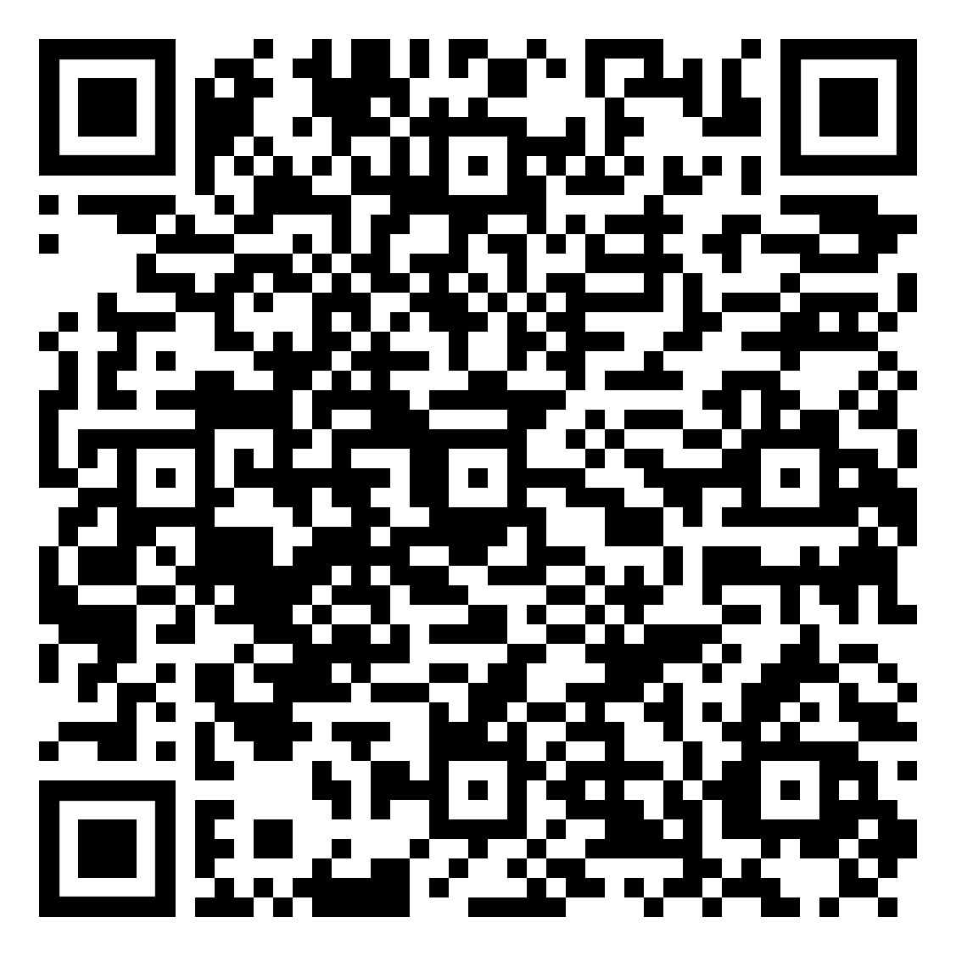
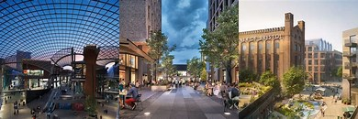
Year 10 Geography Homework – Half Term 4, Week 4
Urban Change in Bristol
Use your case study of Bristol to answer the following exam questions:
1. Explain how urban change in a major city that you have studied has created social opportunities (4 marks)
2. Suggest two ways that urban change in a major UK city you have studied has created economic opportunities (4 marks)
Key words – population, cultural mix, recreation, entertainment, shopping, ethnic makeup, high-tech industries
Extension Task – Carry out research to find out about some of the new industries in Bristol and their role in the city's development.
What have been your strengths in Geography this week?
What have been the areas that have challenged you in Geography this week?
How could you improve next week?
Building good people who take PRIDE in their time at school, RESPECT themselves and others, WORK TOGETHER as a community, showing RESILIENCE and EMPATHY for all.

Slide 60
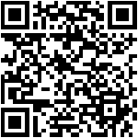
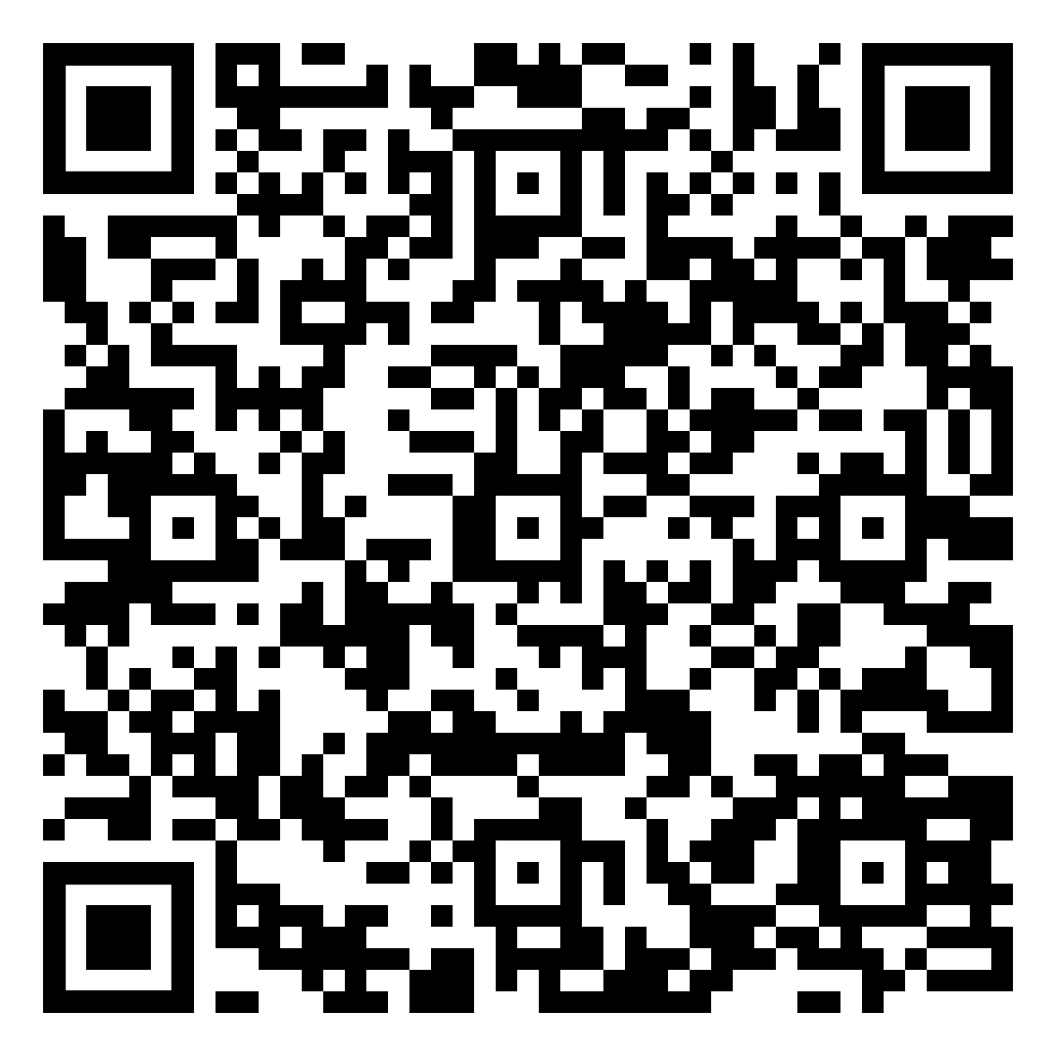
Year 10 History Homework – Half Term 4, Week 4
1. Who was involved in Norfolk's rebellion?
2. Who was involved in Essex's rebellion?
3. Describe the events of Norfolk's rebellion.
4.Describe the events of Essex's rebellion.
5. Why did rebellions against Elizabeth fail?
YouTube:
Go onto YouTube and find 2 videos about the Elizabethan 'Golden Age'.
For each video write down the below:
  The URL/link for the video.
  A 3-sentence summary of what the video summarised.
  An explanation about why you chose that video.
  A review of the video – how well do you think it covers the topic and why?
  Compare the videos.
Key words – theatre, music, art, culture, golden
Extension Task – Seneca:
Join class - Seneca task -
What have been your strengths in History this week?
What have been the areas that have challenged you in History this week?
How could you improve next week?
Building good people who take PRIDE in their time at school, RESPECT themselves and others, WORK TOGETHER as a community, showing RESILIENCE and EMPATHY for all.

Slide 61
Year 10 Languages Homework
Half Term 4
Vocabulary and Translation Practise
For this homework, you will need a copy of the Sentence Builder.
Task 1 | Test yourself on the items in the sentence builder using the Look-Say-Cover-Write-Check method.
Task 2 | Ask a friend or a relative to test you on individual items from the sentence builder.
Task 3 | Ask a friend or a relative to test you on full sentences from the sentence builder.
Task 4 | Practise this week's topic on Linguascope. (See Mr Downey for the login details).
Task 5 | Find a new song in your preferred language on Lyrics Training. Can you challenge yourself to the higher levels?
What have been your strengths in Languages this week?
What have been the areas that have challenged you in Languages this week?
How could you improve next week?
Building good people who take PRIDE in their time at school, RESPECT themselves and others, WORK TOGETHER as a community, showing RESILIENCE and EMPATHY for all.

Slide 62
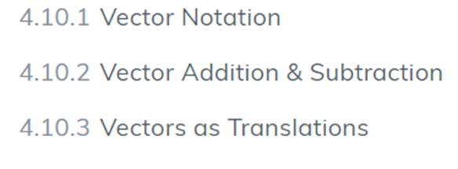
Year 10 Mathematics Homework
Half Term 4, Week 4
Recap Task –
Begin to revise for the end of term assessment taking place in week 6. Use the revision resources given out by Mrs Thompson.
Main Task –SENECA
This weeks homework task is assigned on SENECA, please complete all the sections to the best of your ability. Do any written working in your homework book. Watch the videos on SENECA where necessary to improve your understanding.
Key words – Scalar, Multiple, Vector, Magnitude, Translation, Parallel
Extension Task –
Redo the SENECA tasks, aiming for 100%.
What have been your strengths in maths this week?
What have been the areas that have challenged you in maths this week?
How could you improve next week?
Building good people who take PRIDE in their time at school, RESPECT themselves and others, WORK TOGETHER as a community, showing RESILIENCE and EMPATHY for all.

Slide 63
Year 10 Photography Homework – Half Term 4, Week 1 -6
Preparation Task: Use the power point I have sent to you labelled
Visual Elements – work through the elements and create a photographic library of images on the power point
Photography Year Ten
Visual Elements
LO: To what extent do I understand how to creatively approach the GCSE Photography Course.
Extension Task – Start to gather objects (you may need a shopping list) to create your own photoshoot for your next homework
What have been your strengths in (insert subject) this week?
What have been the areas that have challenged you in (insert topic) this week?
How could you improve next week?

Slide 64
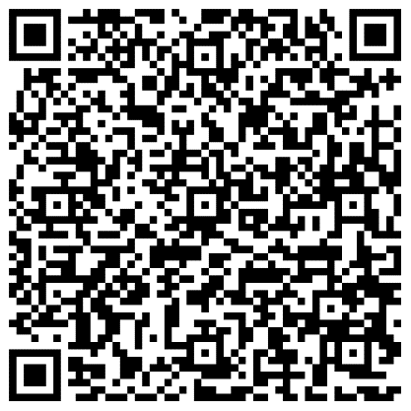
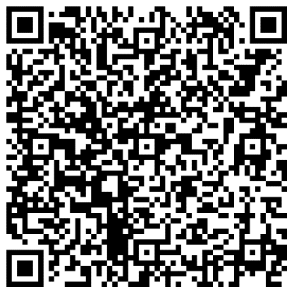
Year 10 Science Homework – Half Term 4, Week 4
Available: 14th March 2024
Due: 21st March 2024
C5: Energy Changes
P4: Atomic Structure
B3: Infection and Response
Main Task:
AND: Complete at least 10 marks of questions inside your exam question mastery booklets.
Leave on the table in lesson, let me know and I’ll mark the questions.
All questions completed should be stamped/ marked by me on or before the due date.
What have been your strengths in (insert subject) this week?
What have been the areas that have challenged you in (insert topic) this week?
How could you improve next week?
Building good people who take PRIDE in their time at school, RESPECT themselves and others, WORK TOGETHER as a community, showing RESILIENCE and EMPATHY for all.

Slide 65

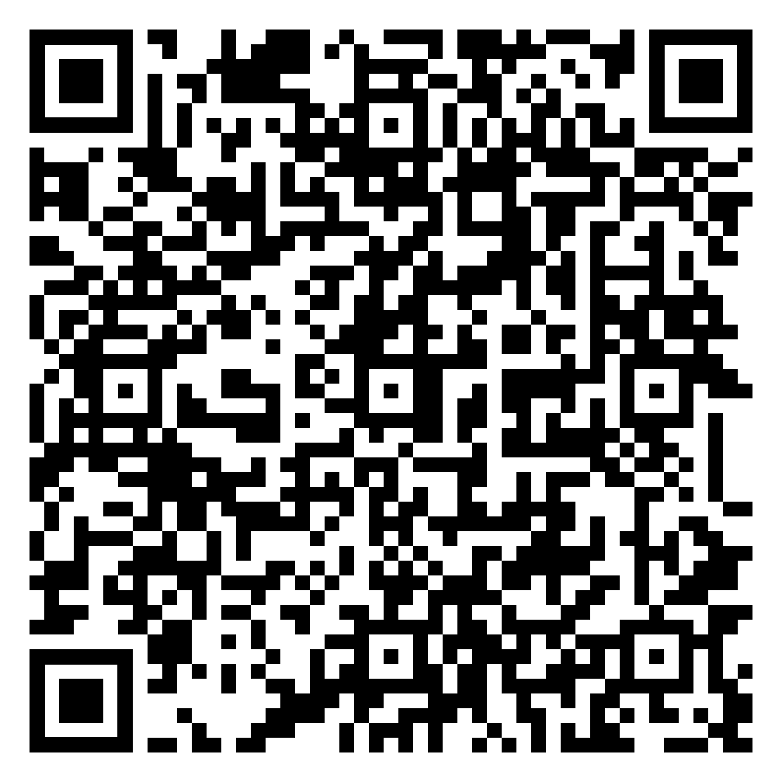
Year 10 RE Homework – Half Term 4, Week 4
Create flashcards for three key words and their definitions for Christian Practices. Choose words you struggle to remember.
Complete the questions (p.13-15) about the oneness of God and the supremacy of God's will in The Oneness of God Week 4 document.
Online document - The Oneness of God Week 4.pdf
Key words – Muslim, Islam, Allah, Tawhid, monotheistic, supremacy
Extension Task – Explain in detail how the nature of Allah influences Muslims today. Use the information on p.16 The Oneness of God Week 4 document to help you.
What have been your strengths in RE this week?
What have been the areas that have challenged you in RE this week?
How could you improve next week?
Building good people who take PRIDE in their time at school, RESPECT themselves and others, WORK TOGETHER as a community, showing RESILIENCE and EMPATHY for all.

Slide 66
Week 5 Homework

Slide 67
Week 5 Homework Due Dates
Subject | Day Due | Date Due
Building good people who take PRIDE in their time at school, RESPECT themselves and others, WORK TOGETHER as a community, showing RESILIENCE and EMPATHY for all.

Slide 68
Year 10 Business, Homework –
Half Term 4, Week 5
Recap Task – define the following:
Quality in business
Main Task
Q1 What is meant by the term ‘customer service’? (2 marks)
Q2 State two ways in which a business might offer good customer service. (2 marks)
Q3 What is meant by ‘customer engagement’? (2 marks)
Q4 What is meant by the term ‘post-sales service’? (2 marks)
Q5 Give two benefits of good customer service. (2 marks)
Key words – Customer service
Extension Task — See Seneca
What have been your strengths this week?
What have been the areas that have challenged you this week?
How could you improve next week?
Building good people who take PRIDE in their time at school, RESPECT themselves and others, WORK TOGETHER as a community, showing RESILIENCE and EMPATHY for all.

Slide 69
Year 10 English Homework
Half Term 4, Week 5
Recap: what should you consider when answering Q3 in Language Paper 1? G = A = P =
Complete the task on page 8 of your homework booklet.
Key words – writing in a suitable style that uses the source material effectively.
Extension Task – how does the key theme of the supernatural affect the characterisation of Lady Macbeth?
What have been your strengths in (insert subject) this week?
What have been the areas that have challenged you in (insert topic) this week?
How could you improve next week?
Building good people who take PRIDE in their time at school, RESPECT themselves and others, WORK TOGETHER as a community, showing RESILIENCE and EMPATHY for all.

Slide 70
Year 10 Fine Art Homework – Half Term, Week 1-6
Preparation Task: Make sure you collect the sketchbook from Miss O'Malley and have the resources your need to work from.
If you need things printing off please arrange this before the deadlines
In your sketchbook over the next 6 week you will have:
Collage – ripped coloured paper pepper
Collage – cut paper collage pepper
Water colour papper
Acrylic painied pepper
String collage and printed pepper
Quick print foam pepper
Key words –Observational studies, media development, line, tone, colour, shape, pattern space
Extension Task Work into your drawings for longer than 20 mins per week.
What have been your strengths in (insert subject) this week?
What have been the areas that have challenged you in (insert topic) this week?
How could you improve next week?
Building good people who take PRIDE in their time at school, RESPECT themselves and others, WORK TOGETHER as a community, showing RESILIENCE and EMPATHY for all.

Slide 71
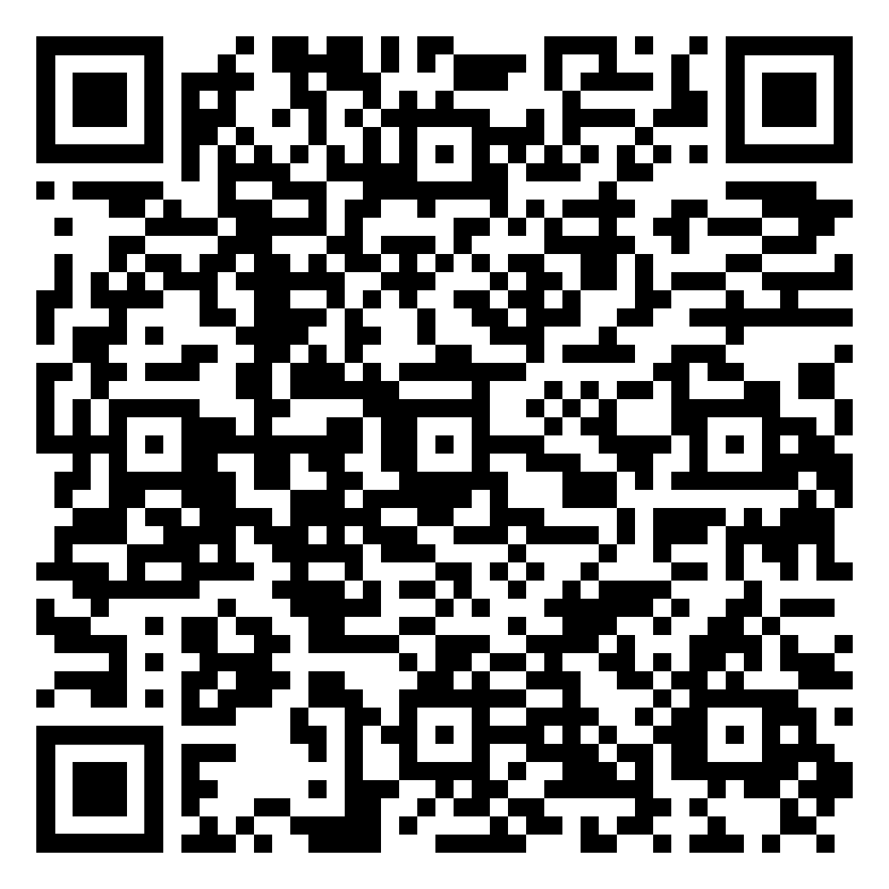
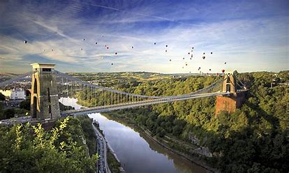
Year 10 Geography Homework – Half Term 4, Week 5
Sustainable Urban Living Quiz
Use your case study of Bristol to answer the following exam questions:
1. Outline the environmental opportunities created by urban change in a major UK city you have studied (4 marks).
2. 'Environmental challenges in UK cities are difficult to manage' Do you agree? Explain your answer using a case study of a UK city you have studied (6 marks)
Key words – integrated transport system, urban greening, green initiatives, dereliction, urban growth, urban sprawl, brownfield site, regeneration
Extension Task – Who are the winners and losers when an area is regenerated?
What have been your strengths in Geography this week?
What have been the areas that have challenged you in Geography this week?
How could you improve next week?
Building good people who take PRIDE in their time at school, RESPECT themselves and others, WORK TOGETHER as a community, showing RESILIENCE and EMPATHY for all.

Slide 72
Year 10 History Homework – Half Term 4, Week 5
1. What was the Great Chain of Being?
2. How did the wealthy show their wealth?
3. How did theatres change in Elizabethan times?
4. Why was there so much poverty in Elizabethan times?
5. How did Elizabeth try to deal with poverty?
Mind Map:
Next, we will look at Elizabethan voyages, research this and complete the tasks below (link to a good website - https://www.bbc.co.uk/bitesize/guides/zy68tyc/revision/5)
Take the key events and put them onto a Mind Map (examples/templates available).
Make sure the events have a title and a brief description.
Make sure it has arrows LINKING events – does one cause another? Do they have things in common? Have you described why they link together?
Make sure it has either colour coding (one colour per area) or pictures/symbols.
Key words – Drake, Hawkins, Raleigh, exploration, voyage
Extension Task – Seneca:
Join class - Seneca task -
What have been your strengths in History this week?
What have been the areas that have challenged you in History this week?
How could you improve next week?
Building good people who take PRIDE in their time at school, RESPECT themselves and others, WORK TOGETHER as a community, showing RESILIENCE and EMPATHY for all.

Slide 73
Year 10 Languages Homework
Half Term 4
Vocabulary and Translation Practise
For this homework, you will need a copy of the Sentence Builder.
Task 1 | Test yourself on the items in the sentence builder using the Look-Say-Cover-Write-Check method.
Task 2 | Ask a friend or a relative to test you on individual items from the sentence builder.
Task 3 | Ask a friend or a relative to test you on full sentences from the sentence builder.
Task 4 | Practise this week's topic on Linguascope. (See Mr Downey for the login details).
Task 5 | Find a new song in your preferred language on Lyrics Training. Can you challenge yourself to the higher levels?
What have been your strengths in Languages this week?
What have been the areas that have challenged you in Languages this week?
How could you improve next week?
Building good people who take PRIDE in their time at school, RESPECT themselves and others, WORK TOGETHER as a community, showing RESILIENCE and EMPATHY for all.

Slide 74
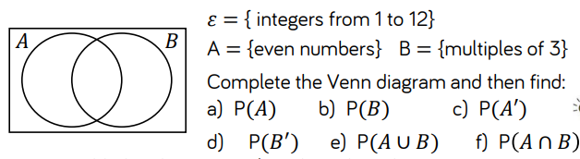
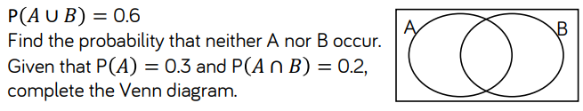
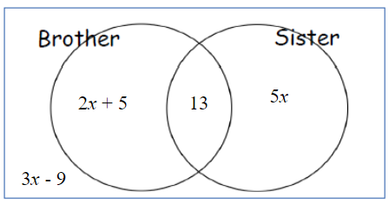
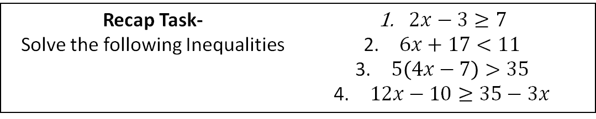
Year 10 Mathematics Homework
Half Term 4, Week 5
Recap Task-
Solve the following Inequalities
$2x−3≥7$
$6x+17<11$
$5\left(4x−7\right)>35$
$12x−10≥35−3x$
Main Task – Venn Diagrams
Key words – set, element, complement, intersect, union, event
Extension Task –
The Venn diagram shows information
about the siblings of 49 students
ξ = 49 students surveyed
13 students have both a brother
and a sister
Work out the probability of a student
having just a sister
What have been your strengths in maths this week?
What have been the areas that have challenged you in maths this week?
How could you improve next week?
Building good people who take PRIDE in their time at school, RESPECT themselves and others, WORK TOGETHER as a community, showing RESILIENCE and EMPATHY for all.

Slide 75
Year 10 Photography Homework – Half Term 4, Week 1 -6
Preparation Task: Use the power point I have sent to you labelled
Visual Elements – work through the elements and create a photographic library of images on the power point
Photography Year Ten
Visual Elements
LO: To what extent do I understand how to creatively approach the GCSE Photography Course.
Extension Task – Start to gather objects (you may need a shopping list) to create your own photoshoot for your next homework
What have been your strengths in (insert subject) this week?
What have been the areas that have challenged you in (insert topic) this week?
How could you improve next week?

Slide 76
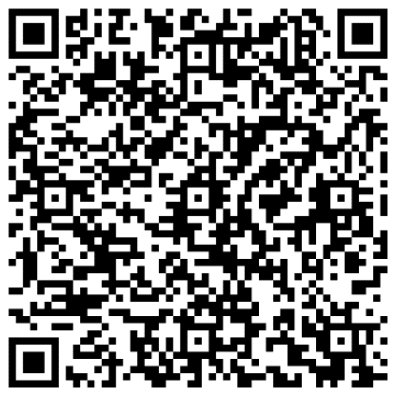
Year 10 Science Homework – Half Term 4, Week 5
Available: 21st March 2024
Due: 28th March 2024
C5: Energy Changes
P4: Atomic Structure
B3: Infection and Response
Main Task:
AND: Complete at least 10 marks of questions inside your exam question mastery booklets.
Leave on the table in lesson, let me know and I’ll mark the questions.
All questions completed should be stamped/ marked by me on or before the due date.
What have been your strengths in (insert subject) this week?
What have been the areas that have challenged you in (insert topic) this week?
How could you improve next week?
Building good people who take PRIDE in their time at school, RESPECT themselves and others, WORK TOGETHER as a community, showing RESILIENCE and EMPATHY for all.

Slide 77

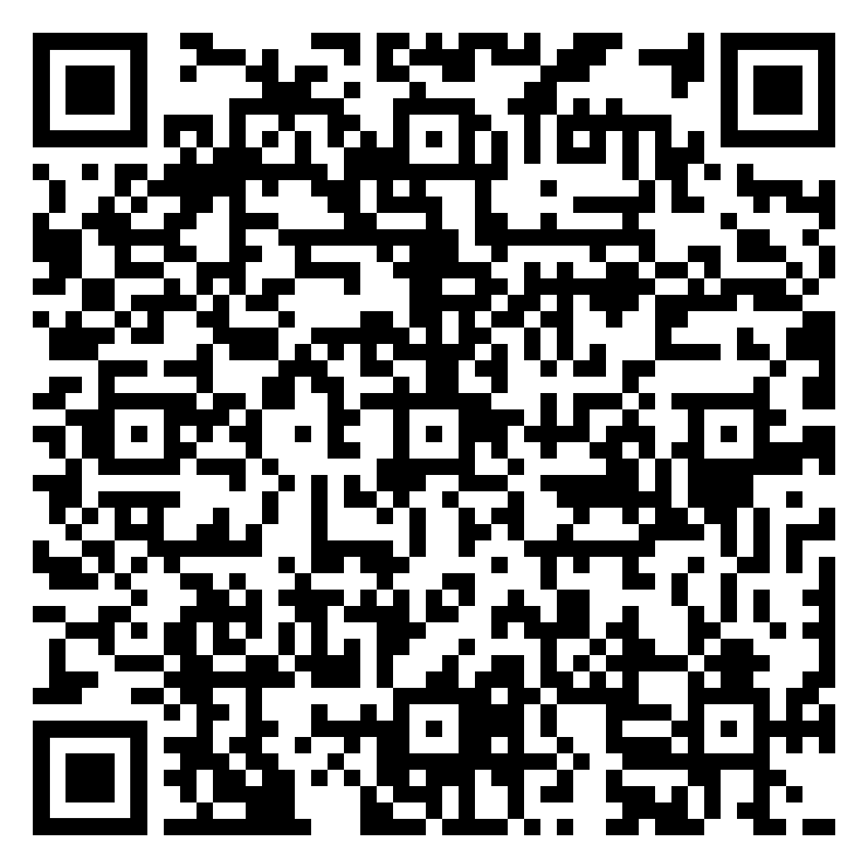
Year 10 RE Homework – Half Term 4, Week 5
What do you know about Islamic Beliefs? List three facts about Islamic beliefs.
1. Read the information and answer the questions in The Nature of Allah Week 5 document.
Answer the exam question, 'Explain the contrasting beliefs in Sunni and Shi'a Islam (4 marks) in The Nature of Allah Week 5 document.
Online document - The Nature of Allah Week 5.pdf
Key words – Qur'an, Sunnah, Sunni, Shi'a, immanent, transcendent, omnipotent, beneficent, merciful, fairness, justice (Adalat in Shi'a Islam)
Extension Task – Answer the 12 mark question, 'God cannot be both immanent and transcendent'
What have been your strengths in RE this week?
What have been the areas that have challenged you in RE this week?
How could you improve next week?
Building good people who take PRIDE in their time at school, RESPECT themselves and others, WORK TOGETHER as a community, showing RESILIENCE and EMPATHY for all.

Slide 78
Week 6 Homework

Slide 79
Week 6 Homework Due Dates
Subject | Day Due | Date Due
Building good people who take PRIDE in their time at school, RESPECT themselves and others, WORK TOGETHER as a community, showing RESILIENCE and EMPATHY for all.

Slide 80
Year 10 Business, Homework –
Half Term 6, Week 6
Recap Task – define the following:
Customer service
Main Task
Complete the test given out in class this week.
Key words – Look at key terms list
Extension Task - See Seneca
What have been your strengths this week?
What have been the areas that have challenged you this week?
How could you improve next week?
Building good people who take PRIDE in their time at school, RESPECT themselves and others, WORK TOGETHER as a community, showing RESILIENCE and EMPATHY for all.

Slide 81
Year 10 English Homework
Half Term 4, Week 6
Recap: what is Shakespeare's message about the divine right of kings? ………………………………………………………………………………………………………………………………………………………………………………………………………………………………………………………………………………………………………………………………………………………………………………………………………………………………………………………………………………………………………………………………………………………………………..
Write a review of 'Macbeth' that uses the six stages of an argument to tell your readers to go and see the play.​
Key words – AREDFEAST?
Extension Task – Are you reading for pleasure? Aim for four times per week for at least 20 minutes each time.
What have been your strengths in (insert subject) this week?
What have been the areas that have challenged you in (insert topic) this week?
How could you improve next week?
Building good people who take PRIDE in their time at school, RESPECT themselves and others, WORK TOGETHER as a community, showing RESILIENCE and EMPATHY for all.

Slide 82
Year 10 Fine Art Homework – Half Term, Week 1-6
Preparation Task: Make sure you collect the sketchbook from Miss O'Malley and have the resources your need to work from.
If you need things printing off please arrange this before the deadlines
In your sketchbook over the next 6 week you will have:
Collage – ripped coloured paper pepper
Collage – cut paper collage pepper
Water colour papper
Acrylic painied pepper
String collage and printed pepper
Quick print foam pepper
Key words –Observational studies, media development, line, tone, colour, shape, pattern space
Extension Task Work into your drawings for longer than 20 mins per week.
What have been your strengths in (insert subject) this week?
What have been the areas that have challenged you in (insert topic) this week?
How could you improve next week?
Building good people who take PRIDE in their time at school, RESPECT themselves and others, WORK TOGETHER as a community, showing RESILIENCE and EMPATHY for all.

Slide 83
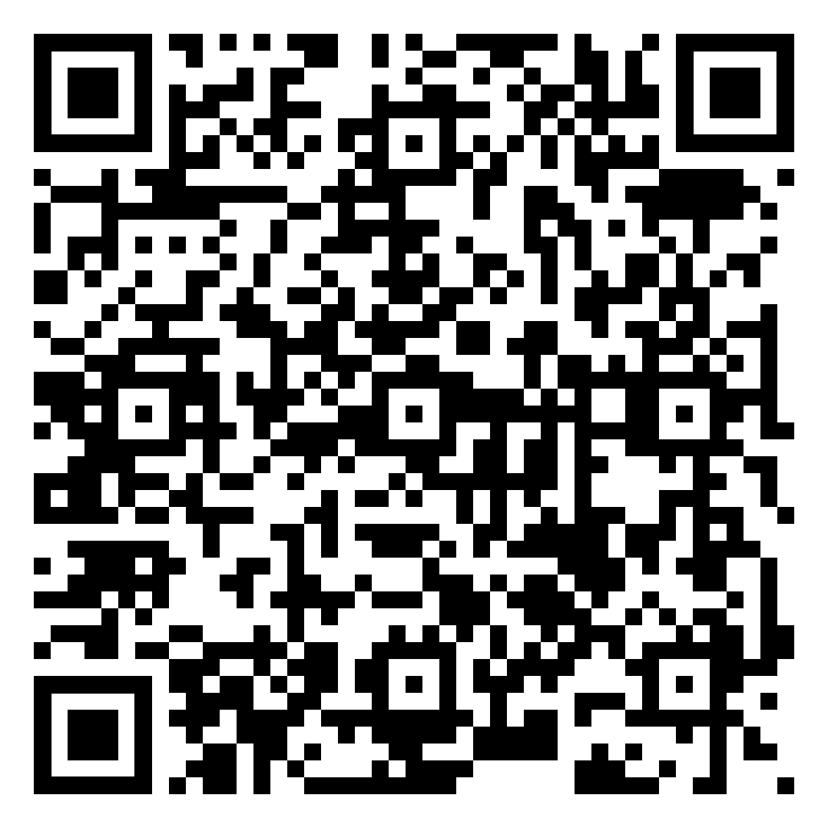
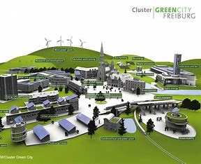
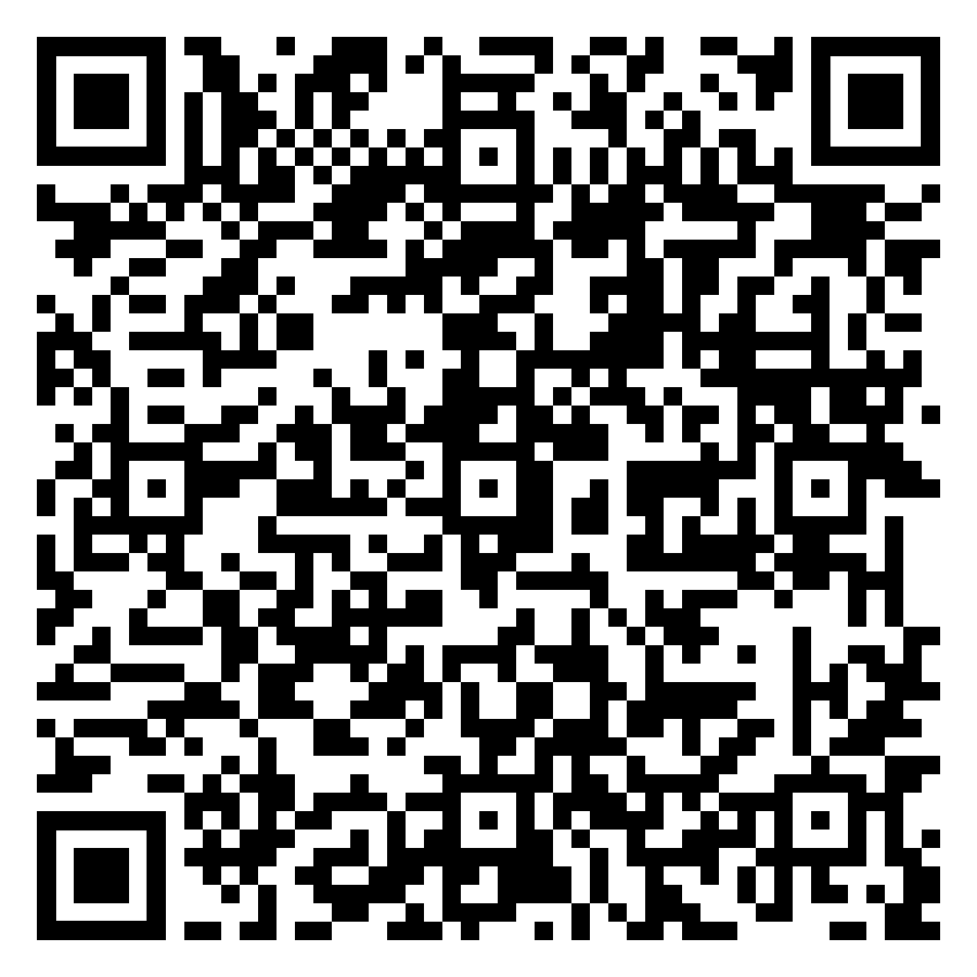
Year 10 Geography Homework – Half Term 4, Week 6
Urbanisation End of Unit Quiz
Complete the activities on the Sustainable Urban Development Freiburg Week 6 document.
Online document:
Sustainable Urban Development Freiburg Week 6.pptx
Key words – sustainability, energy conservation, waste recycling, renewable resources, traffic congestion, traffic plans, social planning, economic planning, environmental planning
Extension Task – Explain how reducing resource use in an urban area can help it to become more sustainable (6 Marks)
What have been your strengths in Geography this week?
What have been the areas that have challenged you in Geography this week?
How could you improve next week?
Building good people who take PRIDE in their time at school, RESPECT themselves and others, WORK TOGETHER as a community, showing RESILIENCE and EMPATHY for all.

Slide 84
Year 10 History Homework – Half Term 4, Week 6
1. What was Papal Bull?
2. What are Missionaries?
3. What are Jesuits?
4. Who was Campion?
5. What were Elizabeth’s new laws?
Flash Cards:
Go back through the work we have completed this half term.
Pick 3-4 key bits from each week.
Take the bits and turn them into flash cards (examples available).
Each card should be around 10cm long and 5cm high.
Each card should have 1 of the key bits described on one side and on the other side it should have a word/clue/picture to summarise it.
Key words – Elizabeth, problems, court, rebellion, religion
Extension Task – Seneca:
Join class - Seneca task -
What have been your strengths in History this week?
What have been the areas that have challenged you in History this week?
How could you improve next week?
Building good people who take PRIDE in their time at school, RESPECT themselves and others, WORK TOGETHER as a community, showing RESILIENCE and EMPATHY for all.

Slide 85
Year 10 Languages Homework
Half Term 4
Vocabulary and Translation Practise
For this homework, you will need a copy of the Sentence Builder.
Task 1 | Test yourself on the items in the sentence builder using the Look-Say-Cover-Write-Check method.
Task 2 | Ask a friend or a relative to test you on individual items from the sentence builder.
Task 3 | Ask a friend or a relative to test you on full sentences from the sentence builder.
Task 4 | Practise this week's topic on Linguascope. (See Mr Downey for the login details).
Task 5 | Find a new song in your preferred language on Lyrics Training. Can you challenge yourself to the higher levels?
What have been your strengths in Languages this week?
What have been the areas that have challenged you in Languages this week?
How could you improve next week?
Building good people who take PRIDE in their time at school, RESPECT themselves and others, WORK TOGETHER as a community, showing RESILIENCE and EMPATHY for all.

Slide 86
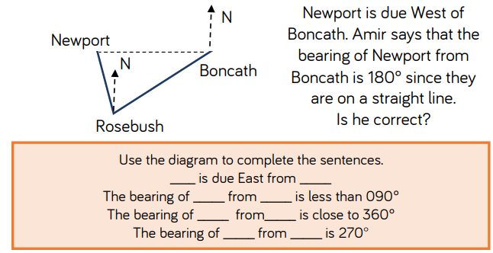
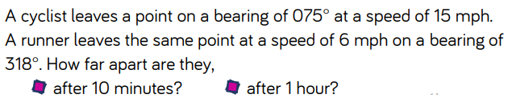
Year 10 Mathematics Homework
Half Term 4, Week 6
Recap Task - Bearings
Main Task – End of Term Review
Review all the maths content you have been taught this term
Make notes on all topics including neatly worked examples
Ask a friend or relative to test you using your notes
Key words – Probability, Vectors, Percentages
Extension Task –
What have been your strengths in maths this week?
What have been the areas that have challenged you in maths this week?
How could you improve next week?
Building good people who take PRIDE in their time at school, RESPECT themselves and others, WORK TOGETHER as a community, showing RESILIENCE and EMPATHY for all.

Slide 87
Year 10 Photography Homework – Half Term 4, Week 1 -6
Preparation Task: Use the power point I have sent to you labelled
Visual Elements – work through the elements and create a photographic library of images on the power point
Photography Year Ten
Visual Elements
LO: To what extent do I understand how to creatively approach the GCSE Photography Course.
Extension Task – Start to gather objects (you may need a shopping list) to create your own photoshoot for your next homework
What have been your strengths in (insert subject) this week?
What have been the areas that have challenged you in (insert topic) this week?
How could you improve next week?

Slide 88
Year 10 Science Homework – Half Term 4, Week 6
Main Task: (Due 18th April 2024)
AND: Complete at least 20 marks each of questions inside your biology, chemistry and physics exam question booklets.
If you have completed the questions, go through with the answers and mark with a purple pen any corrections.
Leave on the table in lesson, let me know and I’ll mark the questions.
All questions completed should be stamped/ marked by me on or before the due date.
Booklet (E.G: C3) | Question / Marks
What have been your strengths in (insert subject) this week?
What have been the areas that have challenged you in (insert topic) this week?
How could you improve next week?
Building good people who take PRIDE in their time at school, RESPECT themselves and others, WORK TOGETHER as a community, showing RESILIENCE and EMPATHY for all.

Slide 89

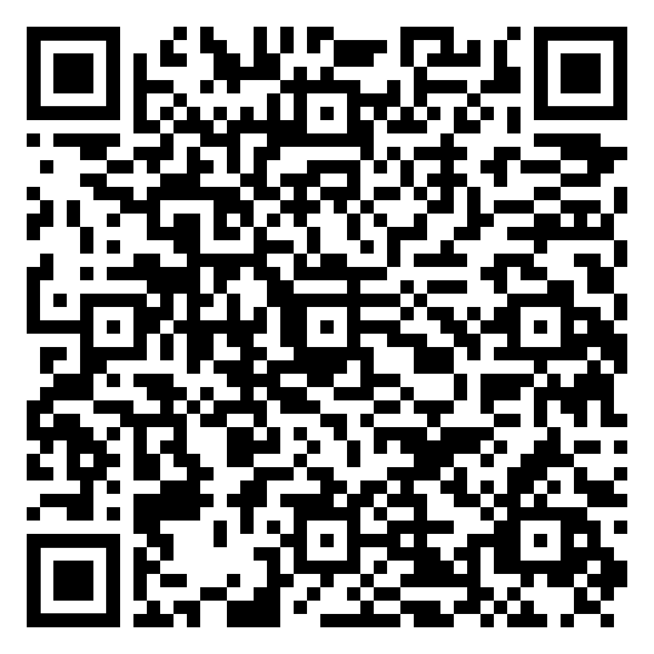


Year 10 RE Homework – Half Term 4, Week 6
The Oneness of God quiz
Draw a comic representing the jobs of at least 5 angels. Use the Angels Week 6 document to help you.
Online document - Angels Week 6.pdf
Key words – angels, day of Judgement, Jibril, Mika'il
Extension Task – complete the table interpreting Islamic teachings about Angels in the Angels Week 6 document.
What have been your strengths in RE this week?
What have been the areas that have challenged you in RE this week?
How could you improve next week?
Building good people who take PRIDE in their time at school, RESPECT themselves and others, WORK TOGETHER as a community, showing RESILIENCE and EMPATHY for all.

Slide 90
Building good people who take PRIDE in their time at school, RESPECT themselves and others, WORK TOGETHER as a community, showing RESILIENCE and EMPATHY for all.

