Slide 1

St. James' School Homework Booklet
Year 11
Lent Term HT4
Building good people who take PRIDE in their time at school, RESPECT themselves and others, WORK TOGETHER as a community, showing RESILIENCE and EMPATHY for all.

Slide 2

Name -
My Timetable at St. James’ School
Friday
Thursday
Wednesday
Tuesday
Monday
 | Tutorial (8.40-8.50) | Tutorial Lesson (8.50-9.20) | Lesson 1 (9.20-10.10) | Lesson 2 (10.10-11.00) | Lesson 3 (11.20-12.10) | Lesson 4 (12.10-13.00) | Extracurricular (13.40-14.10) | Lesson 5 (14.10-15.05) | Lesson 6 (15.05-16.00)
Building good people who take PRIDE in their time at school, RESPECT themselves and others, WORK TOGETHER as a community, showing RESILIENCE and EMPATHY for all.

Slide 3
Homework at St. James’ School
Independent study is an essential part of the learning. Pupils will have homework set on a regular basis that is meaningful and appropriate. This must be clearly recorded in the planner with an appropriate deadline.
Homework is set in order to, involve parents and guardians with learning, develop independent study skills which will allow pupils to achieve academic success, allow pupils to grow as independent and life-long learners through developing their confidence, motivation and self-discipline, reinforce, consolidate and/or extend what pupils know and can do in the classroom.
Regularity of Homework
This will be dependent on curriculum time and the allocation for each subject as well as the age range of the pupils. Pupils will receive at least one piece of homework per subject per week.
Guideline allocation for Homework:
Year 7, 8 and 9: 30 minutes per subject
Year 10 and 11: Around 45 minutes per subject
Year 11 Homework Timetable
Monday​ | Tuesday​ | Wednesday​ | Thursday​ | Friday​
Building good people who take PRIDE in their time at school, RESPECT themselves and others, WORK TOGETHER as a community, showing RESILIENCE and EMPATHY for all.

Slide 4
Lent Term HT4 Uniform and Equipment
Required uniform for ALL pupils:
St. James’ Blazer
St. James’ Tie
Black Trousers/St. James’ Skirt
White Collared Shirt
Black School Shoes
Black Socks with Trousers
Black Tights with Skirts
Optional - Black Jumper/Cardigan
Optional – Plain Dark Coat
St. James’ PE Polo Shirt
St. James’ PE Shorts/Skort
St. James’ PE Tracksuit
St. James’ PE Sports Socks (green)
PE Trainers (any design)
Optional - St. James’ PE Waterproof
Required equipment for ALL pupils:
Black pen
Pencil
Ruler
Rubber
Calculator
Memory Pen
Is your uniform perfect all week? | Tutor Signature
Week 1 – Uniform Perfection?
Week 2 – Uniform Perfection?
Week 3 – Uniform Perfection?
Week 4 – Uniform Perfection?
Week 5 – Uniform Perfection?
Week 6 – Uniform Perfection?
Building good people who take PRIDE in their time at school, RESPECT themselves and others, WORK TOGETHER as a community, showing RESILIENCE and EMPATHY for all.

Slide 5
Lent Term HT4 Attendance
Being in school is important to your achievement, wellbeing, and wider development. Evidence shows that the students with the highest attendance throughout their time in school gain the best GCSE and A Level results.
Research found that pupils who performed better at secondary school missed fewer days than those who didn’t perform as well.
In 2019, secondary school pupils who didn’t achieve grade 9 to 4 in English and Maths missed 10 more days on average over the key stage than those who achieved grade 9 to 5 in both English and Maths.
Every moment in school counts, and days missed add up quickly. For example, a child who is absent for three days over a half term could miss 18 lessons in total.
The higher a pupil’s attendance, the more they are likely to learn, and the better they are likely to perform in exams and formal assessments.
*Information for the Department for Education (https://educationhub.blog.gov.uk/2023/05/18/school-attendance-important-risks-missing-day/)
Year 11 Lent Term HT4 Attendance
How many days did you miss last Half Term?
Last Half Term’s Attendance Percentage
How many days have you missed this Half Term?
This Half Term’s Attendance Percentage
Building good people who take PRIDE in their time at school, RESPECT themselves and others, WORK TOGETHER as a community, showing RESILIENCE and EMPATHY for all.

Slide 6


Pupil Wellbeing Information
Pupil wellbeing is at the centre of life at St. James’, in school you can talk to any member of the school staff who will be willing to listen and support you. Below is the school email for any questions you have or support you require:
wearelistening@saintjames.co.uk
Below this is a series of external support that the school has links with and can also be used:
Building good people who take PRIDE in their time at school, RESPECT themselves and others, WORK TOGETHER as a community, showing RESILIENCE and EMPATHY for all.

Slide 7
Lent Term HT4 Calendar
 | Monday | Tuesday | Wednesday | Thursday | Friday
Week 1 W/C 19/2/24
Week 2 W/C 26/2/24 | Year 11 and 13 Mock Exams | Year 11 and 13 Mock Exams | Year 11 and 13 Mock Exams | Year 11 and 13 Mock Exams | Year 11 and 13 Mock Exams
Week 3 W/C 4/3/24 | Year 11 and 13 Mock Exams English Week | Year 11 and 13 Mock Exams | Year 11 and 13 Mock Exams | Year 11 and 13 Mock Exams | Year 11 and 13 Mock Exams
Week 4 W/C 11/3/24 | Science Week
Week 5 W/C 18/3/24 |  |  |  |  | Blakeney Charity Event
Week 6 W/C 25/3/24 |  | Year 7, 8, 9 Progress Consultation Evening | Year 10, 11, 12, 13 Progress Consultation Evening | School Ends of Easter | Good Friday
*Please note that we will email home if there are any changes to dates.
Building good people who take PRIDE in their time at school, RESPECT themselves and others, WORK TOGETHER as a community, showing RESILIENCE and EMPATHY for all.

Slide 8
Lent Term HT4 Merits
1 | 2 | 3 | 4 | 5
6 | 7 | 8 | 9 | 10
11 | 12 | 13 | 14 | 15
16 | 17 | 18 | 19 | 20
21 | 22 | 23 | 24 | 25
26 | 27 | 28 | 29 | 30
31 | 32 | 33 | 34 | 35
Building good people who take PRIDE in their time at school, RESPECT themselves and others, WORK TOGETHER as a community, showing RESILIENCE and EMPATHY for all.

Slide 9
Lent Term HT4 Merits
36 | 37 | 38 | 39 | 40
41 | 42 | 43 | 44 | 45
46 | 47 | 48 | 49 | 50
51 | 52 | 53 | 54 | 55
56 | 57 | 58 | 59 | 60
61 | 62 | 63 | 64 | 65
66 | 67 | 68 | 69 | 70
Building good people who take PRIDE in their time at school, RESPECT themselves and others, WORK TOGETHER as a community, showing RESILIENCE and EMPATHY for all.

Slide 10
Lent Term HT4 Merits
71 | 72 | 73 | 74 | 75
76 | 77 | 78 | 79 | 80
81 | 82 | 83 | 84 | 85
86 | 87 | 88 | 89 | 90
91 | 92 | 93 | 94 | 95
96 | 97 | 98 | 99 | 100
101 | 102 | 103 | 104 | 105
Building good people who take PRIDE in their time at school, RESPECT themselves and others, WORK TOGETHER as a community, showing RESILIENCE and EMPATHY for all.

Slide 11
Lent Term HT4 Merits
106 | 107 | 108 | 109 | 110
111 | 112 | 113 | 114 | 115
116 | 117 | 118 | 119 | 120
121 | 122 | 123 | 124 | 125
126 | 127 | 128 | 129 | 130
131 | 132 | 133 | 134 | 135
136 | 137 | 138 | 139 | 140
Building good people who take PRIDE in their time at school, RESPECT themselves and others, WORK TOGETHER as a community, showing RESILIENCE and EMPATHY for all.

Slide 12
Lent Term HT4 Notes
Building good people who take PRIDE in their time at school, RESPECT themselves and others, WORK TOGETHER as a community, showing RESILIENCE and EMPATHY for all.

Slide 13
Lent Term HT4 Notes
Building good people who take PRIDE in their time at school, RESPECT themselves and others, WORK TOGETHER as a community, showing RESILIENCE and EMPATHY for all.

Slide 14
Lent Term HT4 Notes
Building good people who take PRIDE in their time at school, RESPECT themselves and others, WORK TOGETHER as a community, showing RESILIENCE and EMPATHY for all.

Slide 15
Lent Term HT4 Notes
Building good people who take PRIDE in their time at school, RESPECT themselves and others, WORK TOGETHER as a community, showing RESILIENCE and EMPATHY for all.

Slide 16
Week 1 Homework

Slide 17
Week 1 Homework Due Dates
Subject | Day Due | Date Due
Building good people who take PRIDE in their time at school, RESPECT themselves and others, WORK TOGETHER as a community, showing RESILIENCE and EMPATHY for all.

Slide 18

Year 11 Business Studies Homework – Half Term 4, Week 1
Recap
Define the following:
Flow, Batch, Job Production
Main Task
Main Task
1 What is an ‘organisational structure’? (2 marks)
2 A business has four levels of hierarchy: a CEO, 4 directors, 16 managers and 64 team leaders. Which of the following is the CEO’s span of control? (1 mark)
3. Explain the difference between a tall and a
flat organisational structure. (4 marks)
4. A business has moved from a tall to a flat organisational structure. List possible positives and negatives. (4 marks)
Key words: Human Resources, Organisational Structures
Extension Task - See Seneca
What have been your strengths this week?
What have been the areas that have challenged you this week?
How could you improve next week?
Building good people who take PRIDE in their time at school, RESPECT themselves and others, WORK TOGETHER as a community, showing RESILIENCE and EMPATHY for all.

Slide 19
Year 11 English Homework
Half Term 4, Week 1
Recap: What are the expectations of IGCSE First Language English Paper One? ………………………………………………………………………………………………………………………………………………………………………………………………………………………………………………………………………………………………………………………………………………………………………………………………………………………………………………………………………………………………………………………………………………………………………..
Homework: read the short story given to you in class.
Key words – metaphor, simile, personification, pathetic fallacy.
Extension Task – Keep in touch with English Literature: Maintain familiarity with Power and Conflict poetry
What have been your strengths in (insert subject) this week?
What have been the areas that have challenged you in (insert topic) this week?
How could you improve next week?
Building good people who take PRIDE in their time at school, RESPECT themselves and others, WORK TOGETHER as a community, showing RESILIENCE and EMPATHY for all.

Slide 20
Year 11 IGCSE ESL Homework – Half Term 4, Week 1
Recap Task – Create a mind map stating some examples of Communities
Unit : Animals and us
Read the article (p.36) describing the basic needs of pets. To check understanding; complete the six questions.
Key words – bonds, forged, nurtured, behavioural, preventive, abandoned, suitability, consistent, environment, factors
Extension Task – Complete reading: English short stories
What have been your strengths in ESL this week?
What have been the areas that have challenged you in ESL this week?
How could you improve next week?
Building good people who take PRIDE in their time at school, RESPECT themselves and others, WORK TOGETHER as a community, showing RESILIENCE and EMPATHY for all.

Slide 21
Year 11 Fine Art / Photography
External Exam Homework Term 3, Week 1
Recap Task – review the External Exam Themes
Do some research in to which one you will spend the next 8 weeks researching
Main Task – The above – if not already complete
If done check all these items are complete before proceeding.
Title page and brainstorm
Mood board / images for inspiration
Statement of intent
Artist 1,2 & 3
Artist copies ( your work but in their style)
Observations studies where appropriate but this could also be a photoshoot and sketches of workings out
Catch up on these if not complete
Then: start to develop your ideas with your artists.
Eg takes ideas from your observational sketches or photographs and repeat these in the artists style. Do this in a range of media appropriate to your artists - ( Chat to Miss in school about this if you are unsure)
Key words line: Colour. Texture, shapes, pattern, space
Extension Task –Make extra studies of your theme using, pen, pencil, biro, watercolours, acrylics, drawing into photographs – add at least one per week to your work.
What have been your strengths in (insert subject) this week?
What have been the areas that have challenged you in (insert topic) this week?
How could you improve next week?
Building good people who take PRIDE in their time at school, RESPECT themselves and others, WORK TOGETHER as a community, showing RESILIENCE and EMPATHY for all.

Slide 22

Year 11 French Homework
Half Term 4
General Conversation Practise
Practise your general conversation questions for all three themes.
Ensure your answers contain:
More than one tense where possible and logical
Example:
Question: Où vas-tu normalement en vacances ?
Answer: Normalement je vais (present) en vacances en Italie avec ma famile mais l'année dernière je suis allée (past tense) en France avec l'école et l'année prochaine j'irai (future) aux États-Unis avec mes copains.
Opinions and justifications at every occasion
Time yourself, and make sure that your conversation lasts at least 6 minutes.
Speak to Mr Downey if you would like your answers recording so you can listen to them
Remember, you cannot have your answers marked because it has to be your own work.
What have been your strengths in Languages this week?
What have been the areas that have challenged you in Languages this week?
How could you improve next week?
Building good people who take PRIDE in their time at school, RESPECT themselves and others, WORK TOGETHER as a community, showing RESILIENCE and EMPATHY for all.

Slide 23
Year 11 GCSE PE Homework – Half Term 4 – Weeks 1 to 6
The aim of the homework this half term is to help build upon the Analysis and Evaluation coursework. Prior to the Christmas break, each pupil submitted a first draft of the A and E piece of course work. Homework is to revisit and make improvements on feedback. Revision will be given on key areas that are linked to mock exams and the work for Paper 1 and Paper 2.
Analysis and Evaluation:
Prior to Christmas, you were given the task of choosing a sport for your Analysis and Evaluation and to write up a strength and weakness of skill in the chosen sport, a strength and weakness for a component of fitness in that chosen sport and to look at the fitness tests that link into the components of fitness that you chose for your sport.
Over the next six weeks, your task will be to improve this piece of work. You have submitted your first and second drafts. These has been marked with feedback and recommended changes given. The deadline for the final piece of work to be submitted will be Tuesday 26th March. This will be the final submission date.
I will be setting tasks in lesson differentiated to each pupils' individual needs that link to the course work. This will be set by myself weekly on a Thursday and are to be completed for the following Thursday's lesson during the 30 minutes allowance for homework. This homework will be based around exam questioning ranging from 1 mark to 9 mark questions.
Key words – Analysis and Evaluation, Skill, Strength, Weakness
Extension Task – Continue to look at lesson notes from week to week to help complete this piece of coursework.
What have been your strengths in GCSE PE this week?
What have been the areas that have challenged you in GCSE PE this week?
How could you improve next week?
Building good people who take PRIDE in their time at school, RESPECT themselves and others, WORK TOGETHER as a community, showing RESILIENCE and EMPATHY for all.

Slide 24

Year 11 Geography Homework – Half Term 4, Week 1
Check your knowledge using:
https://www.internetgeography.net/geography-quizzes/
https://www.tutor2u.net/geography/collections/clear-the-deck-interactive-revision-activities-for-aqa-gcse-geography
Revise for Mock Examination.. Use the following resources to help you:
Geography Folder for Paper 1 and Urban Environments notes in Folder for Paper 2
Revision Guide (Geography AQA GCSE)
https://www.tutor2u.net/geography/reference
https://www.bbc.co.uk/bitesize/examspecs/zy3ptyc
Revision videos: https://cm.tutor2u.net/t/j-l-egkkud-ddltddsv-j/
https://cm.tutor2u.net/t/j-l-egkkud-ddltddsv-t/
https://m.youtube.com/resultssp=mAEA&search_query=Geography+hawks+aqa
Key words – Follow link for list of key words https://filestore.aqa.org.uk/resources/geography/AQA-8035-SSV.PDF
Extension Task – Practice exam questions given individually based on need.
What have been your strengths in Geography this week?
What have been the areas that have challenged you in Geography this week?
How could you improve next week?
Building good people who take PRIDE in their time at school, RESPECT themselves and others, WORK TOGETHER as a community, showing RESILIENCE and EMPATHY for all.

Slide 25
Year 11 History Homework – Half Term 4, Week 1
Go through the textbooks/revision guides and complete the tasks on the pages you are less certain about. The more you do the better your knowledge will become as you review the work.
Revision for the mock exams to be completed.
Please complete at least two of the below methods to revise:
Mind Map
Quiz
A4 Summary
Storyboard
Flash Cards
Exam Questions
If you require any advice or support on these then I have help sheets in my room.
Key words – N/A
Extension Task – Seneca.
What have been your strengths in History this week?
What have been the areas that have challenged you in History this week?
How could you improve next week?
Building good people who take PRIDE in their time at school, RESPECT themselves and others, WORK TOGETHER as a community, showing RESILIENCE and EMPATHY for all.

Slide 26
Year 11 Maths Homework – Half Term 4, Week 1
Recap Task –
When working through the past paper, begin to build up a stack of flash cards with key facts on.
Main Task – Past Paper
Jan 2023 Paper 1 – due on 1st March
Spend the next 2 weeks completing the past paper assigned by Mrs Thompson to the best of your ability.
Complete as much as you can in exam conditions in a black or blue pen
Then complete the questions you need help with in a different colour pen by either:
Looking it up
Asking a friend
Asking Mrs Thompson
Watch the you tube solution video emailed out
Extension Task – SENECA
Task assigned on SENECA based on this week's class content
What have been your strengths in maths this week?
What have been the areas that have challenged you in maths this week?
How could you improve next week?
Building good people who take PRIDE in their time at school, RESPECT themselves and others, WORK TOGETHER as a community, showing RESILIENCE and EMPATHY for all.

Slide 27

Year 11 Music
Composition & Performance
Homework – Half Term 4, Week 1
COMPOSITION
Work on your compositions
1.Composition To a Brief
Using appropriate elements, techniques and resources, compose a piece of music suitable to accompany a House of Horrors attraction at a theme park.
2. Free Composition
Write a folk song containing an instrumental section.
Make sure your compositions demonstrate use of the musical elements, at least two from each of these two lists –
•Rhythm, metre, texture, melody, structure, form
•Harmony, tonality, timbre, dynamics, phrasing, articulation.
e.g. Metre – include changes of time signature
Rhythm – use a variety of rhythmic motifs including triplets,
dotted notes and semi-quavers
Tonality – change key signature at least once, use the relative
minor
PERFORMANCE
Work on your performances
Make sure you are singing in the correct style for your chosen pieces and musical elements including dynamics, articulation and ornamentation where appropriate
What have been your strengths in Music this week?
What have been the areas that have challenged you in Music this week?
How could you improve next week?
Building good people who take PRIDE in their time at school, RESPECT themselves and others, WORK TOGETHER as a community, showing RESILIENCE and EMPATHY for all.

Slide 28
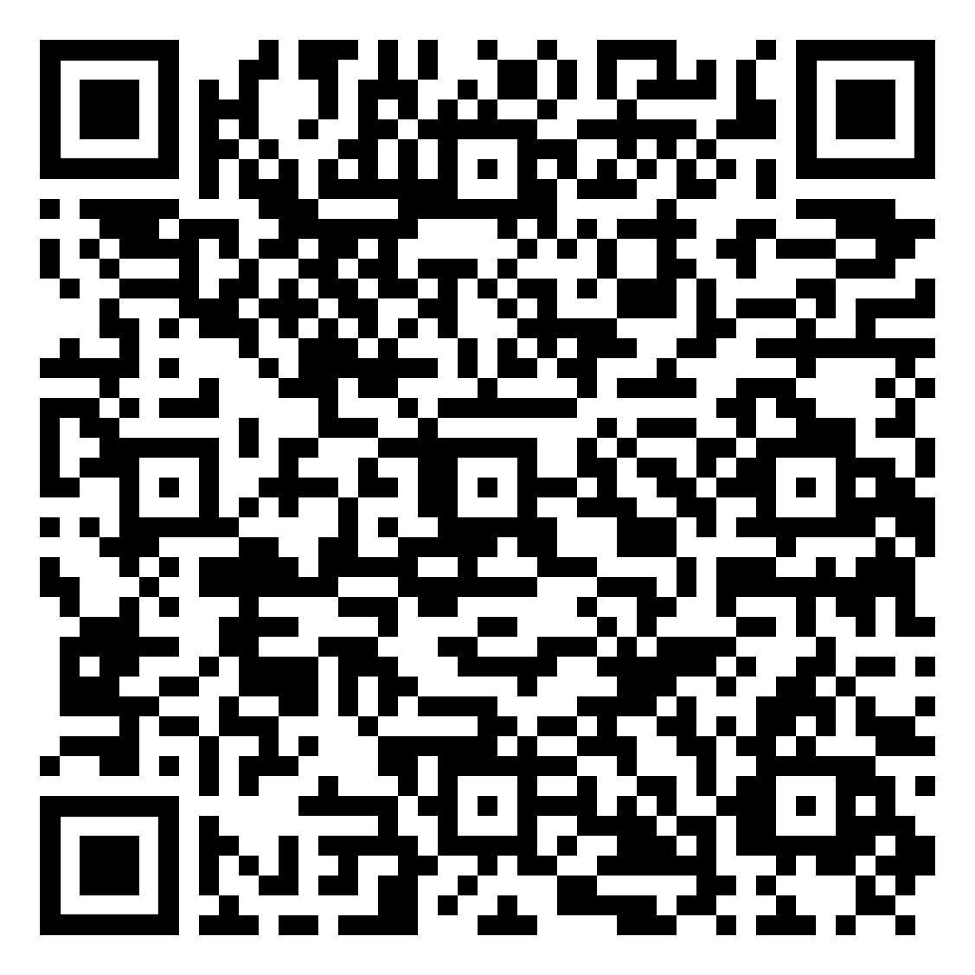
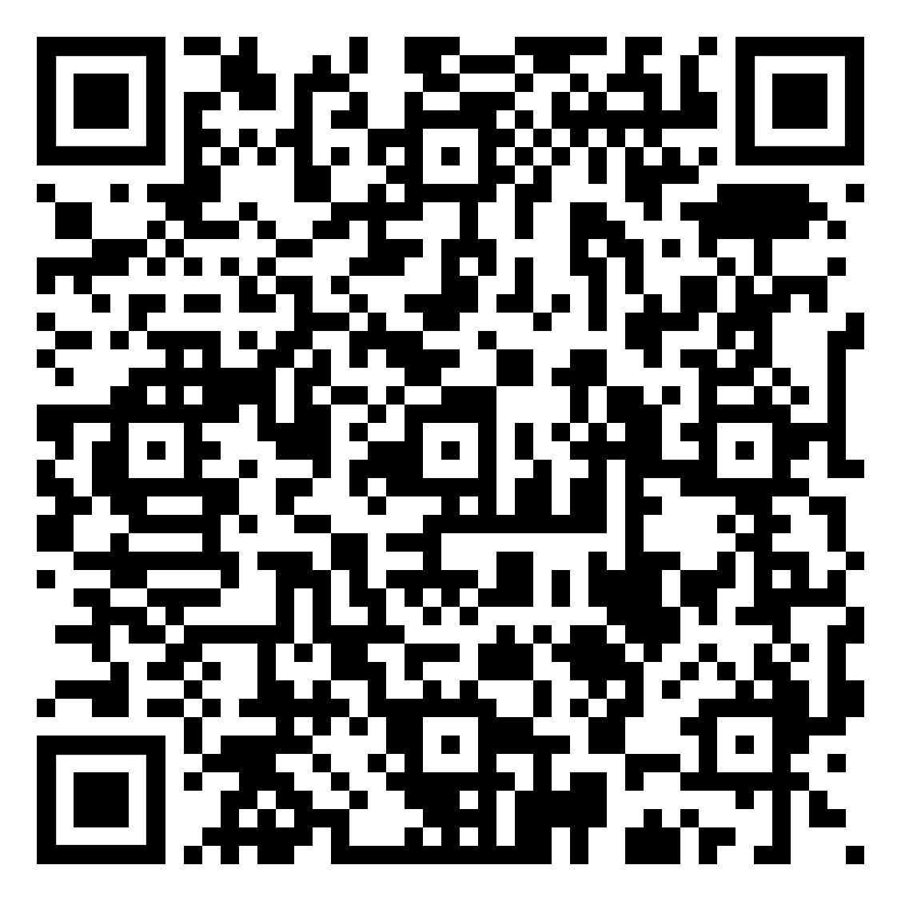
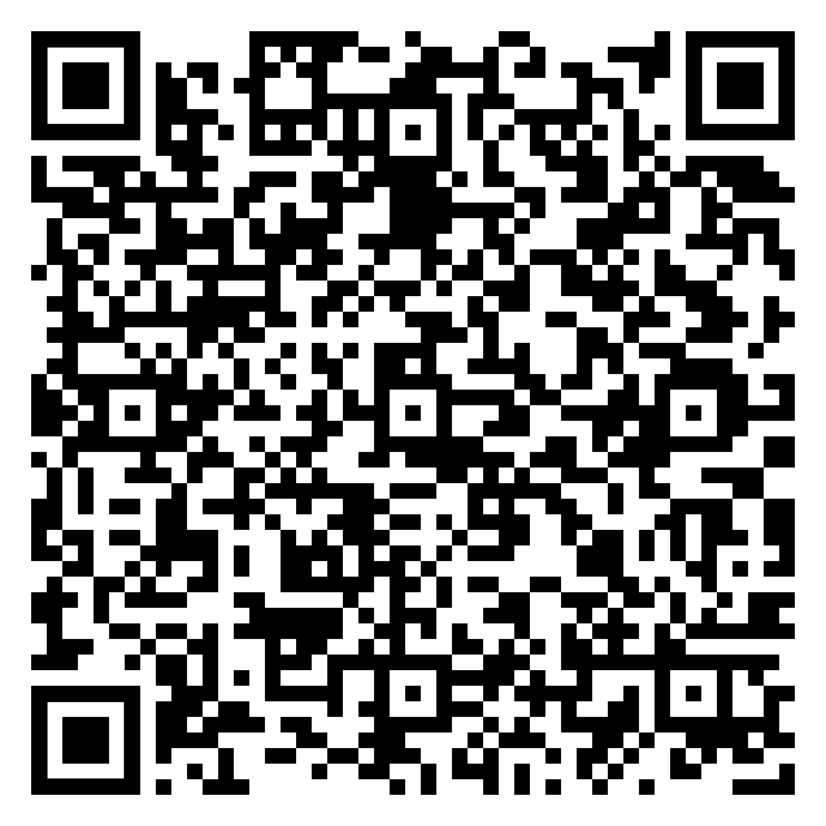
Year 11 RE Homework – Half Term 4, Week 1
Complete Weapons of Mass Destruction Quiz
on Seneca
Revise for Paper 1. See e-mail for more
revision materials.
Complete end of Topic Tests and Exam Questions for Christian and Islamic Beliefs and Practices on Seneca
Online documents - RE Homework Documents
Key words – See Paper 1 Key Words Document
Extension Task – Attempt another practice question from each section.
What have been your strengths in RE this week?
What have been the areas that have challenged you in RE this week?
How could you improve next week?
Building good people who take PRIDE in their time at school, RESPECT themselves and others, WORK TOGETHER as a community, showing RESILIENCE and EMPATHY for all.

Slide 29
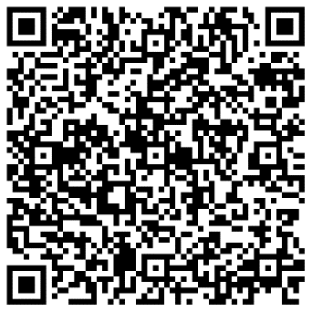
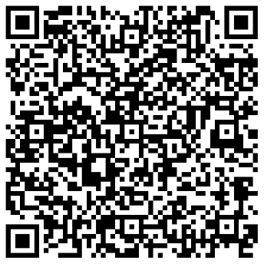
Year 11 Science Homework – Half Term 4, Week 1
Available: 23rd February 2024
Chemistry Paper 1
Physics Paper 1
Biology Paper 1
You are expected to complete the assignments by Week 6
Main Task:
Complete one of the exam papers given to you by your teachers. Show Evidence on the Friday of every week.
You can mark yourself (Mark Schemes on the Year 10/11 Shared Drive), or we can mark it.
Please ensure you highlight any questions so we can go through with you any topics – This will reflect in the revision lessons after Easter.
What have been your strengths in (insert subject) this week?
What have been the areas that have challenged you in (insert topic) this week?
How could you improve next week?
Building good people who take PRIDE in their time at school, RESPECT themselves and others, WORK TOGETHER as a community, showing RESILIENCE and EMPATHY for all.

Slide 30
Week 2 Homework

Slide 31
Week 2 Homework Due Dates
Subject | Day Due | Date Due
Building good people who take PRIDE in their time at school, RESPECT themselves and others, WORK TOGETHER as a community, showing RESILIENCE and EMPATHY for all.

Slide 32
Year 11 Business Studies Homework – Half Term 4, Week 2
Recap
Tall and flat Structures
Main Task
Complete the revision questions given out in class this week.
Key words – Revision Technique
Extension Task - See Seneca
What have been your strengths in organisational structures this week?
What have been the areas that have challenged you in organisational structures this week?
How could you improve next week?
Building good people who take PRIDE in their time at school, RESPECT themselves and others, WORK TOGETHER as a community, showing RESILIENCE and EMPATHY for all.

Slide 33
Year 11 English Homework
Half Term 4, Week 2
Recap: How many marks can you earn in the summary task? ………………………………………………………………………………………………………………………………………………………………………………………………………………………………………………………………………………………………………………………………………………………………………………………………………………………………………………………………………………………………………………………………………………………..……………………………………………………………………………………………………………………….. ….............................
Complete the summary task on page 2 of your homework booklet.
Key words – metaphor, simile, personification, pathetic fallacy.
Extension Task – Keep in touch with GCSE English Literature: Do you have a confident understanding of at least two poems from each of the following key themes: war, nature, family and society?
What have been your strengths in (insert subject) this week?
What have been the areas that have challenged you in (insert topic) this week?
How could you improve next week?
Building good people who take PRIDE in their time at school, RESPECT themselves and others, WORK TOGETHER as a community, showing RESILIENCE and EMPATHY for all.

Slide 34
Year 11 IGCSE ESL Homework – Half Term 4, Week 2
Recap Task- Vocabulary: Review the study set using flashcards provided
Main task: Complete the guideline grid with a set of 5 statements of advice for pet owners.
Language focus: Compose sentences using the animal as a symbol of the characteristic you think it may have.
Key words – elephant/ cow/ bee/ eel/ rhinoceros/ crocodile
Extension Task:
Review vocabulary list from English Short Stories book.
What have been your strengths in ESL this week?,
What have been the areas that have challenged you in ESL this week?
How could you improve next week?
Building good people who take PRIDE in their time at school, RESPECT themselves and others, WORK TOGETHER as a community, showing RESILIENCE and EMPATHY for all.

Slide 35
Year 11 Fine Art / Photography
External Exam Homework Term 3, Week 2
Recap Task – review the External Exam Themes
Do some research in to which one you will spend the next 8 weeks researching
Main Task – The above – if not already complete
If done check all these items are complete before proceeding.
Title page and brainstorm
Mood board / images for inspiration
Statement of intent
Artist 1,2 & 3
Artist copies ( your work but in their style)
Observations studies where appropriate but this could also be a photoshoot and sketches of workings out
Catch up on these if not complete
Then: start to develop your ideas with your artists.
Eg takes ideas from your observational sketches or photographs and repeat these in the artists style. Do this in a range of media appropriate to your artists - ( Chat to Miss in school about this if you are unsure)
Key words line: Colour. Texture, shapes, pattern, space
Extension Task –Make extra studies of your theme using, pen, pencil, biro, watercolours, acrylics, drawing into photographs – add at least one per week to your work.
What have been your strengths in (insert subject) this week?
What have been the areas that have challenged you in (insert topic) this week?
How could you improve next week?
Building good people who take PRIDE in their time at school, RESPECT themselves and others, WORK TOGETHER as a community, showing RESILIENCE and EMPATHY for all.

Slide 36
Year 11 French Homework
Half Term 4
General Conversation Practise
Practise your general conversation questions for all three themes.
Ensure your answers contain:
More than one tense where possible and logical
Example:
Question: Où vas-tu normalement en vacances ?
Answer: Normalement je vais (present) en vacances en Italie avec ma famile mais l'année dernière je suis allée (past tense) en France avec l'école et l'année prochaine j'irai (future) aux États-Unis avec mes copains.
Opinions and justifications at every occasion
Time yourself, and make sure that your conversation lasts at least 6 minutes.
Speak to Mr Downey if you would like your answers recording so you can listen to them
Remember, you cannot have your answers marked because it has to be your own work.
What have been your strengths in Languages this week?
What have been the areas that have challenged you in Languages this week?
How could you improve next week?
Building good people who take PRIDE in their time at school, RESPECT themselves and others, WORK TOGETHER as a community, showing RESILIENCE and EMPATHY for all.

Slide 37
Year 11 Geography Homework – Half Term 4, Week 2
Check your knowledge using:
https://www.internetgeography.net/geography-quizzes/
https://www.tutor2u.net/geography/collections/clear-the-deck-interactive-revision-activities-for-aqa-gcse-geography
Revise for Mock Examination.. Use the following resources to help you:
Geography Folder for Paper 1 and Urban Environments notes in Folder for Paper 2
Revision Guide (Geography AQA GCSE)
https://www.tutor2u.net/geography/reference
https://www.bbc.co.uk/bitesize/examspecs/zy3ptyc
Revision videos: https://cm.tutor2u.net/t/j-l-egkkud-ddltddsv-j/
https://cm.tutor2u.net/t/j-l-egkkud-ddltddsv-t/
https://m.youtube.com/resultssp=mAEA&search_query=Geography+hawks+aqa
Key words – Follow link for list of key words https://filestore.aqa.org.uk/resources/geography/AQA-8035-SSV.PDF
Extension Task – Practice exam questions given individually based on need.
What have been your strengths in Geography this week?
What have been the areas that have challenged you in Geography this week?
How could you improve next week?
Building good people who take PRIDE in their time at school, RESPECT themselves and others, WORK TOGETHER as a community, showing RESILIENCE and EMPATHY for all.

Slide 38
Year 11 History Homework – Half Term 4, Week 2
Go through the textbooks/revision guides and complete the tasks on the pages you are less certain about. The more you do the better your knowledge will become as you review the work.
Revision for the mock exams to be completed.
Please complete at least two of the below methods to revise:
Mind Map
Quiz
A4 Summary
Storyboard
Flash Cards
Exam Questions
If you require any advice or support on these then I have help sheets in my room.
Key words – N/A
Extension Task – Seneca.
What have been your strengths in History this week?
What have been the areas that have challenged you in History this week?
How could you improve next week?
Building good people who take PRIDE in their time at school, RESPECT themselves and others, WORK TOGETHER as a community, showing RESILIENCE and EMPATHY for all.

Slide 39
Year 11 Maths Homework – Half Term 4, Week 2
Recap Task –
When working through the past paper, begin to build up a stack of flash cards with key facts on.
Main Task – Past Paper
Jan 2023 Paper 1 – due on 1st March
Spend the next 2 weeks completing the past paper assigned by Mrs Thompson to the best of your ability.
Complete as much as you can in exam conditions in a black or blue pen
Then complete the questions you need help with in a different colour pen by either:
Looking it up
Asking a friend
Asking Mrs Thompson
Watch the you tube solution video emailed out
Extension Task – SENECA
Task assigned on SENECA based on this week's class content
What have been your strengths in maths this week?
What have been the areas that have challenged you in maths this week?
How could you improve next week?
Building good people who take PRIDE in their time at school, RESPECT themselves and others, WORK TOGETHER as a community, showing RESILIENCE and EMPATHY for all.

Slide 40
Year 11 Music
Composition & Performance
Homework – Half Term 4, Week 2
COMPOSITION
Work on your compositions
1.Composition To a Brief
Using appropriate elements, techniques and resources, compose a piece of music suitable to accompany a House of Horrors attraction at a theme park.
2. Free Composition
Write a folk song containing an instrumental section.
Make sure your compositions demonstrate use of the musical elements, at least two from each of these two lists –
•Rhythm, metre, texture, melody, structure, form
•Harmony, tonality, timbre, dynamics, phrasing, articulation.
e.g. Metre – include changes of time signature
Rhythm – use a variety of rhythmic motifs including triplets,
dotted notes and semi-quavers
Tonality – change key signature at least once, use the relative
minor
PERFORMANCE
Work on your performances
Make sure you are singing in the correct style for your chosen pieces and musical elements including dynamics, articulation and ornamentation where appropriate
What have been your strengths in Music this week?
What have been the areas that have challenged you in Music this week?
How could you improve next week?
Building good people who take PRIDE in their time at school, RESPECT themselves and others, WORK TOGETHER as a community, showing RESILIENCE and EMPATHY for all.

Slide 41

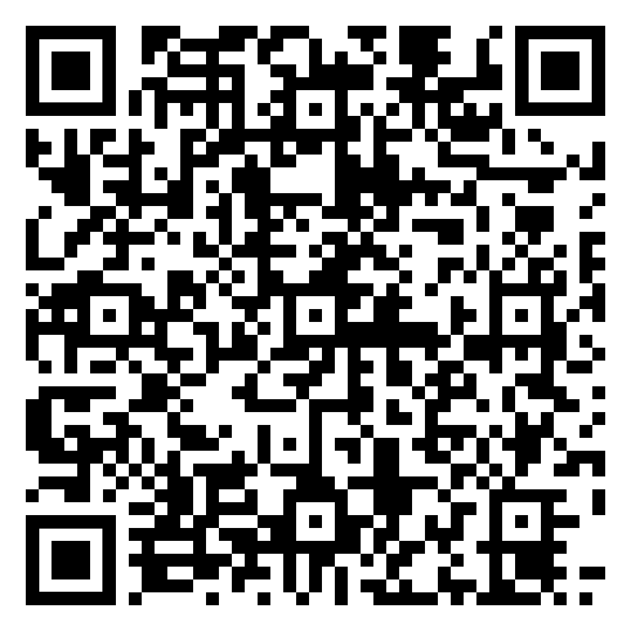
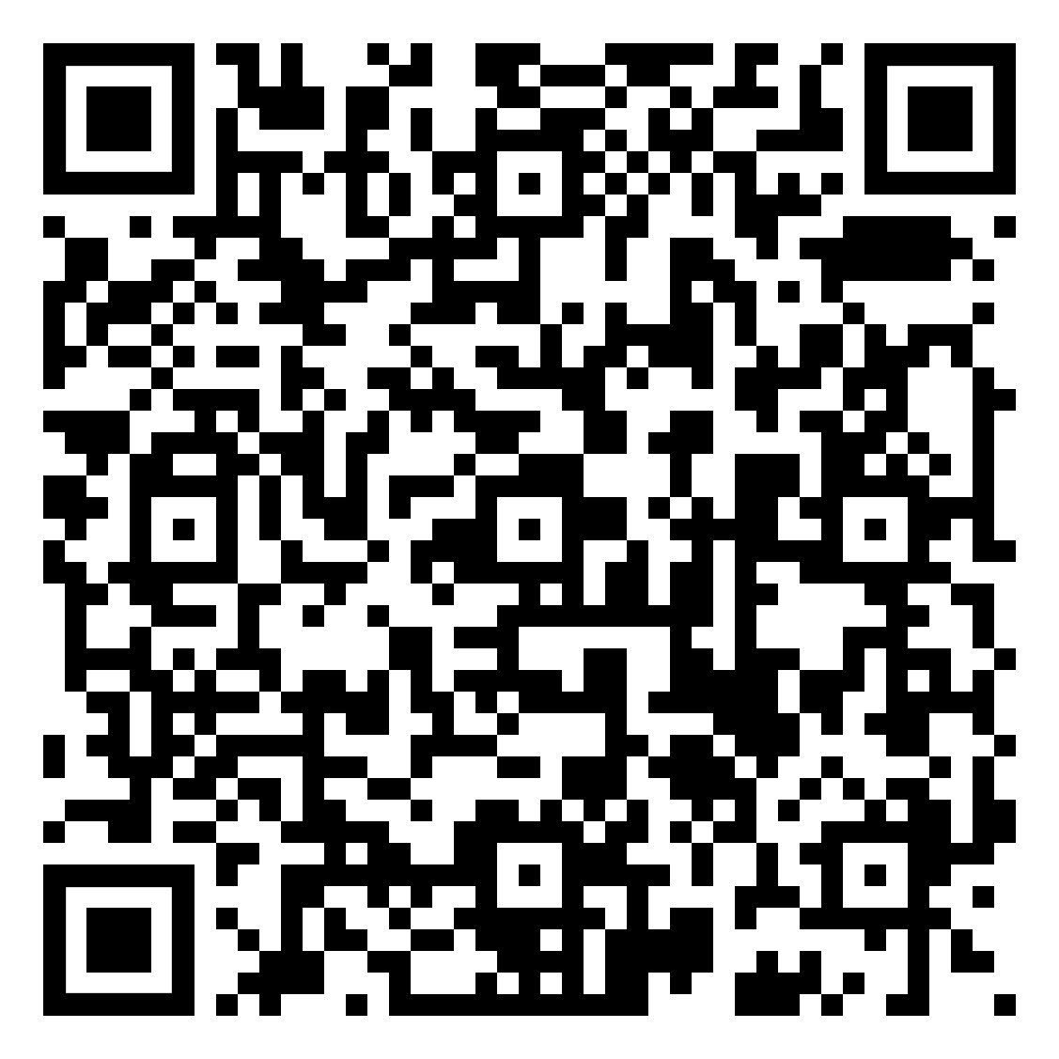
Year 11 RE Homework – Half Term 4, Week 2
Religious Responses to Victims of War Quiz
Revise for Paper 2. See e-mail for
more revision resources.
End of Unit Tests and Exam style Questions for Themes A, B, D and E on Seneca.
Online documents - RE Homework Documents
Key words – See Paper 2 Key Words Document
Extension Task – Attempt another practice question from each section.
What have been your strengths in RE this week?
What have been the areas that have challenged you in RE Revision this week?
How could you improve next week?
Building good people who take PRIDE in their time at school, RESPECT themselves and others, WORK TOGETHER as a community, showing RESILIENCE and EMPATHY for all.

Slide 42
Year 11 Science Homework – Half Term 4, Week 2
Available: 23rd February 2024
Chemistry Paper 1
Physics Paper 1
Biology Paper 1
You are expected to complete the assignments by Week 6
Main Task:
Complete one of the exam papers given to you by your teachers. Show Evidence on the Friday of every week.
You can mark yourself (Mark Schemes on the Year 10/11 Shared Drive), or we can mark it.
Please ensure you highlight any questions so we can go through with you any topics – This will reflect in the revision lessons after Easter.
What have been your strengths in (insert subject) this week?
What have been the areas that have challenged you in (insert topic) this week?
How could you improve next week?
Building good people who take PRIDE in their time at school, RESPECT themselves and others, WORK TOGETHER as a community, showing RESILIENCE and EMPATHY for all.

Slide 43
Week 3 Homework

Slide 44
Week 3 Homework Due Dates
Subject | Day Due | Date Due
Building good people who take PRIDE in their time at school, RESPECT themselves and others, WORK TOGETHER as a community, showing RESILIENCE and EMPATHY for all.

Slide 45
Year 11 Business Studies Homework – Half Term 4, Week 3
Recap:
Define the following:
Main Task
Complete the revision questions given out this week.
Complete the sheet given out regarding how mocks are going.
Key words: Revision Reflection
Extension Task - See Seneca
What have been your strengths in the topic motivation this week?
What have been the areas that have challenged you in the topic motivation this week?
How could you improve next week?
Building good people who take PRIDE in their time at school, RESPECT themselves and others, WORK TOGETHER as a community, showing RESILIENCE and EMPATHY for all.

Slide 46
Year 11 English Homework
Half Term 4, Week 3
Recap: what must you do for Q2d)? ……………………………………………………………………………………………………………………………………………………………………………………………………………………………………………………………………………………………………………………………………………………………………………………………………………………………………………………………………………………………………………………………………………………………………..
Complete the tasks on pages 3 to 5 of your homework booklet.
Key words – shows, portrays, effective, metaphor, simile, personification, setting, stanza, persona, voice, enjambment, caesura.
Extension Task – keep in touch with GCSE English Literature: Which poems make for the most effective comparisons and why?
What have been your strengths in (insert subject) this week?
What have been the areas that have challenged you in (insert topic) this week?
How could you improve next week?
Building good people who take PRIDE in their time at school, RESPECT themselves and others, WORK TOGETHER as a community, showing RESILIENCE and EMPATHY for all.

Slide 47
Year 11 IGCSE ESL Homework – Half Term 4, Week 3
Recap task: Using the whiteboard, list 3 linking words for as many functions as you can think of
Example: Listing; Firstly, secondly , lastly, In conclusion
Main Task:
Check you Understanding by answering the six questions that relate to the article 'How do you make a guide dog?'
Key words – months, training, introduced, owners, disobey, command
Key words – decision , expression, admission, cancellation, education, protection, examination, suggestion ,subtraction
Extension Task – Complete reading from English short stories
What have been your strengths in ESL this week?
What have been the areas that have challenged you in ESL this week?
How could you improve next week?
Building good people who take PRIDE in their time at school, RESPECT themselves and others, WORK TOGETHER as a community, showing RESILIENCE and EMPATHY for all.

Slide 48
Year 11 Fine Art / Photography
External Exam Homework Term 3, Week 3
Recap Task – review the External Exam Themes
Do some research in to which one you will spend the next 8 weeks researching
Main Task – The above – if not already complete
If done check all these items are complete before proceeding.
Title page and brainstorm
Mood board / images for inspiration
Statement of intent
Artist 1,2 & 3
Artist copies ( your work but in their style)
Observations studies where appropriate but this could also be a photoshoot and sketches of workings out
Catch up on these if not complete
Then: start to develop your ideas with your artists.
Eg takes ideas from your observational sketches or photographs and repeat these in the artists style. Do this in a range of media appropriate to your artists - ( Chat to Miss in school about this if you are unsure)
Key words line: Colour. Texture, shapes, pattern, space
Extension Task –Make extra studies of your theme using, pen, pencil, biro, watercolours, acrylics, drawing into photographs – add at least one per week to your work.
What have been your strengths in (insert subject) this week?
What have been the areas that have challenged you in (insert topic) this week?
How could you improve next week?
Building good people who take PRIDE in their time at school, RESPECT themselves and others, WORK TOGETHER as a community, showing RESILIENCE and EMPATHY for all.

Slide 49
Year 11 French Homework
Half Term 4
General Conversation Practise
Practise your general conversation questions for all three themes.
Ensure your answers contain:
More than one tense where possible and logical
Example:
Question: Où vas-tu normalement en vacances ?
Answer: Normalement je vais (present) en vacances en Italie avec ma famile mais l'année dernière je suis allée (past tense) en France avec l'école et l'année prochaine j'irai (future) aux États-Unis avec mes copains.
Opinions and justifications at every occasion
Time yourself, and make sure that your conversation lasts at least 6 minutes.
Speak to Mr Downey if you would like your answers recording so you can listen to them
Remember, you cannot have your answers marked because it has to be your own work.
What have been your strengths in Languages this week?
What have been the areas that have challenged you in Languages this week?
How could you improve next week?
Building good people who take PRIDE in their time at school, RESPECT themselves and others, WORK TOGETHER as a community, showing RESILIENCE and EMPATHY for all.

Slide 50
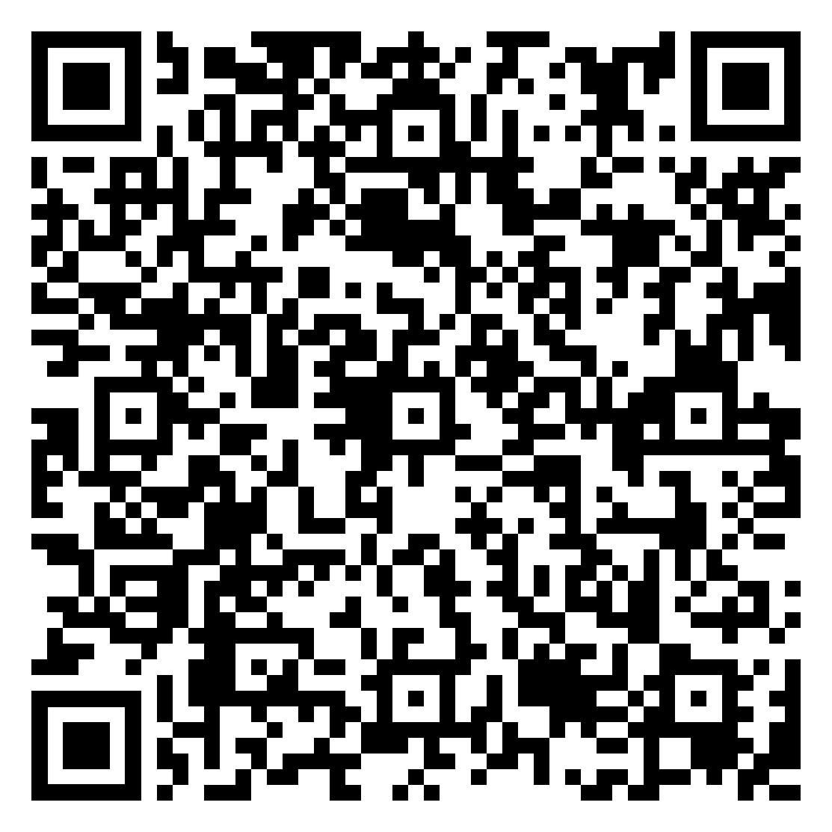
Year 11 Geography Homework – Half Term 4, Week 3
https://www.internetgeography.net/managing-climate-change-quiz/
Extension: Complete any of the quizzes about Weather and Climate on Internet Geography:
https://www.internetgeography.net/geography-quizzes/
Complete Week 5 Final Countdown revision activity on River Landscapes by completing a knowledge organiser for it. Use the QR code on the instruction sheet to access the information required to complete it.
Resources:
The Final Countdown Weeks 1-6
Parental Guidance sheet
Blank Knowledge organiser for River Landscapes
Online link - Year 11 Geography Homework Booklet Week 1 Resources
Key words – Erosion, deposition, transportation, cross profile, waterfall, gorge, V-shaped valleys, meander, floodplain, oxbow lake, mouth, estuary, hydrograph
Extension Task – Complete the Exam Questions from Week 5 The Final Countdown
What have been your strengths in Geography this week?
What have been the areas that have challenged you in Geography this week?
How could you improve next week?
Building good people who take PRIDE in their time at school, RESPECT themselves and others, WORK TOGETHER as a community, showing RESILIENCE and EMPATHY for all.

Slide 51
Year 11 History Homework – Half Term 4, Week 3
1. Who were the key people involved in the Munich Putsch?
2. Give two pieces of unrest from between 1919 and 1923.
3. Who was Gustav Stresemann?
4. What did Stresemann do?
5. Was Stresemann successful?
Storyboard:
Look at your classwork and use other resources to research what happened in relation to the Munich Putsch, political change (1919-1923) and Weimar recovery after 1923.
Pick 8-10 key facts.
Take the key facts and turn them into a storyboard (template available if required) to show what you have learnt.
Make sure it has pictures and description.
Key words – putsch, unrest, political, Stresemann, solution
Extension Task – Can you write a pneumonic to help you remember key events of the Munich Putsch?
What have been your strengths in History this week?
What have been the areas that have challenged you in History this week?
How could you improve next week?
Building good people who take PRIDE in their time at school, RESPECT themselves and others, WORK TOGETHER as a community, showing RESILIENCE and EMPATHY for all.

Slide 52
Year 11 Maths Homework – Half Term 4, Week 3
Recap Task –
When working through the past paper, begin to build up a stack of flash cards with key facts on.
Main Task – Past Paper
Jan 2023 Paper 2 – Due 15th March
Spend the next 2 weeks completing the past paper assigned by Mrs Thompson to the best of your ability.
Complete as much as you can in exam conditions in a black or blue pen
Then complete the questions you need help with in a different colour pen by either:
Looking it up
Asking a friend
Asking Mrs Thompson
Watch the you tube solution video emailed out
Extension Task – SENECA
Task assigned on SENECA based on this week's class content
What have been your strengths in maths this week?
What have been the areas that have challenged you in maths this week?
How could you improve next week?
Building good people who take PRIDE in their time at school, RESPECT themselves and others, WORK TOGETHER as a community, showing RESILIENCE and EMPATHY for all.

Slide 53
Year 11 Music
Composition & Performance
Homework – Half Term 4, Week 3
COMPOSITION
Work on your compositions
1.Composition To a Brief
Using appropriate elements, techniques and resources, compose a piece of music suitable to accompany a House of Horrors attraction at a theme park.
2. Free Composition
Write a folk song containing an instrumental section.
Make sure your compositions demonstrate use of the musical elements, at least two from each of these two lists –
•Rhythm, metre, texture, melody, structure, form
•Harmony, tonality, timbre, dynamics, phrasing, articulation.
e.g. Metre – include changes of time signature
Rhythm – use a variety of rhythmic motifs including triplets,
dotted notes and semi-quavers
Tonality – change key signature at least once, use the relative
minor
PERFORMANCE
Work on your performances
Make sure you are singing in the correct style for your chosen pieces and musical elements including dynamics, articulation and ornamentation where appropriate
What have been your strengths in Music this week?
What have been the areas that have challenged you in Music this week?
How could you improve next week?
Building good people who take PRIDE in their time at school, RESPECT themselves and others, WORK TOGETHER as a community, showing RESILIENCE and EMPATHY for all.

Slide 54
Year 11 Science Homework – Half Term 4, Week 3
Available: 23rd February 2024
Chemistry Paper 1
Physics Paper 1
Biology Paper 1
You are expected to complete the assignments by Week 6
Main Task:
Complete one of the exam papers given to you by your teachers. Show Evidence on the Friday of every week.
You can mark yourself (Mark Schemes on the Year 10/11 Shared Drive), or we can mark it.
Please ensure you highlight any questions so we can go through with you any topics – This will reflect in the revision lessons after Easter.
What have been your strengths in (insert subject) this week?
What have been the areas that have challenged you in (insert topic) this week?
How could you improve next week?
Building good people who take PRIDE in their time at school, RESPECT themselves and others, WORK TOGETHER as a community, showing RESILIENCE and EMPATHY for all.

Slide 55

Year 11 RE Homework – Half Term 4, Week 3
Create flashcards for the key words and their definitions on Islamic Beliefs using the Paper 1 Key Words document.
https://www.bbc.co.uk/bitesize/topics/zbndy9q
https://www.bbc.co.uk/bitesize/topics/z4v7gwx
Work through the revision sections for Christianity and Islam on BBC Bitesize, then complete the tests online for each.
Online documents - RE Homework Documents
Key words – See Paper 1 Key Words document
Extension Task – Attempt another practice question from each section.
What have been your strengths in RE this week?
What have been the areas that have challenged you in RE Revision this week?
How could you improve next week?
Building good people who take PRIDE in their time at school, RESPECT themselves and others, WORK TOGETHER as a community, showing RESILIENCE and EMPATHY for all.

Slide 56
Week 4 Homework

Slide 57
Week 4 Homework Due Dates
Subject | Day Due | Date Due
Building good people who take PRIDE in their time at school, RESPECT themselves and others, WORK TOGETHER as a community, showing RESILIENCE and EMPATHY for all.

Slide 58
Year 11 Business Studies Homework – Half Term 4, Week 4
Recap Test
Complete a SWOT for how your mock exams went
Main Task
The Japanese car manufacturer, Nissan, produces one in three cars that are made in the UK. It faces tough competition from other car manufacturers such as Volkswagen and Ford. The company’s managers say that it is important for it to keep production costs to a minimum.
The company’s factory in Sunderland is the largest car factory in the UK. It has the highest rates of productivity of any car factory in Europe or North America. It manufactured 476,589 cars in 2015, building them at a rate of one car every minute, 24 hours a day. The factory employs more than 6,800 people, and a lot of technology is used on the production lines.
Analyse why it is important for Nissan to operate an effective recruitment and selection process at its factory in Sunderland. (6 marks)
Key words – Recruitment and Selection
Extension Task - See Seneca
What have been your strengths this week?
What have been the areas that have challenged you this week?
How could you improve next week?
Building good people who take PRIDE in their time at school, RESPECT themselves and others, WORK TOGETHER as a community, showing RESILIENCE and EMPATHY for all.

Slide 59
Year 11 English Homework
Half Term 4, Week 4
Recap: D = I = E =
Complete the task on page 6 of your homework booklet.
Key words – shows, portrays, effective, metaphor, simile, personification, setting, engage.
Extension Task – Is your coursework folder as good as it can be? Make sure you email your latest drafts to Mr Wilkinson.
What have been your strengths in (insert subject) this week?
What have been the areas that have challenged you in (insert topic) this week?
How could you improve next week?
Building good people who take PRIDE in their time at school, RESPECT themselves and others, WORK TOGETHER as a community, showing RESILIENCE and EMPATHY for all.

Slide 60
Year 11 IGCSE ESL Homework – Half Term 4, Week 4
Recap Task: Create a mind map describing some of the key instructions and rules around how to train a guide dog . Also,
Main task:
Practice the accurate use of the future verb tense by making changes to the passage contained on page 42/43 of your workbook- use the lines provided.
Complete ‘The World Wildlife Fund’ Crossword on pg.41
Key Words: Subsist, integral, founding, logging, monitoring, furry, function
Extension Task: Review the vocabulary list form the last read chapter of short stories.
What have been your strengths in ESL this week?
What have been the areas that have challenged you in ESL this week?
How could you improve next week?
Building good people who take PRIDE in their time at school, RESPECT themselves and others, WORK TOGETHER as a community, showing RESILIENCE and EMPATHY for all.

Slide 61
Year 11 Fine Art / Photography
External Exam Homework Term 3, Week 4
Recap Task – review the External Exam Themes
Do some research in to which one you will spend the next 8 weeks researching
Main Task – The above – if not already complete
If done check all these items are complete before proceeding.
Title page and brainstorm
Mood board / images for inspiration
Statement of intent
Artist 1,2 & 3
Artist copies ( your work but in their style)
Observations studies where appropriate but this could also be a photoshoot and sketches of workings out
Catch up on these if not complete
Then: start to develop your ideas with your artists.
Eg takes ideas from your observational sketches or photographs and repeat these in the artists style. Do this in a range of media appropriate to your artists - ( Chat to Miss in school about this if you are unsure)
Key words line: Colour. Texture, shapes, pattern, space
Extension Task –Make extra studies of your theme using, pen, pencil, biro, watercolours, acrylics, drawing into photographs – add at least one per week to your work.
What have been your strengths in (insert subject) this week?
What have been the areas that have challenged you in (insert topic) this week?
How could you improve next week?
Building good people who take PRIDE in their time at school, RESPECT themselves and others, WORK TOGETHER as a community, showing RESILIENCE and EMPATHY for all.

Slide 62
Year 11 French Homework
Half Term 4
General Conversation Practise
Practise your general conversation questions for all three themes.
Ensure your answers contain:
More than one tense where possible and logical
Example:
Question: Où vas-tu normalement en vacances ?
Answer: Normalement je vais (present) en vacances en Italie avec ma famile mais l'année dernière je suis allée (past tense) en France avec l'école et l'année prochaine j'irai (future) aux États-Unis avec mes copains.
Opinions and justifications at every occasion
Time yourself, and make sure that your conversation lasts at least 6 minutes.
Speak to Mr Downey if you would like your answers recording so you can listen to them
Remember, you cannot have your answers marked because it has to be your own work.
What have been your strengths in Languages this week?
What have been the areas that have challenged you in Languages this week?
How could you improve next week?
Building good people who take PRIDE in their time at school, RESPECT themselves and others, WORK TOGETHER as a community, showing RESILIENCE and EMPATHY for all.

Slide 63

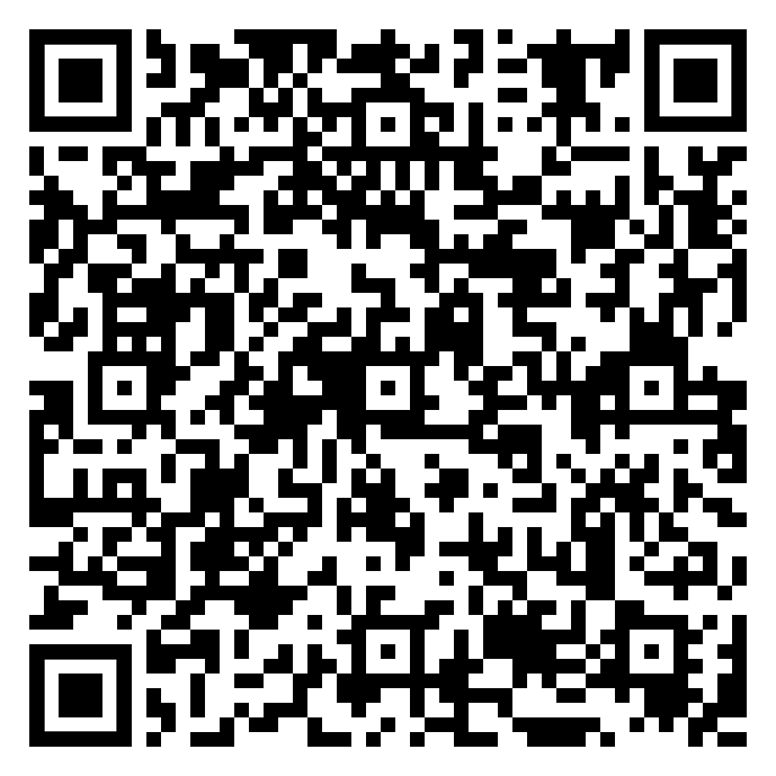
Year 11 Geography Homework – Half Term 4, Week 4
https://www.internetgeography.net/river-landforms-of-erosion-quiz/
https://www.internetgeography.net/river-landforms-of-deposition-quiz/
Extension: Complete any of the quizzes about Weather and Climate on Internet Geography:
https://www.internetgeography.net/geography-quizzes/
Complete Week 6 Final Countdown revision activity on Coastal Landscapes by completing a knowledge organiser for it. Use the QR code on the instruction sheet to access the information required to complete it.
Resources:
The Final Countdown Weeks 1-6
Parental Guidance sheet
Blank Knowledge organiser for Coastal Landscapes
Online link - Year 11 Geography Homework Booklet Week 2 Resources
Key words – headland, bay, constructive waves, destructive waves, arch, stack, stump, wave cut platform, bar, tombolo, spit, longshore drift, erosion, deposition, hard engineering, soft engineering
Extension Task – Complete the Exam Questions from Week 6 The Final Countdown
What have been your strengths in Geography this week?
What have been the areas that have challenged you in Geography this week?
How could you improve next week?
Building good people who take PRIDE in their time at school, RESPECT themselves and others, WORK TOGETHER as a community, showing RESILIENCE and EMPATHY for all.

Slide 64
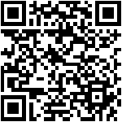

Year 11 History Homework – Half Term 4, Week 4
1. What was the 'Golden Age'?
2. What caused the Depression?
3. What impact did the Depression have on Germany?
4. What factors led to the growth of the Nazi party?
5. Which factor would make the Nazis most popular? Why?
YouTube:
Go onto YouTube and find 2 videos about how Hitler became Chancellor.
For each video write down the below:
  The URL/link for the video.
  A 3-sentence summary of what the video summarised.
  An explanation about why you chose that video.
  A review of the video – how well do you think it covers the topic and why?
  Compare the videos.
Key words – Chancellor, President, Hindenburg, Coalition, von Paper
Extension Task – Seneca:
Join class - Seneca task -
What have been your strengths in History this week?
What have been the areas that have challenged you in History this week?
How could you improve next week?
Building good people who take PRIDE in their time at school, RESPECT themselves and others, WORK TOGETHER as a community, showing RESILIENCE and EMPATHY for all.

Slide 65
Year 11 Maths Homework – Half Term 4, Week 4
Recap Task –
When working through the past paper, begin to build up a stack of flash cards with key facts on.
Main Task – Past Paper
Jan 2023 Paper 2– Due 15th March
Spend the next 2 weeks completing the past paper assigned by Mrs Thompson to the best of your ability.
Complete as much as you can in exam conditions in a black or blue pen
Then complete the questions you need help with in a different colour pen by either:
Looking it up
Asking a friend
Asking Mrs Thompson
Watch the you tube solution video emailed out
Extension Task – SENECA
Task assigned on SENECA based on this week's class content
What have been your strengths in maths this week?
What have been the areas that have challenged you in maths this week?
How could you improve next week?
Building good people who take PRIDE in their time at school, RESPECT themselves and others, WORK TOGETHER as a community, showing RESILIENCE and EMPATHY for all.

Slide 66
Year 11 Music
Composition & Performance
Homework – Half Term 4, Week 4
COMPOSITION
Work on your compositions
1.Composition To a Brief
Using appropriate elements, techniques and resources, compose a piece of music suitable to accompany a House of Horrors attraction at a theme park.
2. Free Composition
Write a folk song containing an instrumental section.
Make sure your compositions demonstrate use of the musical elements, at least two from each of these two lists –
•Rhythm, metre, texture, melody, structure, form
•Harmony, tonality, timbre, dynamics, phrasing, articulation.
e.g. Metre – include changes of time signature
Rhythm – use a variety of rhythmic motifs including triplets,
dotted notes and semi-quavers
Tonality – change key signature at least once, use the relative
minor
PERFORMANCE
Work on your performances
Make sure you are singing in the correct style for your chosen pieces and musical elements including dynamics, articulation and ornamentation where appropriate
What have been your strengths in Music this week?
What have been the areas that have challenged you in Music this week?
How could you improve next week?
Building good people who take PRIDE in their time at school, RESPECT themselves and others, WORK TOGETHER as a community, showing RESILIENCE and EMPATHY for all.

Slide 67
Year 11 RE Homework – Half Term 4, Week 4
Create flashcards for the key words and their definitions on Islamic Practices using the Paper 1 Key Words document.
Open the Islamic Practices Exam Questions document. Choose one question from each section (a 4, a 5 and a 12 mark question) to answer. Use your notes and the guidance in the Paper 1 Key Words document to help you.
Online documents - RE Homework Documents
Key words – See Paper 1 Key Words Document
Extension Task – Attempt another practice question from each section.
What have been your strengths in RE this week?
What have been the areas that have challenged you in RE this week?
How could you improve next week?
Building good people who take PRIDE in their time at school, RESPECT themselves and others, WORK TOGETHER as a community, showing RESILIENCE and EMPATHY for all.

Slide 68
Year 11 Science Homework – Half Term 4, Week 4
Available: 23rd February 2024
Chemistry Paper 1
Physics Paper 1
Biology Paper 1
You are expected to complete the assignments by Week 6
Main Task:
Complete one of the exam papers given to you by your teachers. Show Evidence on the Friday of every week.
You can mark yourself (Mark Schemes on the Year 10/11 Shared Drive), or we can mark it.
Please ensure you highlight any questions so we can go through with you any topics – This will reflect in the revision lessons after Easter.
What have been your strengths in (insert subject) this week?
What have been the areas that have challenged you in (insert topic) this week?
How could you improve next week?
Building good people who take PRIDE in their time at school, RESPECT themselves and others, WORK TOGETHER as a community, showing RESILIENCE and EMPATHY for all.

Slide 69
Week 5 Homework

Slide 70
Week 5 Homework Due Dates
Subject | Day Due | Date Due
Building good people who take PRIDE in their time at school, RESPECT themselves and others, WORK TOGETHER as a community, showing RESILIENCE and EMPATHY for all.

Slide 71
Year 11 Business Studies Homework – Half Term 5, Week 5
Recap Test
Define: Recruitment and Selection
What's the difference? (2 marks)
Main Task
Which of the following is not a fringe benefit?
(a) Health insurance (b) A company car (c) Discounts when buying the company’s products (d) Piecework (1 mark)
2. Explain one reason why training can improve the motivation of a workforce. (3 marks)
3. Explain the difference between salaries and wages. (3 marks)
4. Explain how a business uses financial rewards to motivate its employees. (4 marks)
Key words – Training and Motivation
Extension Task - See Seneca
What have been your strengths in the topic cash flow this week?
What have been the areas that have challenged you in the topic of cash flow this week?
How could you improve next week?
Building good people who take PRIDE in their time at school, RESPECT themselves and others, WORK TOGETHER as a community, showing RESILIENCE and EMPATHY for all.

Slide 72
Year 11 Chemistry Homework – Half Term 4, Week 5
Main Task:
Analyse the mock exam with the mark scheme and model answers provided by your teacher (Yes, I did do the paper myself!). Fill in any corrections with any colour pen apart from black, blue or red.
Then, Fill In The Table and Show Me:
What Topics Went Well | What Topics I need to Improve on | What I have Done to Improve
What Can Your Teacher do to Support:
What have been your strengths in science this week?
What have been the areas that have challenged you in science this week?
How could you improve next week?
Building good people who take PRIDE in their time at school, RESPECT themselves and others, WORK TOGETHER as a community, showing RESILIENCE and EMPATHY for all.

Slide 73
Year 11 English Homework
Half Term 4, Week 5
Recap: what are the key themes in ‘An Inspector Calls'?.
Complete the task on page 8 of your homework booklet.
Key words – writing in a suitable style that uses the source material effectively.
Extension Task – Is your coursework folder as good as it can be? Make sure you email your latest drafts to Mr Wilkinson.
What have been your strengths in (insert subject) this week?
What have been the areas that have challenged you in (insert topic) this week?
How could you improve next week?
Building good people who take PRIDE in their time at school, RESPECT themselves and others, WORK TOGETHER as a community, showing RESILIENCE and EMPATHY for all.

Slide 74
Year 11 IGCSE ESL Homework – Half Term 4, Week 5
Recap Task: Practice the reading aloud of short stories by turning to pg.44 of your booklet and reading the story ‘Belling the Cat’ Attempt to memorise this so you can give a summary during class.
Main Task: Following the reading of the fabel. Attempt to write your own short story with a moral.
You could choose to. Update the story ‘Belling the Cat’ by putting it into a modern setting, or you may prefer to write your own fable by using animals for characters.
Key words – mouse, chief, sly, treacherous, retire, proposal, applause
Extension Task: Re-read the last chapter English Short Stories.
What have been your strengths in ESL this week?
What have been the areas that have challenged you in ESL this week?
How could you improve next week?
Building good people who take PRIDE in their time at school, RESPECT themselves and others, WORK TOGETHER as a community, showing RESILIENCE and EMPATHY for all.

Slide 75
Year 11 Fine Art / Photography
External Exam Homework Term 3, Week 5
Recap Task – review the External Exam Themes
Do some research in to which one you will spend the next 8 weeks researching
Main Task – The above – if not already complete
If done check all these items are complete before proceeding.
Title page and brainstorm
Mood board / images for inspiration
Statement of intent
Artist 1,2 & 3
Artist copies ( your work but in their style)
Observations studies where appropriate but this could also be a photoshoot and sketches of workings out
Catch up on these if not complete
Then: start to develop your ideas with your artists.
Eg takes ideas from your observational sketches or photographs and repeat these in the artists style. Do this in a range of media appropriate to your artists - ( Chat to Miss in school about this if you are unsure)
Key words line: Colour. Texture, shapes, pattern, space
Extension Task –Make extra studies of your theme using, pen, pencil, biro, watercolours, acrylics, drawing into photographs – add at least one per week to your work.
What have been your strengths in (insert subject) this week?
What have been the areas that have challenged you in (insert topic) this week?
How could you improve next week?
Building good people who take PRIDE in their time at school, RESPECT themselves and others, WORK TOGETHER as a community, showing RESILIENCE and EMPATHY for all.

Slide 76
Year 11 French Homework
Half Term 4
General Conversation Practise
Practise your general conversation questions for all three themes.
Ensure your answers contain:
More than one tense where possible and logical
Example:
Question: Où vas-tu normalement en vacances ?
Answer: Normalement je vais (present) en vacances en Italie avec ma famile mais l'année dernière je suis allée (past tense) en France avec l'école et l'année prochaine j'irai (future) aux États-Unis avec mes copains.
Opinions and justifications at every occasion
Time yourself, and make sure that your conversation lasts at least 6 minutes.
Speak to Mr Downey if you would like your answers recording so you can listen to them
Remember, you cannot have your answers marked because it has to be your own work.
What have been your strengths in Languages this week?
What have been the areas that have challenged you in Languages this week?
How could you improve next week?
Building good people who take PRIDE in their time at school, RESPECT themselves and others, WORK TOGETHER as a community, showing RESILIENCE and EMPATHY for all.

Slide 77
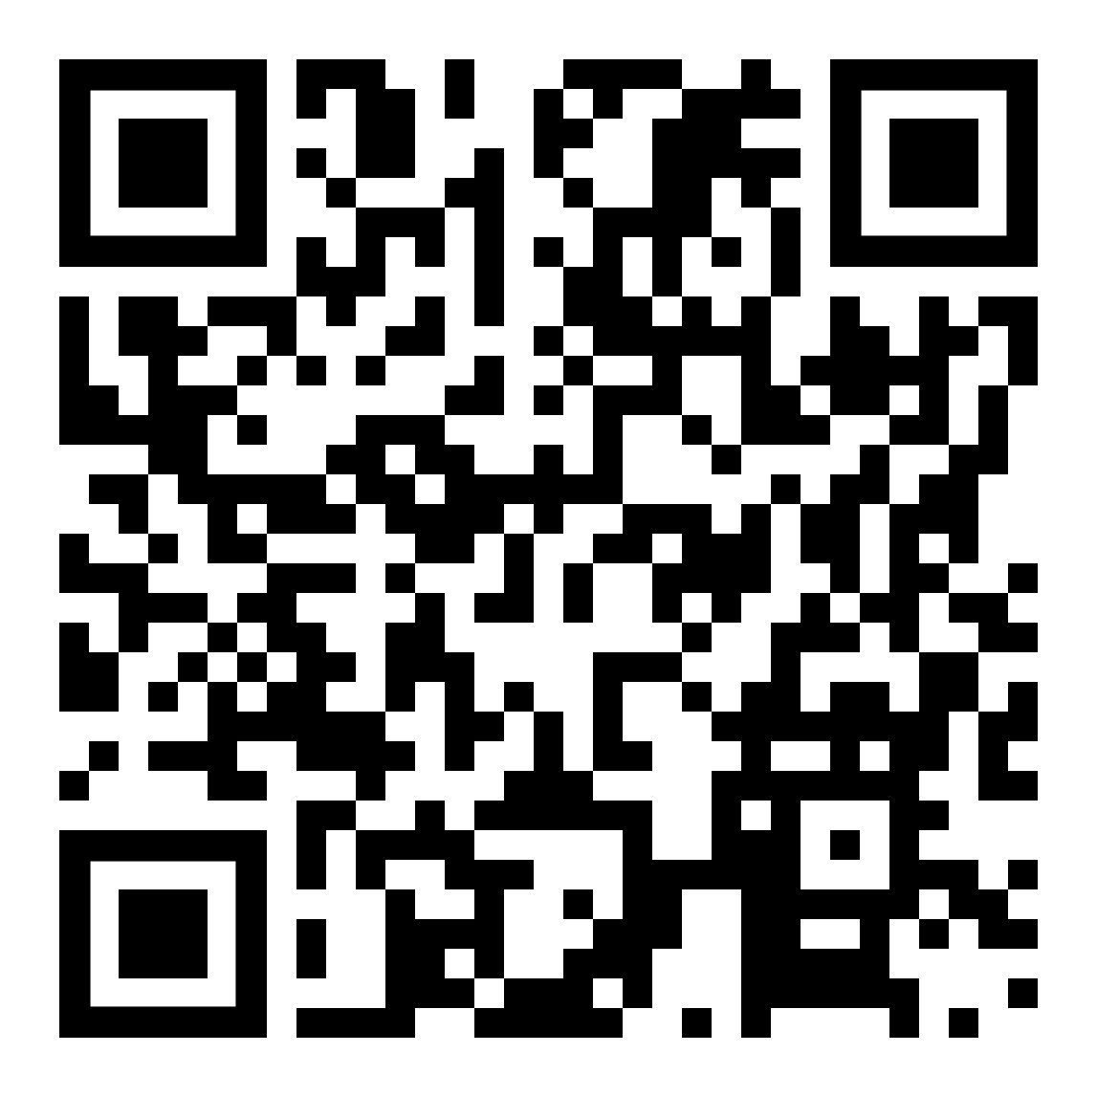
Year 11 Geography Homework – Half Term 4, Week 5
Complete the Internet Geography Quiz about Coastal landscapes in the UK (see QR code)
Extension: Complete any of the quizzes about Weather and Climate on Internet Geography:
https://www.internetgeography.net/geography-quizzes/
Complete Week 7 Final Countdown revision activity on Urban Issues and Challenges – LIC/NEE by completing a knowledge organiser for it. Use the QR code on the instruction sheet to access the information required to complete it.
Resources:
The Final Countdown Weeks 7-12
Parental Guidance sheet
Blank Knowledge organiser for Urban Issues and Challenges – LIC/NEE
Key words – urbanisation, migration, push and pull factors, natural increase, services, resources, opportunities, industry, challenges, slums, squatter settlements, favelas, environment, quality of life
Extension Task – Complete the Exam Questions from Week 7 The Final Countdown
What have been your strengths in Geography this week?
What have been the areas that have challenged you in Geography this week?
How could you improve next week?
Building good people who take PRIDE in their time at school, RESPECT themselves and others, WORK TOGETHER as a community, showing RESILIENCE and EMPATHY for all.

Slide 78
Year 11 History Homework – Half Term 4, Week 5
1. How did Hitler become Chancellor?
2. How did Hitler eliminate his opposition?
3. Who was Ernst Rohm?
4. What was the Night of the Long Knives?
5. How successful was the Night of the Long Knives?
Mind Map:
Next, we will look at how Hitler made Germany self-sufficient, research this and complete the tasks below (link to a good website - https://www.bbc.co.uk/bitesize/guides/zcj6y4j/revision/1)
Take the key events and put them onto a Mind Map (examples/templates available).
Make sure the events have a title and a brief description.
Make sure it has arrows LINKING events – does one cause another? Do they have things in common? Have you described why they link together?
Make sure it has either colour coding (one colour per area) or pictures/symbols.
Key words – self-sufficient, work and bread, economy, manipulation
Extension Task – Seneca:
Join class - Seneca task -
What have been your strengths in History this week?
What have been the areas that have challenged you in History this week?
How could you improve next week?
Building good people who take PRIDE in their time at school, RESPECT themselves and others, WORK TOGETHER as a community, showing RESILIENCE and EMPATHY for all.

Slide 79
Year 11 Maths Homework – Half Term 4, Week 5
Recap Task –
When working through the past paper, begin to build up a stack of flash cards with key facts on.
Main Task – Past Paper
Jan 2023 Paper 1R – due on 28th March
Spend the next 2 weeks completing the past paper assigned by Mrs Thompson to the best of your ability.
Complete as much as you can in exam conditions in a black or blue pen
Then complete the questions you need help with in a different colour pen by either:
Looking it up
Asking a friend
Asking Mrs Thompson
Watch the you tube solution video emailed out
Extension Task – SENECA
Task assigned on SENECA based on this week's class content
What have been your strengths in maths this week?
What have been the areas that have challenged you in maths this week?
How could you improve next week?
Building good people who take PRIDE in their time at school, RESPECT themselves and others, WORK TOGETHER as a community, showing RESILIENCE and EMPATHY for all.

Slide 80
Year 11 Music
Composition & Performance
Homework – Half Term 4, Week 5
COMPOSITION
Work on your compositions
1.Composition To a Brief
Using appropriate elements, techniques and resources, compose a piece of music suitable to accompany a House of Horrors attraction at a theme park.
2. Free Composition
Write a folk song containing an instrumental section.
Make sure your compositions demonstrate use of the musical elements, at least two from each of these two lists –
•Rhythm, metre, texture, melody, structure, form
•Harmony, tonality, timbre, dynamics, phrasing, articulation.
e.g. Metre – include changes of time signature
Rhythm – use a variety of rhythmic motifs including triplets,
dotted notes and semi-quavers
Tonality – change key signature at least once, use the relative
minor
PERFORMANCE
Work on your performances
Make sure you are singing in the correct style for your chosen pieces and musical elements including dynamics, articulation and ornamentation where appropriate
What have been your strengths in Music this week?
What have been the areas that have challenged you in Music this week?
How could you improve next week?
Building good people who take PRIDE in their time at school, RESPECT themselves and others, WORK TOGETHER as a community, showing RESILIENCE and EMPATHY for all.

Slide 81
Year 11 RE Homework – Half Term 4, Week 5
Create flashcards for the key words and their definitions on Christian Beliefs using the Paper 1 Key Words document.
Open the Christian Practices Exam Questions document. Choose one question from each section (a 4, a 5 and a 12 mark question) to answer. Use your notes and the guidance in the Paper 1 Key Words document to help you.
Online documents - RE Homework Documents
Key words – See Paper 1 Key Words Document
Extension Task – Attempt another practice question from each section.
What have been your strengths in RE this week?
What have been the areas that have challenged you in RE this week?
How could you improve next week?
Building good people who take PRIDE in their time at school, RESPECT themselves and others, WORK TOGETHER as a community, showing RESILIENCE and EMPATHY for all.

Slide 82
Year 11 Science Homework – Half Term 4, Week 5
Available: 23rd February 2024
Chemistry Paper 1
Physics Paper 1
Biology Paper 1
You are expected to complete the assignments by Week 6
Main Task:
Complete one of the exam papers given to you by your teachers. Show Evidence on the Friday of every week.
You can mark yourself (Mark Schemes on the Year 10/11 Shared Drive), or we can mark it.
Please ensure you highlight any questions so we can go through with you any topics – This will reflect in the revision lessons after Easter.
What have been your strengths in (insert subject) this week?
What have been the areas that have challenged you in (insert topic) this week?
How could you improve next week?
Building good people who take PRIDE in their time at school, RESPECT themselves and others, WORK TOGETHER as a community, showing RESILIENCE and EMPATHY for all.

Slide 83
Week 6 Homework

Slide 84
Week 6 Homework Due Dates
Subject | Day Due | Date Due
Building good people who take PRIDE in their time at school, RESPECT themselves and others, WORK TOGETHER as a community, showing RESILIENCE and EMPATHY for all.

Slide 85
Year 11 Business Studies Homework – Half Term 4, Week 6
Recap Test
Define:
Financial methods of motivation & non-financial methods of motivation
  Main Task
  Complete the test questions on motivation given out in class this week. Refer to the videos on exam techniques.
Key words – Motivation, Revision Techniques
Extension Task - See Seneca
What have been your strengths this week?
What have been the areas that have challenged you this week?
How could you improve next week?
Building good people who take PRIDE in their time at school, RESPECT themselves and others, WORK TOGETHER as a community, showing RESILIENCE and EMPATHY for all.

Slide 86
Year 11 Fine Art / Photography
External Exam Homework Term 3, Week 6
Recap Task – review the External Exam Themes
Do some research in to which one you will spend the next 8 weeks researching
Main Task – The above – if not already complete
If done check all these items are complete before proceeding.
Title page and brainstorm
Mood board / images for inspiration
Statement of intent
Artist 1,2 & 3
Artist copies ( your work but in their style)
Observations studies where appropriate but this could also be a photoshoot and sketches of workings out
Catch up on these if not complete
Then: start to develop your ideas with your artists.
Eg takes ideas from your observational sketches or photographs and repeat these in the artists style. Do this in a range of media appropriate to your artists - ( Chat to Miss in school about this if you are unsure)
Key words line: Colour. Texture, shapes, pattern, space
Extension Task –Make extra studies of your theme using, pen, pencil, biro, watercolours, acrylics, drawing into photographs – add at least one per week to your work.
What have been your strengths in (insert subject) this week?
What have been the areas that have challenged you in (insert topic) this week?
How could you improve next week?
Building good people who take PRIDE in their time at school, RESPECT themselves and others, WORK TOGETHER as a community, showing RESILIENCE and EMPATHY for all.

Slide 87
Year 11 Science Homework – Half Term 4, Week 6
Available: 23rd February 2024
Chemistry Paper 1
Physics Paper 1
Biology Paper 1
You are expected to complete the assignments by Week 6
Main Task:
Complete one of the exam papers given to you by your teachers. Show Evidence on the Friday of every week.
You can mark yourself (Mark Schemes on the Year 10/11 Shared Drive), or we can mark it.
Please ensure you highlight any questions so we can go through with you any topics – This will reflect in the revision lessons after Easter.
What have been your strengths in (insert subject) this week?
What have been the areas that have challenged you in (insert topic) this week?
How could you improve next week?
Building good people who take PRIDE in their time at school, RESPECT themselves and others, WORK TOGETHER as a community, showing RESILIENCE and EMPATHY for all.

Slide 88
Year 11 English Homework
Half Term 4, Week 6
Recap: what are the key themes in your Shakespeare play ………………………………………………………………………………………………………………………………………………………………………………………………………………………………………………………………………………………………………………………………………………………………………………………………………………………………………………………………………………………………………………………………………………………………………..
Is your coursework up to date?
Have you completed all of the edits given to you in class?
Key words – Shakespearian comedy, characterisation, conform or subvert expectations, mistaken identity
Extension Task – Is your coursework folder as good as it can be? Make sure you email your latest drafts to Mr Wilkinson.
What have been your strengths in (insert subject) this week?
What have been the areas that have challenged you in (insert topic) this week?
How could you improve next week?
Building good people who take PRIDE in their time at school, RESPECT themselves and others, WORK TOGETHER as a community, showing RESILIENCE and EMPATHY for all.

Slide 89
Year 10 IGCSE ESL Homework – Half Term 4, Week 6
Recap Task: Create a mind map consisting of the key words used with their definitions used from the blog about James Bond on pg.6.
Main Task: Complete discussion point on pg.8 by writing
Key Words:
Extension Task: Familiarise yourself with the next unit key words list.
What have been your strengths in ESL this week?
What have been the areas that have challenged you in ESL this week?
How could you improve next week?
Building good people who take PRIDE in their time at school, RESPECT themselves and others, WORK TOGETHER as a community, showing RESILIENCE and EMPATHY for all.

Slide 90
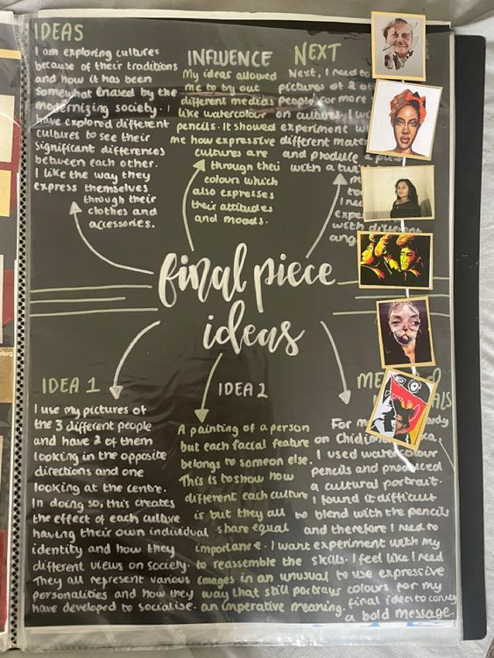
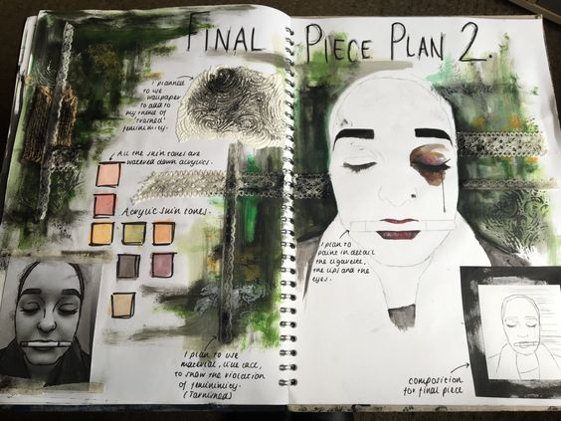
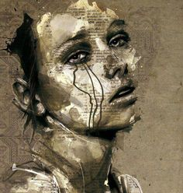
Year 11 Fine Art Mock Exam Homework Term 3, Week 6
Recap Task –Evaluate where you are with your media development. What has worked well, why? What needs further development?
Main Task – plan out your final piece(s) idea, create a 'mock up', try out different colourways, different materials, editing, etc
Include the formal elements of art ( below) in your evaluations.
Key words line: Colour. Texture, shapes, pattern, space
Extension Task –Make extra studies of your theme using, pen, pencil, biro, watercolours, acrylics, drawing into photographs – add at least one per week to your work.
What have been your strengths in (insert subject) this week?
What have been the areas that have challenged you in (insert topic) this week?
How could you improve next week?
Building good people who take PRIDE in their time at school, RESPECT themselves and others, WORK TOGETHER as a community, showing RESILIENCE and EMPATHY for all.

Slide 91
Year 11 French Homework
Half Term 4
General Conversation Practise
Practise your general conversation questions for all three themes.
Ensure your answers contain:
More than one tense where possible and logical
Example:
Question: Où vas-tu normalement en vacances ?
Answer: Normalement je vais (present) en vacances en Italie avec ma famile mais l'année dernière je suis allée (past tense) en France avec l'école et l'année prochaine j'irai (future) aux États-Unis avec mes copains.
Opinions and justifications at every occasion
Time yourself, and make sure that your conversation lasts at least 6 minutes.
Speak to Mr Downey if you would like your answers recording so you can listen to them
Remember, you cannot have your answers marked because it has to be your own work.
What have been your strengths in Languages this week?
What have been the areas that have challenged you in Languages this week?
How could you improve next week?
Building good people who take PRIDE in their time at school, RESPECT themselves and others, WORK TOGETHER as a community, showing RESILIENCE and EMPATHY for all.

Slide 92
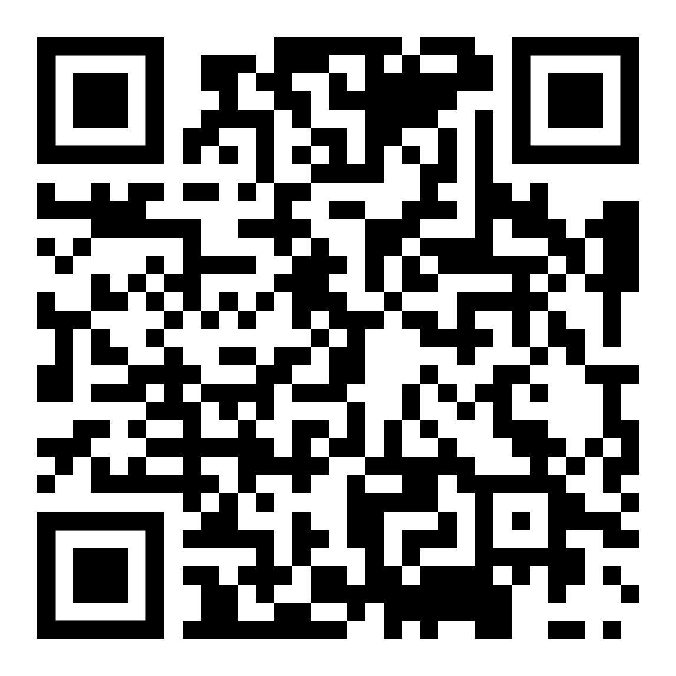
Year 11 Geography Homework – Half Term 4, Week 6
Complete the Internet Geography Quiz about Urban Issues and Challenges – LIC/NEE (see QR code)
Extension: Complete any of the quizzes about Weather and Climate on Internet Geography:
https://www.internetgeography.net/geography-quizzes/
Complete Week 7 Final Countdown revision activity on Urban Issues and Challenges – city in an HIC by completing a knowledge organiser for it. Use the QR code on the instruction sheet to access the information required to complete it.
Resources:
The Final Countdown Weeks 7-12
Parental Guidance sheet
Blank Knowledge organiser for Urban Issues and Challenges – LIC/NEE
Key words – migration, international city, urban change, cultural mix, recreation, entertainment, employment, high-tech industries, financial services, integrated transport system, urban greening, urban deprivation, inequalities, dereliction, brownfield and greenfield land, urban sprawl, rural-urban fringe, commuter settlements, urban regeneration, sustainability
Extension Task – Complete the Exam Questions from Week 8 The Final Countdown
What have been your strengths in Geography this week?
What have been the areas that have challenged you in Geography this week?
How could you improve next week?
Building good people who take PRIDE in their time at school, RESPECT themselves and others, WORK TOGETHER as a community, showing RESILIENCE and EMPATHY for all.

Slide 93
Year 11 History Homework – Half Term 4, Week 6
1. What did 'Work and Bread' refer to?
2. Give two ways that the Nazis made Germany more self-sufficient.
3. Give two ways that the Nazis did not make Germany self-sufficient.
4. How were Germans better off under the Nazis?
5. How were Germans worse off under the Nazis?
Flash Cards:
Go back through the work we have completed this half term.
Pick 3-4 key bits from each week.
Take the bits and turn them into flash cards (examples available).
Each card should be around 10cm long and 5cm high.
Each card should have 1 of the key bits described on one side and on the other side it should have a word/clue/picture to summarise it.
Key words – Depression, Weimar, establishment, Nazi, economy
Extension Task – Seneca:
Join class - Seneca task -
What have been your strengths in History this week?
What have been the areas that have challenged you in History this week?
How could you improve next week?
Building good people who take PRIDE in their time at school, RESPECT themselves and others, WORK TOGETHER as a community, showing RESILIENCE and EMPATHY for all.

Slide 94
Year 11 Maths Homework – Half Term 4, Week 6
Recap Task –
When working through the past paper, begin to build up a stack of flash cards with key facts on.
Main Task – Past Paper
Jan 2023 Paper 1R – due on 28th March
Spend the next 2 weeks completing the past paper assigned by Mrs Thompson to the best of your ability.
Complete as much as you can in exam conditions in a black or blue pen
Then complete the questions you need help with in a different colour pen by either:
Looking it up
Asking a friend
Asking Mrs Thompson
Watch the you tube solution video emailed out
Extension Task – SENECA
Task assigned on SENECA based on this week's class content
What have been your strengths in maths this week?
What have been the areas that have challenged you in maths this week?
How could you improve next week?
Building good people who take PRIDE in their time at school, RESPECT themselves and others, WORK TOGETHER as a community, showing RESILIENCE and EMPATHY for all.

Slide 95
Year 11 Music
Composition & Performance
Homework – Half Term 4, Week 6
COMPOSITION
Work on your compositions
1.Composition To a Brief
Using appropriate elements, techniques and resources, compose a piece of music suitable to accompany a House of Horrors attraction at a theme park.
2. Free Composition
Write a folk song containing an instrumental section.
Make sure your compositions demonstrate use of the musical elements, at least two from each of these two lists –
•Rhythm, metre, texture, melody, structure, form
•Harmony, tonality, timbre, dynamics, phrasing, articulation.
e.g. Metre – include changes of time signature
Rhythm – use a variety of rhythmic motifs including triplets,
dotted notes and semi-quavers
Tonality – change key signature at least once, use the relative
minor
PERFORMANCE
Work on your performances
Make sure you are singing in the correct style for your chosen pieces and musical elements including dynamics, articulation and ornamentation where appropriate
What have been your strengths in Music this week?
What have been the areas that have challenged you in Music this week?
How could you improve next week?
Building good people who take PRIDE in their time at school, RESPECT themselves and others, WORK TOGETHER as a community, showing RESILIENCE and EMPATHY for all.

Slide 96
Year 11 RE Homework – Half Term 4, Week 6
Create flashcards for the key words and their definitions on Christian Practices using the Paper 1 Key Words document.
Open the Theme A Exam Questions document. Choose one question from each section (a 4, a 5 and a 12 mark question) to answer. Use your notes and the guidance in the Paper 2 Key Words document to help you.
Online documents - RE Homework Documents
Key words – See Paper 1 Key Words document and paper 2 Key Words document
Extension Task – Attempt another practice question from each section.
What have been your strengths in RE this week?
What have been the areas that have challenged you in RE this week?
How could you improve next week?
Building good people who take PRIDE in their time at school, RESPECT themselves and others, WORK TOGETHER as a community, showing RESILIENCE and EMPATHY for all.

Slide 97
Building good people who take PRIDE in their time at school, RESPECT themselves and others, WORK TOGETHER as a community, showing RESILIENCE and EMPATHY for all.

